Slide 1
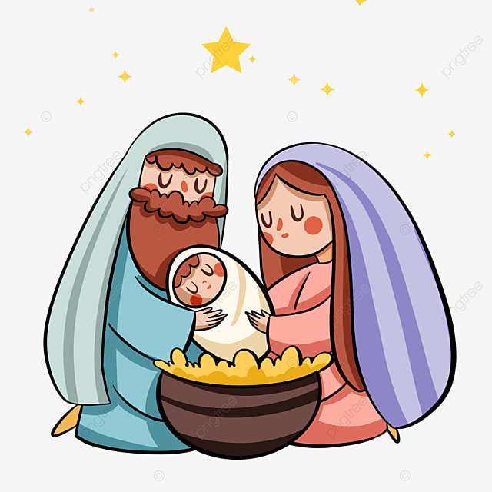
Ministry Friends of Jesus and Mary
Cycle A - I Sunday of Christmas
John 1, 1-18 o 1, 1-5. 9-14
The Birth of Jesus
www.fcpeace.org

Slide 2
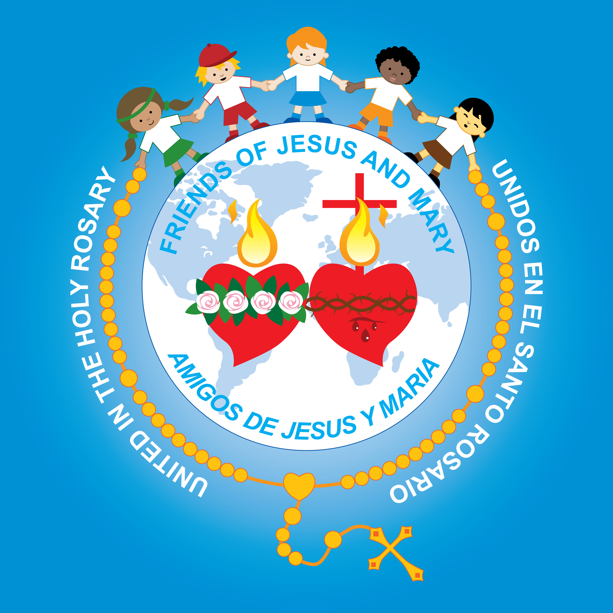
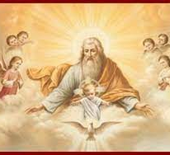
The Birth of Jesus
In the beginning was the Word, and the Word was with God, and the Word was God. He was in the beginning with God. All things came to be through him, and without him nothing came to be. What came to be through him was life, and this life was the light of the human race; the light shines in the darkness, and the darkness has not overcome it. The true light, which enlightens everyone, was coming into the world. He was in the world, and the world came to be through him, but the world did not know him.

Slide 3
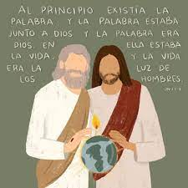
The Birth of Jesus
He came to what was his own, but his own people did not accept him. But to those who did accept him he gave power to become children of God, to those who believe in his name, who were born not by natural generation nor by human choice nor by a man’s decision but of God. And the Word became flesh and made his dwelling among us, and we saw his glory, the glory as of the Father’s only Son, full of grace and truth.
The Gospel of the Lord,
Praise to You Lord Jesus Christ.

Slide 4
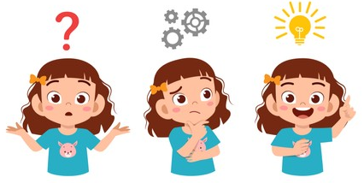
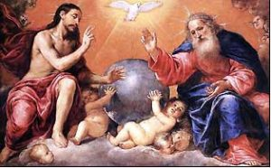
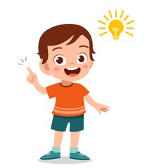
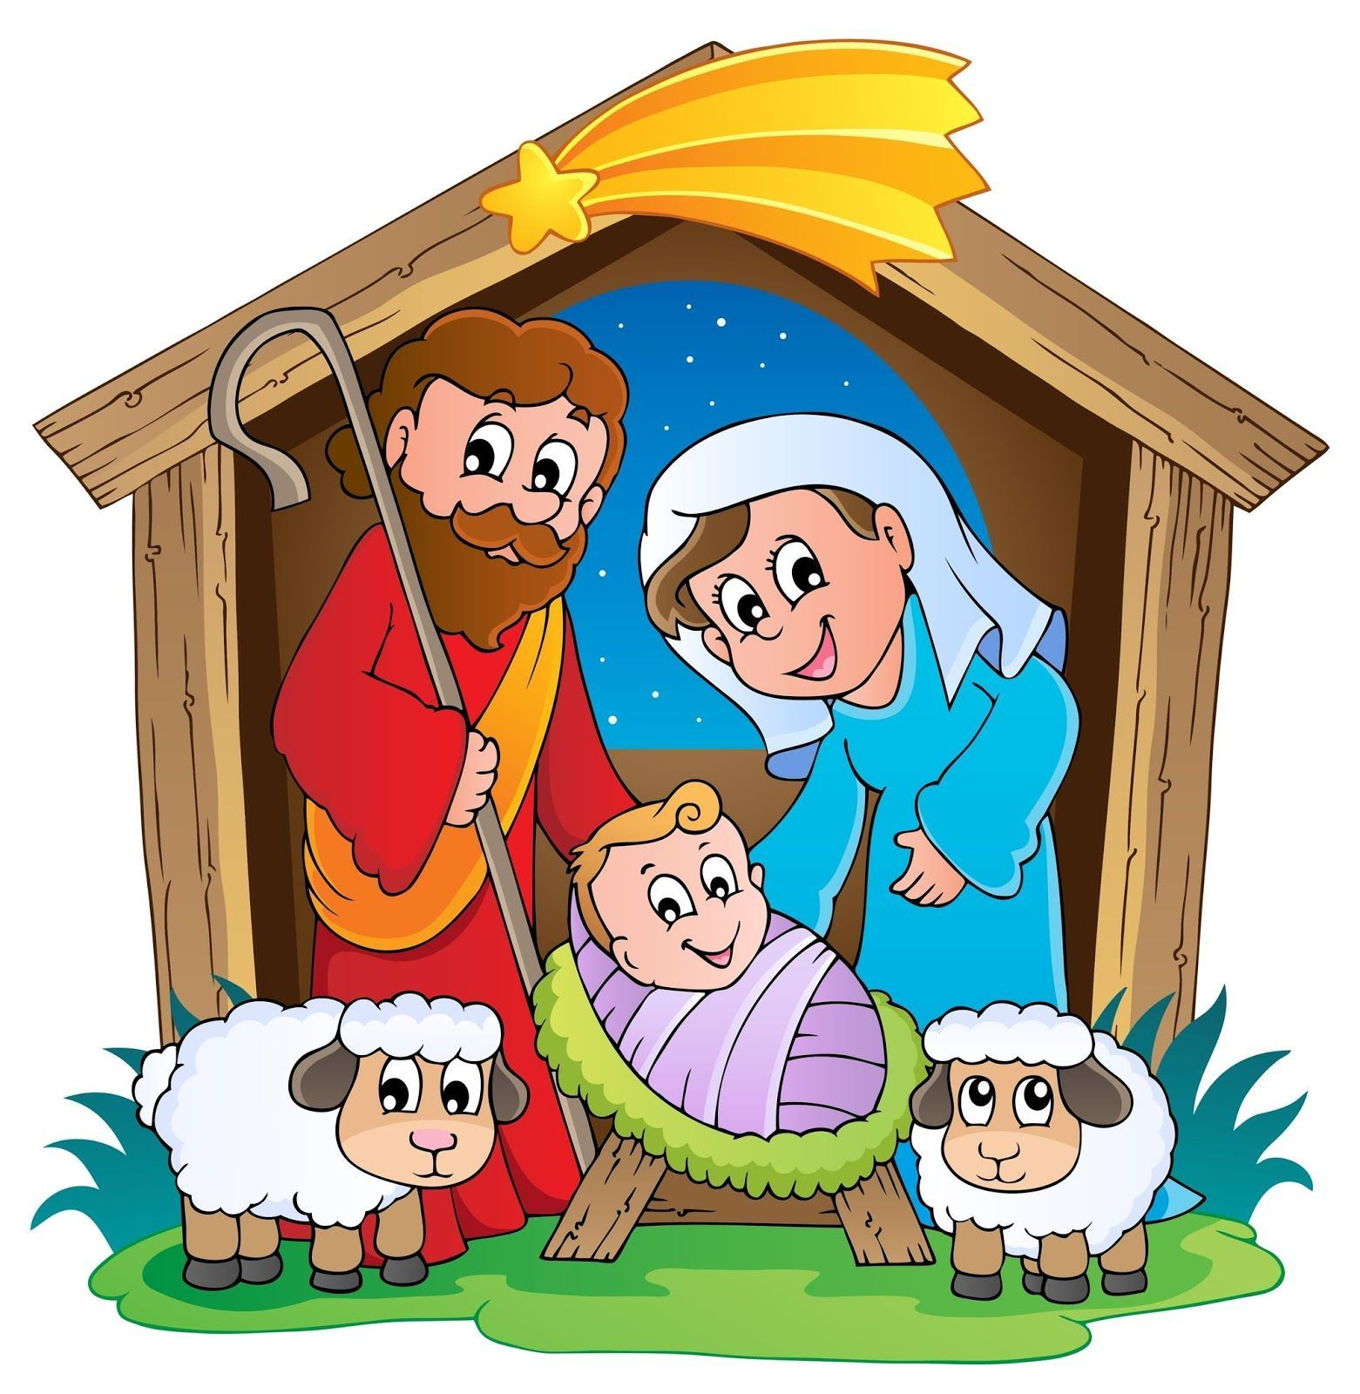
REFLECTION

Slide 5
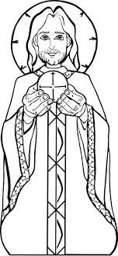
The Gospel begins speaking about the Word as a person; and that person was there since the beginning with God and was God. Who is the Gospel talking about?
Jesus is the Word of God. When we hear the words of Jesus in the Gospel, we are hearing God, Himself.

Slide 6
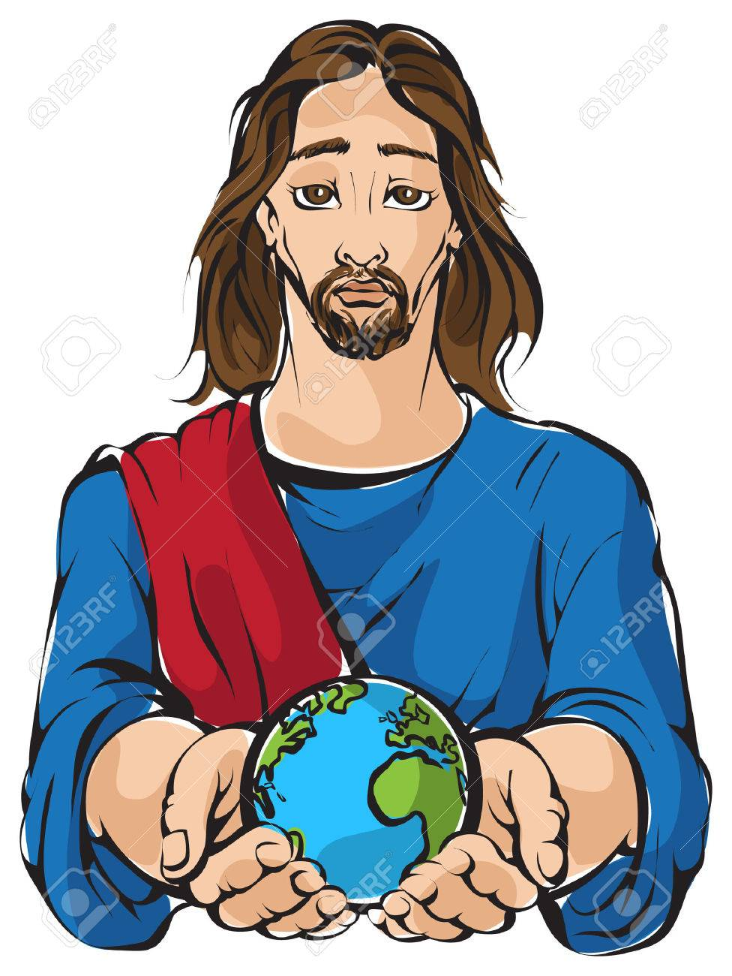
Did Jesus create the world?
Yes, the Gospel says that, without the Word, nothing came to be. Jesus is God.

Slide 7
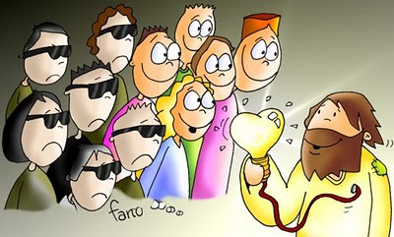
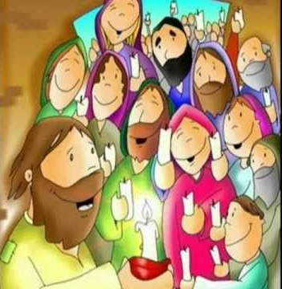
The Gospel also says that the Word is true ____________?
…light which enlightens everyone.
What does Jesus enlighten for us?
The path to happiness and to Heaven, eternal happiness.

Slide 8
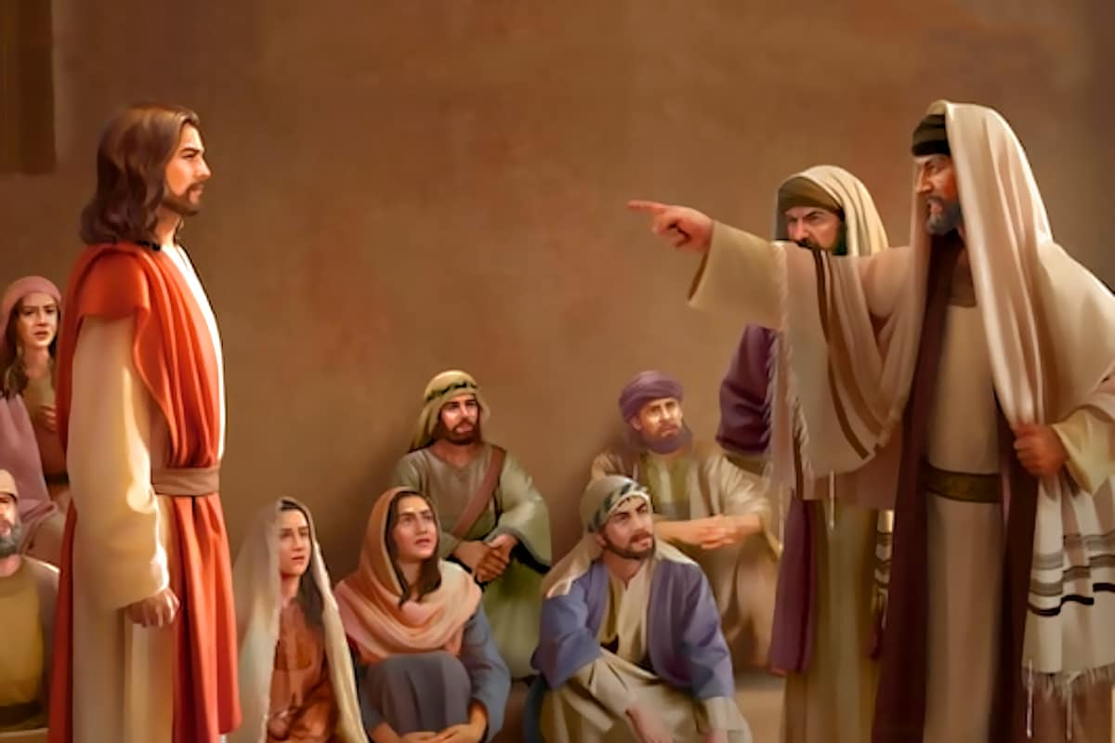
His own people did not accept him. To whom is the Gospel referring?
…to the leaders of God’s chosen people who had their hearts full of sin.

Slide 9
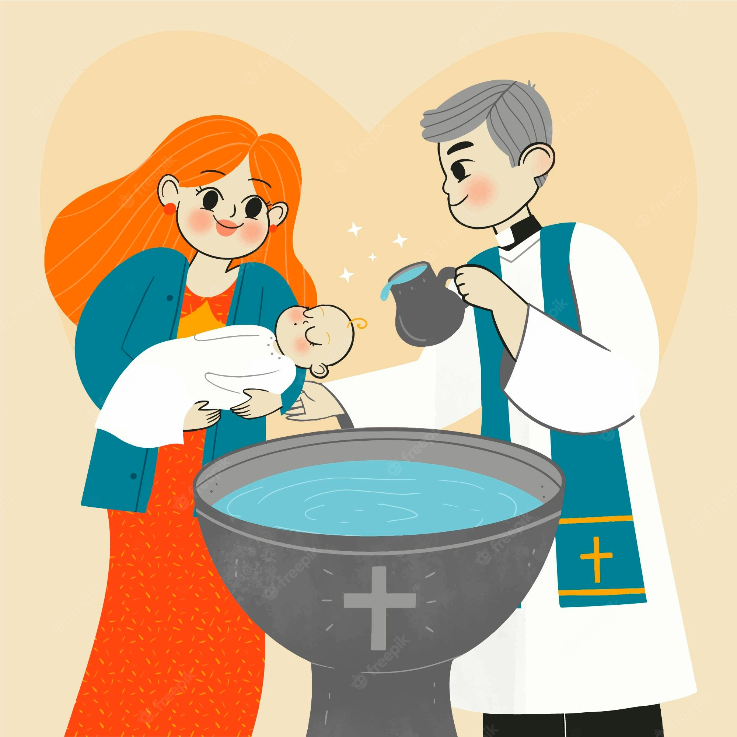
The Gospel says that those that did accept him he gave power to become children of God. How do we become children of God?
In the Sacrament of Baptism, we receive the Holy Spirit and enter into God’s family.

Slide 10
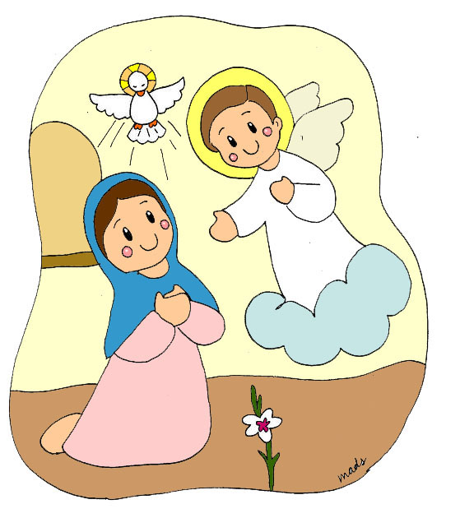
The Gospel says that the Word became flesh and made his dwelling among us. When does this important event happen?
In the Annunciation and in Christmas; God became man to reveal His love for us and to save us.

Slide 11
…We saw the glory of the Father’s only Son, full of grace and truth. How can we live full of grace and truth?
We can approach Jesus in the Sacraments and open our hearts to His Grace (His life) which leads us to live as children of God.

Slide 12
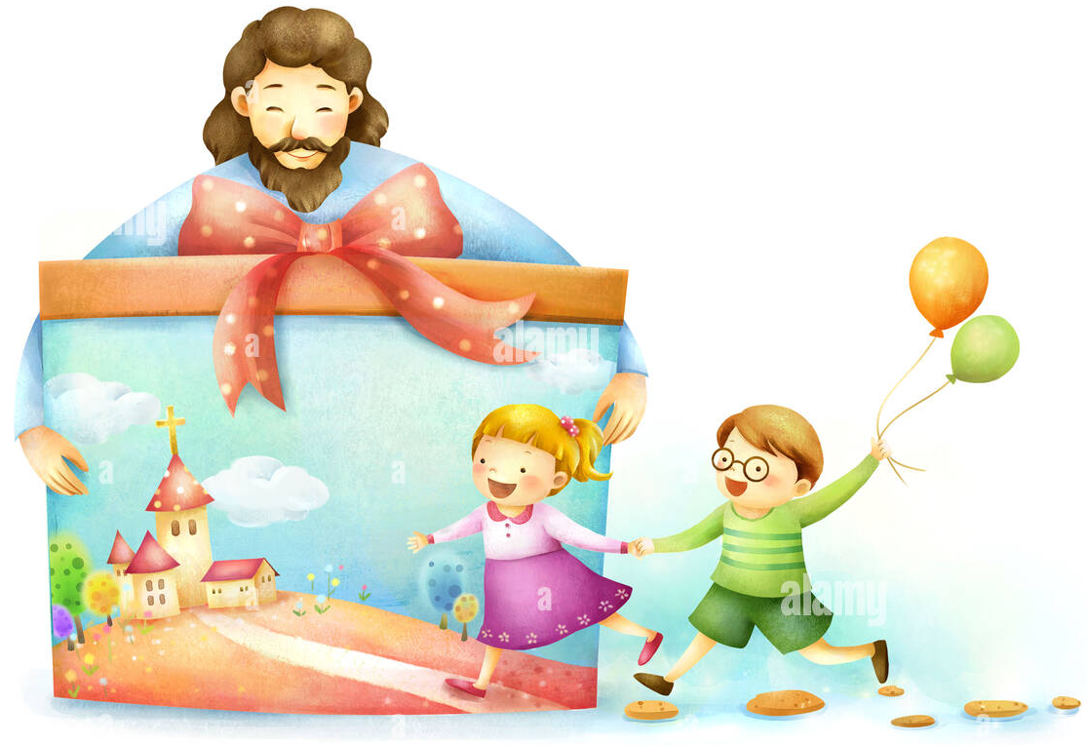
ACTIVITIES
On the following page, make the Story of Christmas book. Tell someone the story. On the last page, make a card and give to someone who needs love this Christmas.

Slide 13
THE CHRISMAS STORY
THE CHRISMAS STORY BOOK
Instructions: Color and cut each picture writing underneath. Fold a piece of construction paper in half, top to bottom, then again, top to bottom. Cut along the folds. Fold the strips of paper in half and staple at the fold to form a book with the fold on top. Glue the title on the front and a picture on each page. Write a note to Jesus on the last page.

Slide 14
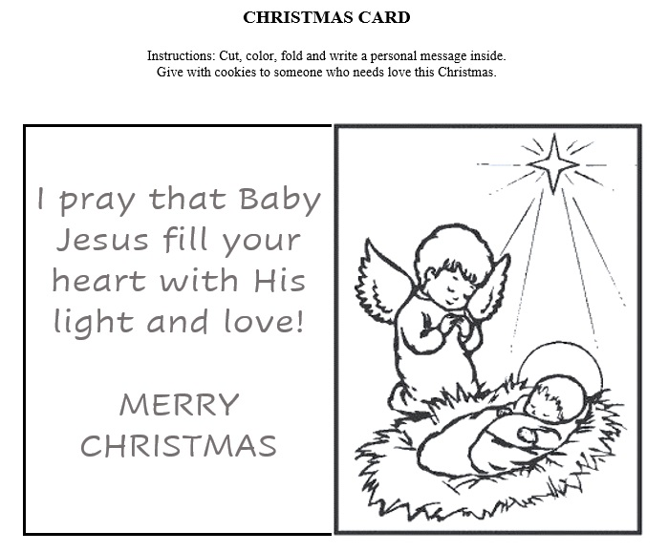

Slide 15
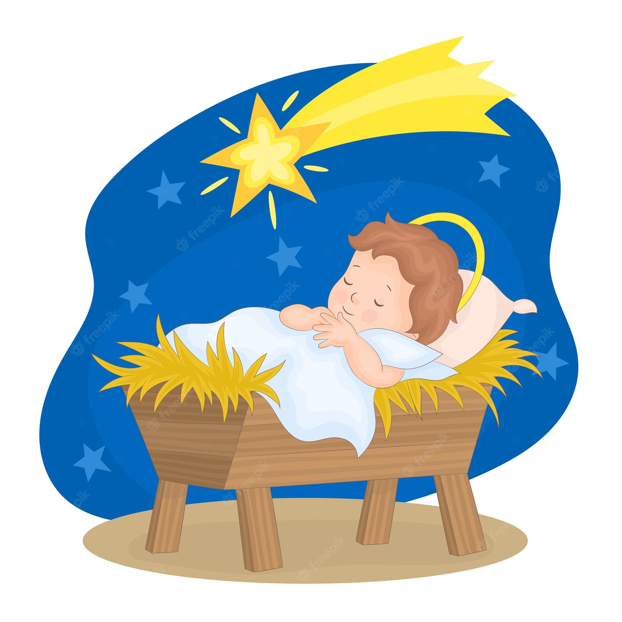
PRAYER
Baby Jesus,
Thank you for the love you showed me by coming to earth, and living and dying for me. I want to celebrate this Christmas with you. I want to know you, to receive you and your gift of eternal life. Please help me to share that love with everyone.
Amen.

Slide 16
The Little Drummer Boy, https://youtu.be/_6p5icEYBus

Slide 17
Joy to the World, Lifetree Kids, https://youtu.be/bQ8gE0L1524

Slide 18
MERRY CHRISTMAS

