Slide 1
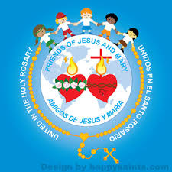
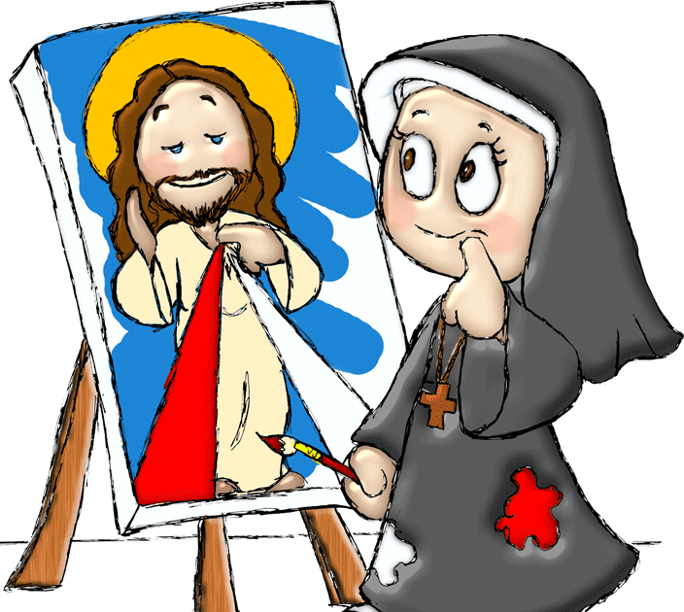
Ministry Friends of Jesus and Mary
Cycle C - II Sunday of Easter
Jesus Appears to His Disciples John 20: 19-31
Feast of the Divine Mercy
www.fcpeace.org

Slide 2
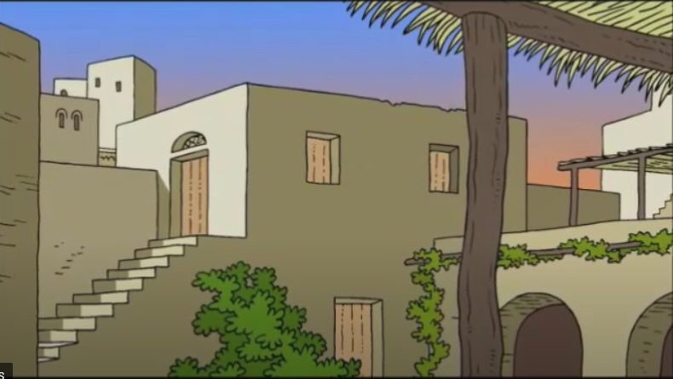
On the evening of that first day of the week, when the doors were locked,

Slide 3
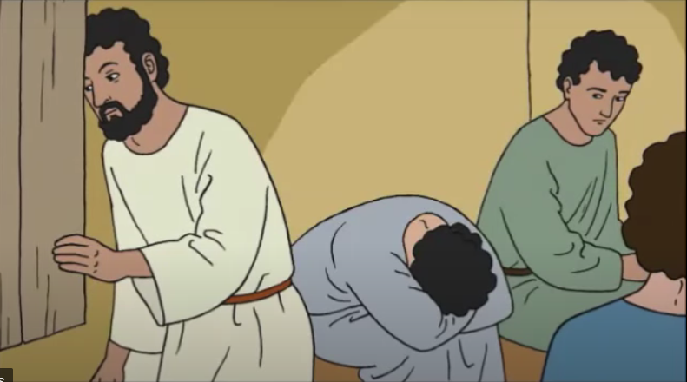
…where the disciples were, for fear of the Jews.

Slide 4
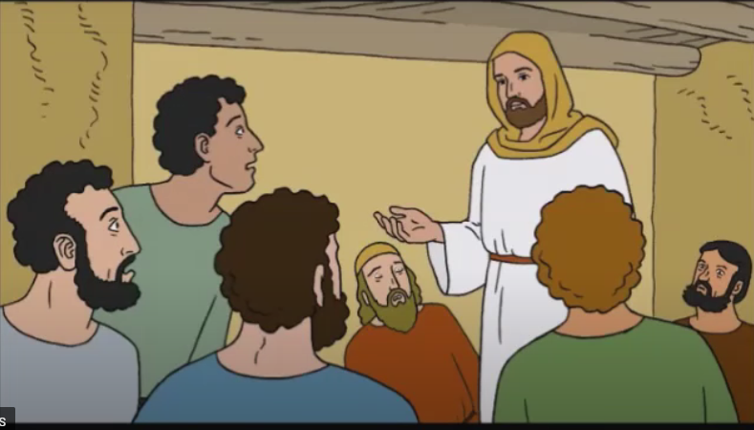
Jesus came and stood in their midst and said to them, "Peace be with you."

Slide 5
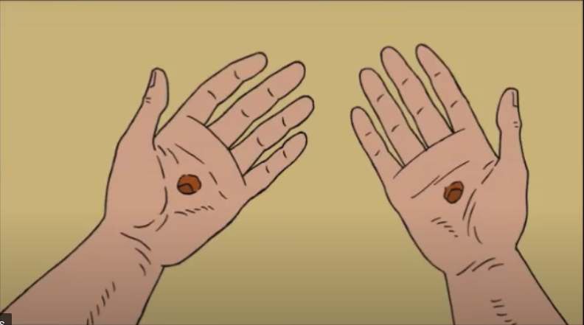
When he had said this, he showed them his hands and his side.

Slide 6
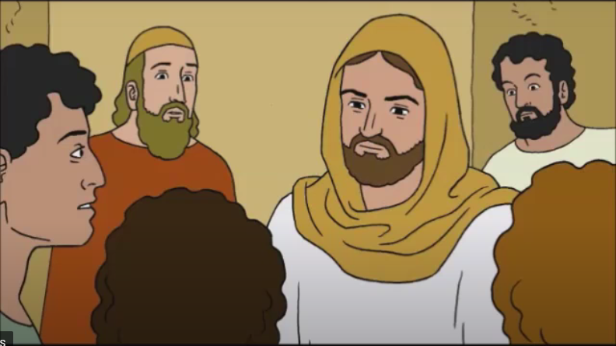
The disciples rejoiced when they saw the Lord. Jesus said to them again, "Peace be with you. As the Father has sent me, so I send you."

Slide 7
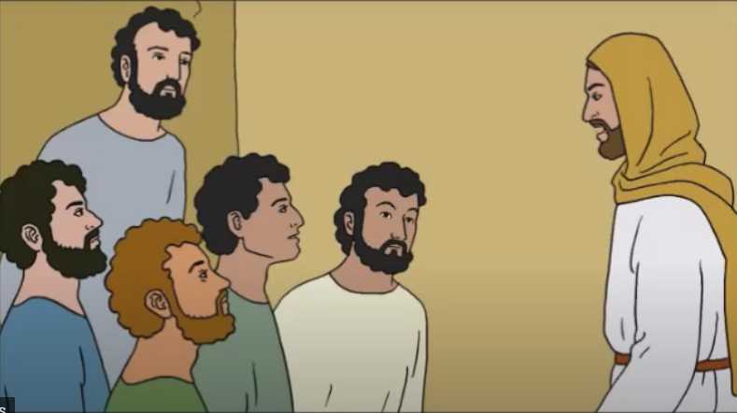
And when he had said this, he breathed on them and said to them, "Receive the Holy Spirit. Whose sins you forgive are forgiven them, and whose sins you retain are retained."

Slide 8
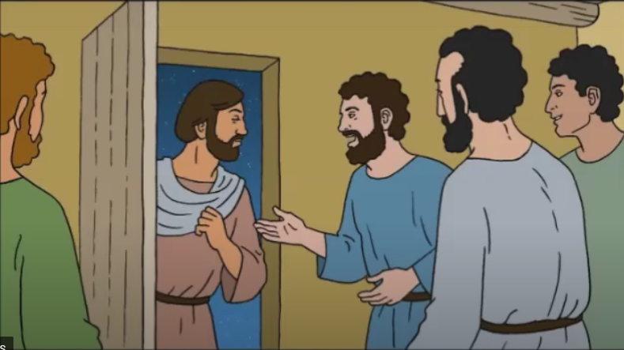
Thomas, called Didymus, one of the Twelve, was not with them when Jesus came. So the other disciples said to him, "We have seen the Lord."

Slide 9
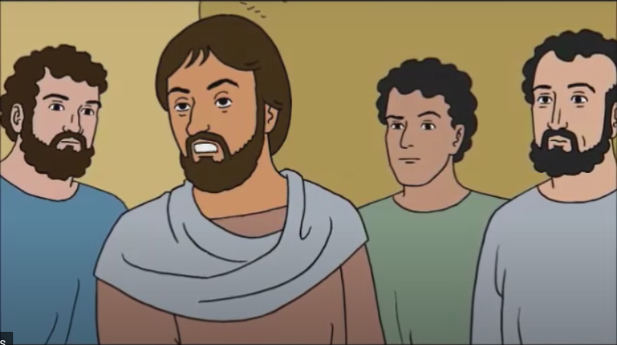
But he said to them, "Unless I see the mark of the nails in his hands and put my finger into the nail marks and put my hand into his side, I will not believe."

Slide 10
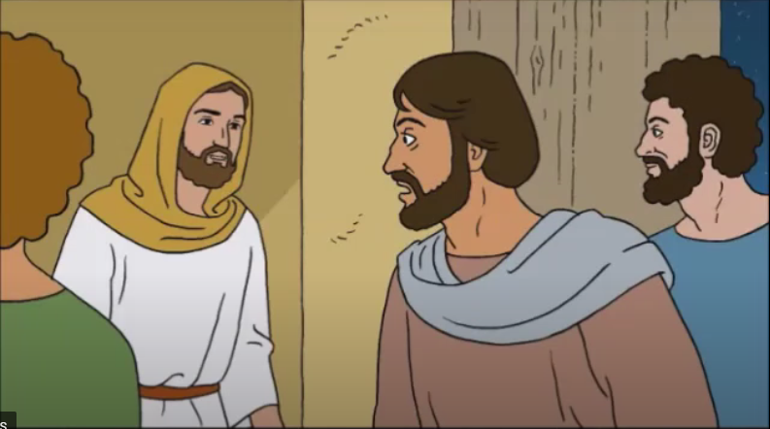
Now a week later his disciples were again inside and Thomas was with them. Jesus came, although the doors were locked, and stood in their midst and said,

Slide 11
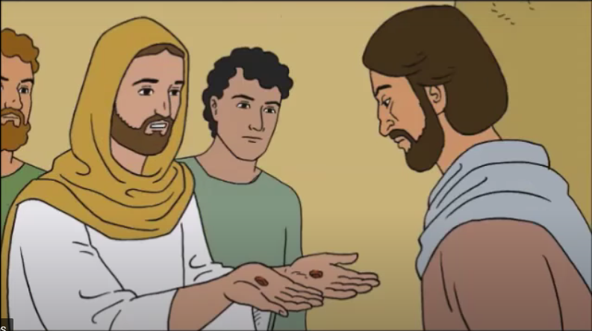
"Peace be with you." Then he said to Thomas, "Put your finger here and see my hands, and bring your hand and put it into my side, and do not be unbelieving, but believe."

Slide 12
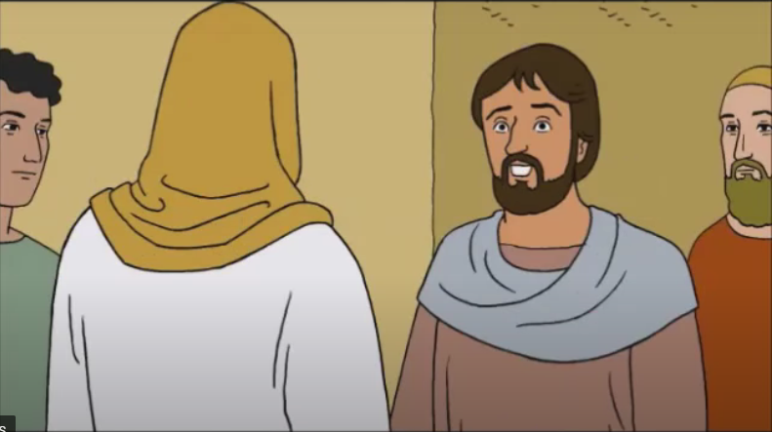
Thomas answered and said to him, "My Lord and my God!" Jesus said to him, "Have you come to believe because you have seen me? Blessed are those who have not seen and have believed."

Slide 13
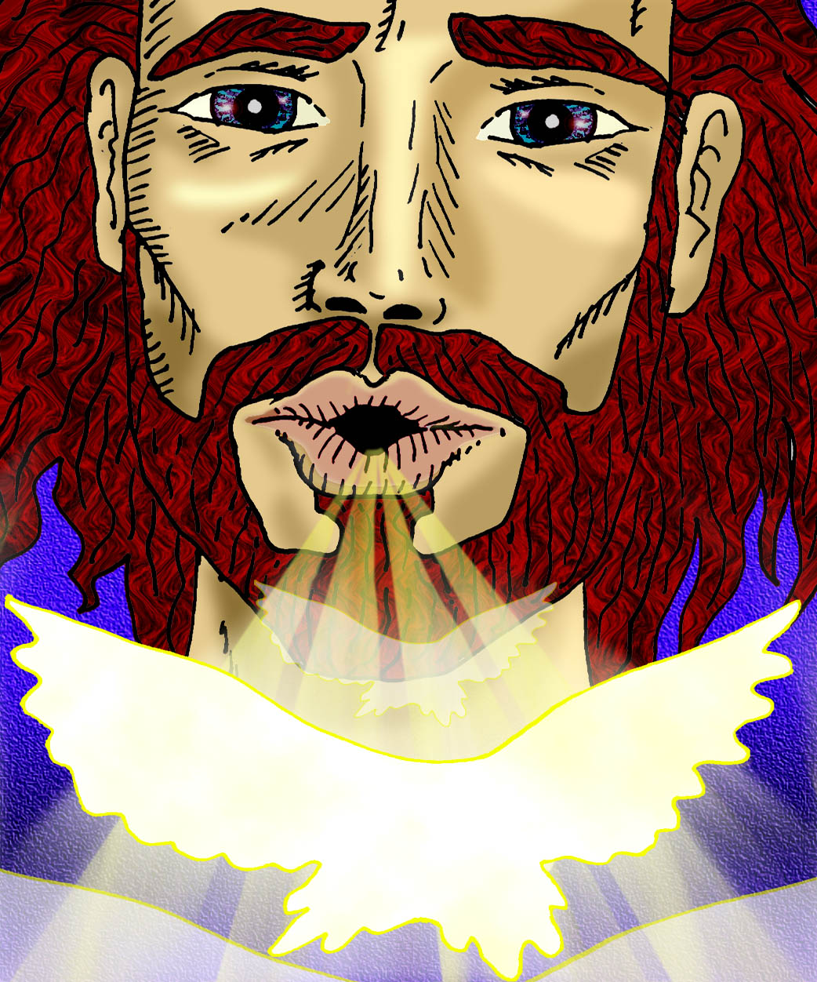
Now Jesus did many other signs in the presence of his disciples that are not written in this book. But these are written that you may come to believe that Jesus is the Christ, the Son of God, and that through this belief you may have life in his name.
THE GOSPEL OF THE LORD, PRAISE TO YOU LORD JESUS CHRIST.

Slide 14
REFLECTION
Why were the disciples hiding? Who did they fear?
They were afraid of dying because those who killed Jesus were looking for them.
How did Jesus enter if the doors were locked? What does He say?
Jesus is God, He did not need to open doors to enter. He appears to them and says, “Peace be with you.”
How do you think the disciples felt seeing Jesus?
The fear and terror changes to
peace, happiness, and joy.

Slide 15
Jesus knows He will soon depart to Heaven, but first He must prepare His apostles to continue His mission. So He sends them to proclaim the Gospel and Jesus breathes on them. What does this mean?
He gives them the Holy Spirit, God Himself, to help them.

Slide 16
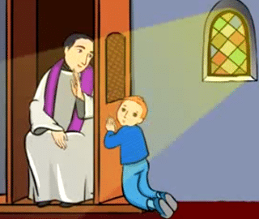
When Jesus tells His disciples, “If you forgive people’s sins, they are forgiven; if you do not forgive them, they are not forgiven,” He gives them the power to forgive sins. Do you remember to which Sacrament we go to for the forgiveness of our sins?
The Sacrament of Confession
(also called Reconciliation or Penance)
Who were the first priests?
Jesus’ apostles
Can I confess directly to God?
Or do I need to confess my sins to a priest?
Jesus gave authority and power exclusively to the priests so they can forgive our sins because He wants us to confess our sins to the priest and to forgive us through them.

Slide 17
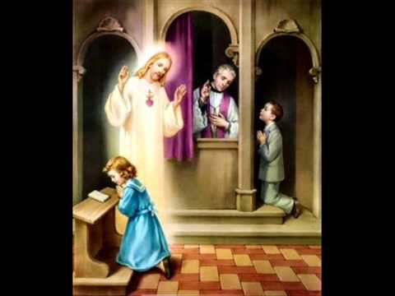
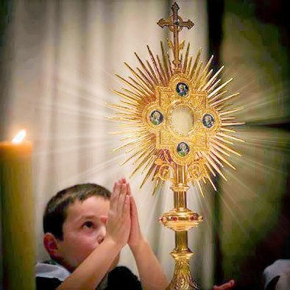
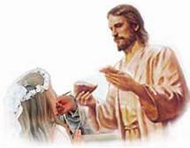
One apostle was missing the first time Jesus appeared to them. Do you remember his name?
Thomas
Did Thomas believe his friends?
NO
What did he need to do to believe?
Thomas needed to touch Jesus’ scars. (See to believe)
And you? Do you need to see to believe? Or is your faith capable of believing that which you cannot see?
THE REAL PRESENCE OF JESUS IN THE EUCHARIST
THE EUCHARIST, REAL FOOD: HIS BODY AND BLOOD.
JESUS FORGIVES US THROUGH THE SACRAMENT

Slide 18
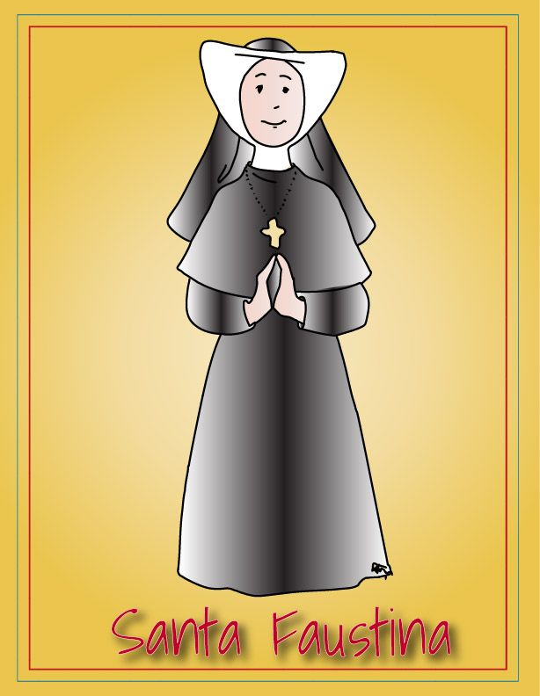
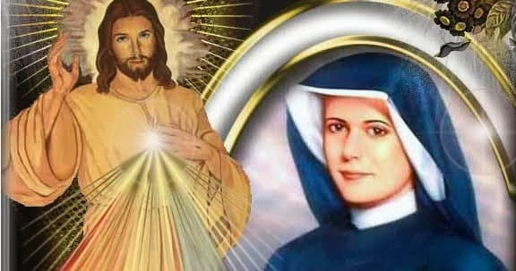
Second Sunday of Easter
Divine Mercy Sunday
HISTORY
Movie: https://youtu.be/SAv4CeyU4Ao
- Saint Faustina was born in Poland in 1905.
- When she was 7 years old, she heard the voice of God for the first time inviting her to live a more perfect life.
- At 15 years old, she begins to work as a domestic servant; she feels a strong call to the religious life, but her parents oppose it.
- Despite their opposition, Faustina eventually leaves her family and joins the religious life.

Slide 19
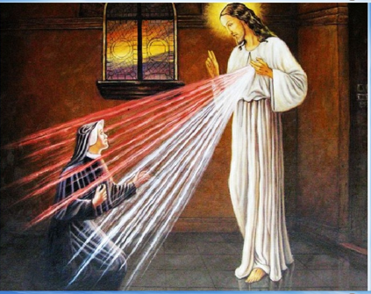
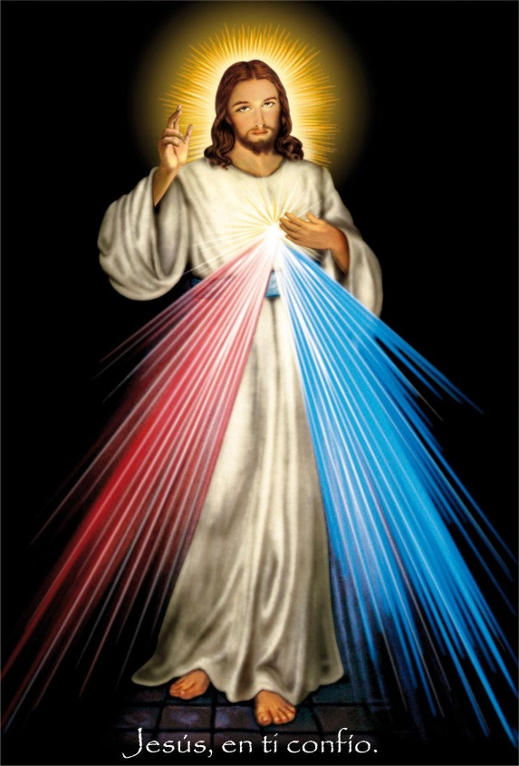
Divine Mercy Sunday
-Jesus appeared to Sister Faustina and told her that 3pm in the afternoon, the time Jesus died…is a time of great mercy.
-From His heart flowed two rays: one red and one white, symbolizing the blood and water that gushed from His side.
-Jesus said to her: My daughter, Paint a picture of what you see with the words: “JESUS I TRUST IN YOU”.
-Jesus promised great blessings for those who venerate this picture.

Slide 20
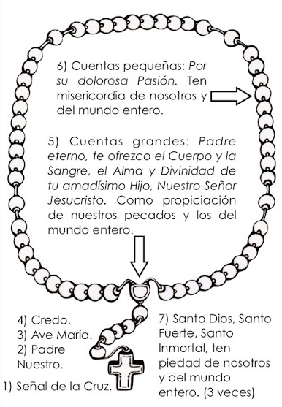
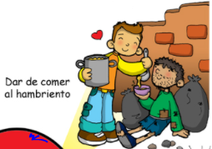
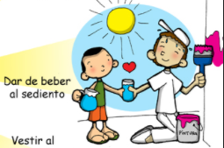
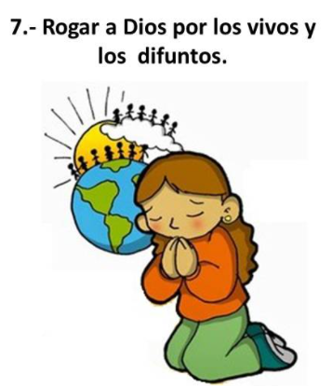
Chaplet and Feast of the Divine Mercy
-Jesus also asked that everyone pray at 3pm in the afternoon the Chaplet of Divine Mercy and that,
-The Church celebrate on the 2nd Sunday of Easter the FEAST OF THE DIVINE MERCY.
-In this feast we celebrate Jesus’s Love and Mercy for us, and He invites us to share this love and mercy with others, especially the most needy.
Pray for the living and the dead.
Feed the Hungry
Give drink to the thirsty

Slide 21
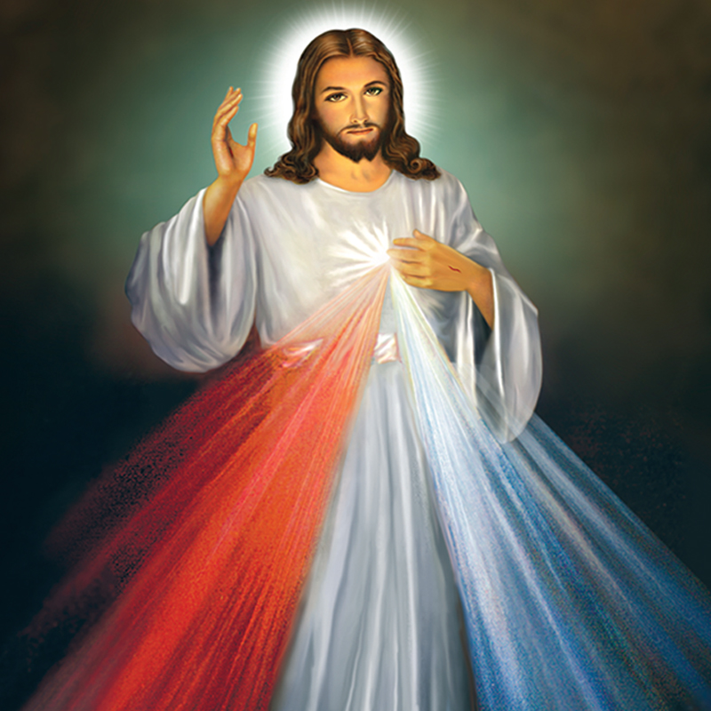
(Optional)
You expired, Jesus, but the source of life gushed forth for souls, and the ocean of mercy opened up for the whole world. O Fount of Life, unfathomable Divine Mercy, envelop the whole world and empty Yourself out upon us. (Diario, 1319).
O Blood and Water, which gushed forth from the Heart of Jesus as a fount of mercy for us, I trust in You!

Slide 22
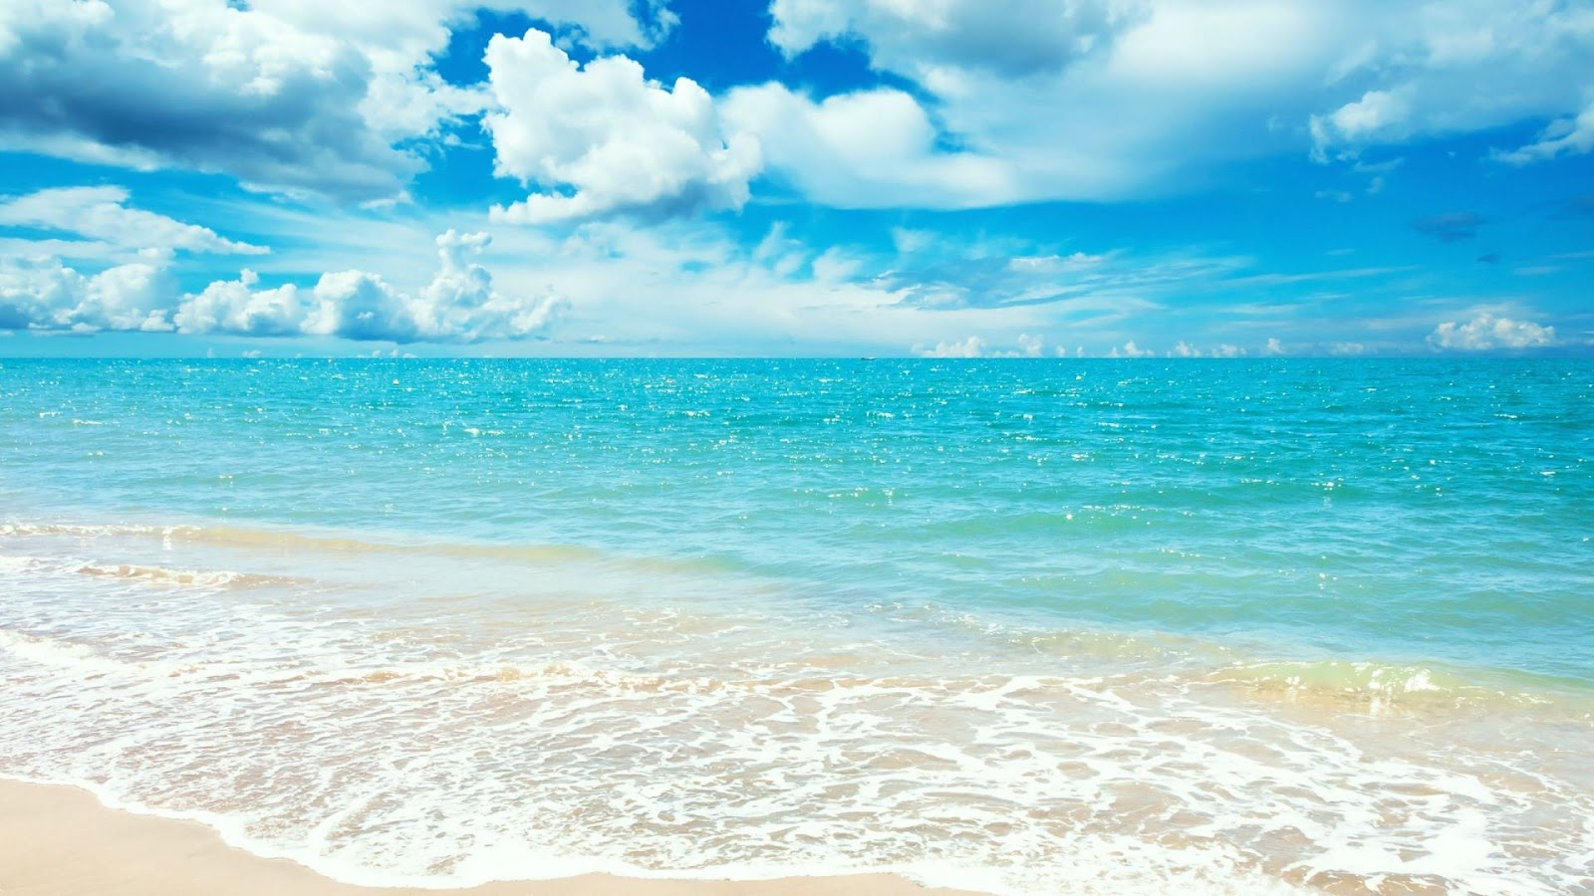
OUR FATHER
HAIL MARY

Slide 23
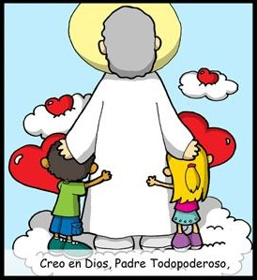
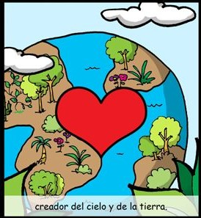
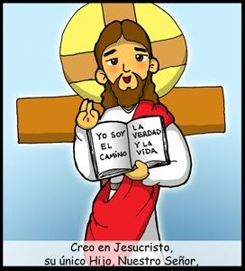
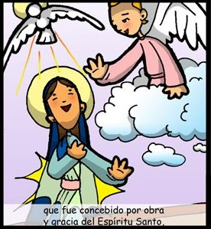
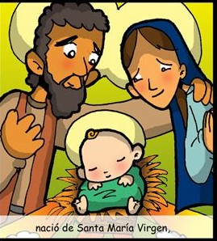
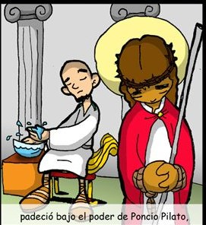
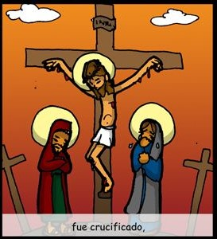
THE
CREED
I believe in one God, the Father Almighty,
Creator of Heaven and Earth,
and in Jesus Christ,
His only Son, Our Lord,
who was conceived
by the Holy Spirit,
born of the Virgin Mary,
Was crucified,
suffered under Pontius Pilate,

Slide 24
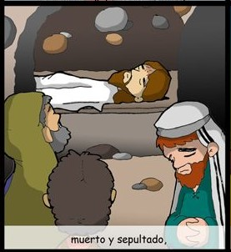
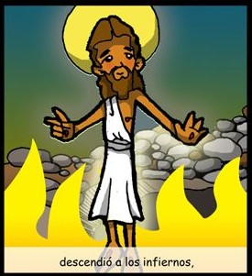
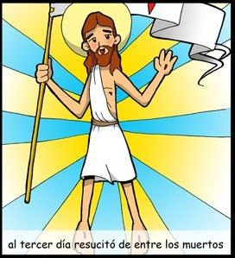
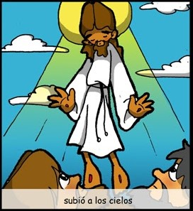
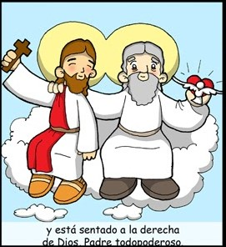
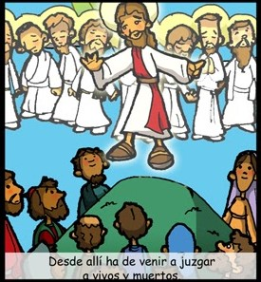
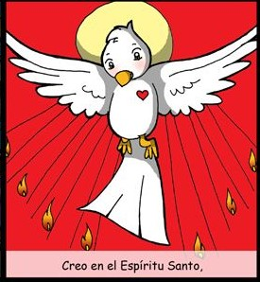
died and was buried.
He descended into Hell,
On the 3rd day He rose from the dead,
ascended into Heaven,
And is seated at the
right hand of the Father.
From thence He shall come
to judge the living and the dead.
I believe in the Holy Spirit,
the Holy Catholic Church,

Slide 25
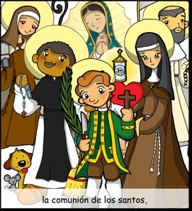
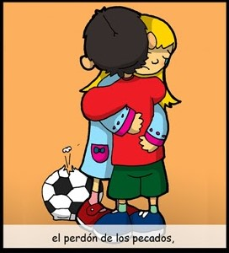
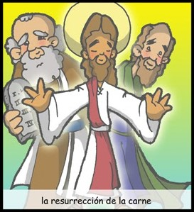
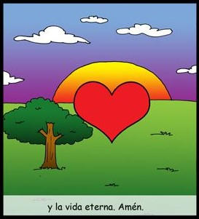
the communion of Saints,
The forgiveness of sins,
the resurrection of the body,
and life everlasting.
AMEN

Slide 26
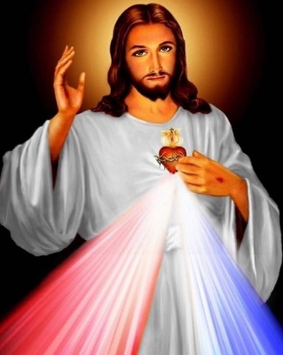
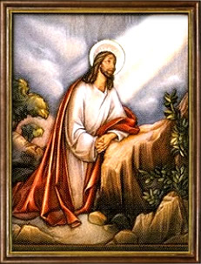
ETERNAL FATHER, I offer You the Body and Blood, Soul and Divinity of Your dearly beloved Son, Our Lord Jesus Christ
R.- in atonement for our sins and those of the whole world.
For the sake of His Sorrowful Passion,
R. Have Merciy on us and on the whole world.

Slide 27
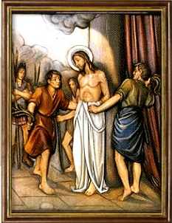
ETERNAL FATHER, I offer You the Body and Blood, Soul and Divinity of Your dearly beloved Son, Our Lord Jesus Christ
R.- in atonement for our sins and those of the whole world.
For the sake of His Sorrowful Passion,
R. Have Merciy on us and on the whole world.

Slide 28
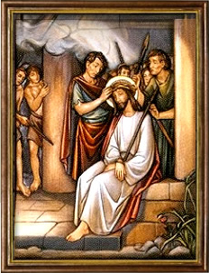
ETERNAL FATHER, I offer You the Body and Blood, Soul and Divinity of Your dearly beloved Son, Our Lord Jesus Christ
R.- in atonement for our sins and those of the whole world.
For the sake of His Sorrowful Passion,
R. Have Merciy on us and on the whole world.

Slide 29
ETERNAL FATHER, I offer You the Body and Blood, Soul and Divinity of Your dearly beloved Son, Our Lord Jesus Christ
R.- in atonement for our sins and those of the whole world.
For the sake of His Sorrowful Passion,
R. Have Merciy on us and on the whole world.

Slide 30
ETERNAL FATHER, I offer You the Body and Blood, Soul and Divinity of Your dearly beloved Son, Our Lord Jesus Christ
R.- in atonement for our sins and those of the whole world.
For the sake of His Sorrowful Passion,
R. Have Merciy on us and on the whole world.

Slide 31
HOLY GOD,
HOLY MIGHTY ONE,
HOLY IMPORTAL ONE,
HAVE MERCY ON US AND ON THE WHOLE WORLD.

Slide 32
(Optional)
Eternal God, in whom mercy is endless, and the treasury of compassion inexhaustible, look kindly upon us, and increase Your mercy in us, that in difficult moments we might not despair, nor become despondent, but with great confidence submit ourselves to Your holy will, which is Love and Mercy itself. Amen.

Slide 33
ACTIVITY

Slide 34
PEACE
THE FATHER
YOU
BREATHED
HOLY SPIRIT
SINS
FORGIVEN
RETAIN

Slide 36
PRAYER
My God, I believe, I adore, I trust, and I love you. I beg pardon for those who do not believe, do not adore, and do not love you.
Amen.

Slide 37
The Lord is Merciful and Compassionate https://youtu.be/3YBIka9ngKI

