Slide 1
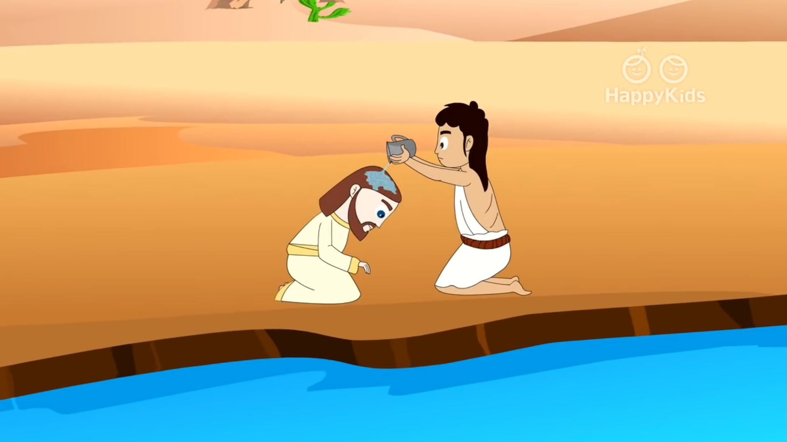
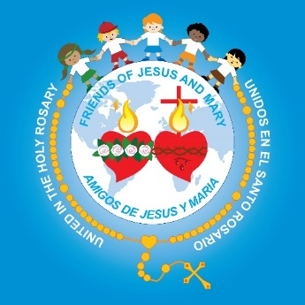
Ministry Friends of Jesus and Mary
www.fcpeace.org
II Sunday of Ordinary Time - Cycle A
The Baptism of the Lord (John 1:29-34)

Slide 2
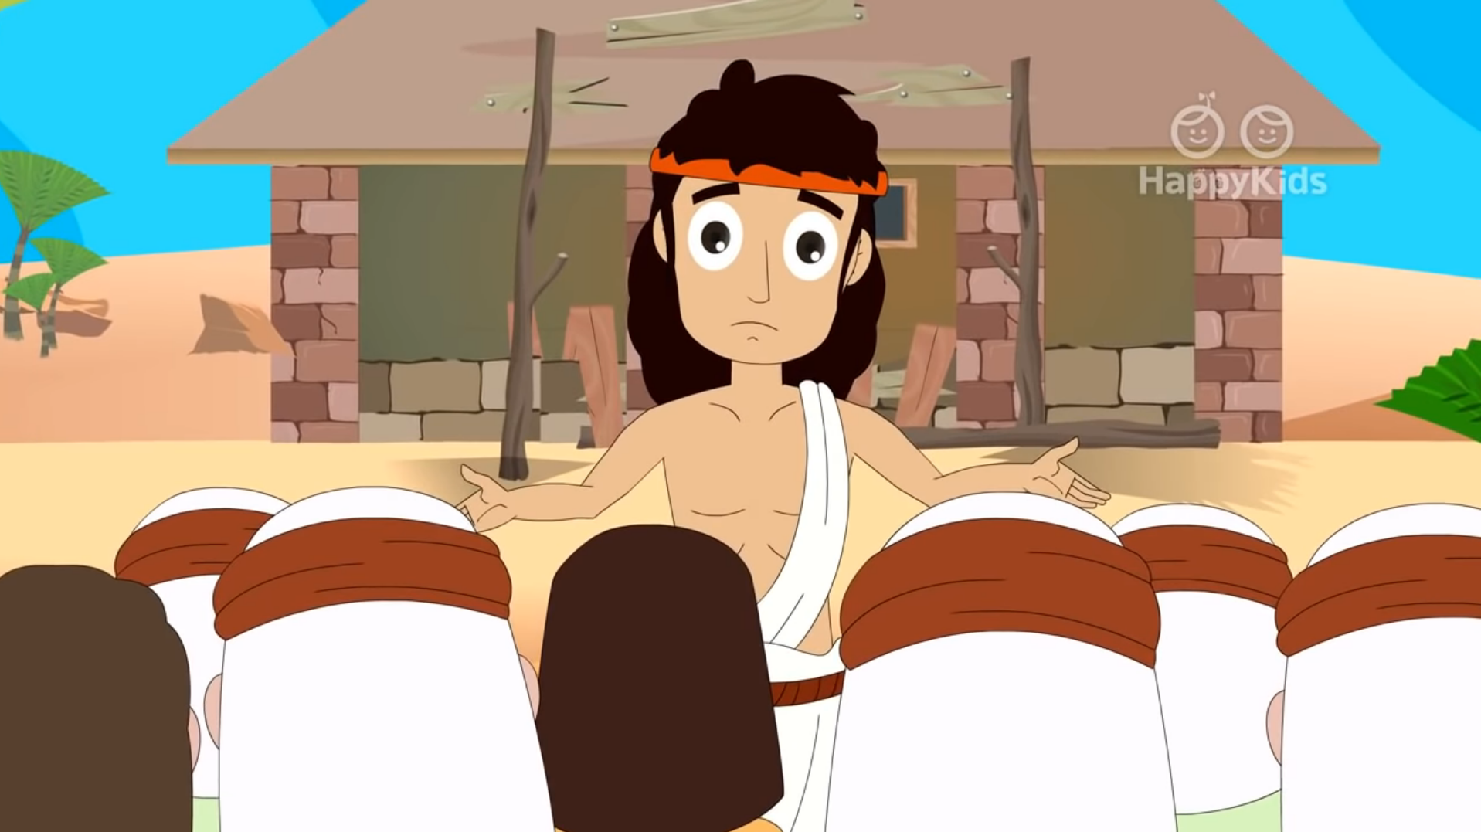
John the Baptist saw Jesus coming toward him and said:

Slide 3
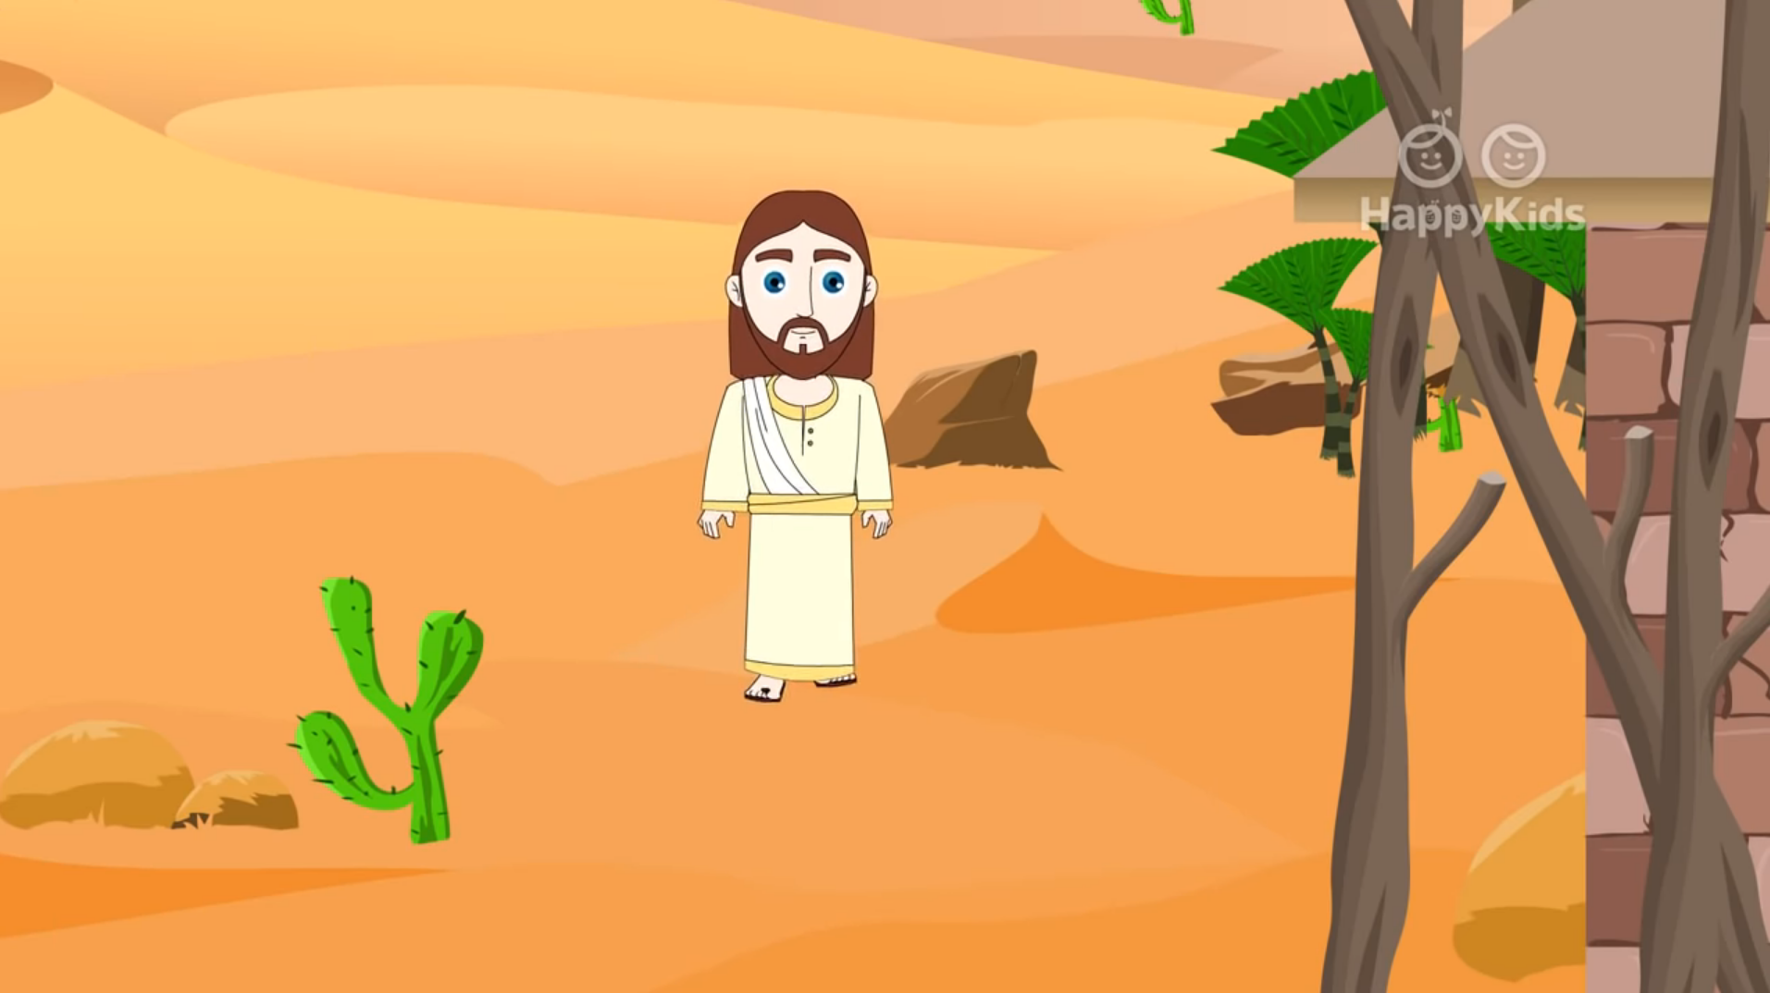
"Behold, the Lamb of God, who takes away the sin of the world”.

Slide 4
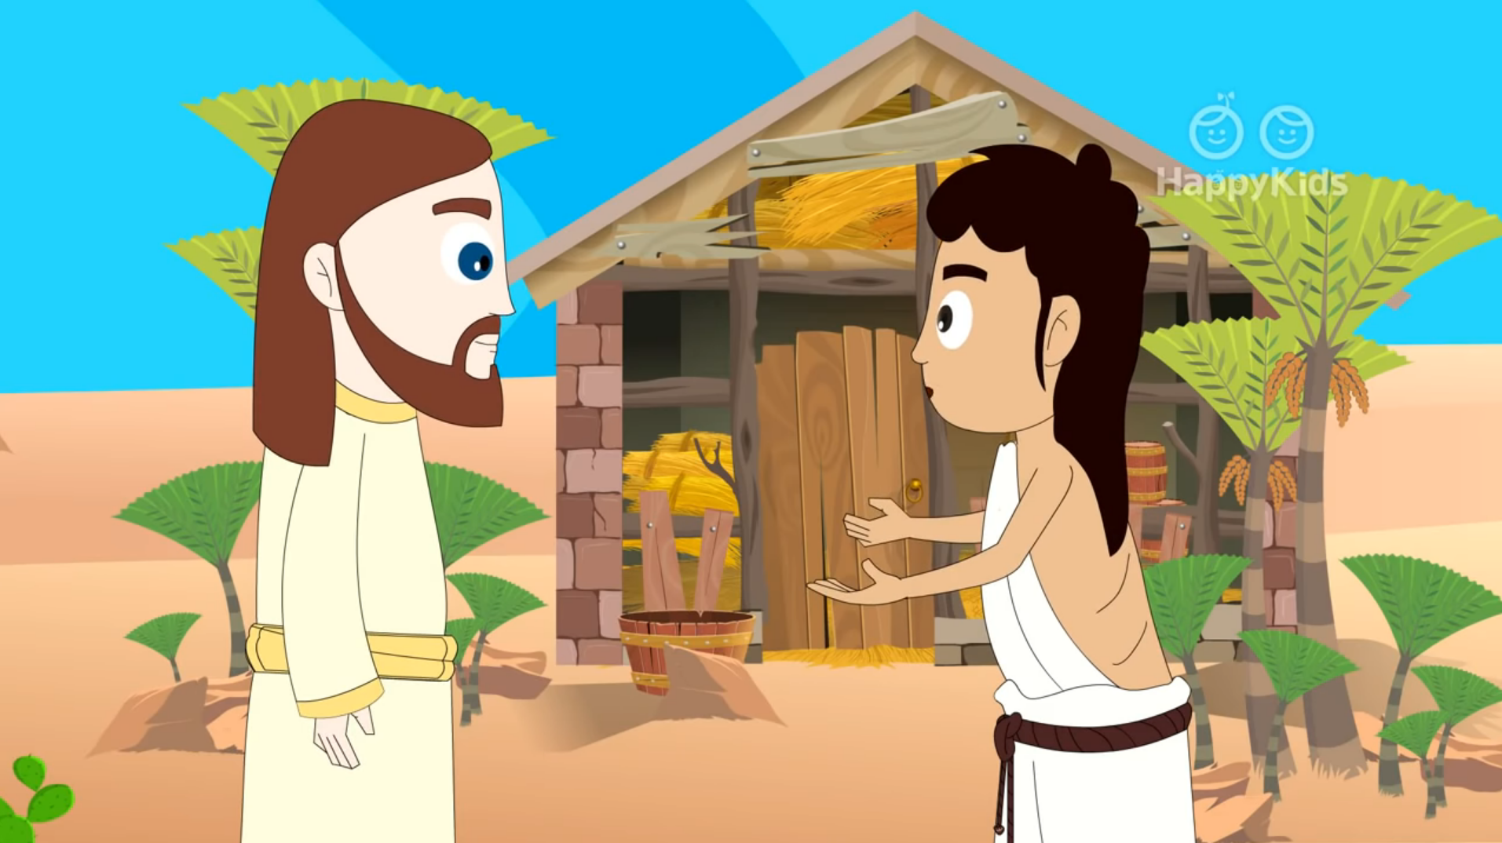
He is the one of whom I said, 'A man is coming after me who ranks ahead of me
because he existed before me.'

Slide 5
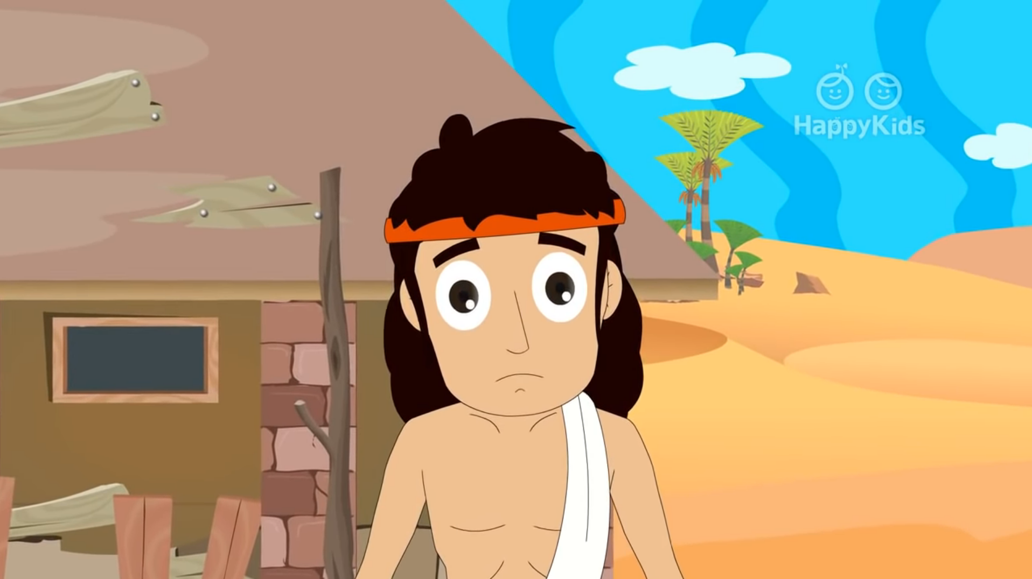
“I did not know him, but the reason why I came baptizing with water was that he might be made known to Israel”.

Slide 6
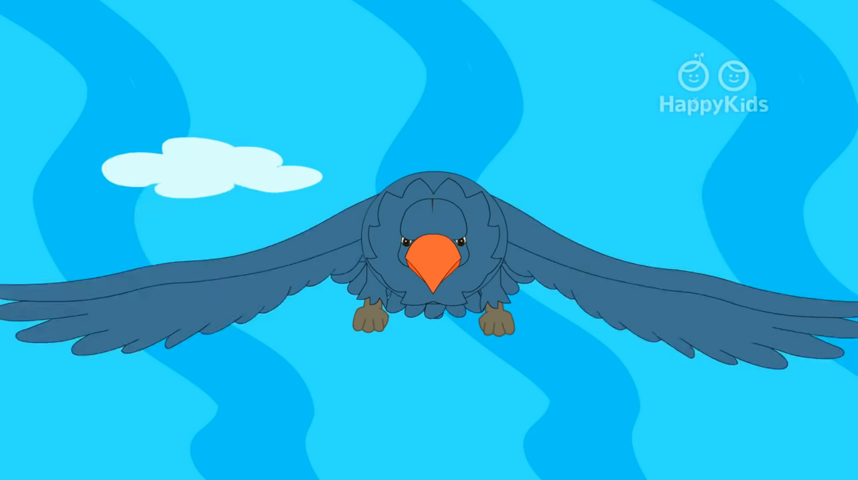
John testified further, saying, "I saw the Spirit come down like a dove from heaven and remain upon him.

Slide 7
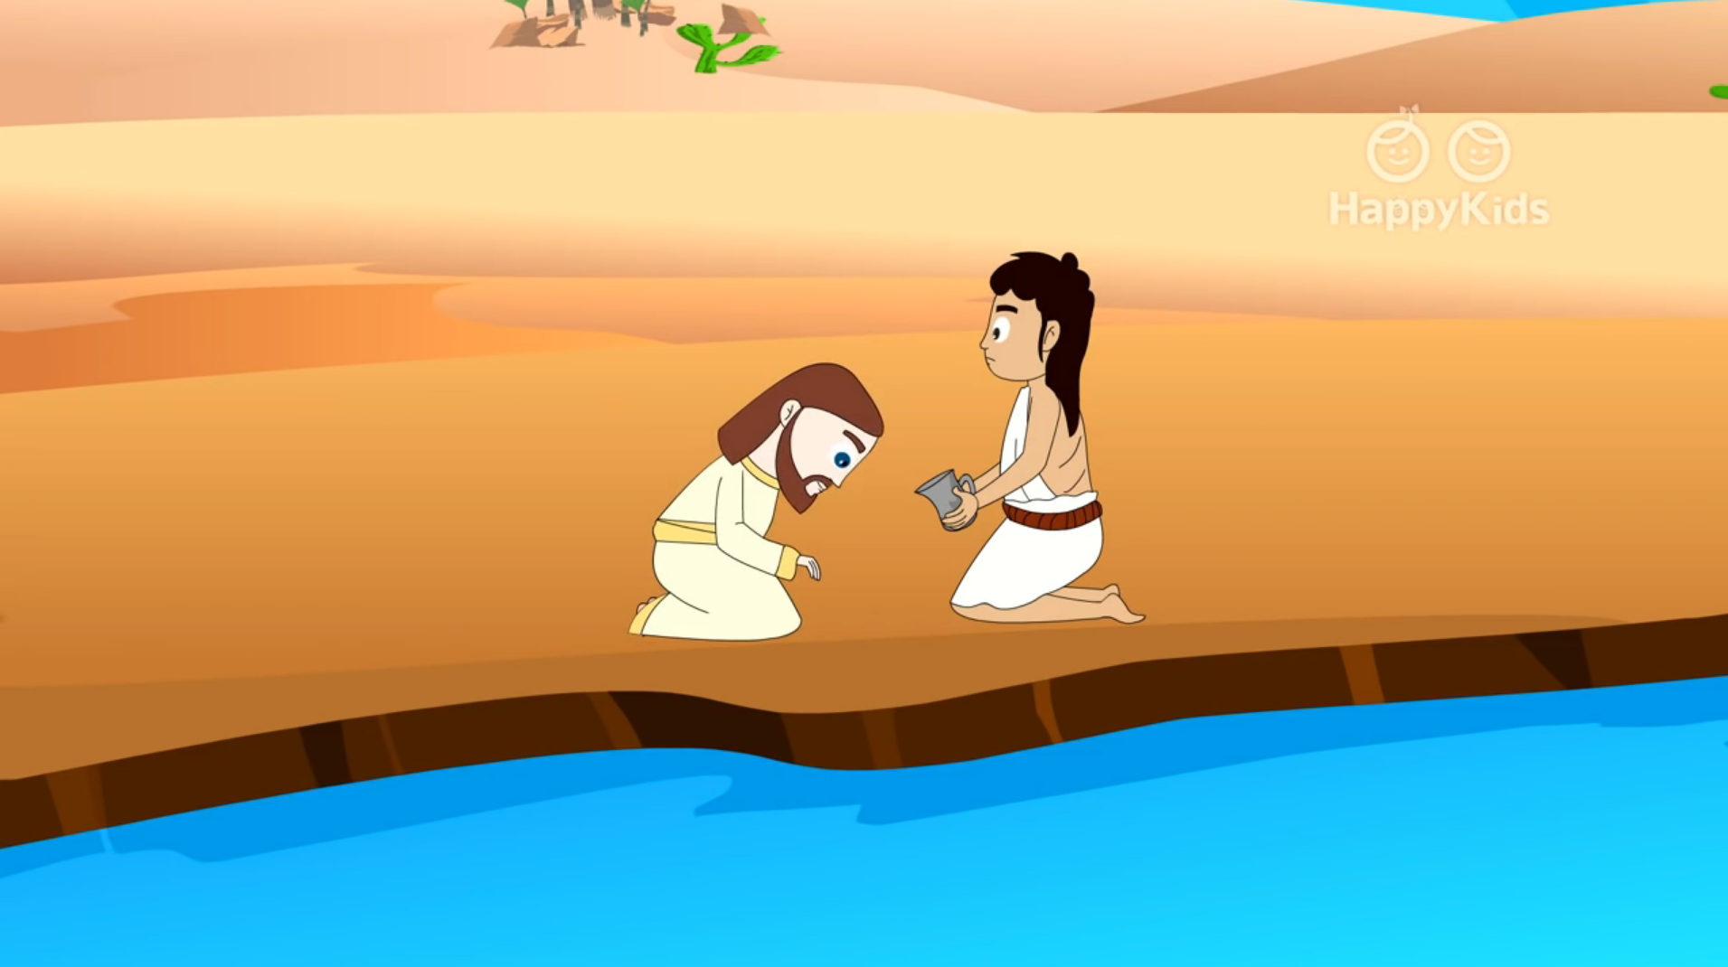
I did not know him, but the one who sent me to baptize with water told me, 'On whomever you see the Spirit come down and remain,

Slide 8
He is the one who will baptize with the Holy Spirit.’ Now I have seen and testified that he is the Son of God.”
The Gospel of the Lord
Praise to You Lord Jesus Christ

Slide 9
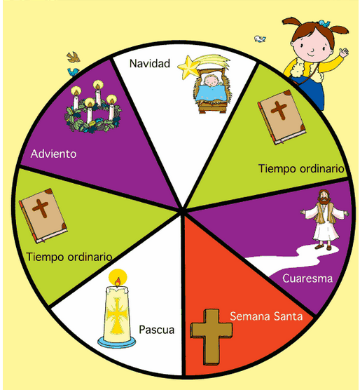
New Liturgical Cycle
Christmas
Advent
The season of Christmas ends…
Ordinary Time
The 1st Ordinary
Time begins.
Ordinary Time
Lent
Easter
Holy Week

Slide 10
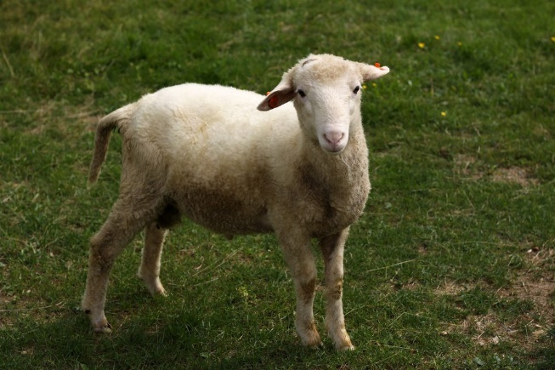
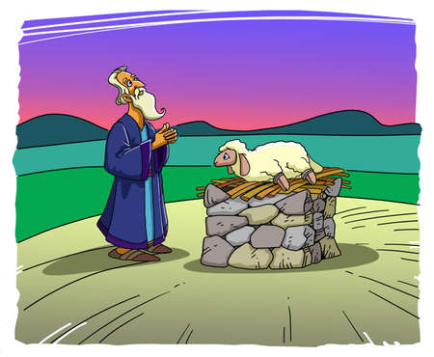
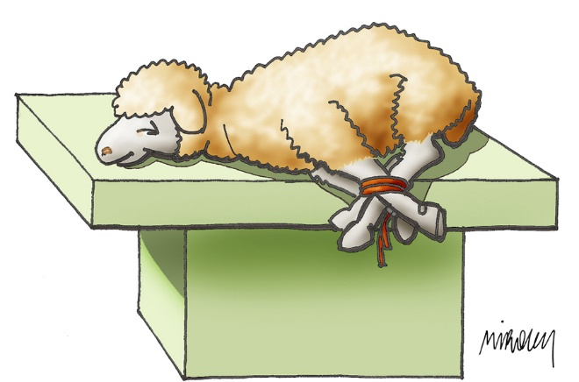
REFLECTION
John the Baptist proclaimed, “This is the Lamb of God.” Why does He say this?
The Jewish people offered sacrifices of innocent animals to God to ask for forgiveness for their sins.
The lamb is a meek, tame
animal who doesn’t resist
death.
A person wanting forgiveness would take the lamb to a Jewish priest who would sacrifice the animal to obtain forgiveness for that person.
God taught that sin was so awful in His sight, that the blood of an innocent animal should be shed so the sinner could be forgiven.

Slide 11
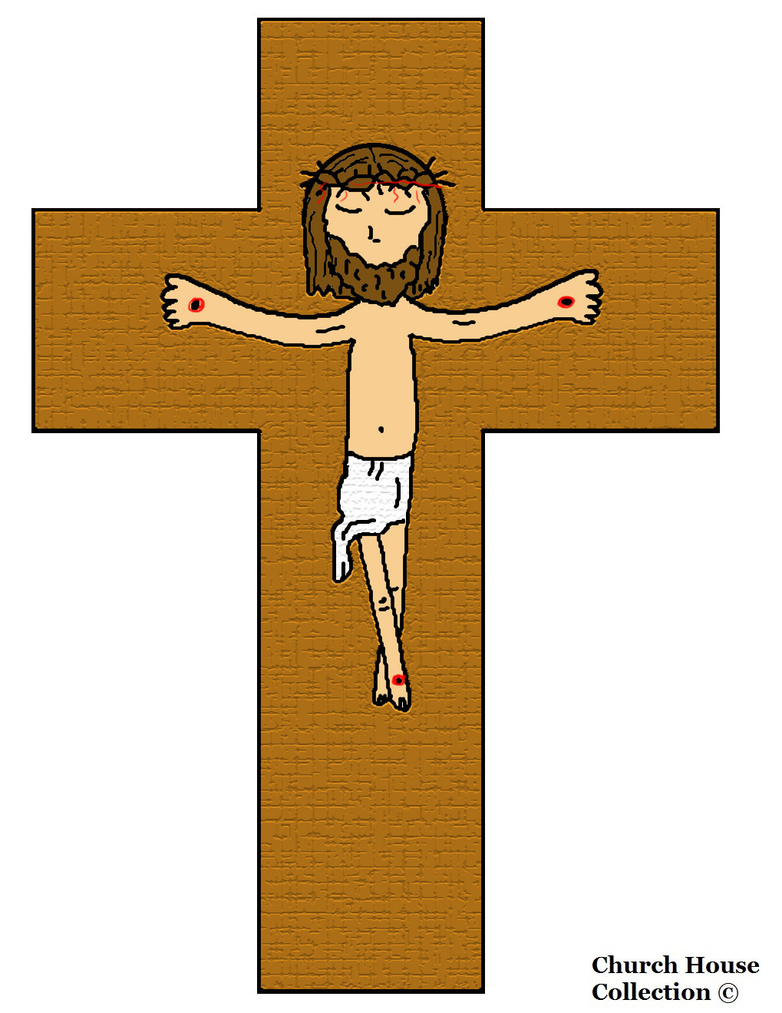
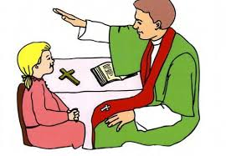
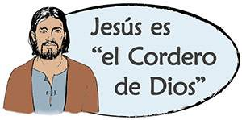
REFLECTION
Jesus is the Lamb of God, the perfect sacrifice. Although innocent, He did not resist suffering and dying for us because it was His Father’s will. Jesus sacrificed Himself to obtain the forgiveness of our sins! After His death, no other animal needed to be sacrificed!!!
How does God give us forgiveness for our sins?
Through the Sacrament of Reconciliation.
JESUS IS THE LAMB OF GOD

Slide 12
John also says that a man is coming after him who ranks ahead of him because he existed before him. We know that John was born before Jesus, so why did he say this?
John knows that Jesus is God, who always existed.
Why does John baptize with water?
To recognize the Savior, they must stop sinning and turn to God. John’s baptism symbolizes a cleansing; a conversion or change to holiness.
When Jesus approaches John, how does he know Jesus is the Savior?
He saw the Holy Spirit descend in the form of a dove and remain upon Him.

Slide 13
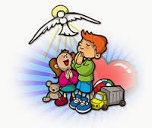
John says someone will come who will baptize with the Holy Spirit. How is this different from his baptism with water?
Jesus baptizes with the Holy Spirit who has the power to forgive our sins.
What happens when we are baptized?
*Our soul is cleansed of Original Sin, the sin of Adam and Eve.
*We become children of God.
*We receive Jesus’ mission for the world: to proclaim the Good News of God’s love to everyone.
*And we receive the Holy Spirit!

Slide 14

ACTIVITY

Slide 15
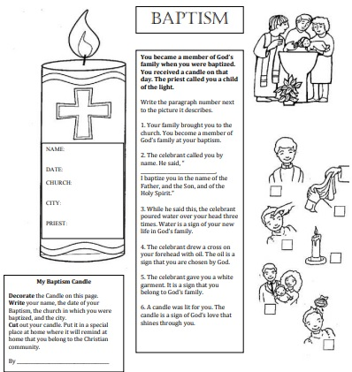
Match the paragraph with the picture by filling in the corresponding number in the box. Cut and color the candle and fill in the facts about your Baptism so you remember to celebrate every year.
2
5
4
6
1
3

Slide 16
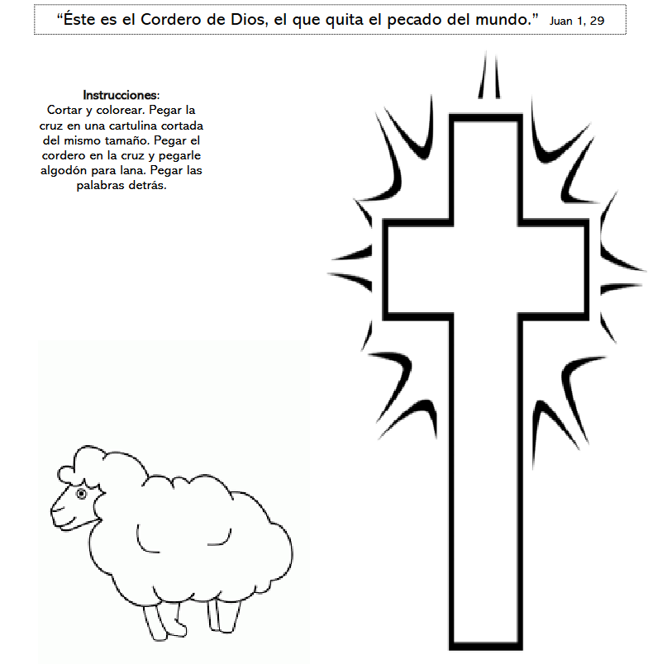
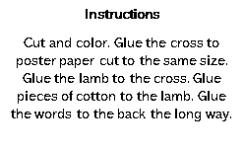

Slide 17


PRAYER
Thank you, Lord, for coming to save us and for your great love for us. Help us to follow you as you always followed your Father. Give us a heart attentive to you so we may construct a better world of love and be a strong light for others. Amen

Slide 18

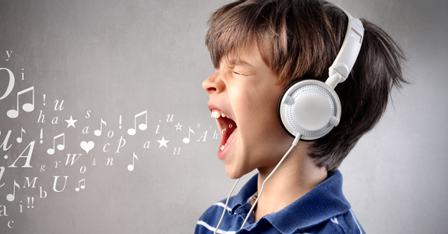
SONG

Slide 19

I have decided to follow Jesus, Lifetree Kids, https://youtu.be/sEL0WpeH088

