Slide 1
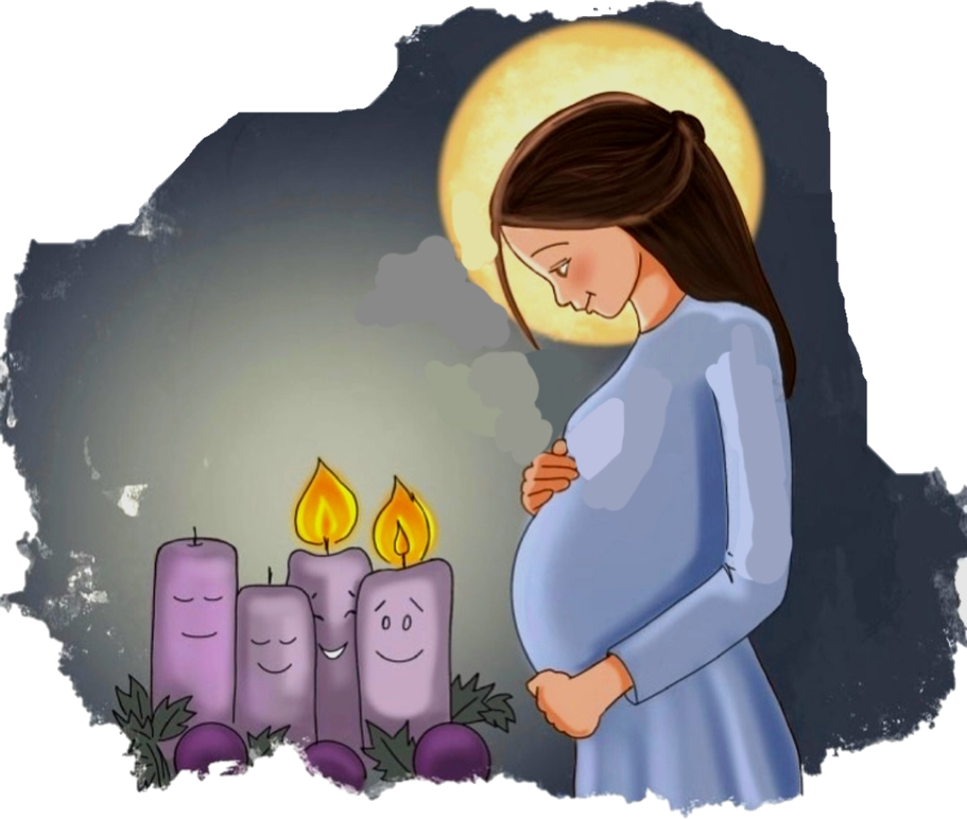
Ministry Friends of Jesus and Mary
www.fcpeace.org
MY MESSENGER PREPARES THE WAY
Cycle A-III Sunday of Advent
Matthew 11, 2-11

Slide 2
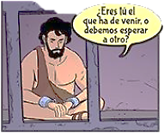
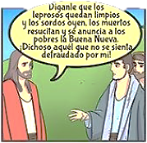
When John the Baptist heard in prison of the works of the Christ, he sent his disciples to Jesus with this question,"Are you the one who is to come, or should we look for another?"
"Are you the one who is to come, or should we look for another?"
Tell him what you hear and see: the blind regain their sight, the lame walk, lepers are cleansed, the deaf hear, the dead are raised, and the poor have the good news proclaimed to them.
Jesus said to them in reply, "Go and tell John what you hear and see: the blind regain their sight, the lame walk, lepers are cleansed, the deaf hear, the dead are raised, and the poor have the good news proclaimed to them.

Slide 3
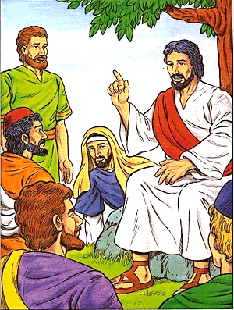
And blessed is the one who takes no offense at me." As they were going off, Jesus began to speak to the crowds about John, "What did you go out to the desert to see? A reed swayed by the wind? Then what did you go out to see? Someone dressed in fine clothing? Those who wear fine clothing are in royal palaces. Then why did you go out? To see a prophet?

Slide 4
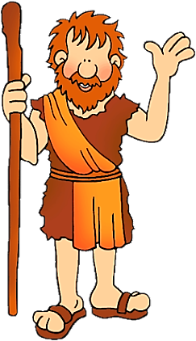
Yes, I tell you, and more than a prophet. This is the one about whom it is written: Behold, I am sending my messenger ahead of you; he will prepare your way before you. Amen, I say to you, among those born of women there has been none greater than John the Baptist; yet the least in the kingdom of heaven is greater than he."
The Gospel of the Lord,
Praise to you Lord Jesus Christ.

Slide 5
HAIL MARY
REFLECTION
YES
REFLECTION

Slide 6
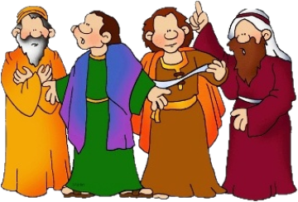
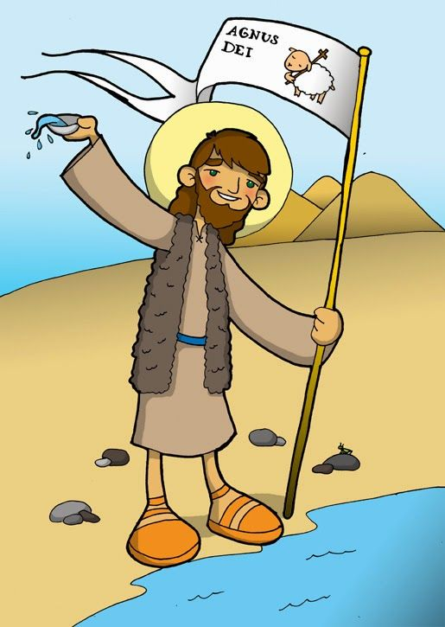
What is a prophet?
A Messenger of God.
Jesus says that John the Baptist was God’s messenger. What was John the Baptist’s message?
Stop sinning; love God and your neighbor, change your life.

Slide 7
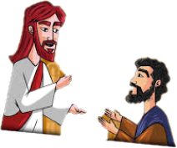
Why does St. John the Baptist ask this?
He wants them to prepare their hearts to receive Jesus, the Messiah, God made man. A heart full of sin cannot see God.
The emperor Herod jailed John because his wife did not like how John insisted Herod had to change his life and stop sinning. John sent Jesus a message from jail, asking Jesus if He was the promised Savior. How did Jesus answer?
Jesus sends a messenger to describe to John all the miracles and good things He was doing.

Slide 8
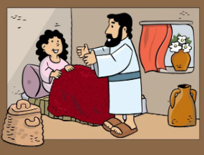
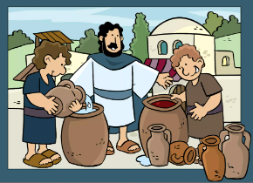
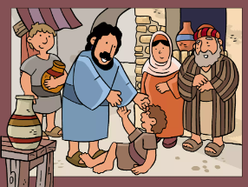
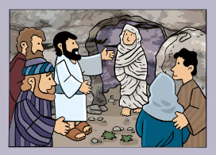
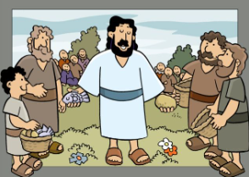
What miracles did Jesus do?
The blind see, the deaf hear…
The prophet, Isaiah, who had lived many years before had said about the Savior,
"Then will the eyes of the blind be opened and the ears of the deaf unstopped. Then will the lame leap like a deer, and the mute tongue shout for joy.…” (Isaiah, 35, 5-6)
St. John the Baptist would have understood this response and known Jesus was the Messiah.
Jesus also told his apostles that the poor have the Good News proclaimed to them. Does this mean that the message is not for the rich?
No, Jesus is talking about a poor heart; a humble heart listens to the Gospel because it know it needs God’s mercy and love.

Slide 9
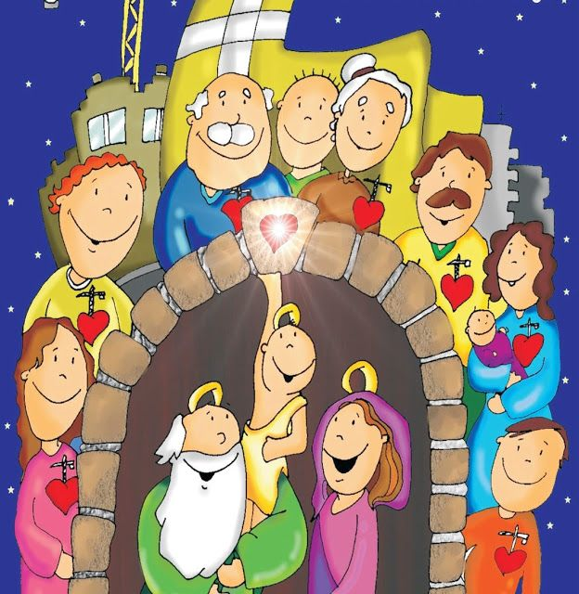
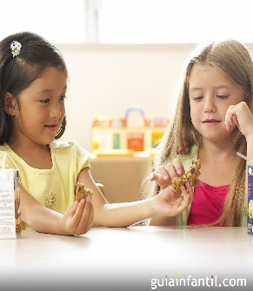
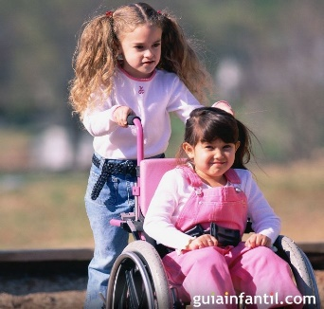
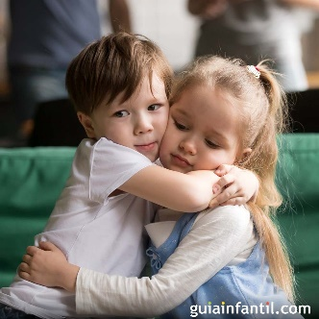
Jesus says John is more than a prophet because, “This is the one about whom it is written: Behold, I am sending my messenger ahead of you; he will prepare your way before you.” (Malachi3:1) St. John the Baptist prepared the way for the coming of Jesus, the Savior of the world. How can we prepare our hearts for the coming of Jesus this Christmas?
Sharing,
helping,
forgiving,
sacrificing…

Slide 10
BE IT DONE TO ME ACCORDING TO YOUR WILL.
ACTIVITIES
ACTIVIITIES

Slide 11
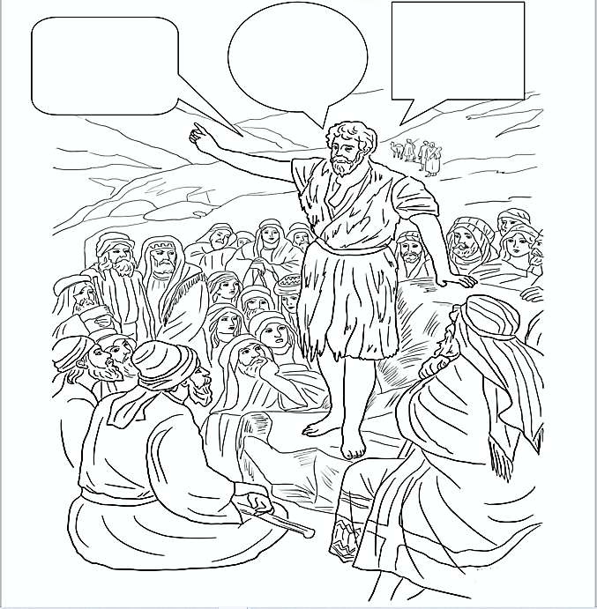
Love God and your neighbor!
Stop sinning!
Change your life!
MESSAGE OF
ST. JOHN THE BAPTIST

Slide 12
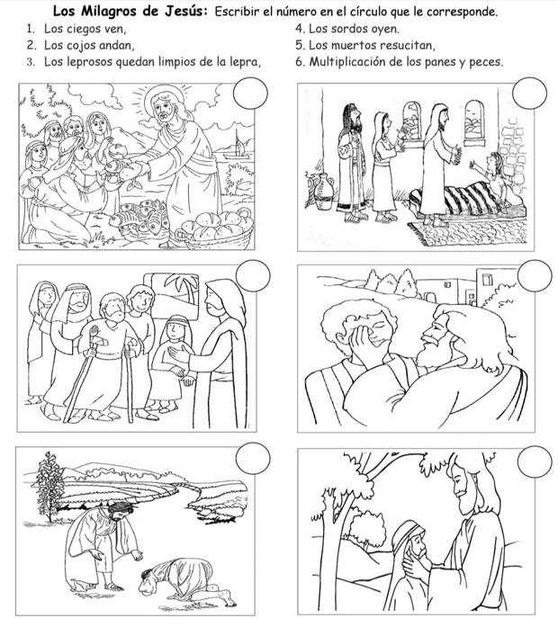
Jesus’ Miracles: Write the number in the picture that corresponds with the miracle.
The blind see, 4. The deaf hear.
The lame walk, 5. The dead resurrect,
The lepers are healed of leprosy, 6. The multiplication of the bread and fish.
6
5
JESUS’
MIRACLES
2
1
3
4

Slide 13
THE ANNUNCIATION
One day, the angel Gabriel visited Mary to announce that God had chosen her to be the Mother of His Son saying,
“Hail Mary, full of grace, the Lord is with you.”
Mary accepted the will of God saying “I am the handmaiden of the Lord, let it happen to me as you have said.”
Mary set out to visit her cousin Elizabeth. As soon as Elizabeth heard Mary's greeting, the child leapt in her womb and Elizabeth was filled with the Holy Spirit.
She cried out, Blessed are you amongst women, and blessed is the fruit of your womb.
Luke 1, 26-42
Match the question with the correct answer with a line.
To whom did the angel speak?
That God wanted her to be the Mother of, the Savior, His Son.
THE VISITATION
How did the angel greet Mary?
Hail Mary
What did the angel announce?
To Mary of Nazareth
Who did Mary visit?
Let it happen to me as you have said.
What did Mary respond?
Her cousin Elizabeth

Slide 14
SONG:
Joy to the World, Lifetree Kids, https://youtu.be/bQ8gE0L1524

Slide 15
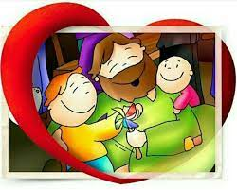
PRAYER
Lord, give me a humble heart so I may always seek you, always love you, always seek your forgiveness. Thank you, for becoming small so we may better understand the great Love God has for us.
Amen

