Slide 1
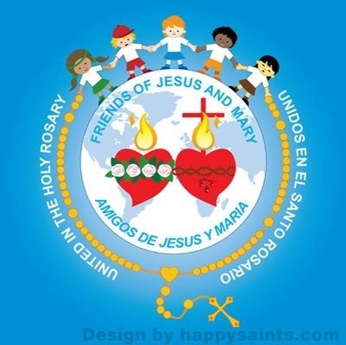
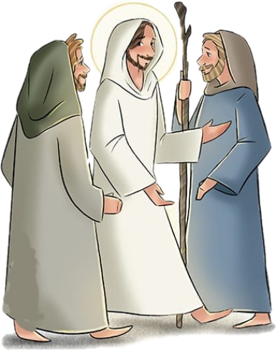
Ministry Friends of Jesus and Mary www.fcpeace.org
Jesus in Emmaus
Cycle A – III Sunday of Easter
Luke 24, 13-35

Slide 2
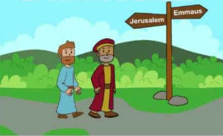
That very day, the first day of the week, two of Jesus’ disciples were going to a village seven miles from Jerusalem called Emmaus, and they were conversing about all the things that had occurred.
And it happened that while they were conversing and debating, Jesus himself drew near and walked with them, but their eyes were prevented from recognizing him.

Slide 3
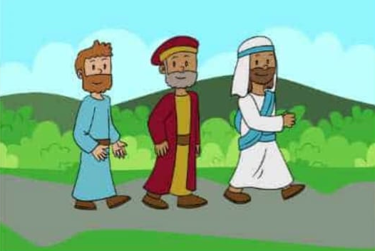
He asked them, “What are you discussing as you walk along?” They stopped, looking downcast. One of them, named Cleopas, said to him in reply, “Are you the only visitor to Jerusalem who does not know of the things that have taken place there in these days?”
And he replied to them, “What sort of things?” They said to him, “The things that happened to Jesus the Nazarene, who was a prophet mighty in deed and word before God and all the people, how our chief priests and rulers both handed him over to a sentence of death and crucified him. But we were hoping that he would be the one to redeem Israel; and besides all this, it is now the third day since this took place.
Some women from our group, however, have astounded us: they were at the tomb early in the morning and did not find his body; they came back and reported that they had indeed seen a vision of angels who announced that he was alive.

Slide 4
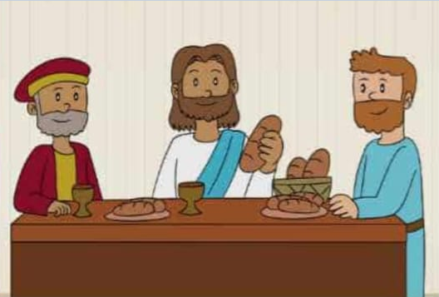
Then some of those with us went to the tomb and found things just as the women had described, but him they did not see.” And he said to them, “Oh, how foolish you are! How slow of heart to believe all that the prophets spoke! Was it not necessary that the Christ should suffer these things and enter into his glory?” Then beginning with Moses and all the prophets, he interpreted to them what referred to him in all the Scriptures.
As they approached the village to which they were going, he gave the impression that he was going on farther. But they urged him, “Stay with us, for it is nearly evening and the day is almost over.”
So he went in to stay with them. And it happened that, while he was with them at table, he took bread, said the blessing, broke it, and gave it to them. With that their eyes were opened, and they recognized him, but he vanished from their sight.

Slide 5
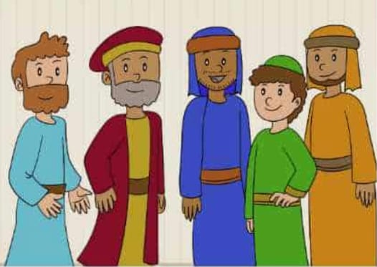
Then they said to each other, “Were not our hearts burning within us while he spoke to us on the way and opened the Scriptures to us?” So they set out at once and returned to Jerusalem where they found gathered together the eleven and those with them who were saying, “The Lord has truly been raised and has appeared to Simon!”
Then the two recounted what had taken place on the way and how he was made known to them in the breaking of bread.

Slide 7
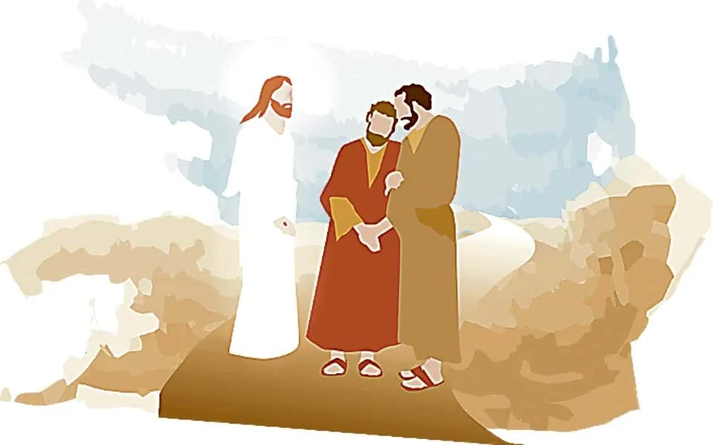
Reflection

Slide 8
Two disciples of Jesus were returning from Jerusalem to a village called Emmaus.
What is a disciple?
A person that follows the teachings of a master, in this case Jesus.
How did these disciples feel after their master’s death?
They all felt alone and filled with sadness, because their master had been crucified; and although they had heard rumors that he could be alive, they felt uncertain. They had believed, followed, and waited for their master, but now, they felt that he had failed and had abandoned them.
Why did the disciples not recognize Jesus when he came on the road talking to them?
Their eyes were veiled, which means that they were miraculously unable to recognize him. Jesus comes to accompany and comfort them in their sadness.

Slide 9
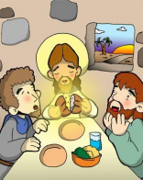
How did the disciples feel in the presence of Jesus?
They felt their hearts burn! Jesus walked with them, explained the Scriptures, made them see that the Passion suffered by Jesus was necessary to fulfill the Plan of God. He filled them with enthusiasm and made them feel his presence.
When did the disciples see Jesus?
Jesus stands at the table, takes the bread, blesses it, breaks it, and there their eyes (previously veiled) are opened and they recognize him, but he disappears.
Jesus remains with us in the Eucharist: the Sacrament that contains His Body, Blood, Soul, and Divinity. Also, He is present when we come together in His name. We find Him when we go to Mass!

Slide 10
Activity
T
U
E
E
C R U C I F Y
B
E
D
M O S E S
V I S I T O R
P
E
W
L
K
D A Y
T A L K I N G

Slide 11
Activity
WORD
EUCHARIST

Slide 12
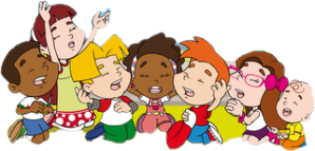
Prayer
Lord, help me to see you in the Mass, in your Word, and in your presence in the Eucharist. I love you very much. Amen.

Slide 13
Eucharist Song by Collins Susan, https://www.youtube.com/watch?v=_GEqnKMN1zE (3-7 years)

Slide 14
One Bread One Body, San Miguel, https://youtu.be/OshpSD0z1ts (8+ years)

