Slide 1
MINISTRY FRIENDS OF JESUS AND MARY
CYCLE A - IV SUNDAY OF ADVENT
THE VIRGIN WILL CONCEIVE
MATTHEW 1, 18-24
www.fcpeace.org

Slide 2
THE GOSPEL ACCORDING TO
ST. MATTHEW 1: 18-24

Slide 3
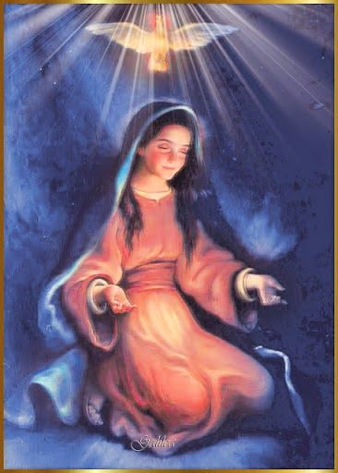
“The virgin shall conceive and bear a son.”
This is how the birth of Jesus Christ came about. When his mother Mary was betrothed to Joseph, but before they lived together, she was found with child through the Holy Spirit .

Slide 4
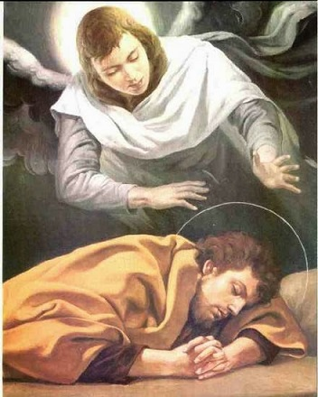
Joseph her husband, since he was a righteous man, yet unwilling to expose her to shame, decided to divorce her quietly. Such was his intention when, behold, the angel of the Lord appeared to him in a dream and said, "Joseph, son of David, “Do not be afraid to take Mary your wife into your home. For it is through the Holy Spirit that this child has been conceived in her. She will bear a son and you are to name him Jesus, because he will save his people from their sins."

Slide 5
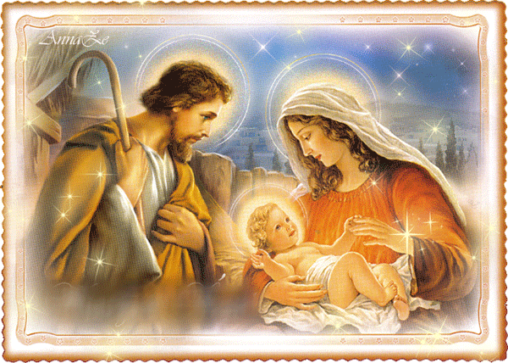
All this took place to fulfill what the Lord had said through the prophet: “Behold, the virgin shall conceive and bear a son, and they shall name him Emmanuel, which means "God is with us." When Joseph awoke, he did as the angel of the Lord had commanded him and took his wife into his home.

Slide 6
THE GOSPEL OF THE LORD,
PRAISE TO YOU LORD JESUS CHRIST.

Slide 7
REFLECTION

Slide 8
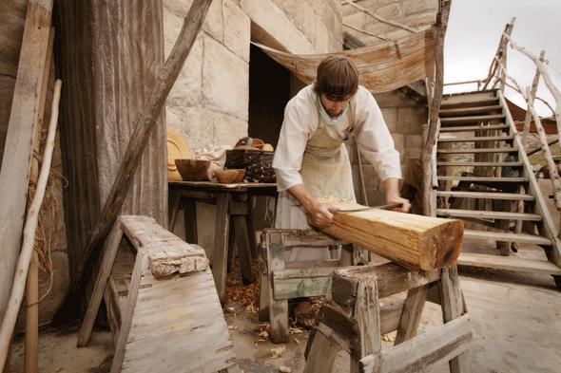
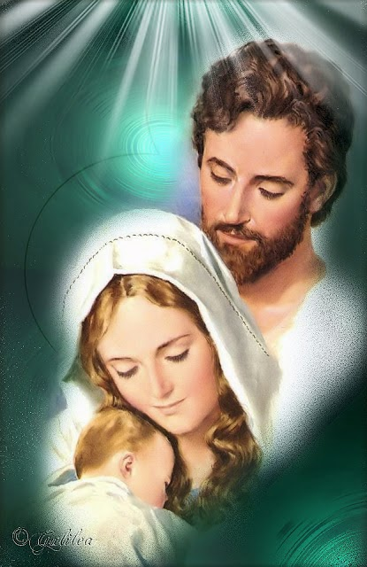
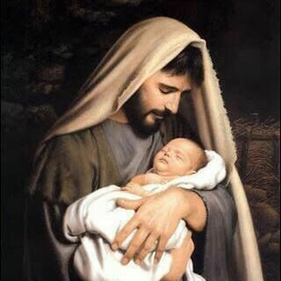
Few days are left for Christmas and today the Gospel speaks to us about a man named Joseph.
WHO WAS JOSEPH?
A CARPENTER WHO DESCENDED FROM KING DAVID
THE VIRGIN MARY’S HUSBAND
JESUS’ EARTHLY FATHER

Slide 9
How did Joseph feel when he found out Mary was with child?
Joseph was upset because they had not yet lived together.

Slide 10
What did the law say about these cases?
Joseph could accuse Mary and she could be stoned to death for infidelity.

Slide 11
What does Joseph do?
Joseph was a just man and knew Mary was innocent and good. Instead, he remained silent and left all in God’s hands.

Slide 12
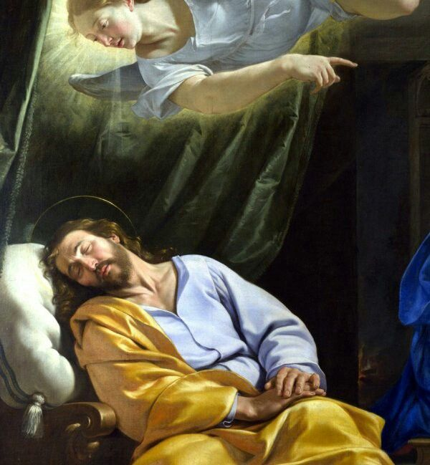
How did Joseph find out that God is the Father of Jesus?
God sent him an angel in a dream who told him not to fear taking Mary as his wife since she conceived by the Holy Spirit. God was the Father.
And so he did when he awoke.

Slide 13
The angel told him to name the child Jesus. What does Jesus mean?
GOD SAVES.
What does Emmanuel mean?
GOD IS WITH US.

Slide 14
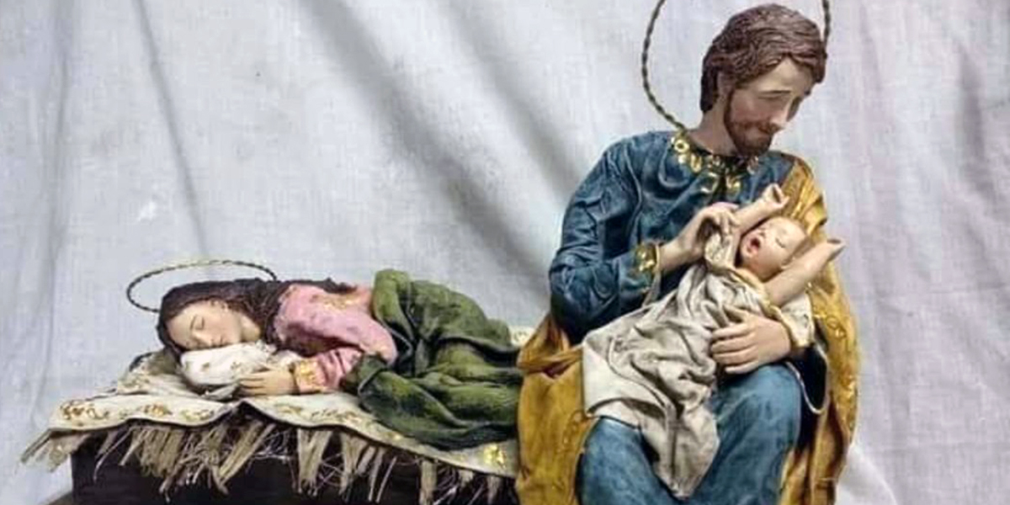
ST. JOSEPH
He was an excellent Father who greatly loved and cared for Jesus and Mary.
He was always obedient to God.
Together they form the Holy Family, our family in Heaven.

Slide 15
ARE WE LIKE STAINT JOSEPH?
OBEDIENT
ALWAYS TRUSTING GOD
ALWAYS LOVING
AND CARING FOR
THOSE OTHERS
I help

Slide 16
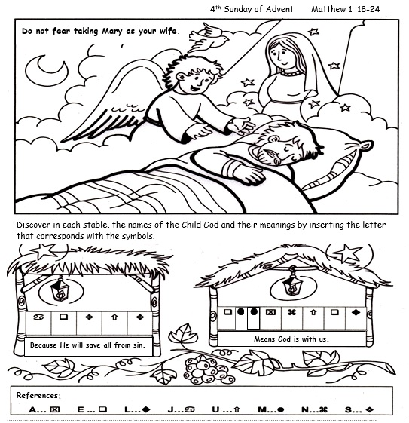
J
E
S
U
S
E
M
M
A
N
U
E
L

Slide 17
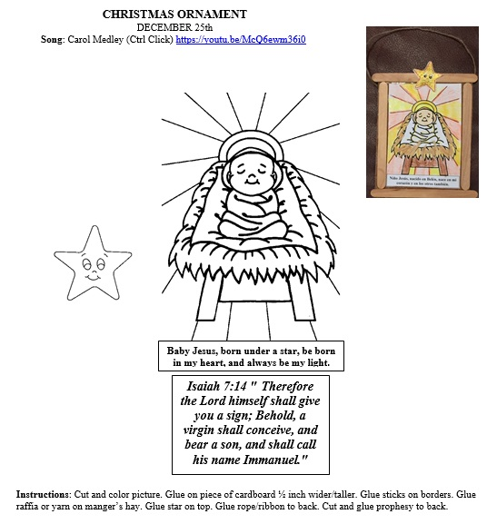

Slide 18
PRAYER
My God, I want to imitate St. Joseph and do what you ask of me. Help me to always accept your plans. Help me to let go of fear and leave all in your hands staying united to you in prayer. Please be born in my heart and stay with me always.
Amen.

Slide 19
Papa Joseph, LIHM Sisters, https://youtu.be/EWmiJ25eMkk (3-7 years)

Slide 20
Joseph’s Song, Michael Card, https://youtu.be/KT4VDAIaMwU (8+ years)

