Slide 1
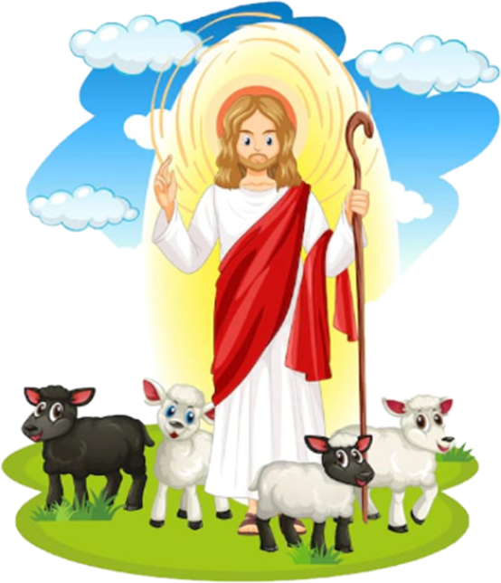
Ministry Friends of Jesus and Mary
Cycle A, IV Sunday of Easter
John 10, 1-10
Jesus, the Good Shepherd
www.fcpeace.org

Slide 2
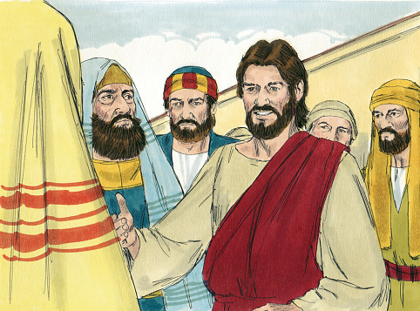
Jesus said to the Pharisees:

Slide 3
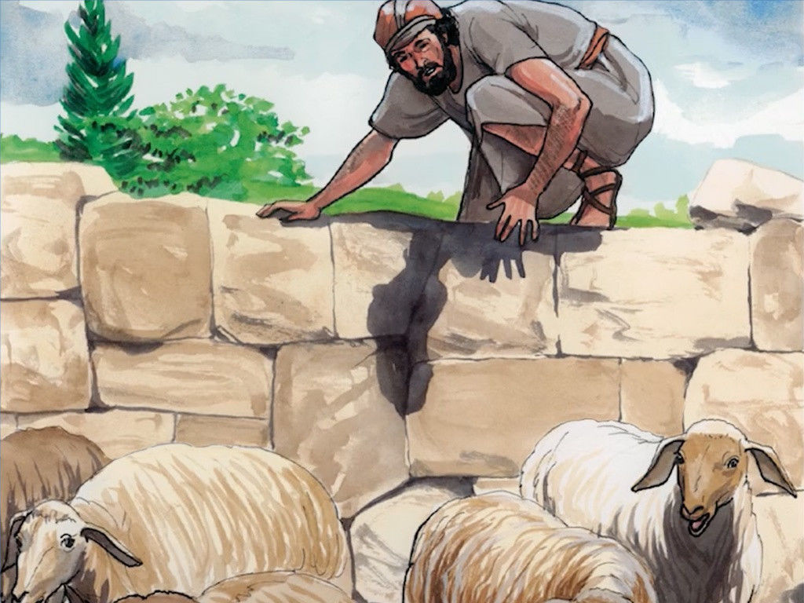
“Amen, amen, I say to you, whoever does not enter a sheepfold through the gate but climbs over elsewhere is a thief and a robber.

Slide 4
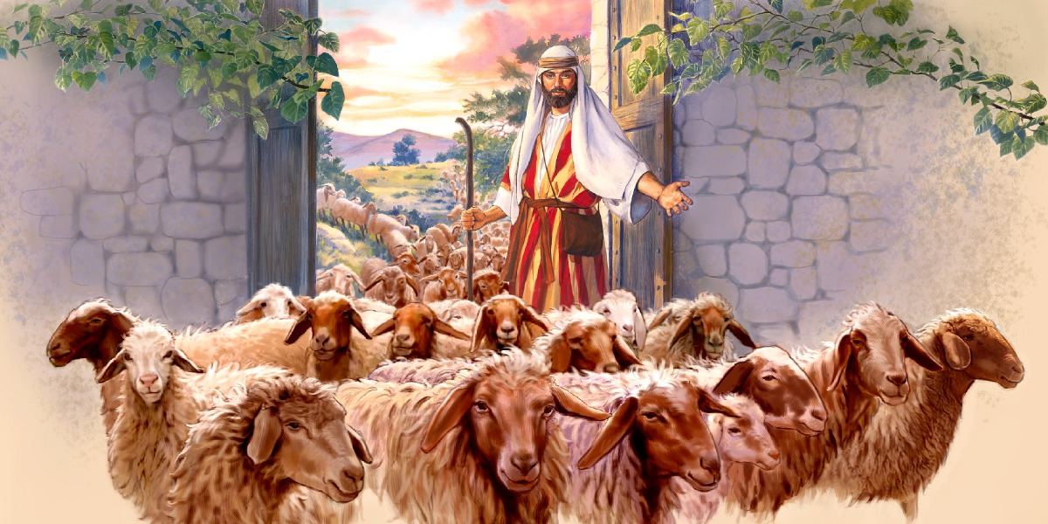
But whoever enters through the gate is the shepherd of the sheep. The gatekeeper opens it for him, and the sheep hear his voice, as the shepherd calls his own sheep by name and leads them out.

Slide 5
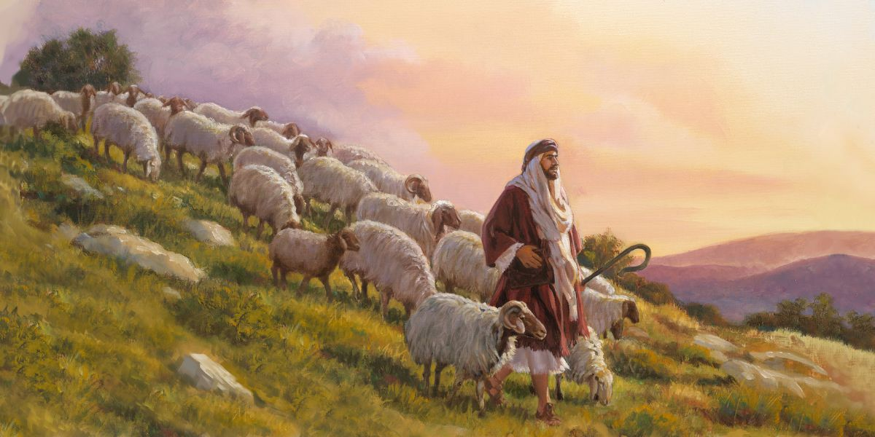
When he has driven out all his own, he walks ahead of them, and the sheep follow him, because they recognize his voice. But they will not follow a stranger; they will run away from him, because they do not recognize the voice of strangers.”

Slide 6
Although Jesus used this figure of speech, the Pharisees did not realize what he was trying to tell them.

Slide 7
So Jesus said again, “Amen, amen, I say to you, I am the gate for the sheep. All who came before me are thieves and robbers, but the sheep did not listen to them. I am the gate.

Slide 8
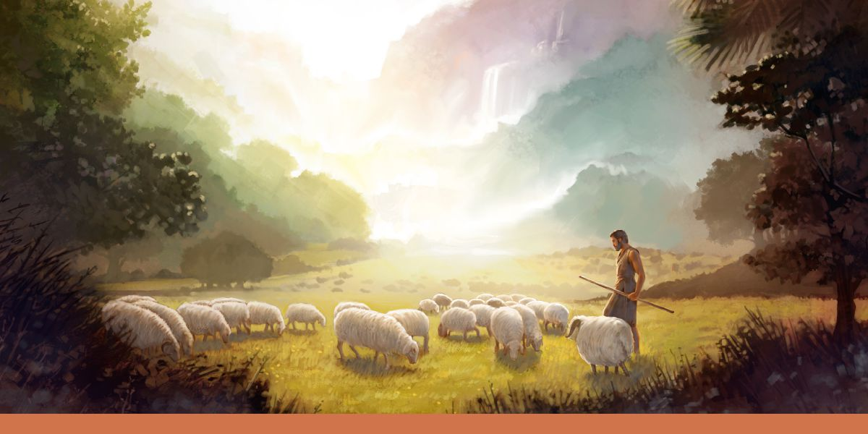
Whoever enters through me will be saved, and will come in and go out and find pasture. A thief comes only to steal and slaughter and destroy; I came so that they might have life and have it more abundantly.”

Slide 9
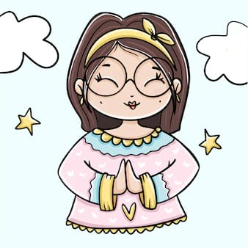
The Gospel of the Lord,
Praise to you, Lord Jesus Christ.

Slide 10
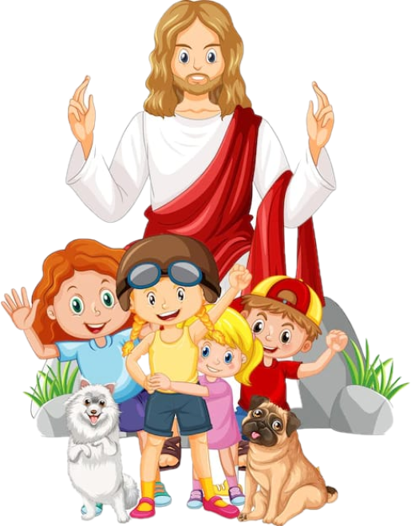
Reflection

Slide 11
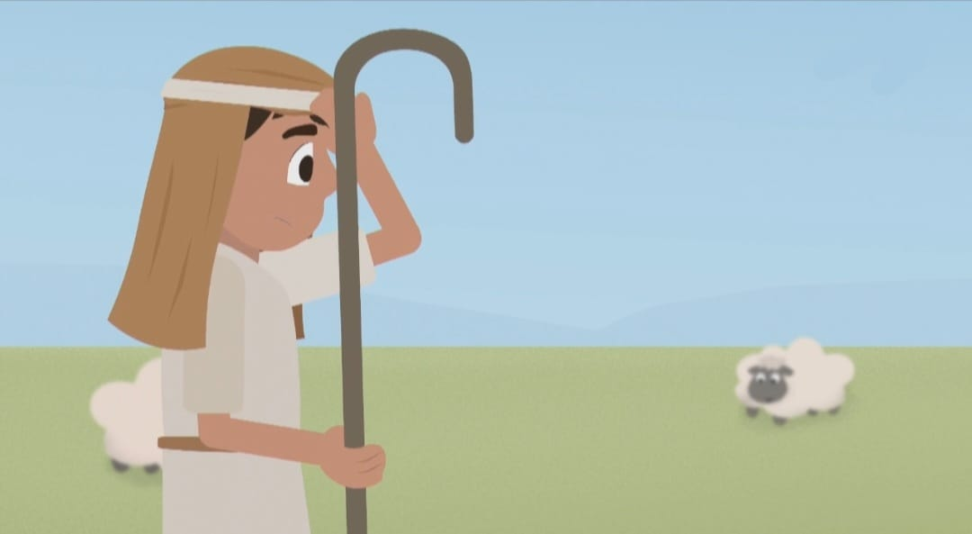
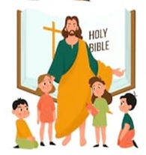
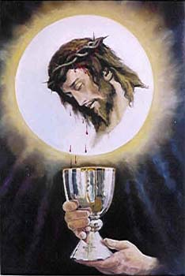
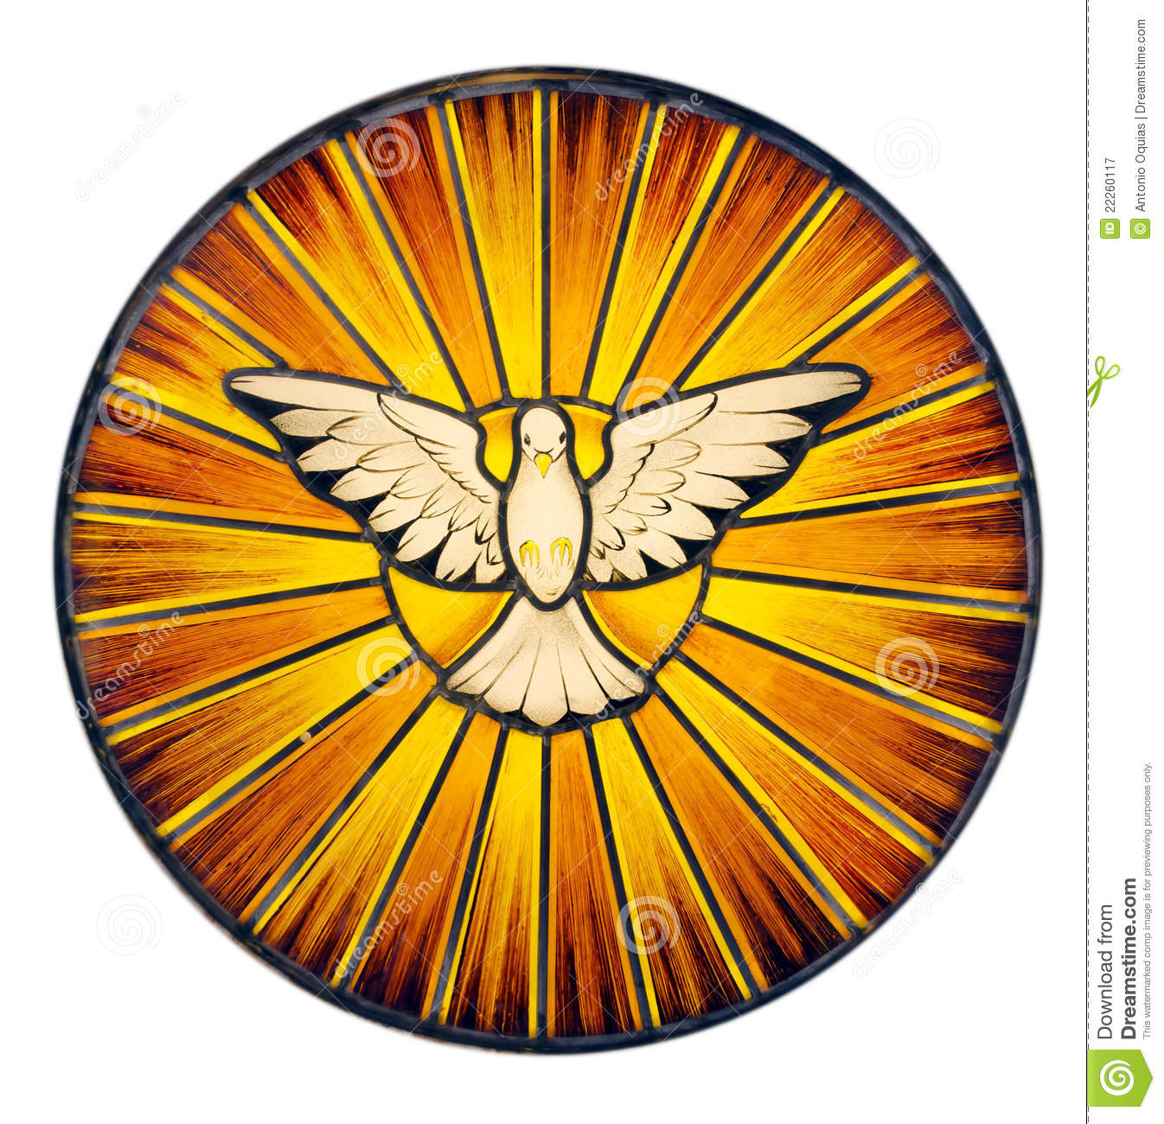
Jesus compares Himself to a shepherd,
¿What is the work of a shepherd?
A shepherd protects and guides the sheep so they are safe and well fed.
¿How is Jesus a shepherd?
With His Word, His presence in the Eucharist, and with the Holy Spirit, Jesus guides us on how to do what’s right and how to get closer to God so we can get to Heaven. He also protects us and provides all that is good for us.

Slide 12
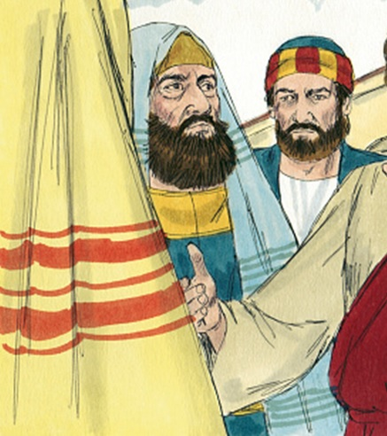
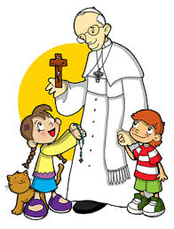
Jesus says that there are shepherds which are thieves; they don’t enter through the gate of the sheepfold or pen but jump over the fence. But the sheep don’t follow them because they don’t recognize the voice. To whom was Jesus referring?
Jesus was referring to the Pharisees who led the Jewish people, but who did not have God in their hearts; instead they desired power and riches.
Jesus says that whoever enters through the gate is the good shepherd; Jesus says He is the gatekeeper and He lets them in. Who are our good shepherds that Jesus lets in?
Pope Francis is the main shepherd of our Catholic Church. He names bishops who lead the local churches, and priests to be our shepherds guiding us to Heaven with the mass and the sacraments.

Slide 13
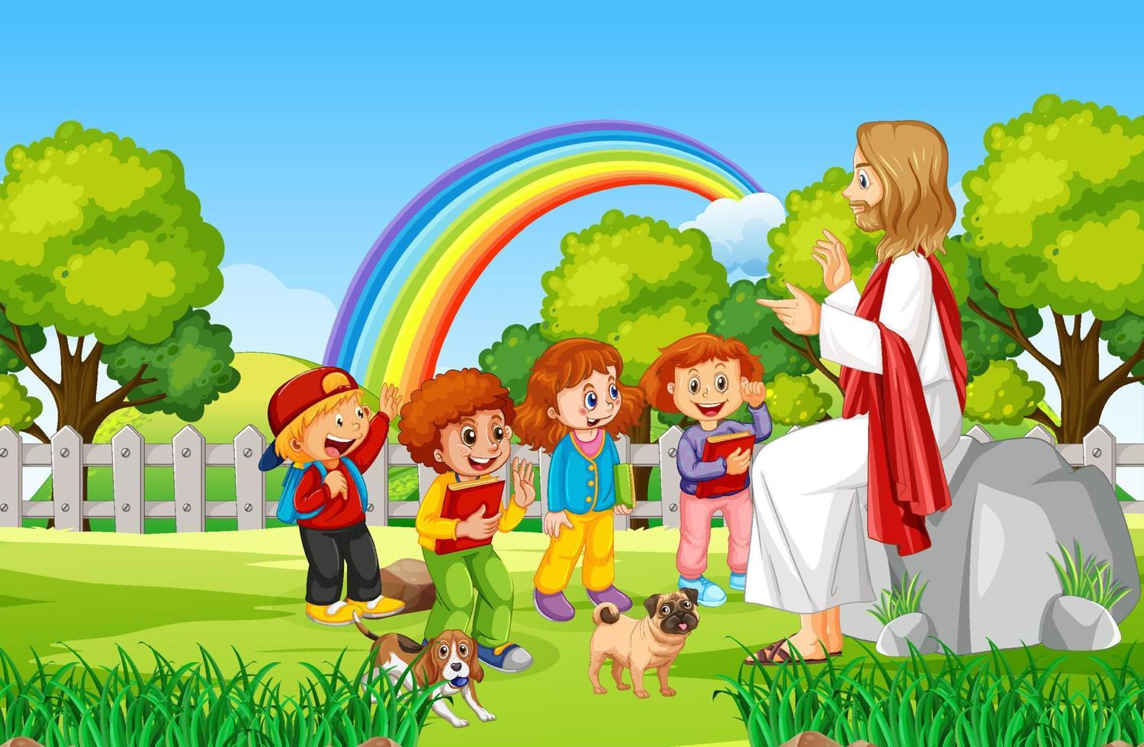
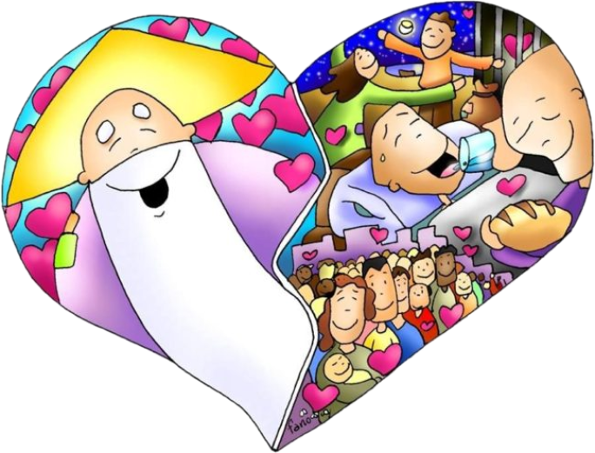
Jesus says that His sheep follow the good shepherd because they recognize His voice. How do we listen to Jesus’ voice?
We pray and listen to or read scripture; Jesus speaks to our heart with ideas and inspirations. If these ideas and inspirations lead us to do good and obey God, we know they are from Jesus.
What does Jesus tell us in His Word and by His example that we must do to follow Him?
Jesus tells us to love God and love our neighbor. He showed us when He prayed and practiced His faith and when He cured the sick, fed the hungry, forgave sins, and washed His apostle’s feet…

Slide 14
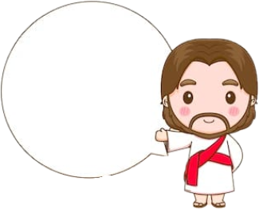
Activity

Slide 15
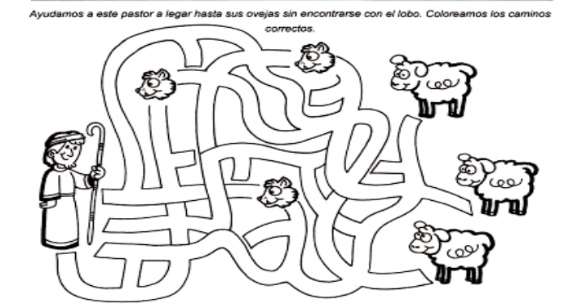
Let’s help the shepherd reach his sheep while avoiding the wolves. Color the correct path.

Slide 16
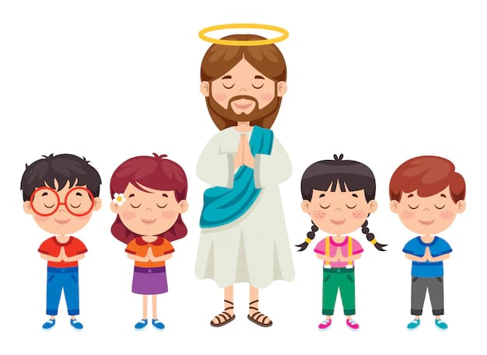
Prayer
Jesus, help me to pray more each day so I may know you better, and always recognize your voice. Thank you for always loving me, caring for me, and guiding me. I love you very much.
Amen.

Slide 17
I Will Follow You, Roy Rantung, https://youtu.be/jpVuBcbZ24c , (3-7 years)

Slide 18
I Will Follow, Summit Kids, https://youtu.be/QywIgYfCQm4, (8+ years)

