Slide 1
Ministry Friends of Jesus and Mary
CYCLE A, IV SUNDAY OF LENT
JOHN 9, 1. 6-9. 13-17. 34-38
www.fcpeace.org

Slide 2
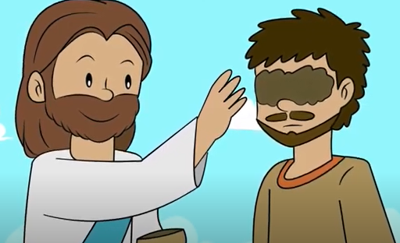
Jesus cures a blind man.
As Jesus passed by, he saw a man blind from birth. He spat on the ground and made clay with the saliva, and smeared the clay on his eyes, and said to him,
“Go wash in the Pool of Siloam” — which means Sent —.

Slide 3
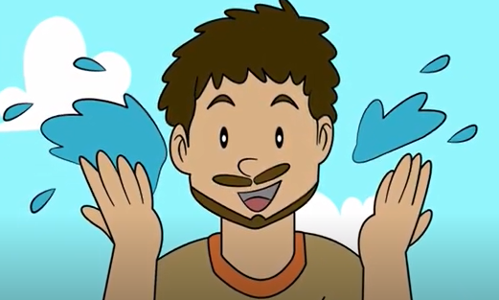
Jesus cures a blind man.
So he went and washed, and came back able to see.
His neighbors and those who had seen him earlier as a beggar said, “Isn’t this the one who used to sit and beg?” Some said, “It is, “but others said, “No, he just looks like him.” He said, “I am.”

Slide 4
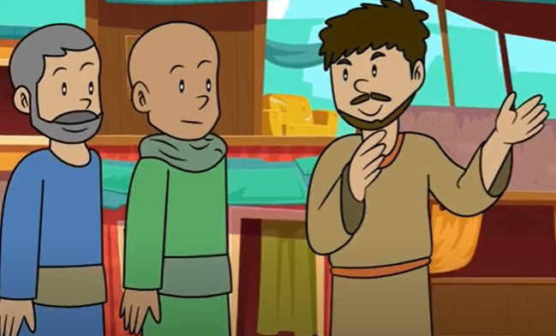
Jesus cures a blind man.
They brought the one who was once blind to the Pharisees. Now Jesus had made clay and opened his eyes on a Sabbath.
So then the Pharisees also asked him how he was able to see. He said to them, “He put clay on my eyes, and I washed, and now I can see.”

Slide 5
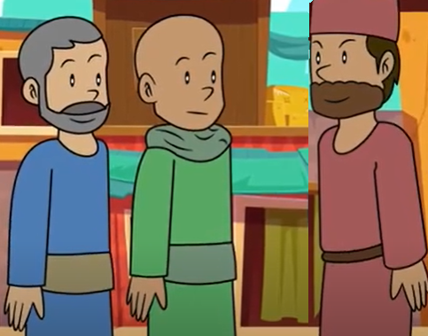
Jesus cures a blind man.
So some of the Pharisees said, “This man is not from God, because he does not keep the Sabbath.”
But others said, “How can a sinful man do such signs?” And there was a division among them. So they said to the blind man again, “What do you have to say about him, since he opened your eyes?”

Slide 6
Jesus cures a blind man.
He said, “He is a prophet.” They answered and said to him, “You were born totally in sin, and are you trying to teach us?” Then they threw him out.

Slide 7
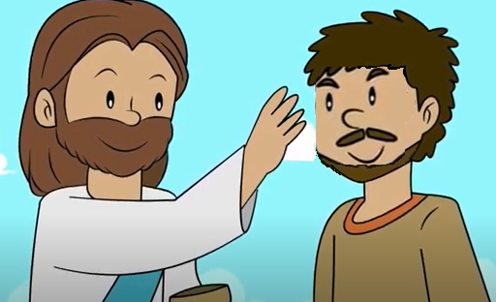
Jesus cures a blind man.
When Jesus heard that they had thrown him out, he found him and said, “Do you believe in the Son of Man?”
He answered and said, “Who is he, sir that I may believe in him?” Jesus said to him, “You have seen him, and the one speaking with you is he.”

Slide 8
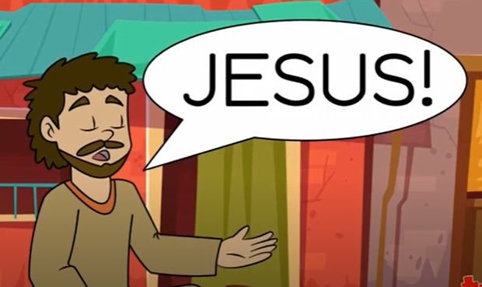
Jesus cures a blind man.
He said, “I do believe, Lord,” and he worshiped him.
The Gospel of the Lord,
Praise to you Lord Jesus Christ.

Slide 9
Let’s Reflect.

Slide 10
¿What did people think during that time about a person who was born blind?
He was a great sinner since birth, or that his parents were sinners.
EXCELLENT
Jesus is moved at seeing a blind man begging, and goes to heal him. He smears mud on his eyes and asks him to go wash in the pool of Siloam, which means sent.

Slide 11
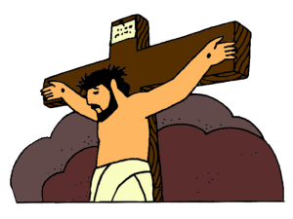
What symbolism might this meaning have?
Just as Jesus was the Son sent by the Father to heal us of the sins that blind us to God,
MARVELOUS
this blind man was now sent by the Son to wash and be healed of his physical blindness thus seeing God.

Slide 12
What attitude did the hypocritical Pharisees have before this miracle?
They were upset that Jesus had healed him on Saturday because the law said one cannot work on Saturday. They did not care that Jesus was healing someone from a lifelong illness.
AMAZING

Slide 13
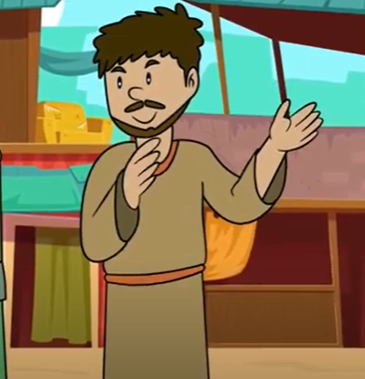
Then they asked him who had healed him. What did he answer?
A prophet!
WOW!!

Slide 14
How did the Pharisees react at this answer?
They expelled him from the Temple because they did not want to accept that the healer was a man of God.
GREAT

Slide 15
Jesus finds him, and asks him if he believes in the Son of Man. When the blind man says, show me Him, what does Jesus say?
“You have seen him, and the one speaking with you is he.”
AWESOME

Slide 16
How does the healed man react?
The man believed and fell down and worshiped Him.
FANTASTIC

Slide 17
Unscramble the words that fit into the sentences below them and fill in the word in the boxes. Take the circled letters and unscramble them to complete Jesus’ sentence at the bottom of the page.
B L I N D
H E A L
G L O R Y
B I R T H
L
I
G
H
T
I L G T H

Slide 18
PRAYER
Jesus, you are the Light of the World. You give us sight so that, through You, with You, and in You, we can be saved. Open the eyes of our hearts that we may see you. Amen

Slide 19
Jump into the Light by Jana Alayra, https://www.youtube.com/watch?v=xVGORBCdh5A (3-7 yrs.)

Slide 20
Open the Eyes of My Heart Lord, Ft. Paul Baloche, https://youtu.be/r_2xLdgkNKs (8+ yrs.)

