Slide 1
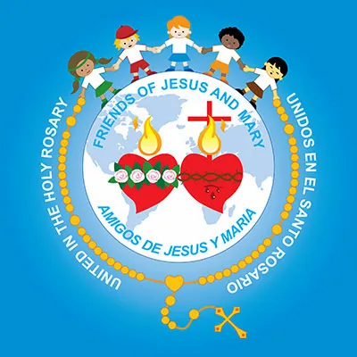
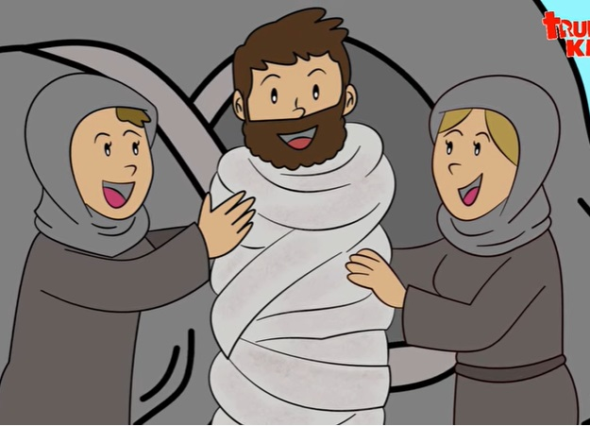
MINISTRY FRIENDS OF JESUS AND MARY
CYCLE A - V SUNDAY OF LENT
JESUS RESURRECTS LAZARUS
www.fcpeace.org

Slide 2
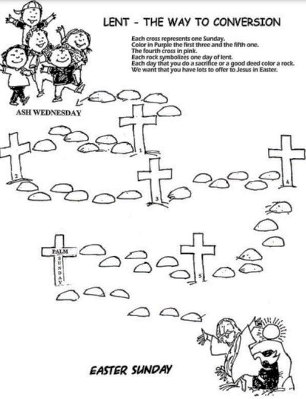
LENT – THE WAY OF CONVERSION
We enter the 4th week of Lent. We continue preparing our hearts offering acts of prayer, sacrifice and almsgiving for love of Jesus.
Ash Wednesday
1
2
4
3
PALMS
5
HOLY WEEK

Slide 3
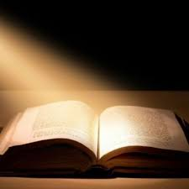
THE GOSPEL ACCORDING TO
SAINT JOHN 11, 3-7. 17. 20-27. 33b-45

Slide 4
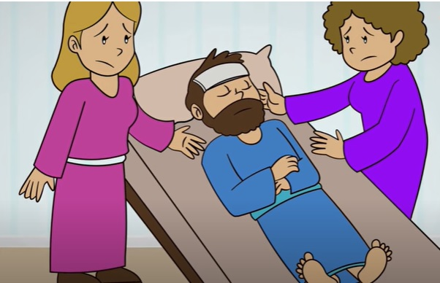
The sisters of Lazarus sent word to Jesus, saying, “Master, the one you love is ill.”

Slide 5
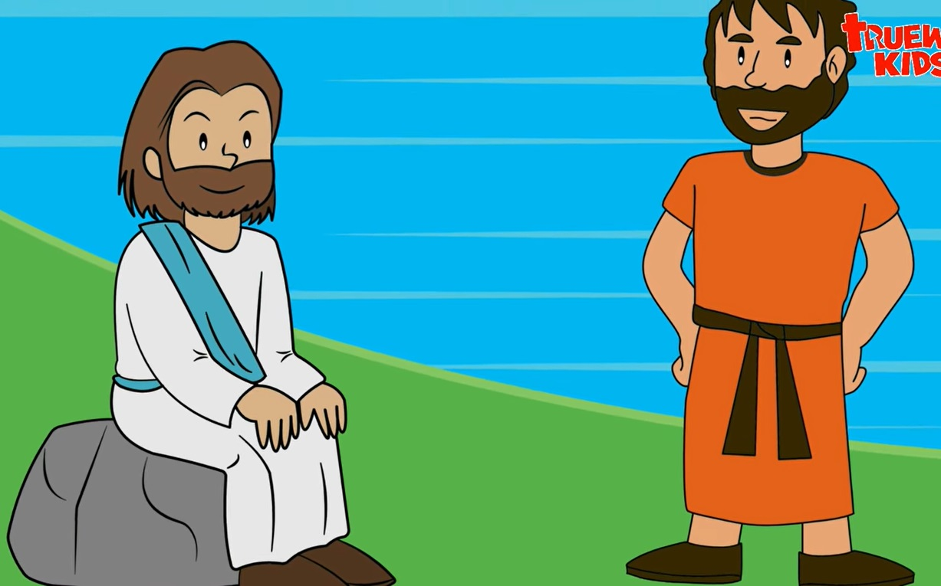
When Jesus heard this, he said, “This illness is not to end in death, but is for the glory of God, that the Son of God may be glorified through it.”
Now Jesus loved Martha and her sister and Lazarus. So when he heard that he was ill, he remained for two days in the place where he was. Then after this he said to his disciples, “Let us go back to Judea.”

Slide 6
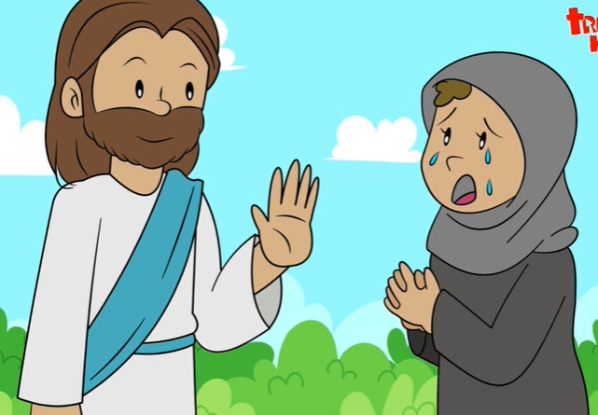
When Jesus arrived, he found that Lazarus had already been in the tomb for four days. When Martha heard that Jesus was coming, she went to meet him; but Mary sat at home. Martha said to Jesus, “Lord, if you had been here, my brother would not have died. But even now I know that whatever you ask of God, God will give you.”
Jesus said to her, Your brother will rise.” Martha said, “I know he will rise, in the resurrection on the last day.” Jesus told her, “I am the resurrection and the life; whoever believes in me, even if he dies, will live, and everyone who lives and believes in me will never die. Do you believe this?”
She said to him, “Yes, Lord. I have come to believe that you are the Christ, the Son of God, the one who is coming into the world.”

Slide 7
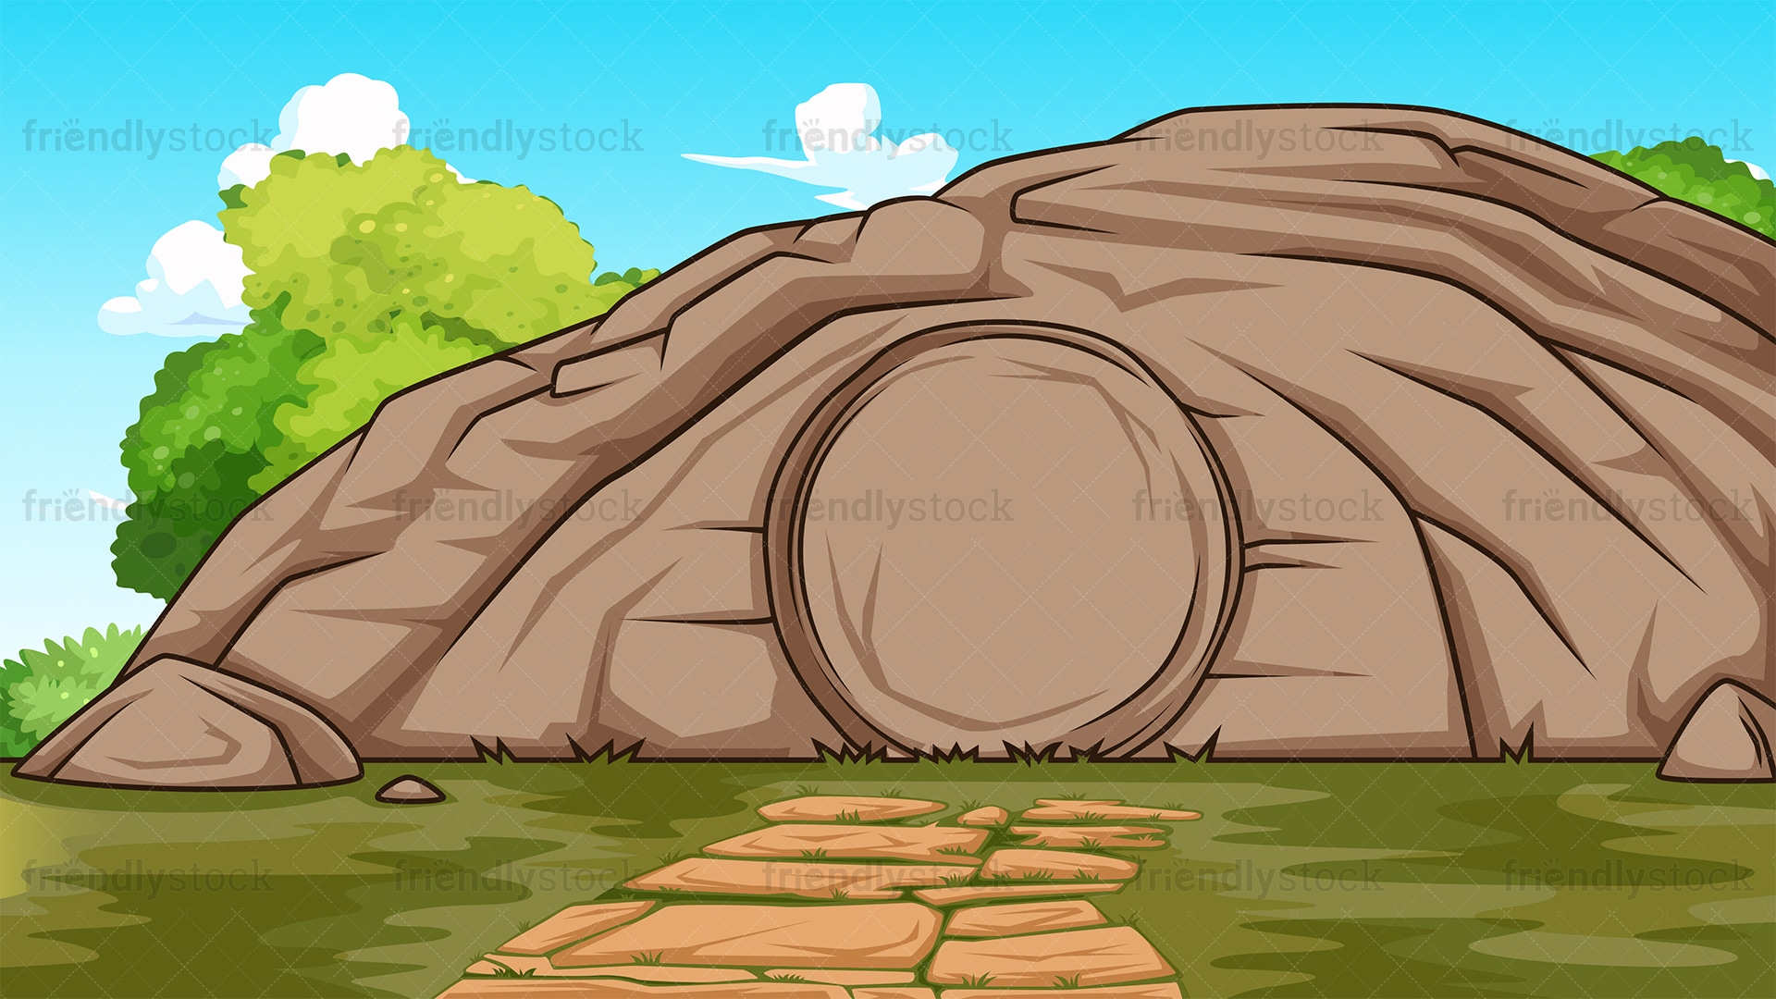
He became perturbed and deeply troubled, and said, “Where have you laid him?” They said to him, “Sir, come and see.” And Jesus wept. So the Jews said, “See how he loved him.” But some of them said, “Could not the one who opened the eyes of the blind man have done something so that this man would not have died?”
So Jesus, perturbed again, came to the tomb. It was a cave, and a stone lay across it. Jesus said, “Take away the stone.”
Martha, the dead man’s sister, said to him, “Lord, by now there will be a stench; he has been dead for four days.” Jesus said to her, “Did I not tell you that if you believe you will see the glory of God?”

Slide 8
So they took away the stone. And Jesus raised his eyes and said, “Father, I thank you for hearing me. I know that you always hear me; but because of the crowd here I have said this, that they may believe that you sent me.”
And when he had said this, He cried out in a loud voice, “Lazarus, come out!” The dead man came out, tied hand and foot with burial bands, and his face was wrapped in a cloth. So Jesus said to them, “Untie him and let him go.” Now many of the Jews who had come to Mary and seen what he had done began to believe in him.
THE GOSPEL OF THE LORD
PRAISE TO YOU LORD JESUS CHRIST

Slide 9
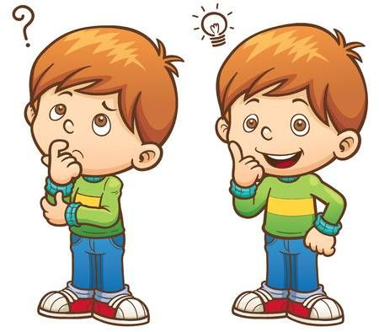
REFLECTION

Slide 10
Jesus had a lot of affection for three brothers and sisters: Lazarus, Mary and Martha who lived in Bethany. Although a messenger warns Jesus that his great friend Lazarus was dying, Jesus delays a few days. Why didn’t Jesus go immediately to see his friend Lazarus?
Jesus had a purpose; he, wanted to show them that He was God, with the power to raise someone from the dead.

Slide 11
When Jesus returns to Lazarus’ house, he was already dead. ¿What does Martha say to Jesus?
Lord, if you had been here, my brother would not have died.
What does Jesus answer?
“Your brother will rise.” … “I am the resurrection and the life; whoever believes in me, even if he dies, will live, and everyone who lives and believes in me will never die.
What is He telling her?
HE IS GOD!

Slide 12
Jesus asks Martha, “Do you believe this?” What does she answer?
“Yes, Lord. I have come to believe that you are the Christ, the Son of God, the one who is coming into the world.”
Moved by her faith, what does Jesus do?
He performs the miracle of raising Lazarus in the sight of all as a sign that He truly is God. Many Jews came to believe in Him.

Slide 13
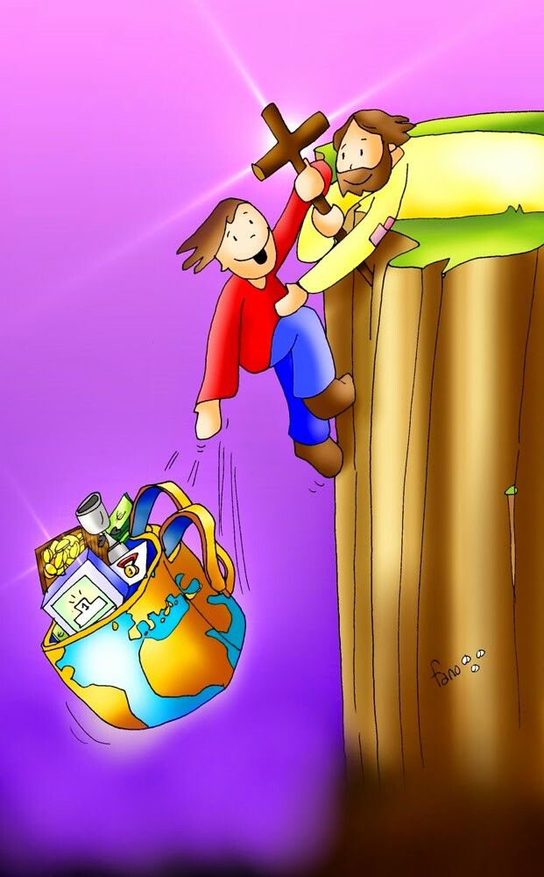
All who believe in Jesus as Savior and Lord will also have eternal life and will resurrect in the last days.

Slide 14
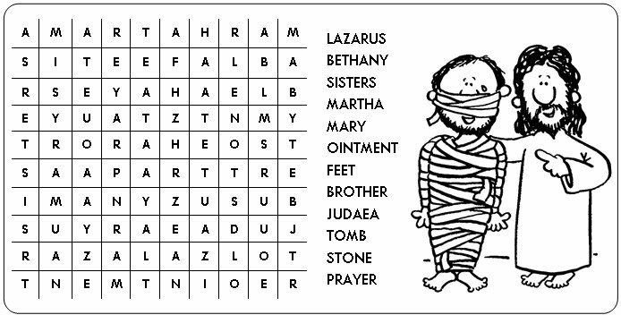

Slide 15
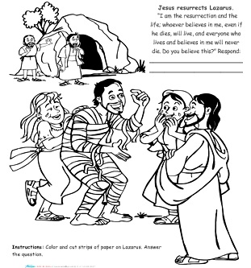
Yes Jesus, I believe you are the Son of God, the Savior of the World!

Slide 16
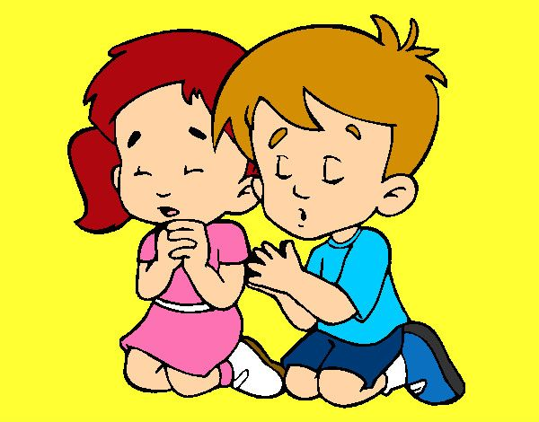
PRAYER
Lord, stay with me. Help me to always believe in you, in your words and works, so I may enjoy God’s Glory.
Amén.

Slide 17
Sing High Low by Thrisha Aguilar, https://youtu.be/LzxMcZhu9Kc (3-7 yrs.)

Slide 18
Jesus, Chris Tomlin, https://youtu.be/cEbQswNB6Wc, (8+ years)

