Slide 1
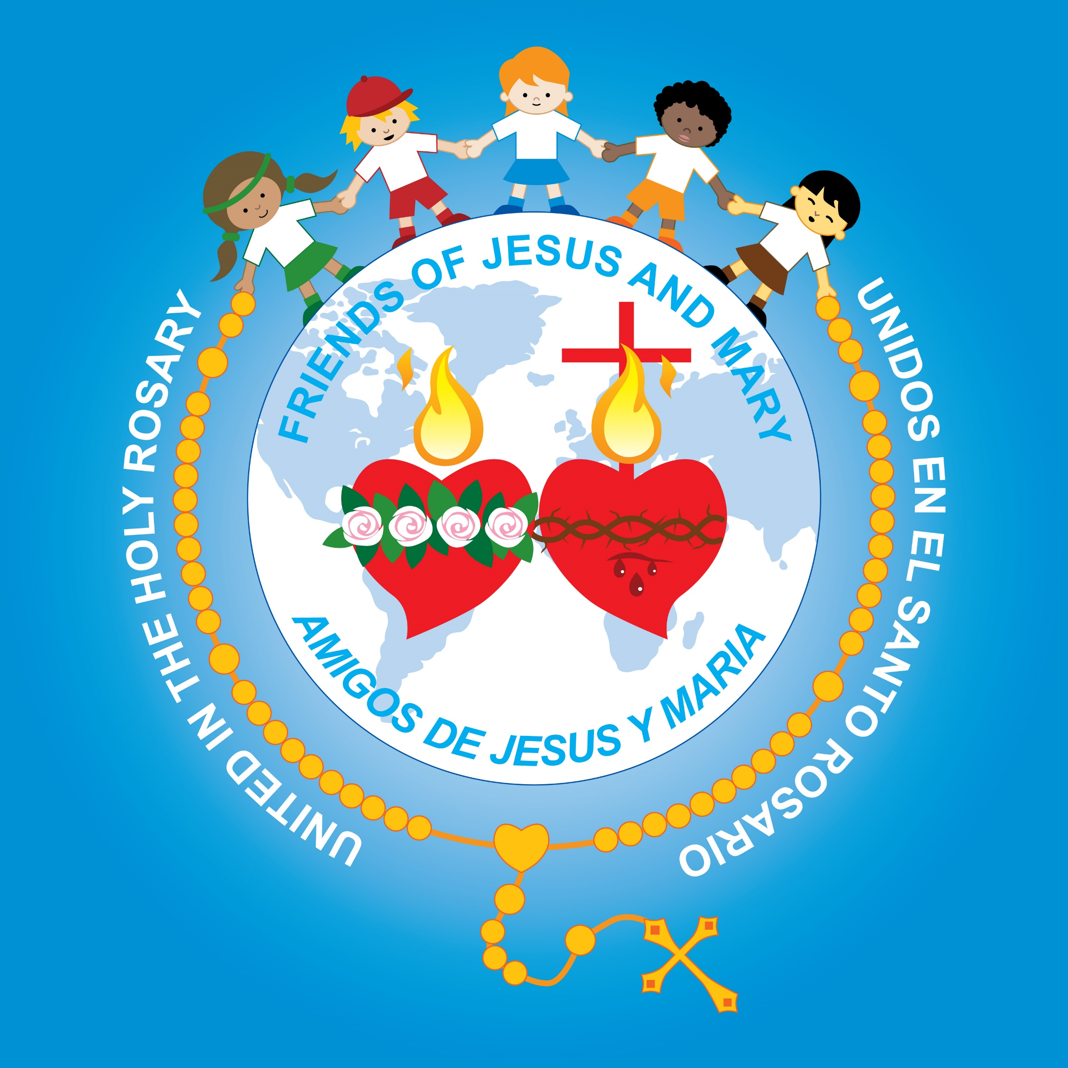
Friends of Jesus and Mary
Cycle A - VI Sunday of Easter
John 14, 15-21
He will give you…the Spirit of Truth
www.fcpeace.org

Slide 2
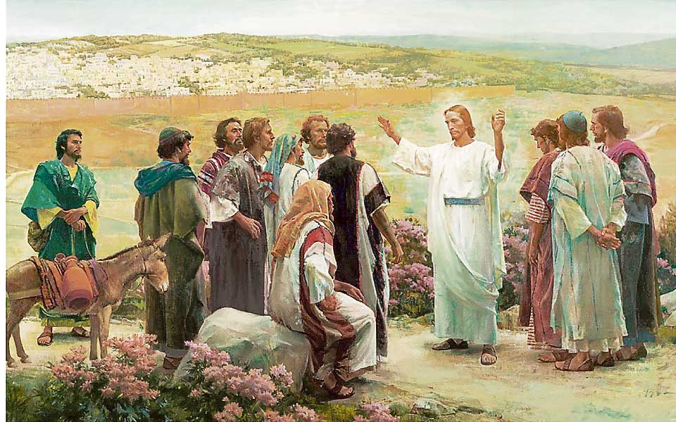
He will give you…the Spirit of Truth

Slide 3
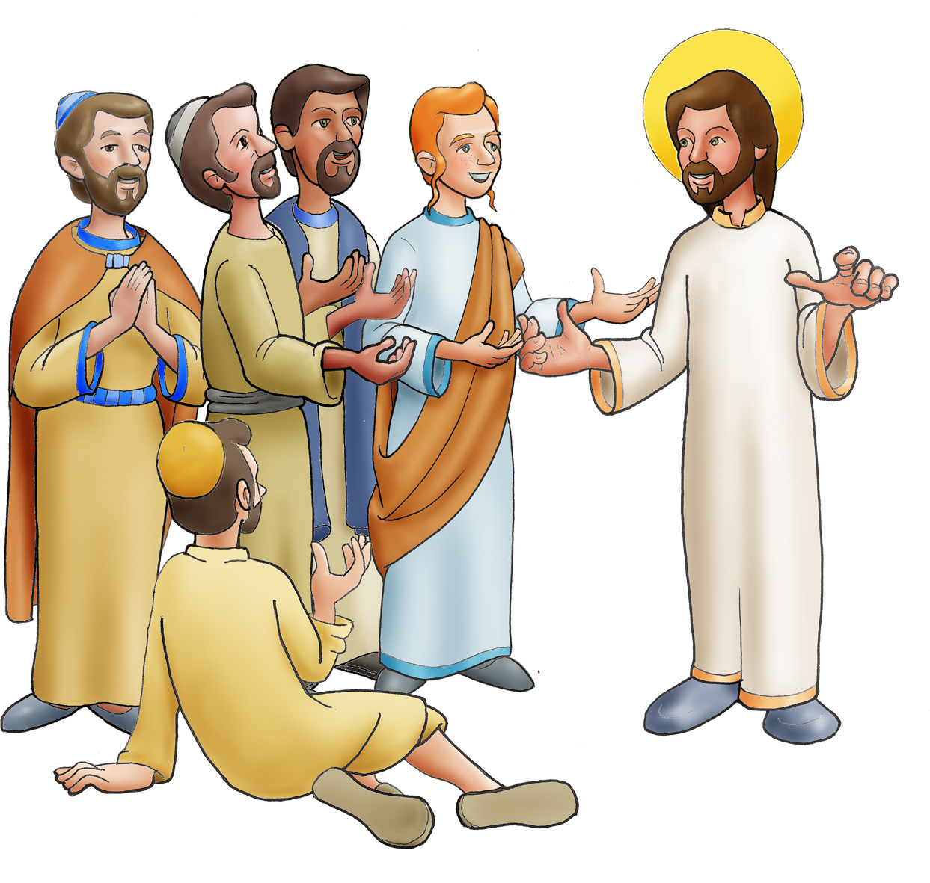
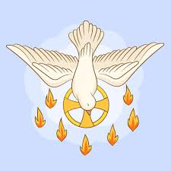
Jesus said to his disciples: “If you love me, you will keep my commandments.
And I will ask the Father, and he will give you another Advocate to be with you always, the Spirit of truth, whom the world cannot accept, because it neither sees nor knows him.
But you know him, because he remains with you, and will be in you.

Slide 4
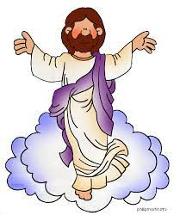
I will not leave you orphans; I will come to you. In a little while the world will no longer see me, but you will see me, because I live and you will live. On that day you will realize that I am in my Father and you are in me and I in you.
Whoever has my commandments and observes them is the one who loves me. And whoever loves me will be loved by my Father, and I will love him and reveal myself to him.”

Slide 5
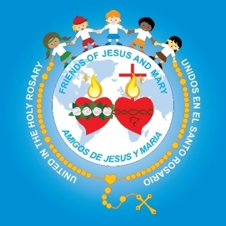
The Gospel of the Lord,
Praise to you Lord Jesus Christ.

Slide 6
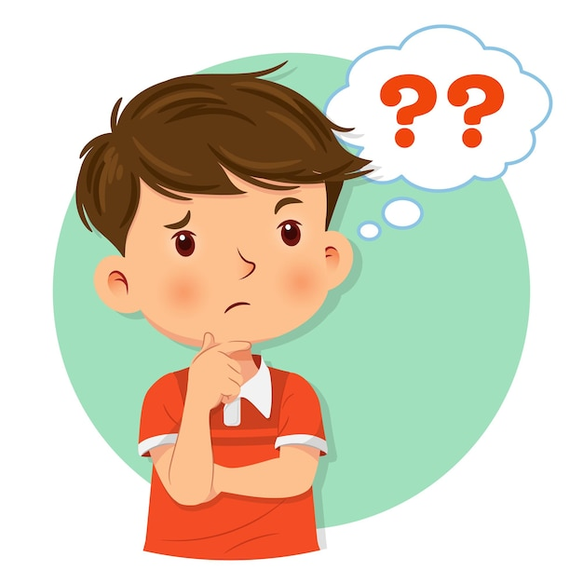
Reflection

Slide 7
Jesus says that if we love Him, we will follow His commandments. Why?
When we love someone, we want to please them and make them happy. And since Jesus is God, we also trust that what He asks is for our own good because He knows everything and knows and loves us better than anyone.

Slide 8
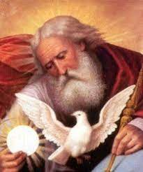
Jesus promises to send an Advocate.
What is an advocate?
Someone that protects and helps us so we will be well.

Slide 9
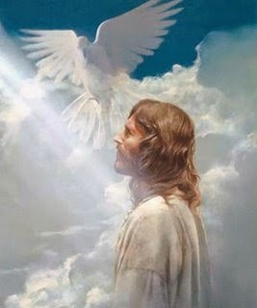
Jesus calls this Advocate the Spirit of truth. Jesus said recently that He is the way, the truth, and the life.
What is Jesus telling us?
He and the Spirit of truth are one.

Slide 10
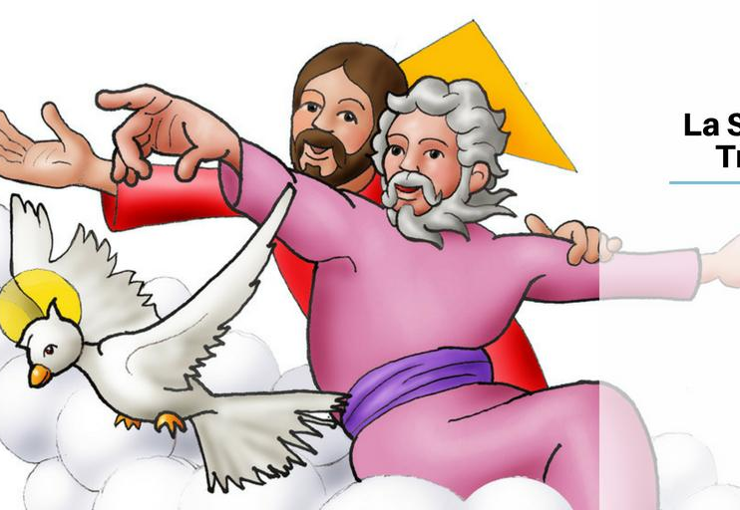
Jesus also told us that He and the Father are one. He is revealing God the Father, the Son, and the Holy Spirit: 1 God in 3 persons.
What do we call this mystery of our faith?
The Holy Trinity

Slide 11
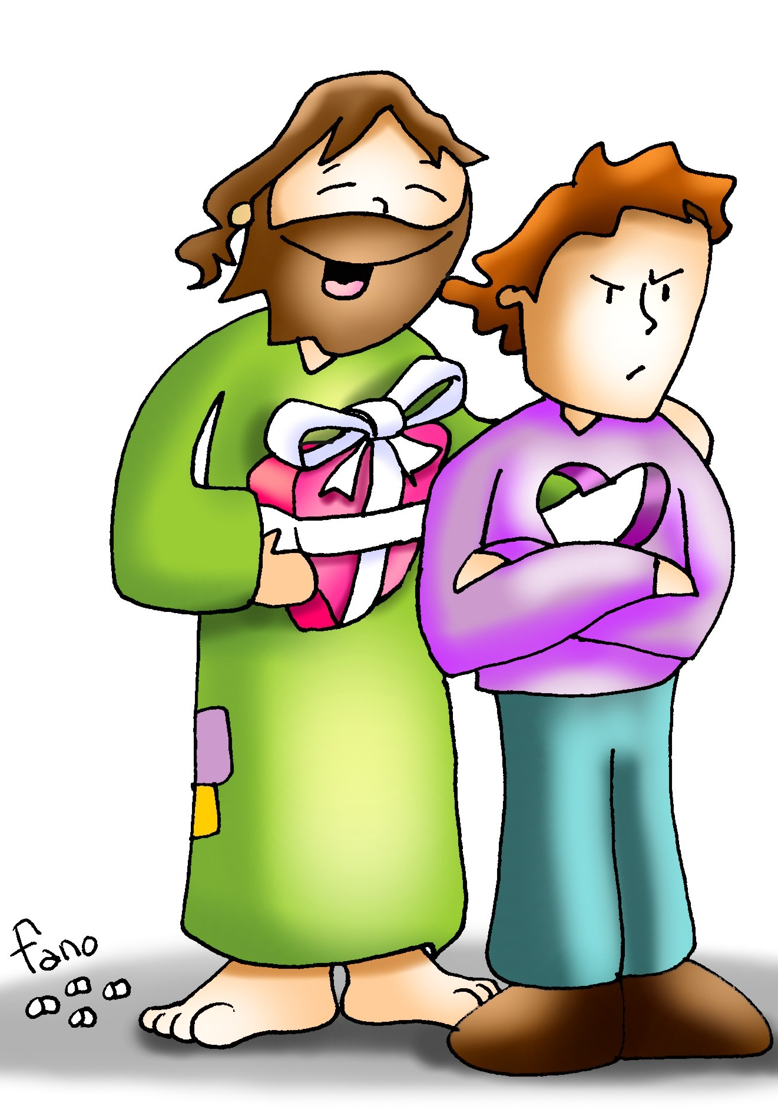
Jesus says the world does not accept or know the Holy Spirit.
Why?
The world does not recognize the Holy Spirit because their hearts are full of sin and they do not want to repent. For the same reason, they did not recognize Jesus.

Slide 12
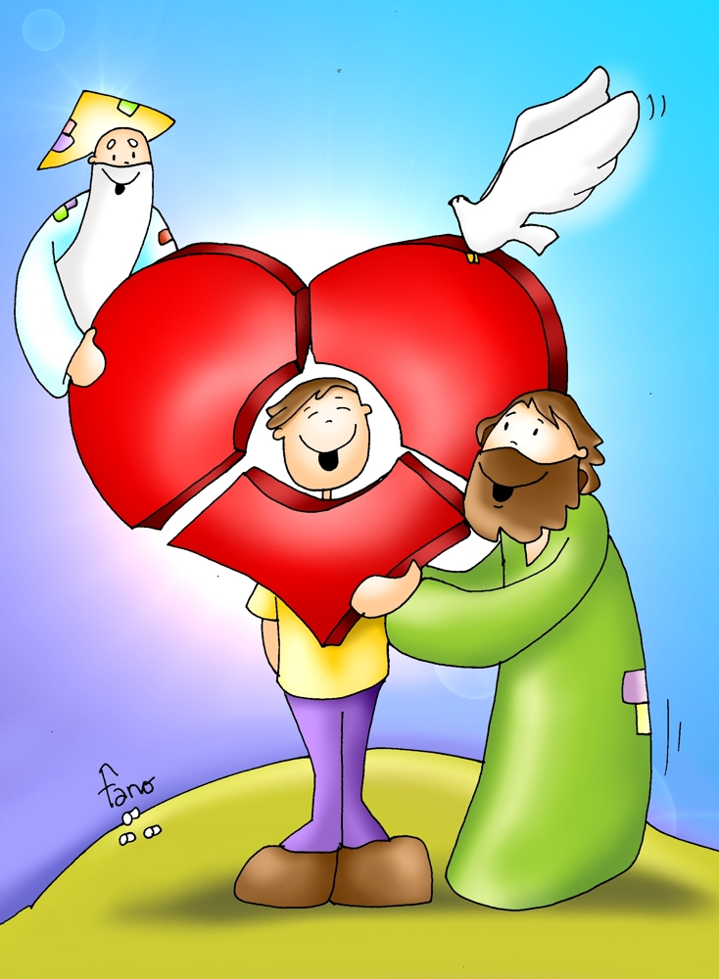
Jesus said that He lives among them and they also will live.
How does He live in us?
The Holy Spirit lives in the hearts of those who love and obey God. Because God the Father, the Son, and the Holy Spirit are one, they all live in us.
The Holy Trinity is a mystery we cannot understand but we accept in faith because we know Jesus does not lie.

Slide 13
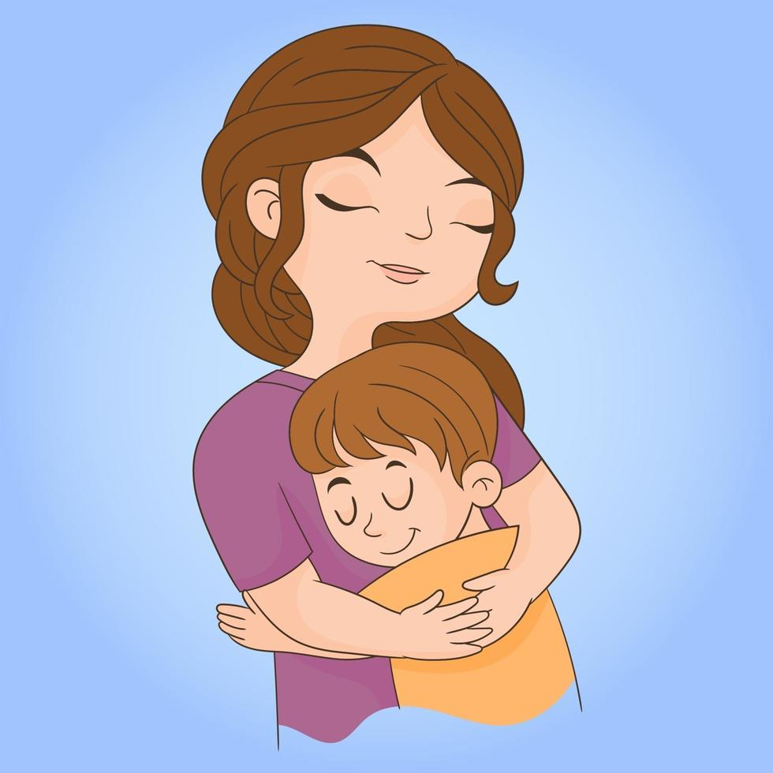
Jesus promised to show Himself to those who love Him.
How does He reveal Himself to us?
God reveals Himself in our heart with good ideas, with our conscience, and with good sentiments of joy, love, and compassion for others.
He also reveals Himself through other people.

Slide 14
The Trinity, Catholic Central, https://youtu.be/wkYM9OvX7f8

Slide 15
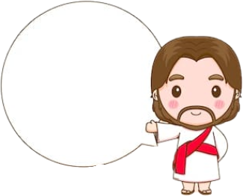
Activity

Slide 16
Color and fill in the blanks with words from the Gospel.
Cycle A
6th SUNDAY OF EASTER
love
If you ______ me, you will keep my _____________; and I will ask the _________ and He will give you another ________ to be with you always, the Spirit of _________.
commandments
Father
Advocate
truth
commandments
Whoever has my ____________ and observes them, is the one who _______ me. And whoever loves me will be loved by my __________, and I will love them and reveal myself to them.
loves
Father

Slide 17
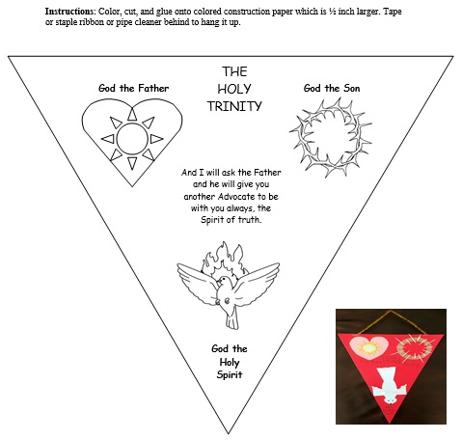

Slide 18
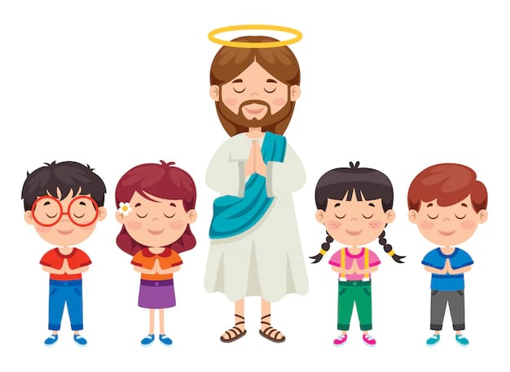
PRAYER
Dear Jesus,
Thank you for sending the Spirit of truth to love us, take care of us, and to guide us to Heaven. Help me to love and obey you more each day so I may hear your voice in my heart and glorify you.
Amen.

Slide 19
The Trinity Song, The Trinity Song, https://youtu.be/gZ_vnP0kwrQ

