Slide 1
Friends of Jesus and Mary
Cycle A - VI Sunday in Ordinary Time
The Spirit of the Law: Love
Sirach 15, 16-21; Psalm 118; 1Corinthians 2, 6-10; Matthew 5, 17-37 or short (5, 20-22. 27-28. 33-37)

Slide 2
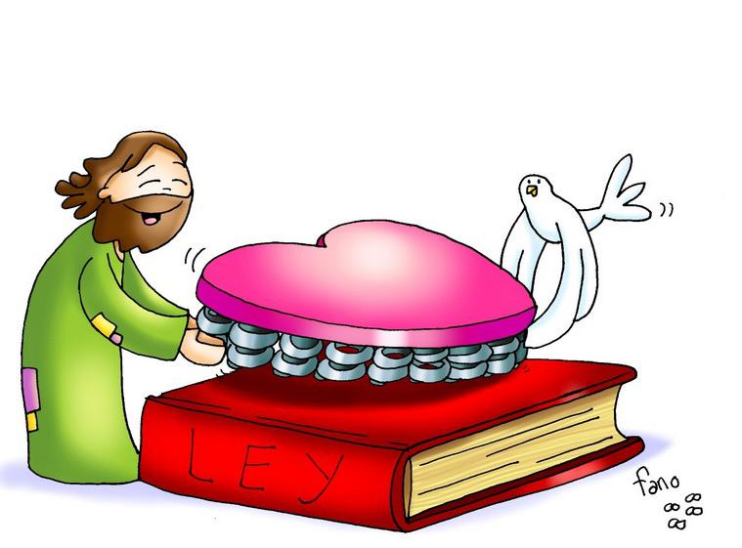
The Spirit of the Law: Love
Matthew 5, 17-37
Jesus said to his disciples: "I tell you, unless your righteousness surpasses that of the scribes and Pharisees, you will not enter the kingdom of heaven. "You have heard that it was said to your ancestors, You shall not kill; and whoever kills will be liable to judgment. But I say to you, whoever is angry with his brother will be liable to judgment."

Slide 3
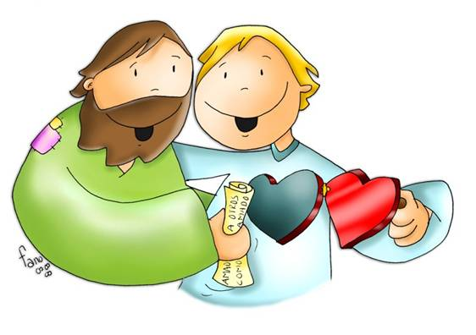
You have heard that it was said, You shall not commit adultery. But I say to you, everyone who looks at a woman with lust has already committed adultery with her in his heart. "Again you have heard that it was said to your ancestors, Do not take a false oath, but make good to the Lord all that you vow. But I say to you, do not swear at all. Let your 'Yes' mean 'Yes’, and your 'No' mean 'No’. Anything more is from the evil one."
THE GOSPEL OF THE LORD PRAISE TO YOU LORD JESUS CHRIST

Slide 4
REFLECTION

Slide 5
Who were the scribes and the Pharisees?

Slide 6
A scribe was an expert in the law of Moses and all its traditions and additions. The Pharisees were also experts of the law of Moses and looked down on those that did not practice it closely.

Slide 7
Why was Jesus against the scribes and Pharisees?

Slide 8
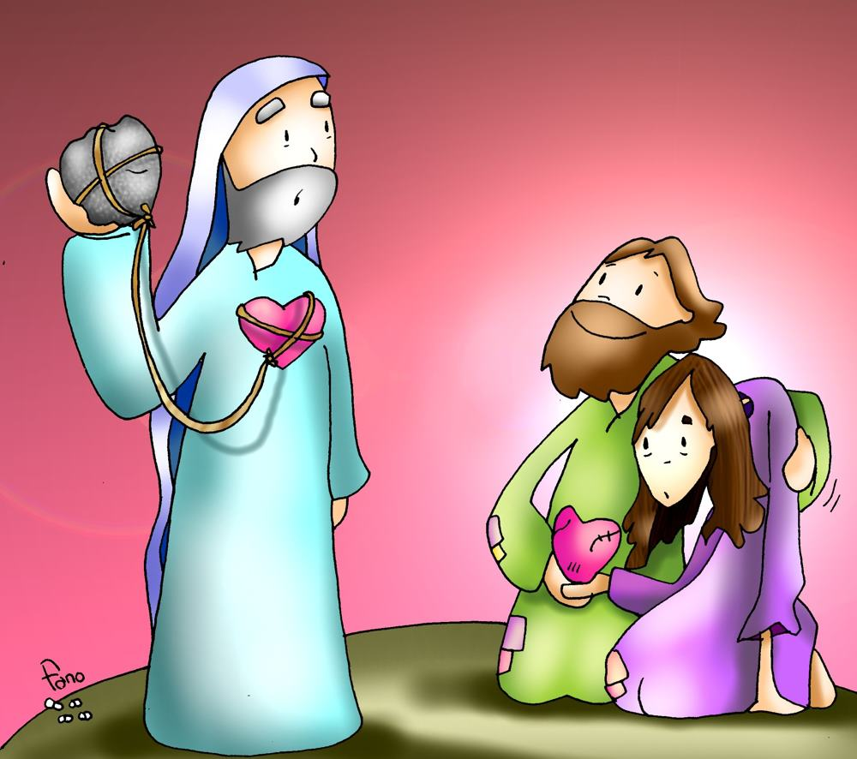
They were more occupied with following the law closely, rather than showing love and mercy to others.

Slide 9
What does Jesus want from us?

Slide 10
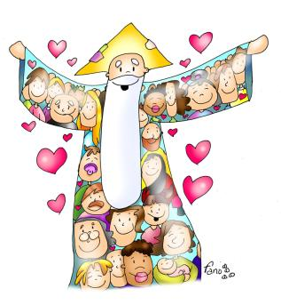
Jesus says it is not enough to just follow the law, we must show love for God and others.

Slide 11
Jesus gives examples. He says it’s not enough to not kill.
What does Jesus say this commandment also requires from us?

Slide 12
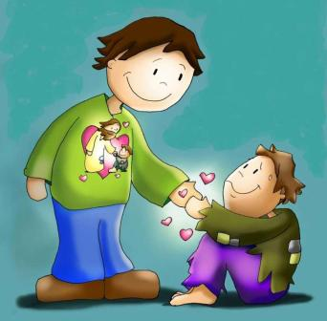
We should not become angry with each other; we should love one another and never injure, not even with mean words.

Slide 13
Jesus also says it is not enough to not take a false oath.
What must we do more?

Slide 14
Never swear; always tell the truth, then everyone will believe your words the first time.

Slide 15
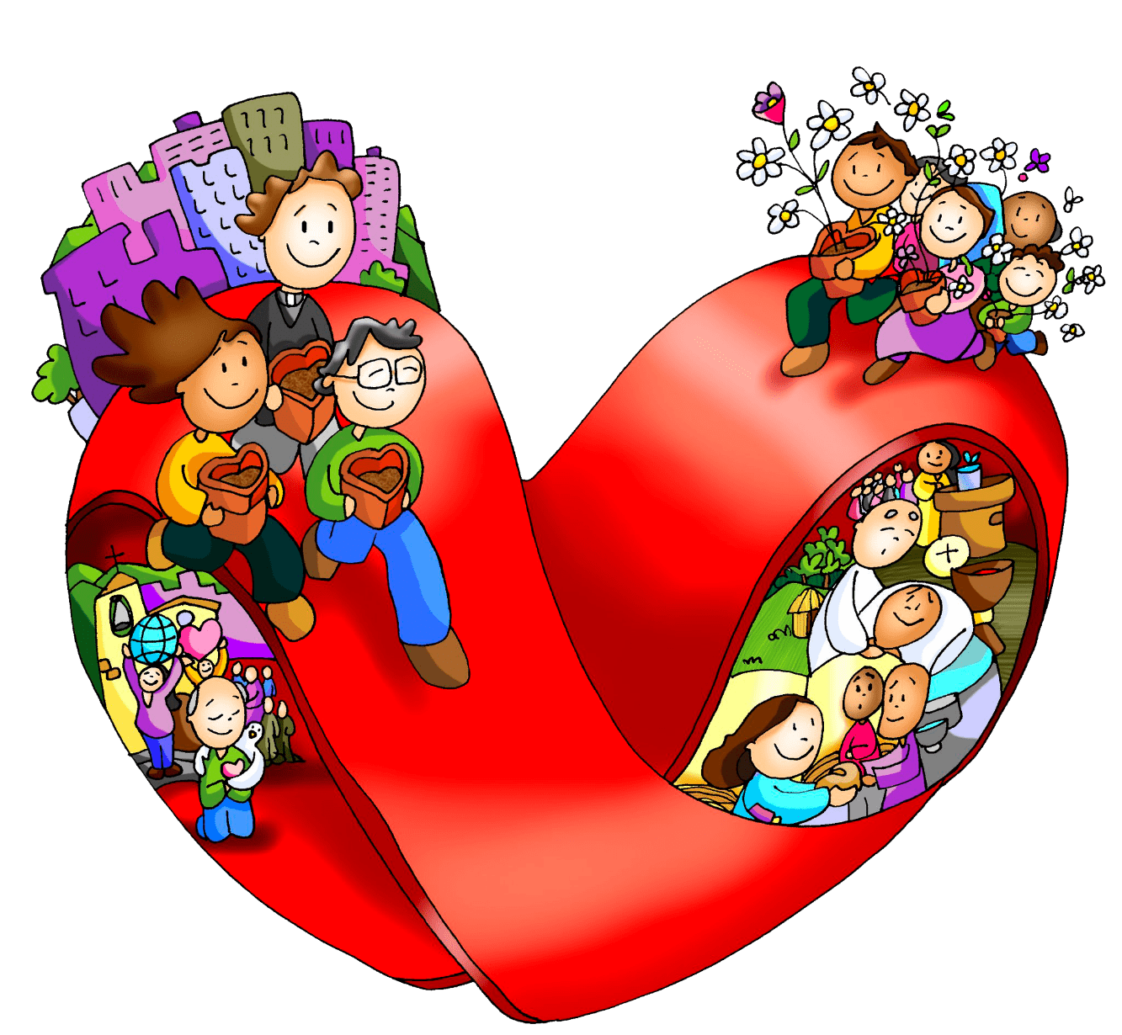
In the same way, all the commandments must be fulfilled out of love for God and each other. This love will bring us to do more than just fulfill the law.

Slide 16
ACTIVITIES

Slide 17
On the following page, underline the words that Jesus asks us to do.
Make the craft on the last page which highlights the love we must have for God and neighbor in fulfilling the commandments.
Talk about how we can love better with each commandment.

Slide 18
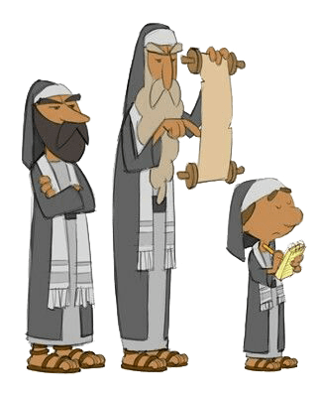
Who were the scribes and the Pharisees?
During the time of Jesus, a “Scribe” was someone instructed in the Law with all its traditions and additions.
Did you know?
The Pharisees thought they were perfect because they followed the Law perfectly and looked down upon those that did not know or practice the Law. As a result, they suffered from extreme pride and did not recognize Jesus of Nazareth as the Son of God.
Jesus says:
I tell you, unless your righteousness surpasses that of the scribes and Pharisees, you will not enter the kingdom of heaven.
Read and underline what Jesus wants us to do:
You shall not kill; and whoever kills will be liable to judgment.
Whoever is angry with his brother will be liable to judgment.
Do not take a false oath.
Do not swear at all.
Unless your righteousness surpasses that of the scribes and Pharisees, you will not enter the kingdom of heaven.

Slide 19
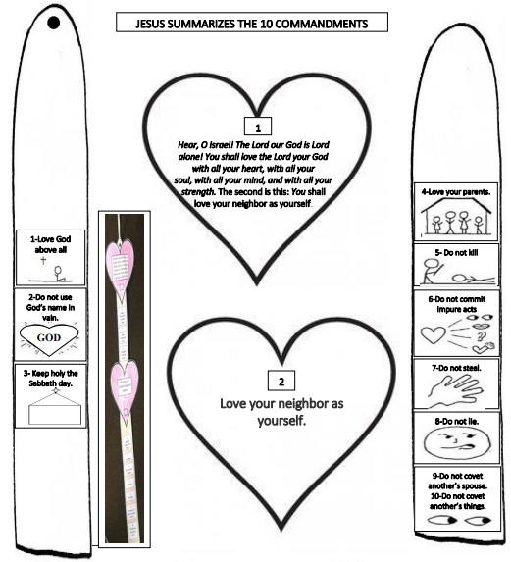

Slide 20
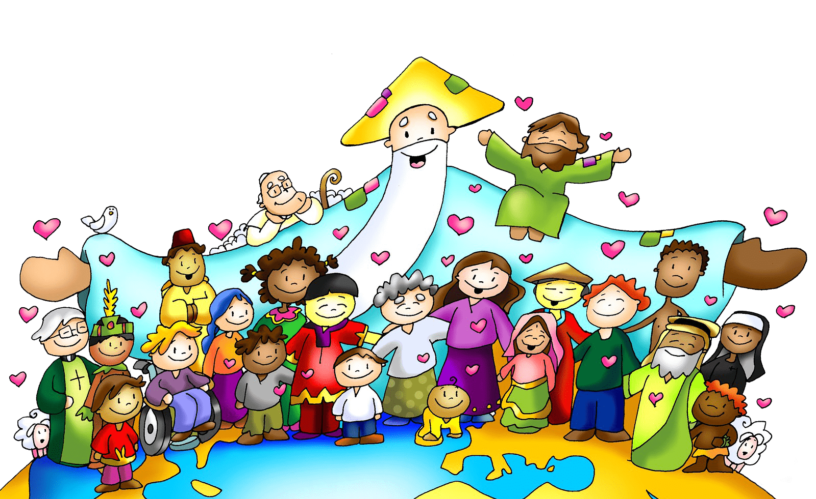
PRAYER
God the Father, who makes the sun rise every day, and with your love cares for the fields and the flowers; please care for all my loved ones, that all may love you greatly and be ready to do your holy will always.
Amen

Slide 21
Love One Another, Dakota Pyle, https://youtu.be/p9diFwUly4M (3-7 yrs.)

Slide 22
Love One Another, Orange Kids Music, https://youtu.be/JysQNwalyIQ (8+ yrs.)

