Slide 1
Ministry Friends of Jesus and Mary
Jesus Prays for His Own & the Ascension
Cycle A, VII Sunday of Easter
John 17, 1-11
www.fcpeace.org

Slide 2
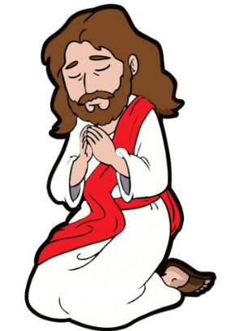
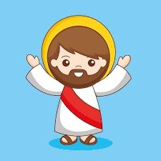
Jesus Prays for His Own
Jesus raised his eyes to heaven and said, “Father, the hour has come. Give glory to your son, so that your son may glorify you, just as you gave him authority over all people, so that your son may give eternal life to all you gave him.

Slide 3
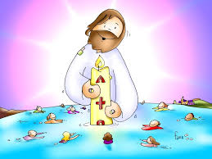
Jesus Prays for His Own
Now this is eternal life, that they should know you, the only true God, and the one whom you sent, Jesus Christ. I glorified you on earth by accomplishing the work that you gave me to do.

Slide 4
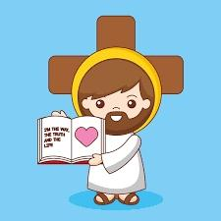
Jesus Prays for His Own
Now glorify me, Father, with you, with the glory that I had with you before the world began. “I revealed your name to those whom you gave me out of the world. They belonged to you, and you gave them to me, and they have kept your word.

Slide 5
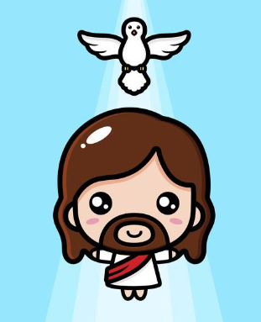
Jesus Prays for His Own
Now they know that everything you gave me is from you, because the words you gave to me I have given to them, and they accepted them and truly understood that I came from you, and they have believed that you sent me.

Slide 6
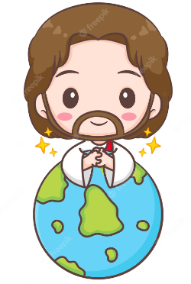
Jesus Prays for His Own
I pray for them. I do not pray for the world but for the ones you have given me, because they are yours, and everything of mine is yours and everything of yours is mine, and I have been glorified in them. And now I will no longer be in the world, but they are in the world, while I am coming to you.”
THE GOSPEL OF THE LORD,
PRAISE TO YOU LORD JESUS CHRIST

Slide 7
Reflection
Jesus speaks to His Father and asks Him to glorify Him so that the Father may be glorified.
How do people glorify themselves in our world?
Winning sports, becoming famous movie stars, getting high positions in companies or governments, making large sums of money...

Slide 8
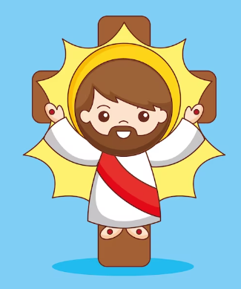
Reflection
How does God glorify Jesus and Jesus glorify God?
Suffering and dying on the cross in the hands of His enemies and later resurrecting from the dead.

Slide 9
Reflection
Why does Jesus glorify the Father in this manner?
Jesus reveals God’s extreme love for us. In order to be with us for eternity, He was willing to suffer and die. He shows His power and victory over death with His resurrection.

Slide 10
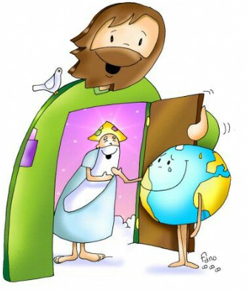
Reflection
Jesus then asks God to give eternal life to those who love Him and He describes eternal life. What is eternal life?
It is to know God and Jesus Christ.

Slide 11
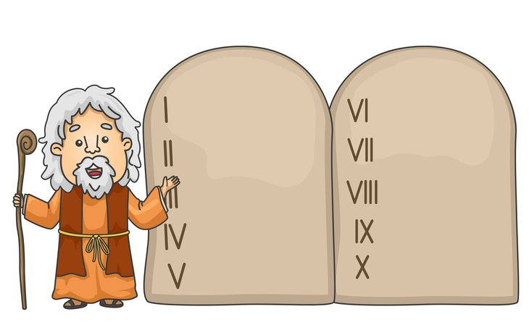
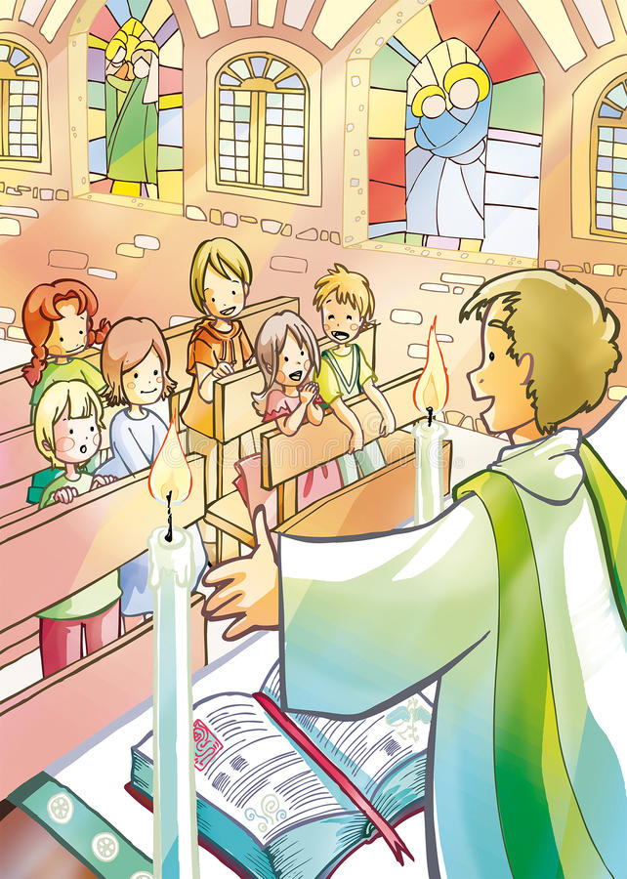
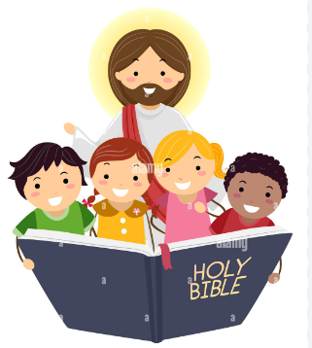
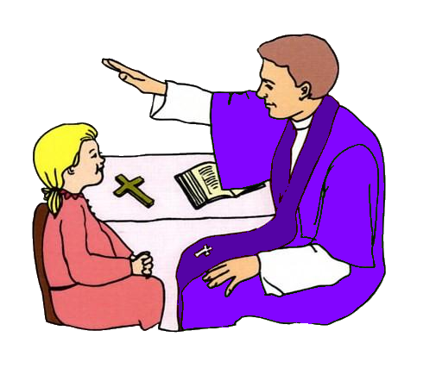
Reflection
How can we know God better?
We can pray more, read the bible more, go to mass attentively, go to confession regularly, and obey God.

Slide 12
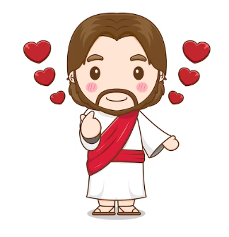
Reflection
Jesus repeats that He and God are one and those who believe this will be glorified.
How can we glorify Jesus?
When we trust in Jesus and we follow His commandments out of love for Him, we glorify Him.

Slide 13
Let’s Play!
FILL IN THE BLANKS:
Now this is eternal life, that they should ______ you, the only true ____, and the one whom you sent, ____________… They … know that everything you gave me is from ____, because the _____ you gave to me I have given to them; they … understood I came from ___, and they have believed that you ____ me.
(John 17, 1-11)
know
God
Jesus Christ
you
words
you
sent

Slide 14
What is the Ascension, Catolikids, https://youtu.be/1SpNKkeOAGY

Slide 15
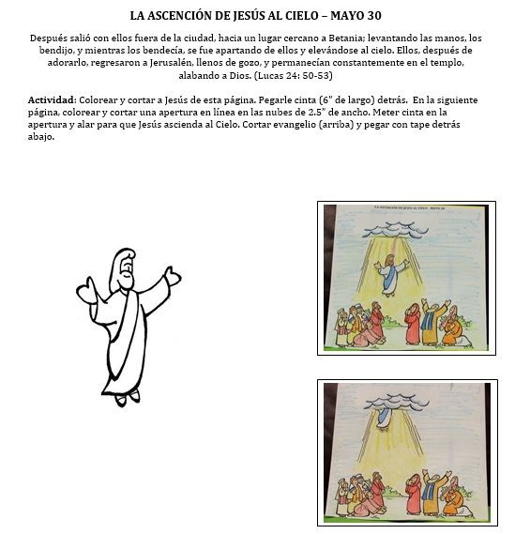
Activity Instructions: Cut the figure of Jesus and the scene on the next page and color. Glue a 4” ribbon to the back of Jesus. Cut a 1” horizontal slit under the cloud. Put the top of the ribbon through the slit and pull up from the back to see Jesus ascend.
AFTER 40 DAYS, JESUS ASCENDED INTO HEAVEN
The eleven disciples went to Galilee, to the mountain to which Jesus had ordered them. When they saw him, they worshiped, but they doubted. Then Jesus approached and said to them, “All power in heaven and on earth has been given to me. Go, therefore, and make disciples of all nations, baptizing them in the name of the Father, and of the Son, and of the Holy Spirit, teaching them to observe all that I have commanded you. And behold, I am with you always, until the end of the age.” (Mt 28, 16-20)

Slide 16
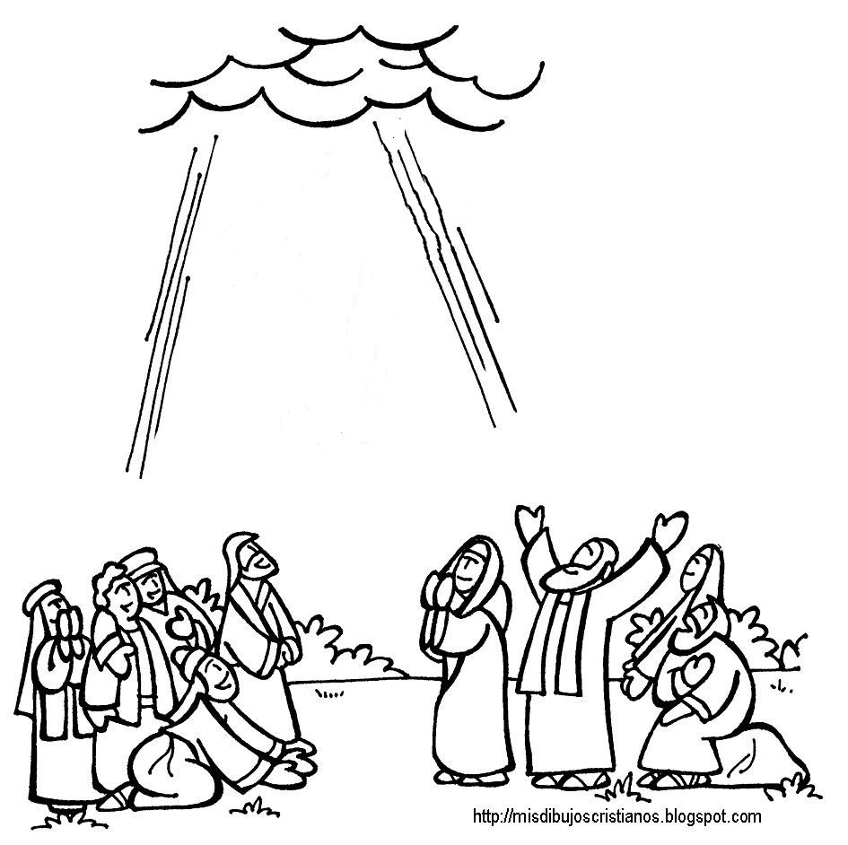
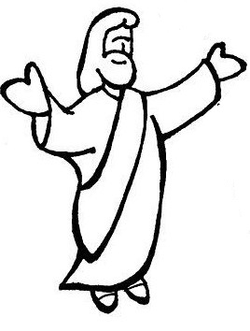

Slide 17
Let’s Sing!
To God be the Glory, Lifetree Kids, https://youtu.be/Y0dQbfbSW0Q

Slide 18
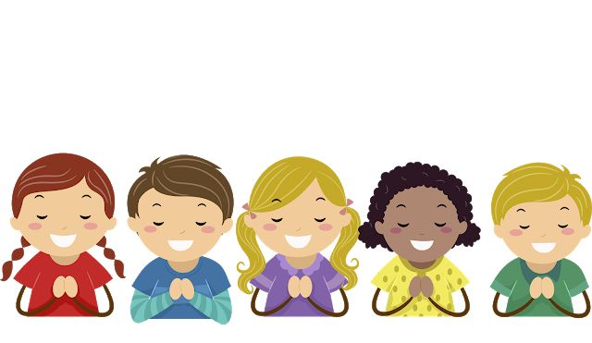
PRAYER
Jesus, help me not to seek the glory of this world but Your glory. Help me to imitate You in humility, obedience, service, and love. Help me to believe and always glorify you.
Amen

