Slide 1

Friends of Jesus and Mary
Prayer Group for Children
Cycle A – VII Sunday in Ordinary Time
Love Your Enemies– Mathew 5, 38-48
www.fcpeace.org

Slide 2
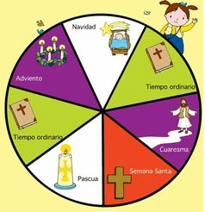
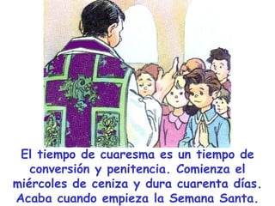
Next week we begin the season of Lent, a time of preparation.
Christmas
Advent
Ordinary Time
Lent is a time of conversion and penance. It begins on Ash Wednesday and lasts for 40 days. It ends when Holy Week begin.
Ordinary Time
Lent
Holy Week
Easter
The priest wears purple which signifies spiritual preparation and penance.
ALLELUIA

Slide 3
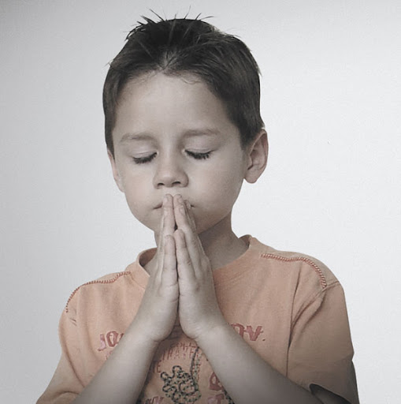

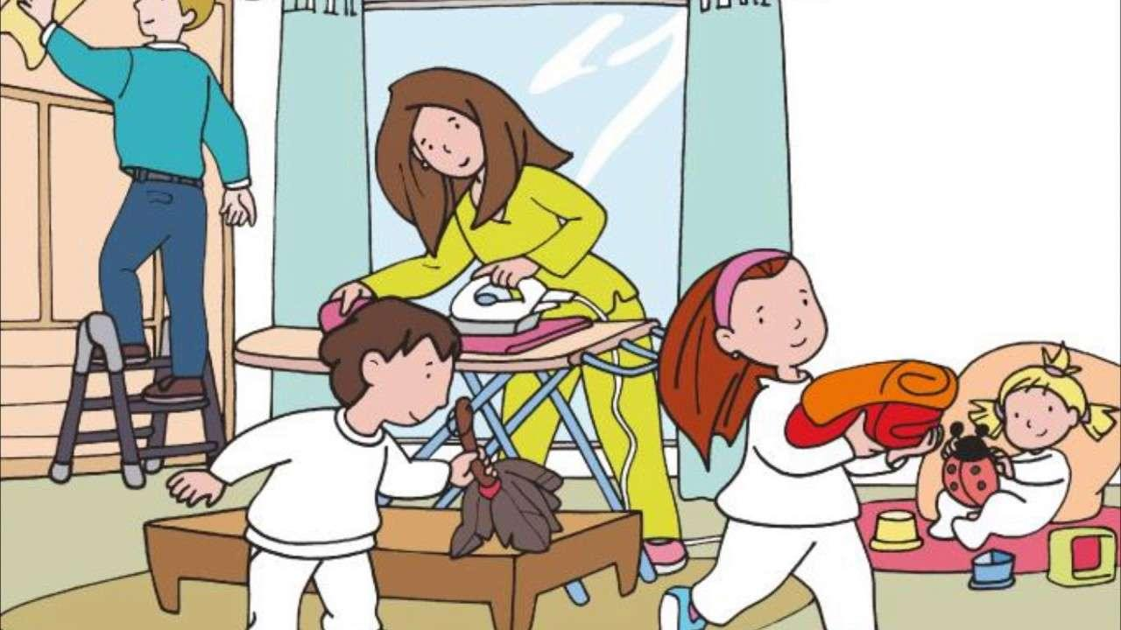
Throughout the 40 days of Lent, we prepare our hearts for Jesus’ great act of love: His passion, death, and resurrection.
We prepare with:
Prayer,
Fasting and Sacrifices,
and Acts
of Love,

Slide 4

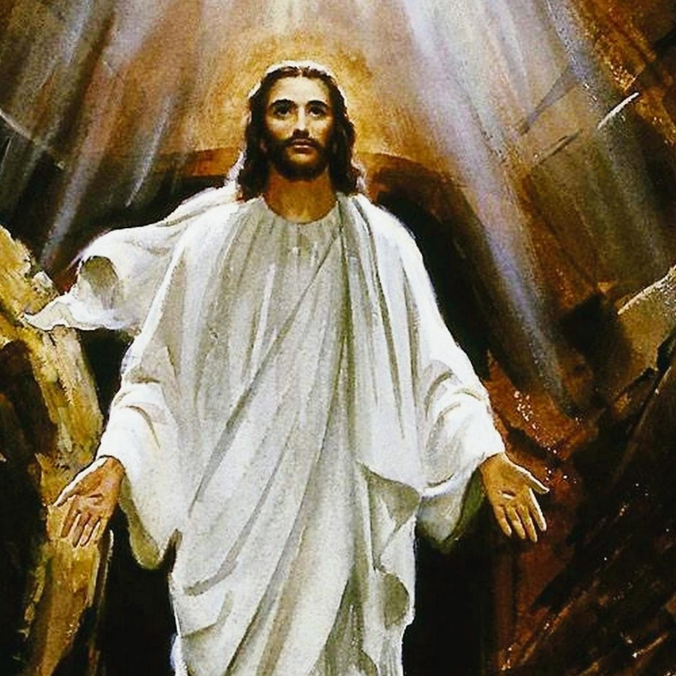
…To receive the Resurrected Christ
into our hearts on Easter Sunday.

Slide 5

ASH WEDNESDAY
The priest traces the Sign of the Cross on our forehead with ashes. These ashes are from the burning of last year’s Palm Sunday palms.
The priest may say when he puts on the ashes: “Repent and believe in the Gospel.” or “Remember that you are dust, and to dust you shall return.”
Did you know…?
The ancient Hebrew people had a tradition that when they knew they had sinned or when they were preparing for an important feast in which they must be purified, they would cover themselves in ashes and would dress in sack cloth. In this way, they recognized that they were small before God, were sinners, and needed God’s forgiveness. They recognized that from dust they came (Adam) and from dust they would return.

Slide 6

What is Lent? https://youtu.be/tXs6qQ_o-lk

Slide 7
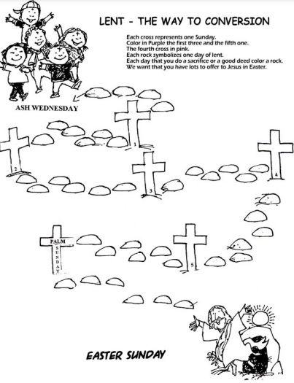
PREPARE OUR HEART
The crosses represent the Sundays of Lent and the stones are the days. The priest dresses in purple the 1st, 2nd, 3rd, and 5th Sundays of Lent signifying spiritual preparation and penance, so we color these crosses purple. He dresses in Pink (signifying joy) the 4th Sunday and Palm Sunday since Jesus’ victorious resurrection is near.
Each time you do something special out of love for Jesus (see below), color the stone for that day a pretty color. Hopefully your way of conversion will be full of beautiful colors for Jesus! Examples of acts of love:
A sacrifice (not eat something you love, not play a favorite game or watch a favorite show…)
A good deed (Help your parents or neighbor…)
Pray a decade of the Rosary for the intentions of our Blessed Mother Mary.
Forgive someone that hurt you.
Ask someone you hurt to forgive you.

Slide 8
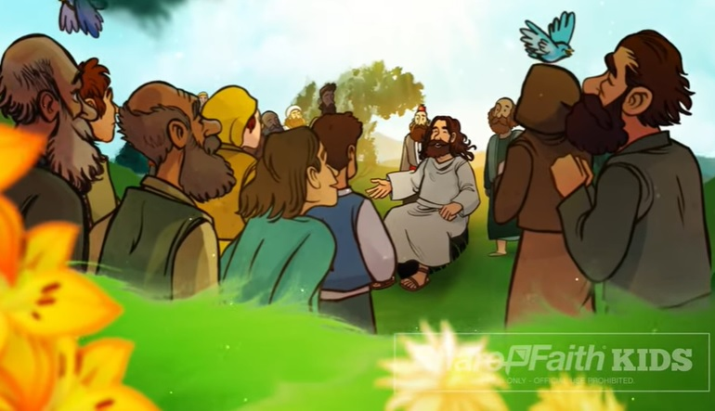
During that time,
Jesus said to His disciples:
The Gospel according to Matthew 5, 38-48 – Love Your Enemies

Slide 9
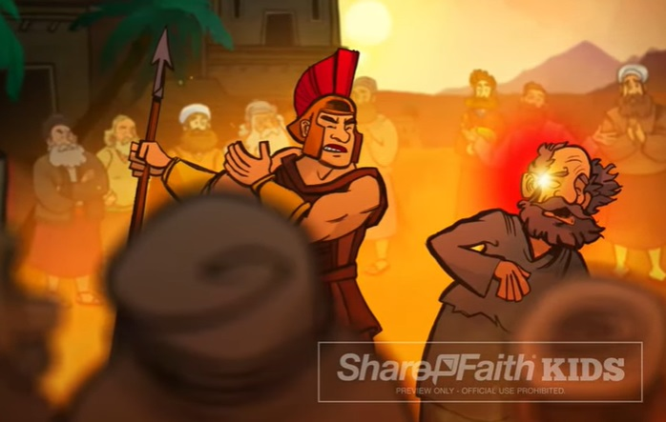
You have heard that it was said, ‘An eye for an eye and a tooth for a tooth.’ But I say to you, offer no resistance to one who is evil. When someone strikes you on [your] right cheek, turn the other one to him as well.

Slide 10
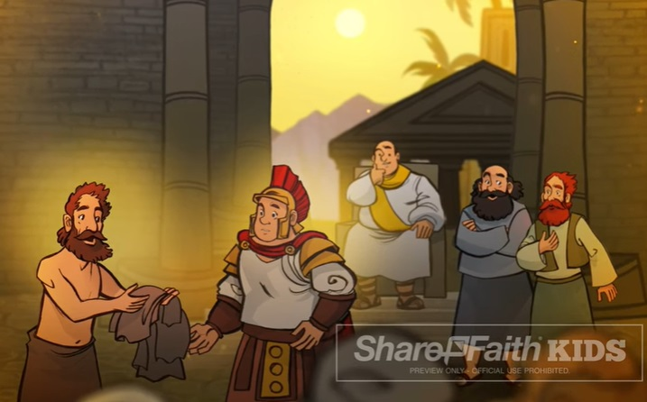
If anyone wants to go to law with you over your tunic, hand him your cloak as well.

Slide 11
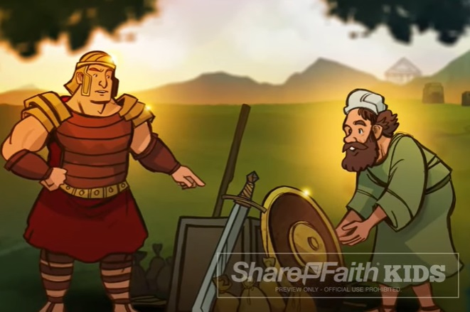
Should anyone press you into service for one mile, go with him for two miles.

Slide 12
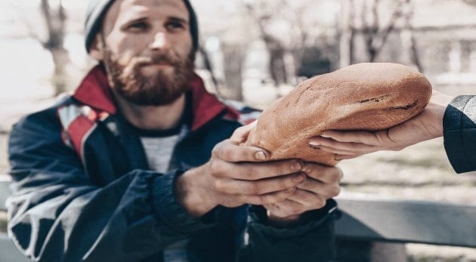
Give to the one who asks of you, and do not turn your back on one who wants to borrow.

Slide 13

You have heard that it was said, ‘You shall love your neighbor and hate your enemy. But I say to you, love your enemies.

Slide 14

…and pray for those who persecute you,

Slide 15
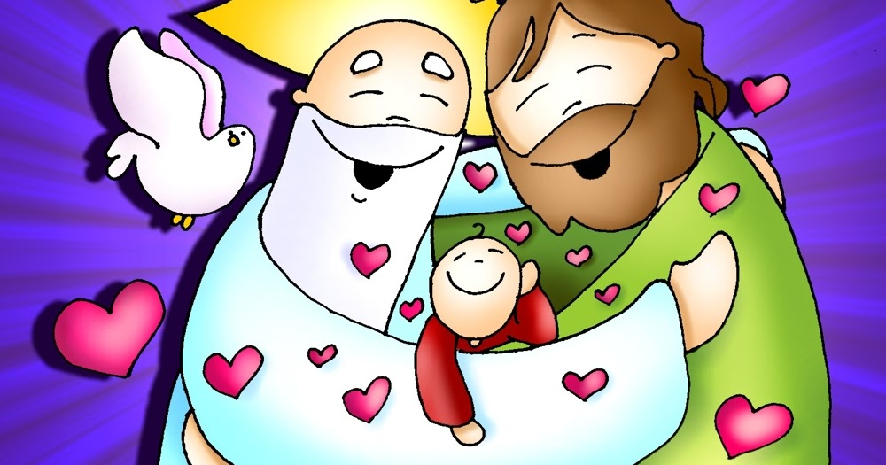
…that you may be children of your heavenly Father.

Slide 16


…for he makes his sun rise on the bad and the good, and causes rain to fall on the just and the unjust.

Slide 17
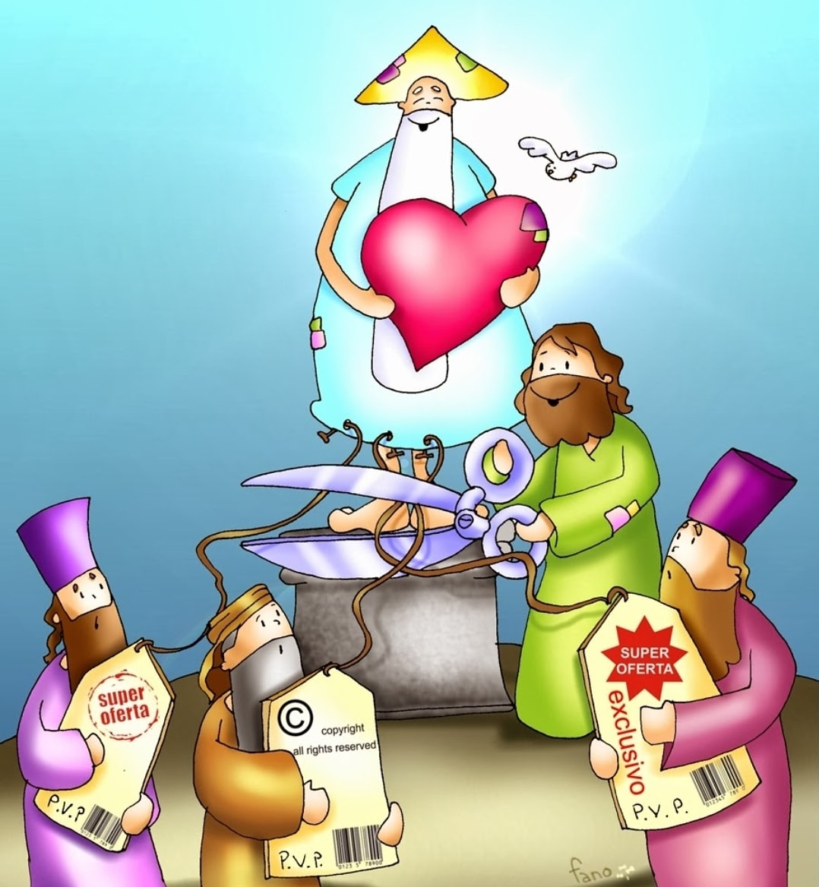
For if you love those who love you, what recompense will you have? Do not the tax collectors do the same?

Slide 18

And if you greet your brothers only, what is unusual about that?
Do not the pagans do the same?

Slide 19

So be perfect, just as your heavenly Father is perfect.
The Gospel of the Lord,
Praise to you
Lord Jesus Christ.

Slide 20
REFLECTION

Slide 21

What does the phrase “an eye for an eye, a tooth for a tooth” mean”?
This is a phrase that refers to the idea that people should be punished to the degree in which they have offended.

Slide 22
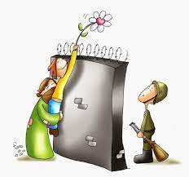
What does Jesus say about this phrase?
Jesus wants us to NOT apply it anymore; instead, He wants us to learn to forgive and not to hold a grudge.

Slide 23
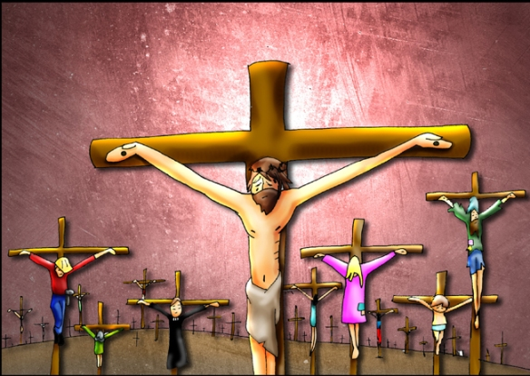
What did Jesus do when they tortured and crucified Him?
He prayed for His persecuters,
“God forgive them, they know not what they do.”

Slide 24
What does Jesus want us to do?
Jesus wants us to love our enemies, to pray for them, and to forgive them.

Slide 25
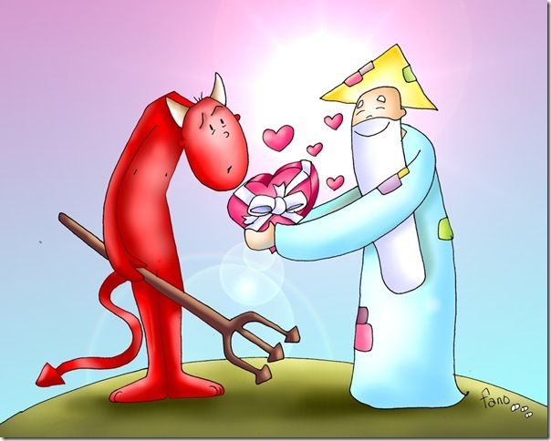
Jesus asks us to do something extraordinary!
Extraordinary is everything that is going beyond what is usual, ordinary or regular. It is extraordinary to love those who do NOT love us, to greet those who do NOT greet us, without reservations, or grudges.
God is extraordinary and loves without limits.

Slide 26

Why does Jesus want us to do something extraordinary like this?
So we may be sons of the Celestial Father,
glorifying Him by doing as He did.

Slide 27

Activity

Slide 28
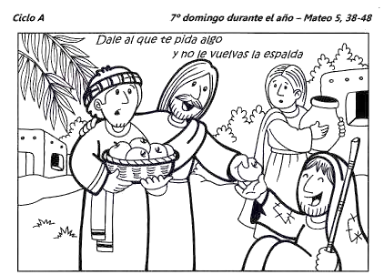
Cycle A 7th Sunday in Ordinary Time-Matthew 5: 38-48
Give to the one who asks of you,
Color this picture and write on the lines a goal to fulfill what Jesus asks us in this Gospel, for example: I will pray for those who make me feel bad, I will share my colors with others, etc. Jesus said: “Give to the one who asks of you, and do not turn your back on one who wants to borrow ..love your enemies, and pray for those who persecute you, that you may be children of your heavenly Father, for he makes his sun rise on the bad and the good, and causes rain to fall on the just and the unjust”.
GOAL:
____________________________________________________________________________________________________________________________________________________________________________________________________________________________________
and do not turn your back.

Slide 29
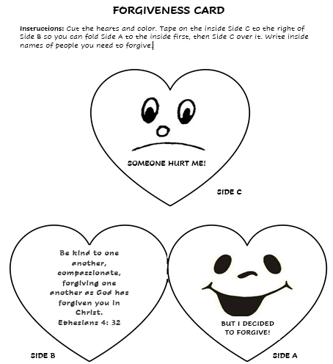
Make the forgiveness card. Think of someone you want to forgive and someone you want to ask forgiveness from this week.

Slide 30
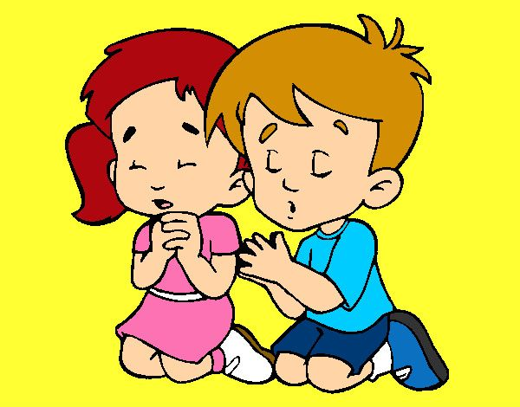
Prayer
Lord, make me a channel of your peace. Where there is hatred, let me bring Your love. Where there is injury, your pardon Lord, where there is darkness, only light; and where there’s sadness, ever joy.
AMEN

Slide 31
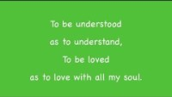
Song-Make me a Channel of your Peace, Mark G.- https://www.youtube.com/watch?v=ihhvm6eLWZI

