Slide 1
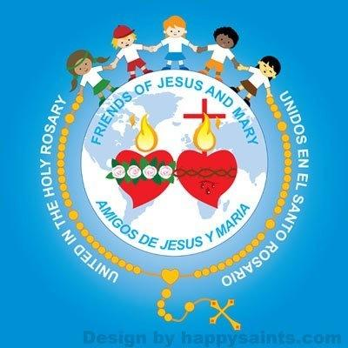
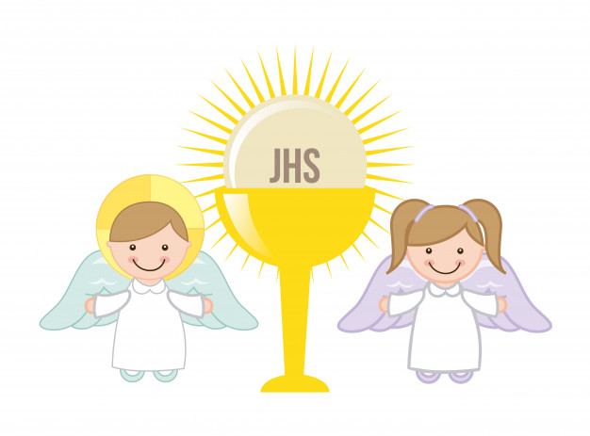
SOLEMNITY OF CORPUS CHRISTI (6-9 years)
Ministry Friends of Jesus and Mary
Cycle A - X Sunday of Ordinary Time—(John 6, 51-58)
www.fcpeace.org

Slide 2
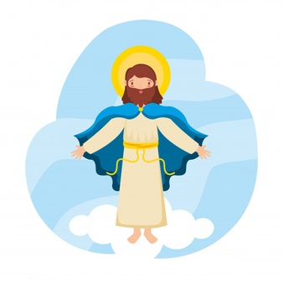
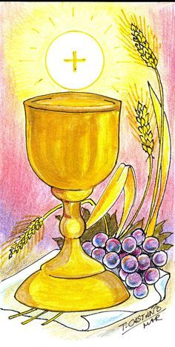
Jesus said to the Jewish crowds: "I am the living bread that came down from heaven; whoever eats this bread will live forever …
… and the bread that I will give is my flesh for the life of the world”.

Slide 3
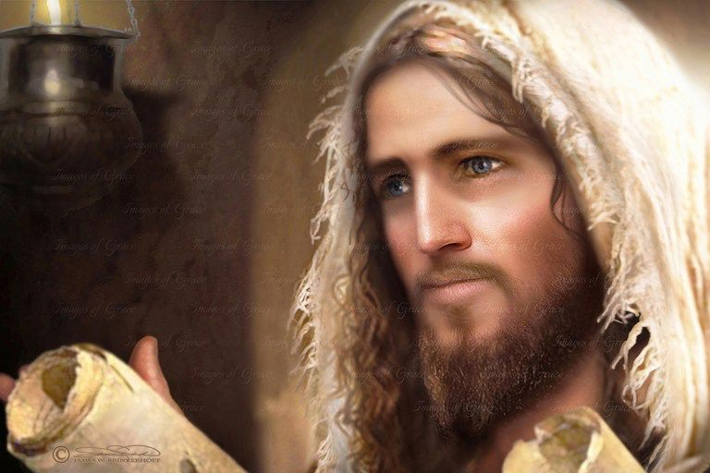
SUMMARY: Jesus Will give us bread that is His flesh,
…and that bread gives us LIFE.

Slide 4
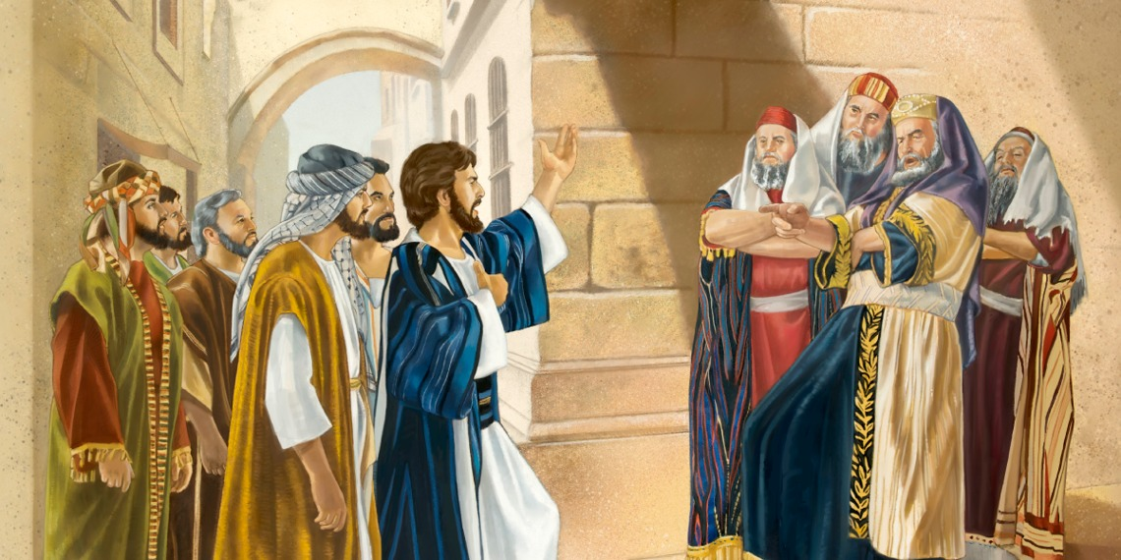
The Jews quarreled among themselves, saying, "How can this man give us his flesh to eat?"

Slide 5
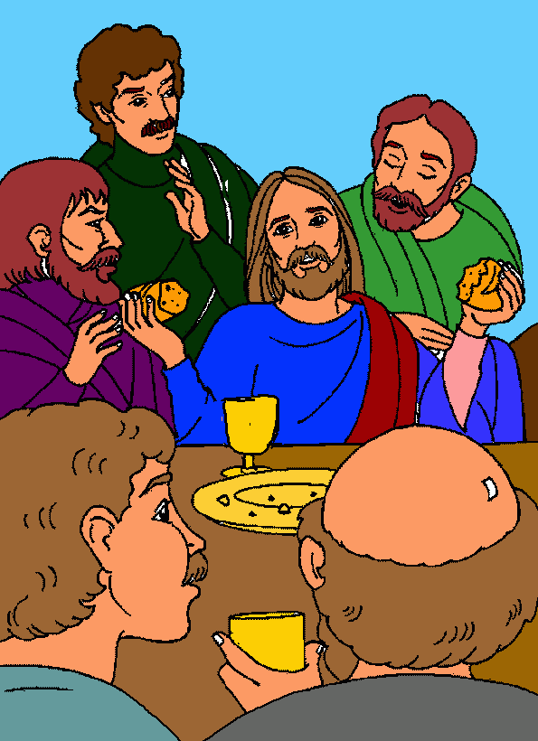
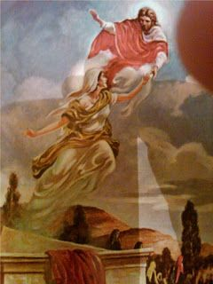
Jesus said to them, "Amen, amen, I say to you, unless you eat the flesh of the Son of Man and drink his blood, you do not have life within you.
Whoever eats my flesh and drinks my blood has eternal life, and I will raise him on the last day.

Slide 6
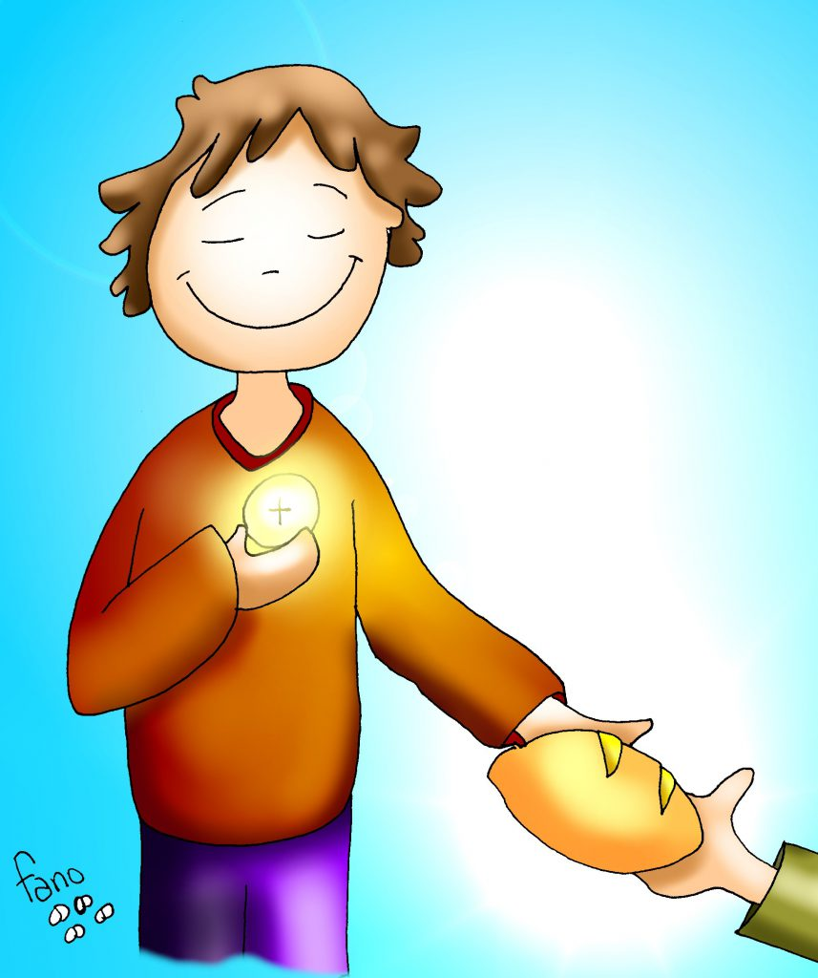
For my flesh is true food, and my blood is true drink.
Whoever eats my flesh and drinks my blood remains in me and I in him.

Slide 7
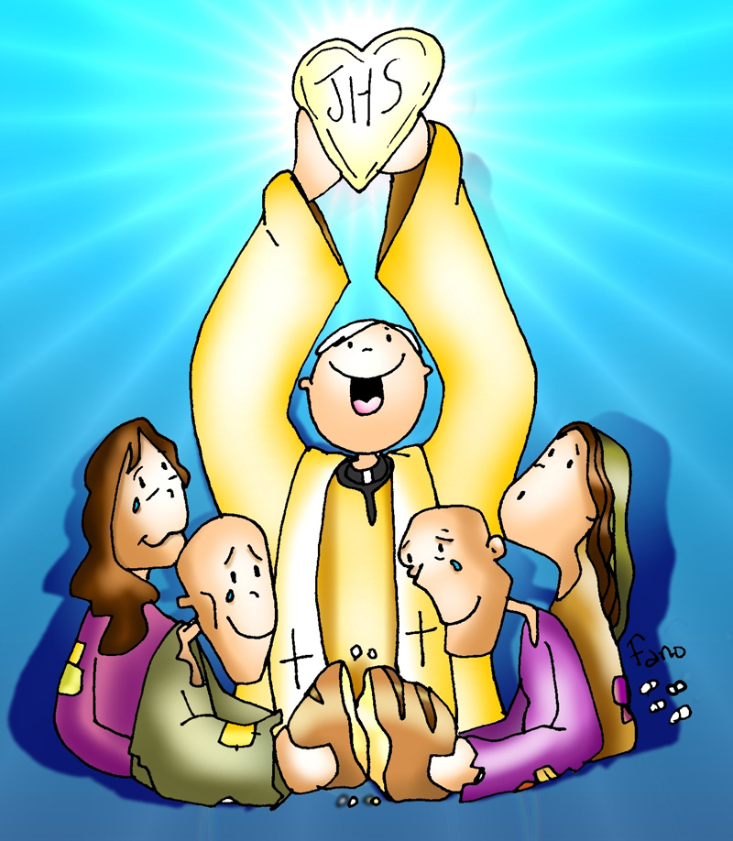
Just as the living Father sent me and I have life because of the Father,
…so also the one who feeds on me will have life because of me.

Slide 8
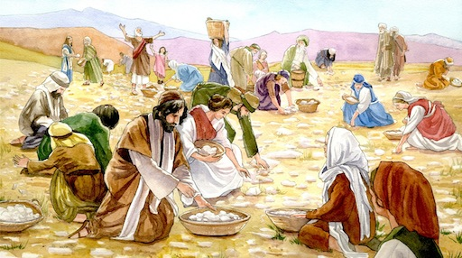
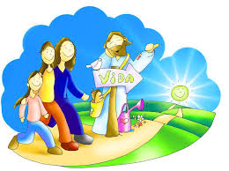
This is the bread that came down from heaven.
LIFE
Unlike your ancestors who ate and still died,
whoever eats this bread will live forever.

Slide 9
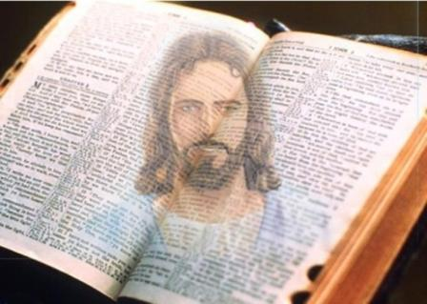
The Gospel of the Lord, Praise to You Lord Jesus Christ.

Slide 10
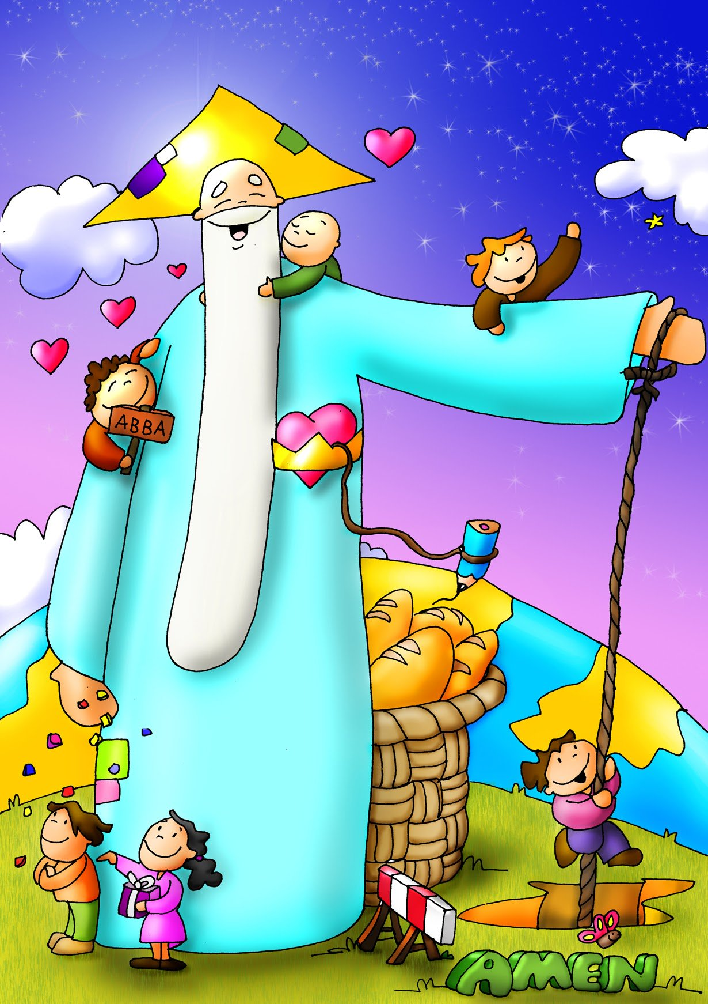
God the Father loves us and takes care of us.
He creates the visible, what we can see.
What did He create?

Slide 11
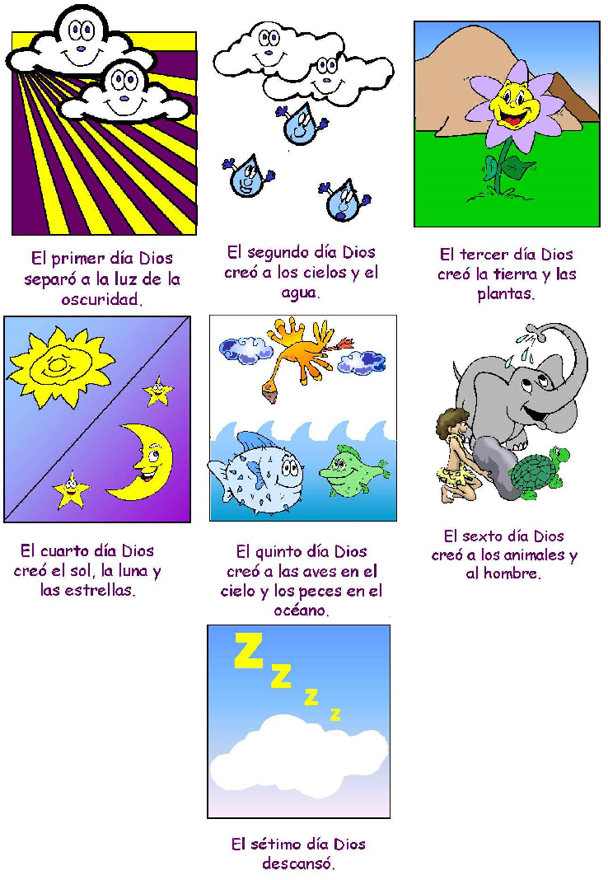
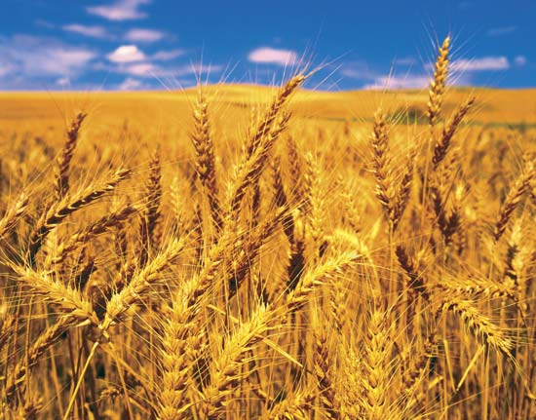
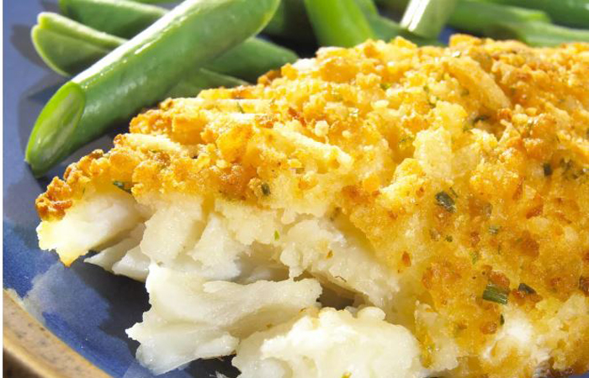
He created the sun, the rain, the animals…
So we could have bread, fruit, vegetables,
…and meat to eat.

Slide 12
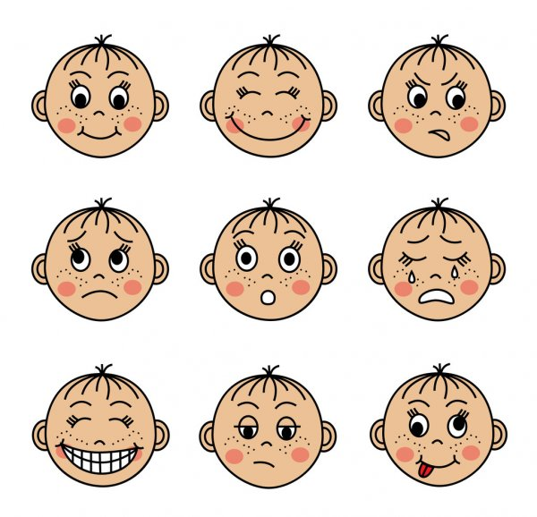
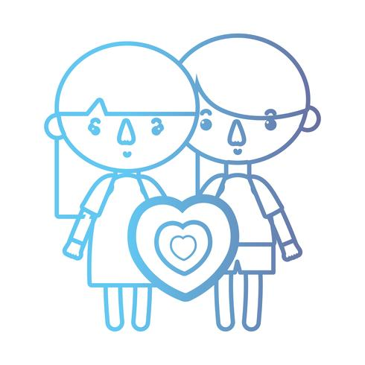
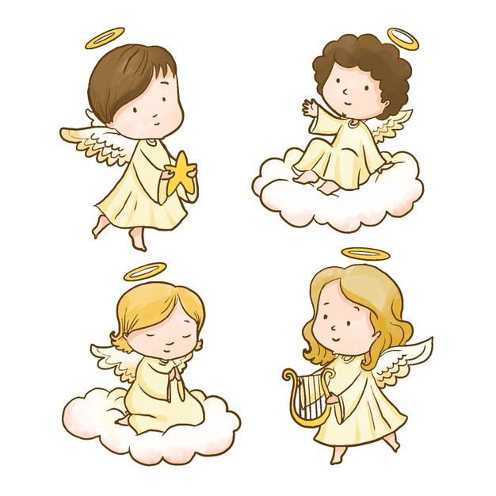
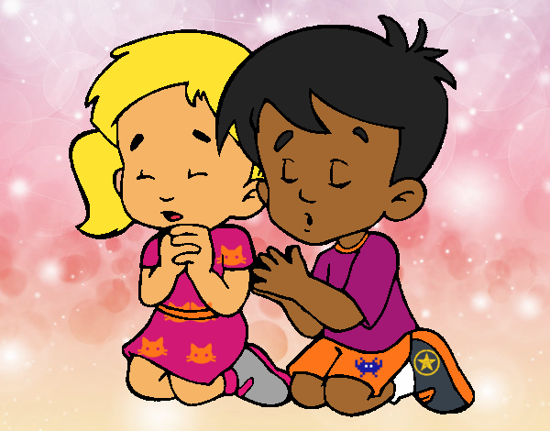
He also creates the invisible, what we cannot see.
What invisible things did He create?
Our thoughts and feelings,
Our soul, or spiritual heart,
The angels and Heaven,
Prayer.

Slide 13
Which is more important?
Both are important, but…

Slide 14
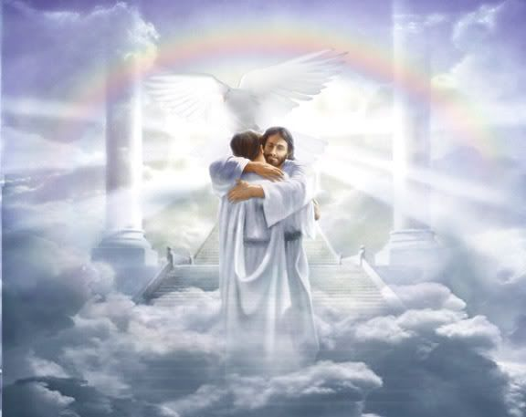
The invisible is more important because this life is shore and eternity never ends.

Slide 15
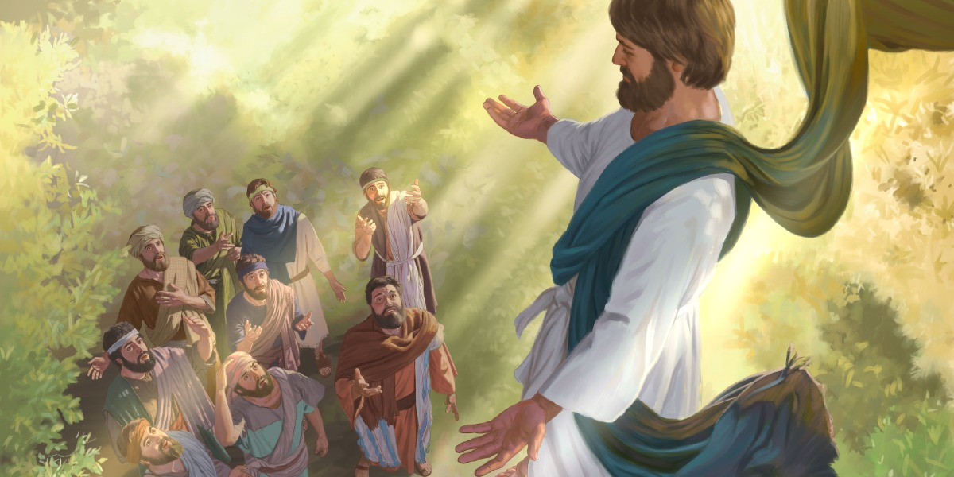
Jesus wants to help us get to Heaven,
Before ascending into Heaven, He promised,
“I will be with you always until the end of time.”

Slide 16
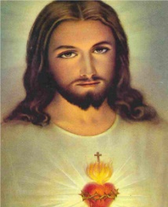
He is hidden in our heart.
Where is Jesus?

Slide 17
He is present in Holy Scripture.

Slide 18
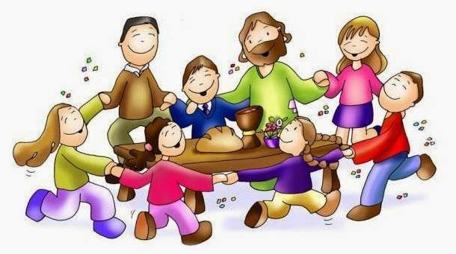
He is present in the community.
He promised that where two or more are gathered in His name, He is present.

Slide 19
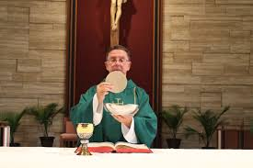
He acts through the priest to give us the miracle of the Eucharist.

Slide 20
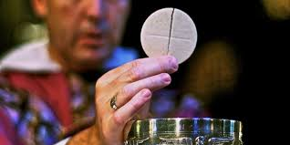
Jesus is hidden in the bread and wine we eat during mass, the Eucharist.
It is a Miracle!

Slide 21
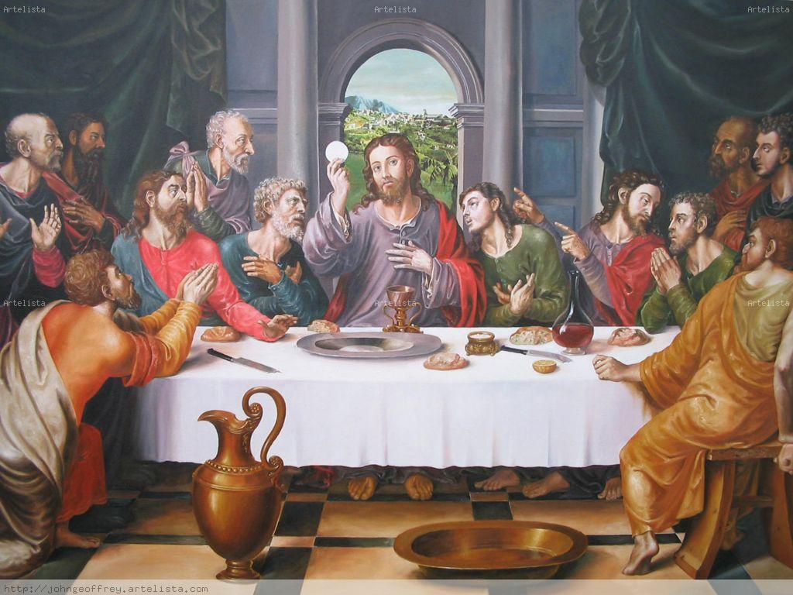
How is He present?
In the last supper, Jesus broke the bread, blessed it, and gave it to his disciples saying,
“Take this bread and eat it. This IS my body which will be given up for you.”
Then He took the wine and blessed it saying,
“Take this wine and drink it, this IS my blood that will be shed for you for the forgiveness of sin.
“Do this in memory of me.”

Slide 22
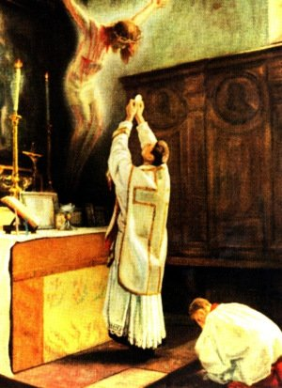
During the mass, the priest repeats these words over the bread and wine.
This is the moment of the
CONSECRATION,
When God changes the bread and wine
to the body and blood of Jesus.
IT IS A MIRACLE!
Often a bell is rung to announce this important moment.

Slide 23
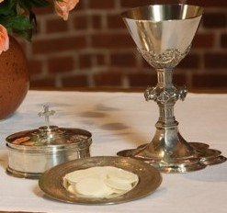
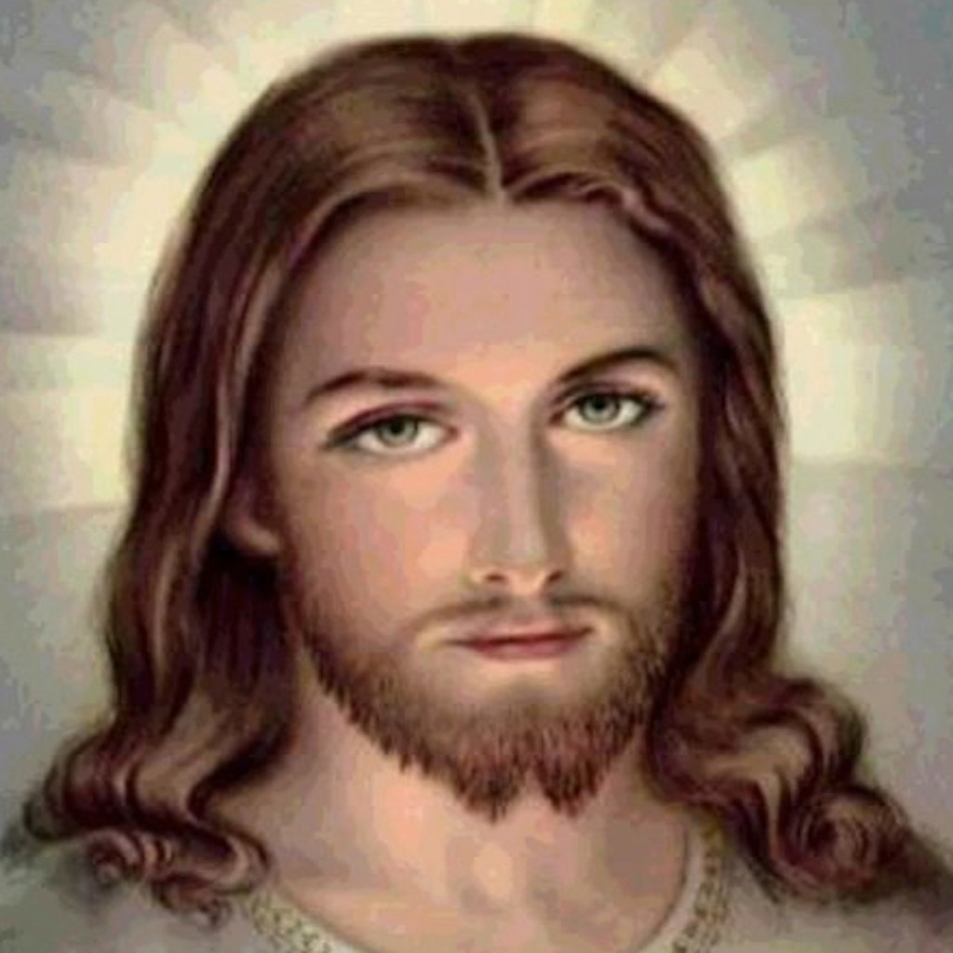
The Miracle is called Transubstantiation
trans = to cross over, to change
sustance = the material
ation = the action of

Slide 24
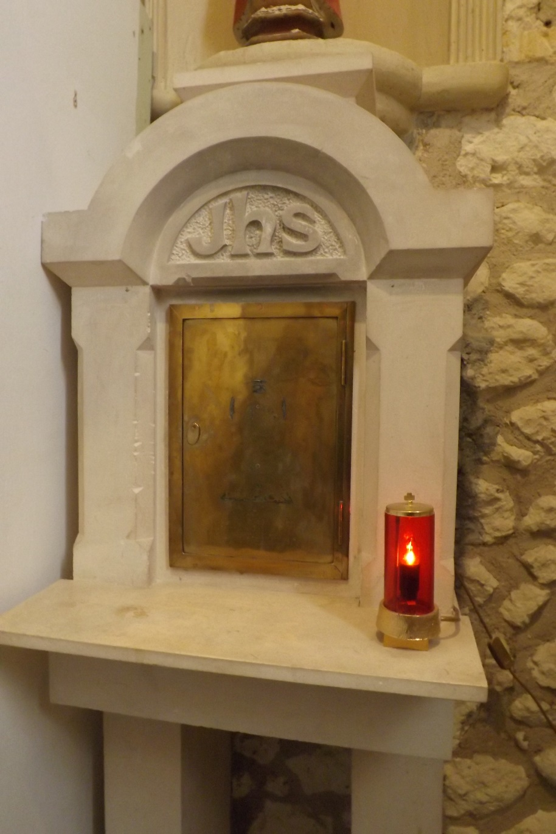
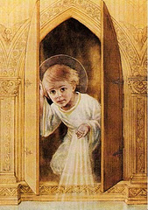
In the Church, Jesus in the Eucharist stays in the Taberncle.
The red light lit near the Tabernacle indicates Jesus is present there.
He waits for
us to visit.
Jesus is there!

Slide 25
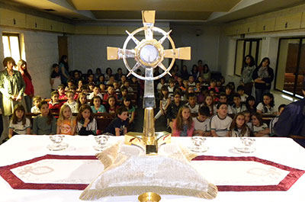
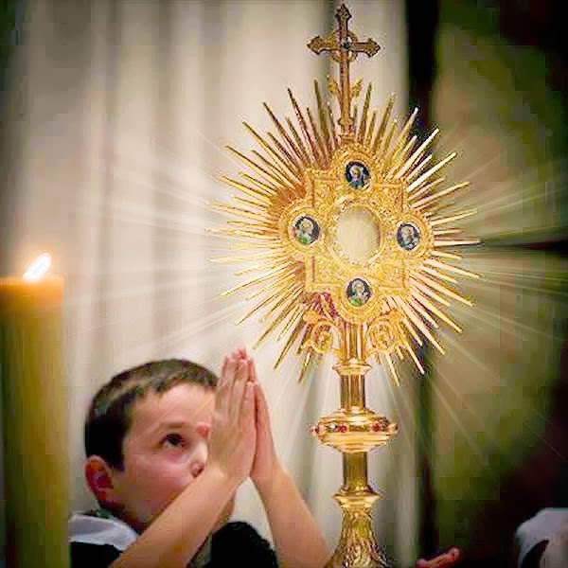
When we want to adore Jesus in a group, the priest puts Jesus in a Monstrance so he can bring Him close to the people.
We adore Jesus in the Blessed Sacrament.

Slide 26
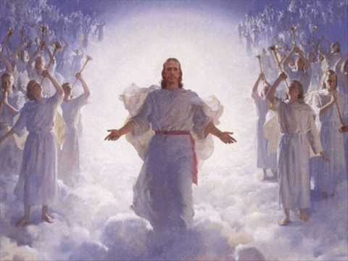
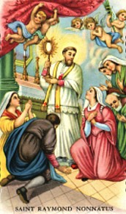
Wherever Jesus is, the angels and saints are also there adoring and praising their God and King.
And in the Eucharist
In Heaven…

Slide 27
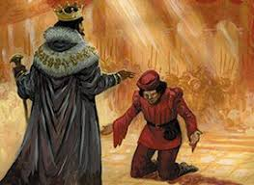
How do we behave before a King?
We bow and treat them with much respect.

Slide 28
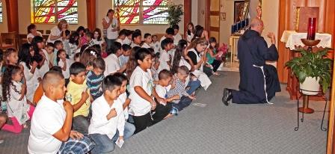
How do we behave before our King?
We kneel silently and respectfully.

Slide 29
What is the Real Presence? Catholic Kids https://youtu.be/JYkvjq6pG1Y

Slide 30
Why do we believe in the Real Presence in the Eucharist, UTG Detroit, https://youtu.be/cKbrFhAwBFQ

Slide 31
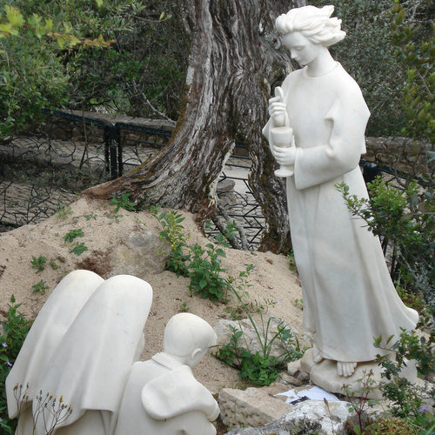
The angel of Peace in Fatima, Portugal asked the three children to pray often before Jesus in the Eucharist the following:
My God
I believe
I adore
I trust
And I love you.
I beg pardon for those who Do not believe
Do not adore
Do not Trust
And do not love you.(3X)

Slide 32
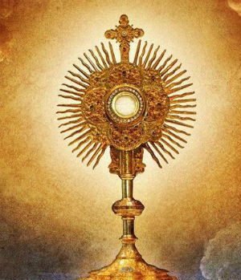
Let’s pray this prayer before Jesus in the Eucharist often.
https://youtu.be/QVpT2mBq5Zk

Slide 33
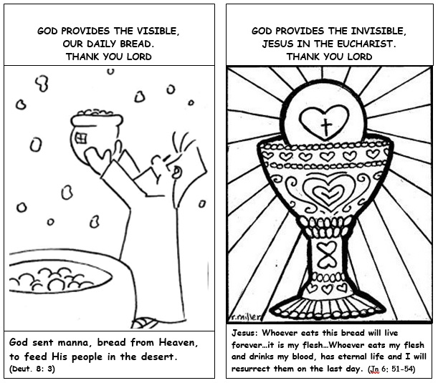
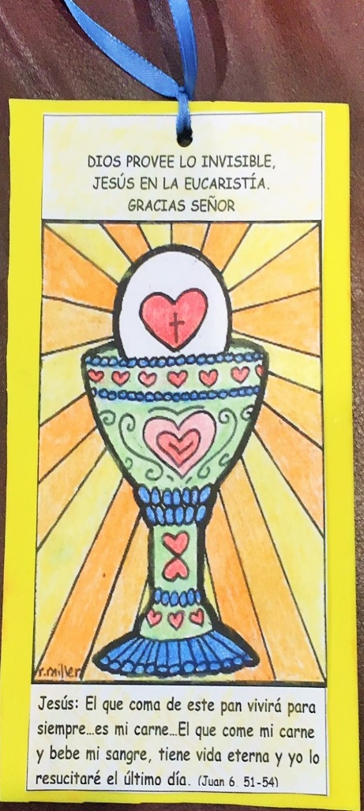
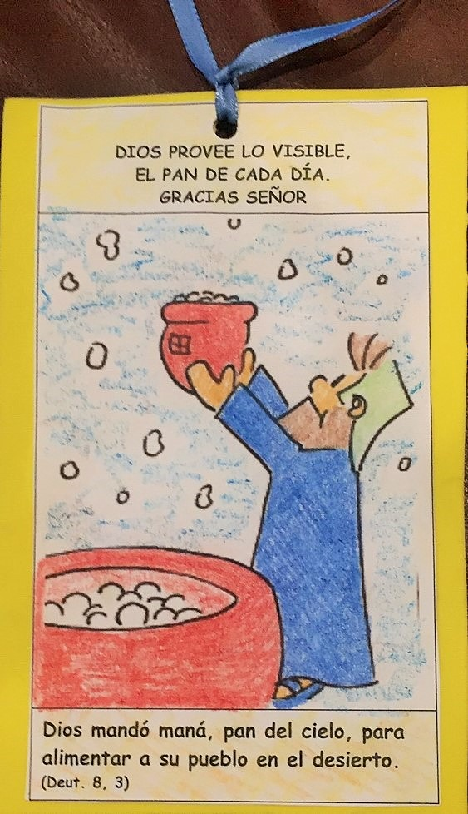
Activity Book Mark
Instructions: Cut, color and glue first half to one side and other half to other side of construction or poster paper cut a little larger. Punch a hole in the middle of the top and tie a ribbon through it.

