Slide 1
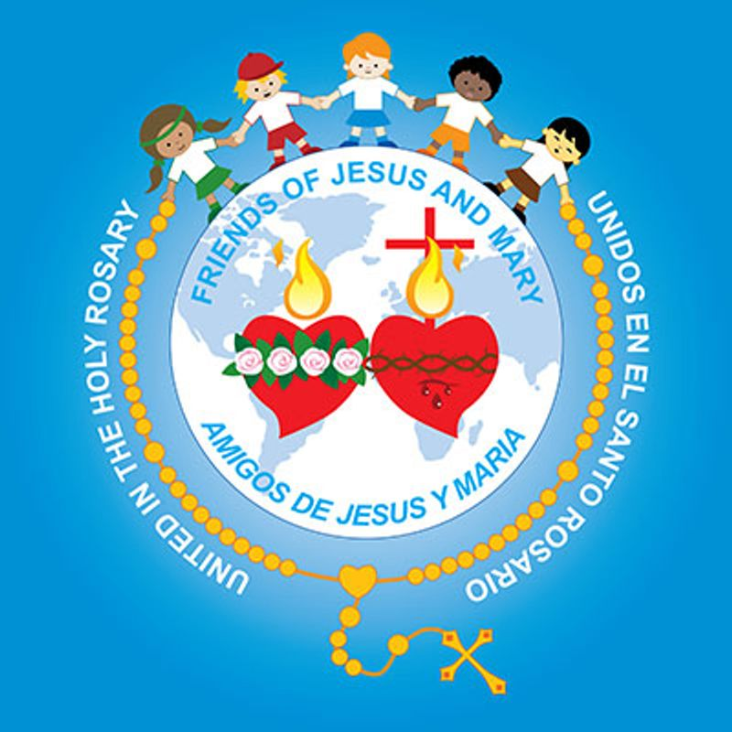
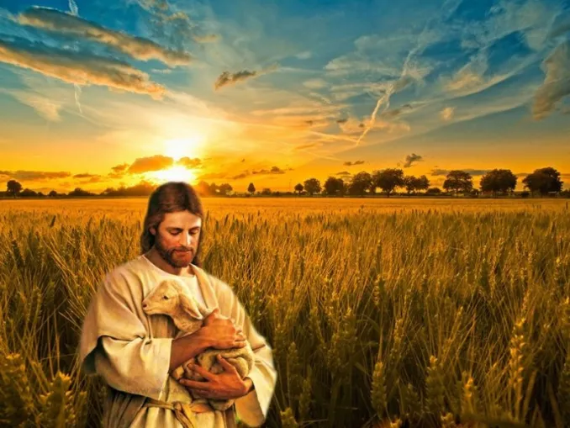
Ministry Friends of Jesus and Mary
www.fcpeace.org
The harvest is abundant, but the laborers few.
Cycle A-XI Sunday in Ordinary Time
Matthew 9: 36—10, 8

Slide 2
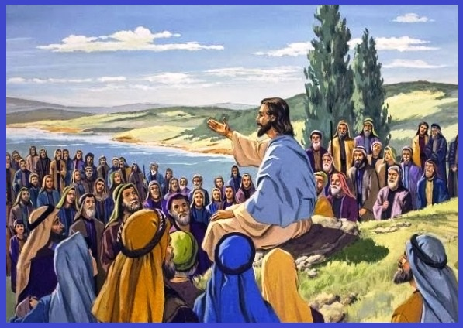
At the sight of the crowds, Jesus’ heart was moved with pity for them because they were troubled and abandoned, like sheep without a shepherd. Then he said to his disciples, “The harvest is abundant but the laborers are few; so ask the master of the harvest to send out laborers for his harvest.”

Slide 3
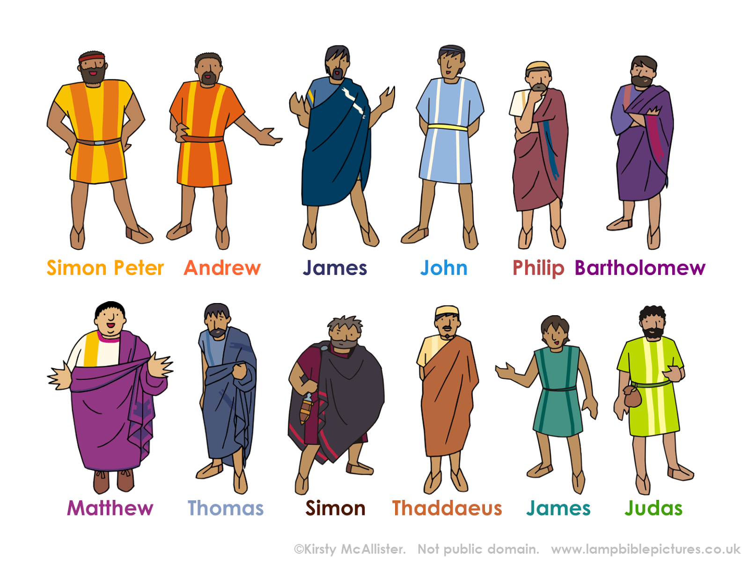
The names of the twelve apostles are these: first, Simon called Peter, and his brother Andrew; James, the son of Zebedee, and his brother John; Philip and Bartholomew, Thomas and Matthew the tax collector; James, the son of Alphaeus, and Thaddeus; Simon from Cana, and Judas Iscariot who betrayed him.

Slide 4
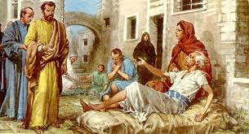
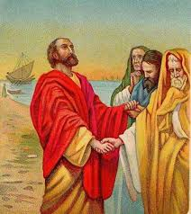
Jesus sent out these twelve after instructing them thus, “Do not go into pagan territory or enter a Samaritan town. Go rather to the lost sheep of the house of Israel. As you go, make this proclamation: ‘The kingdom of heaven is at hand.’ Cure the sick, raise the dead, cleanse lepers, drive out demons. Without cost you have received; without cost you are to give.”
The Gospel of the Lord,
Praise to you Lord Jesus Christ.

Slide 5
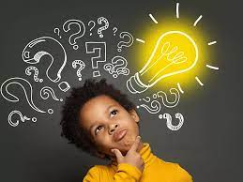
REFLECTION

Slide 6
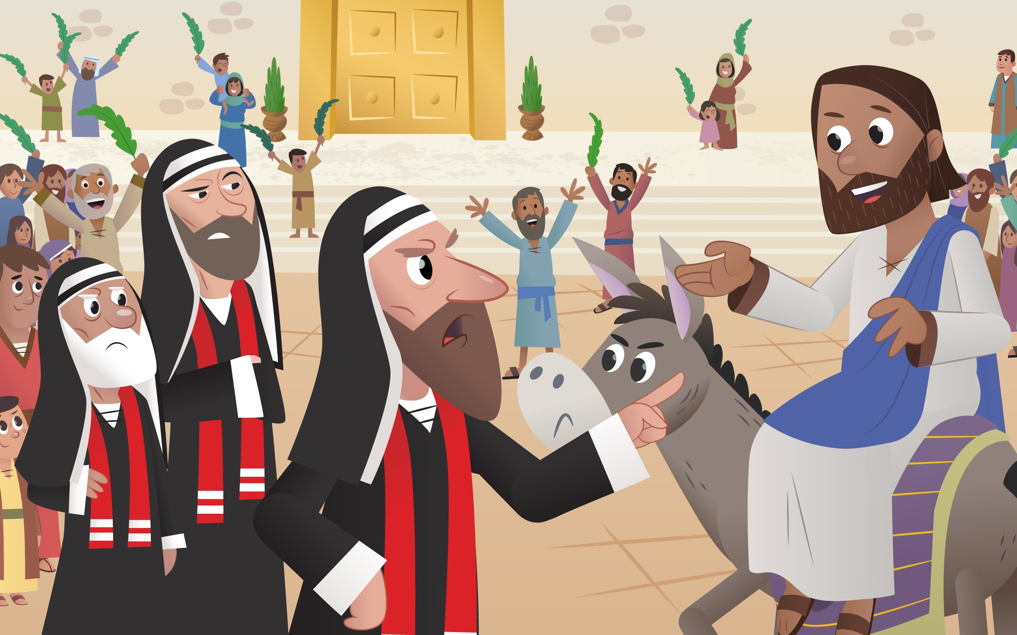
Jesus was moved with pity for His people because they were like sheep without a shepherd, lost and hungry. Why were they without a shepherd?
The pastors, or leaders of their faith, the Pharisees, did not have God in their hearts and did not show them the way to Him.

Slide 7
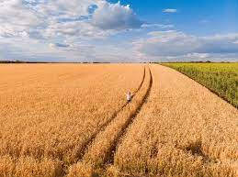
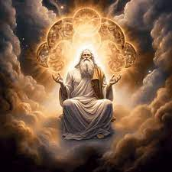
Then Jesus compares His people to a field that needed harvesting, but with few workers available to harvest it. What does Jesus ask His apostles to do?
Ask the master of the harvest to send out laborers for his harvest.
Who is the master of the harvest?
God.

Slide 8
Who were the first laborers?
The 12 apostles.

Slide 9
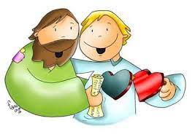
What does Jesus want them to do?
To spread the Gospel, the Good News of God’s love to all..

Slide 10
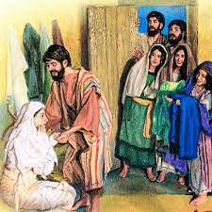
Jesus gave the apostles special powers to help them convert hearts. What were they?
The power to expel impure spirits and to cure sicknesses.

Slide 11
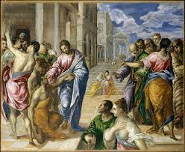
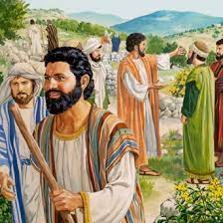
How do you think the people that the apostles freely healed felt?
Very grateful and ready to listen to them teach about Jesus.

Slide 12
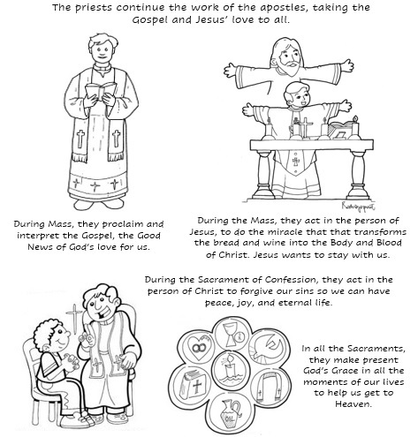

Slide 13
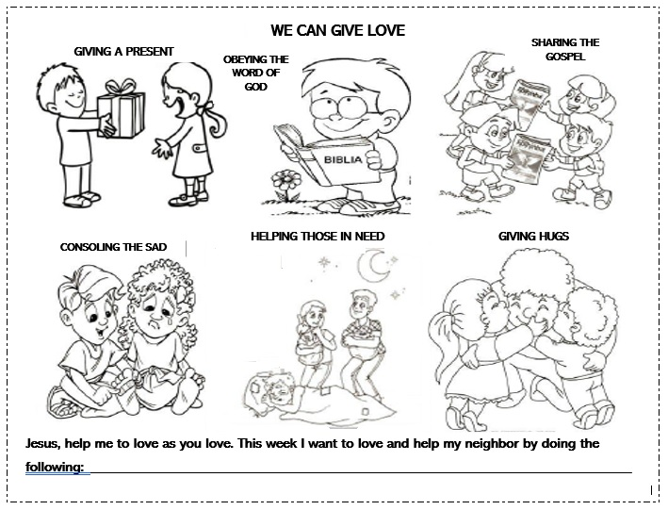
How can we help Jesus in this work? Share.

Slide 14
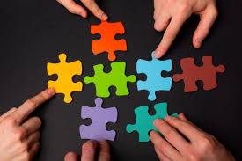
ACTIVITIES

Slide 15
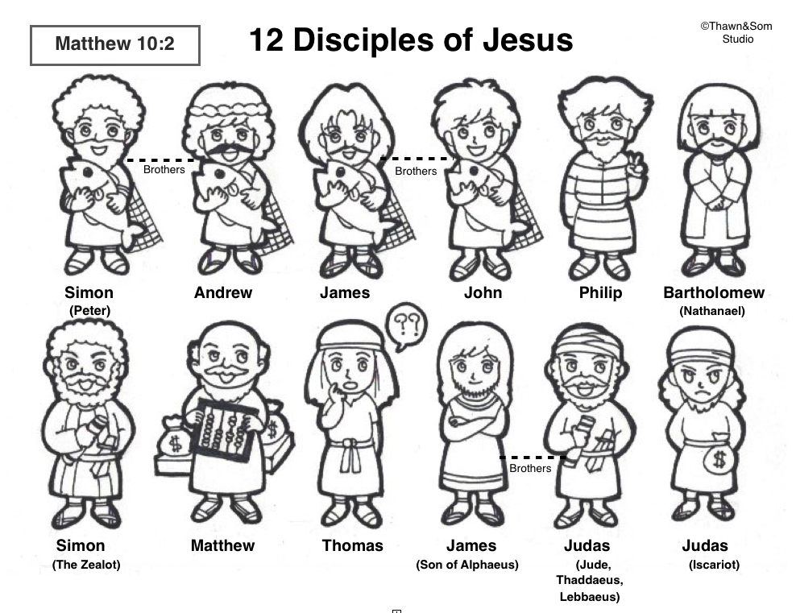
Color the 12 apostles and learn about each...
Andrew: brother of Peter, a Bethsaida fisherman and disciple of John the Baptist, and also the First-Called Apostle.
Simon: Jesus changed his name to Peter (means rock) saying “upon this rock I will build my church.” He was the first Pope. He was originally a fisherman from Bethsaida "of Galilee" and Andrew's brother.
John son of Zebedee and James’ brother, referred to as Sons of Thunder. Known as the only apostle who was not martyred, and also has his own Gospel in the New Testament.
James (the Major)-Son of Zebedee and John's brother, referred to as Sons of Thunder.

Slide 16
Philip: from Bethsaida "of Galilee".
James (the Lessor): Son of Cleopas and of Maria (Maria was at the foot of the cross with the Virgin Mary.) He is the author of the Letters of James in the New Testament.
Judas Thaddeus: brother of James. Not Jesus’ betrayer.
Bartholomew: also called Nathanael. He was very honest.
Thomas: He doubted that the others had seen the resurrected Jesus. He wanted to see for himself and touch His wounds. Jesus appeared to Him and asked him to touch His wounds. He believed.

Slide 17
Matthew: the tax collector, son of Alphaeus - Author of the Gospel of Matthew.
Simon the Canaanite: called in Luke and Acts "Simon the Zealot". The Zealot’s believed in using violence to get rid of the Romans who were oppressing the Jews.
Judas Iscariot: He betrayed Jesus by turning him over to the Pharisees for 30 silver pieces. He was replaced as an apostle in Acts by Saint Matthias

Slide 18
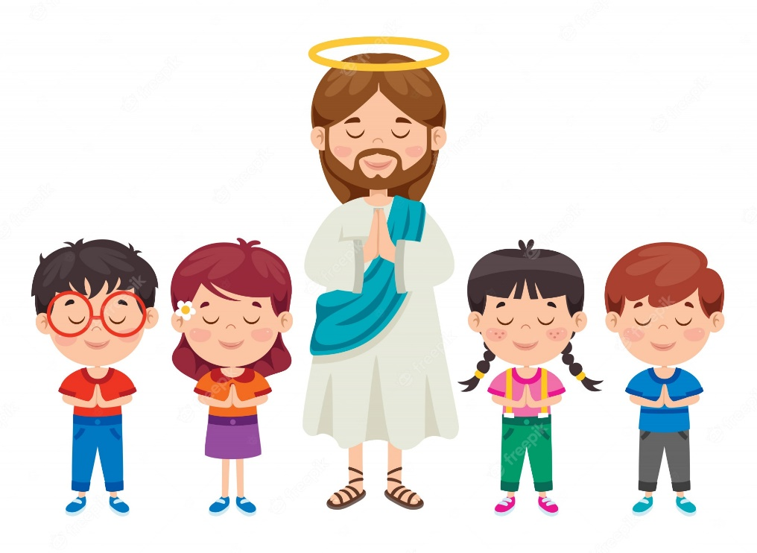
Prayer
Jesus, thank you for loving us so much that you worry when we are lost. Help me to always stay close to you and to always share your love so I may attract more souls to you. I pray for all our priests, that they may always glorify you. Amen.

Slide 19
I Have Decided to Follow Jesus, Lifetree Kids, https://youtu.be/sEL0WpeH088

