Slide 1
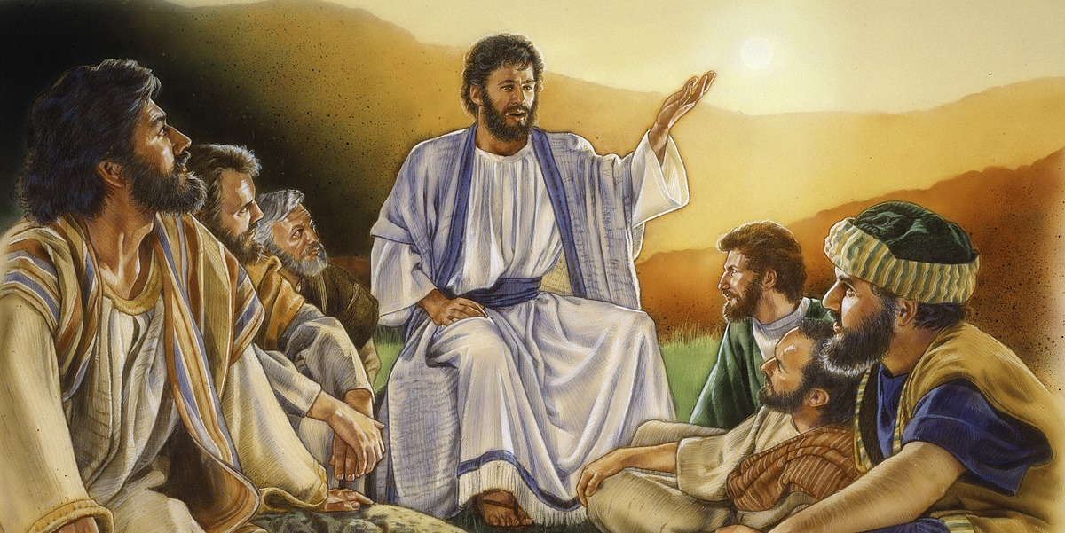
Cycle A - XII Ordinary Time-Do not be afraid. (3-7 years) Matthew 10: 26-33
MINISTRY FRIENDS OF JESUS AND MARY
WWW.FCPEACE.ORG

Slide 2
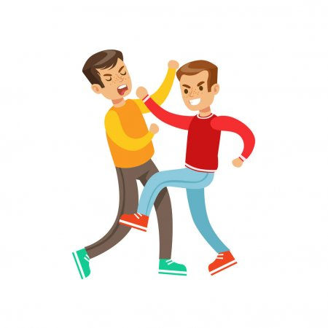
Jesus sends His apostles to share the message of God’s love and tells them… “And do not be afraid of those who kill the body but cannot kill the soul; rather, be afraid of the one who can destroy both soul and body in Gehenna. .”

Slide 3
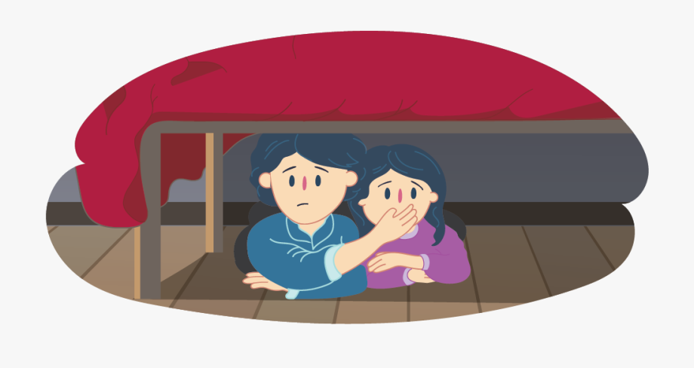
What do we do when we are afraid?

Slide 4
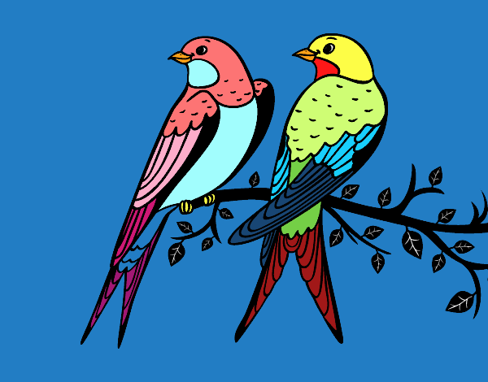
Jesus shows us that God is always in control and we must trust in Him. He gave us examples:
Are not two sparrows sold for a small coin? Yet not one of them falls to the ground without your Father’s knowledge.
Even all the hairs of your head are counted.
So do not be afraid; you are worth more than many sparrows..

Slide 5
God is…
Almighty,
All knowing,
And all loving.

Slide 6
Jesus wants us to fear those that lead us to disobey God.
Disobeying God is called
SIN.
It stains our heart and separates us from God.

Slide 7
There are Venial Sins (Small) which are less important and don’t separate us from God, but they cause Him pain.
And Capital or Mortal Sins (Big) kill the life of God in our heart.

Slide 8
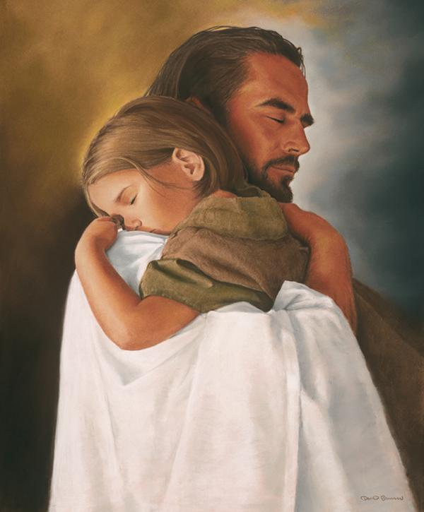
But Jesus always forgives us when we ask with a sincere heart!

Slide 9
ACTIVITY

Slide 10
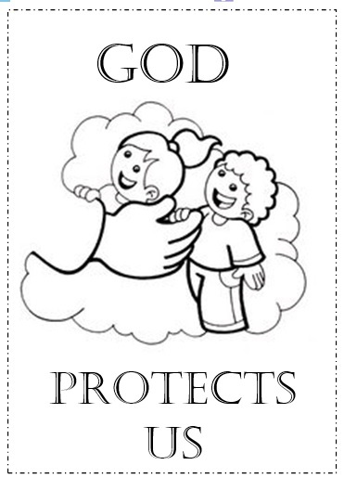
Color

Slide 11
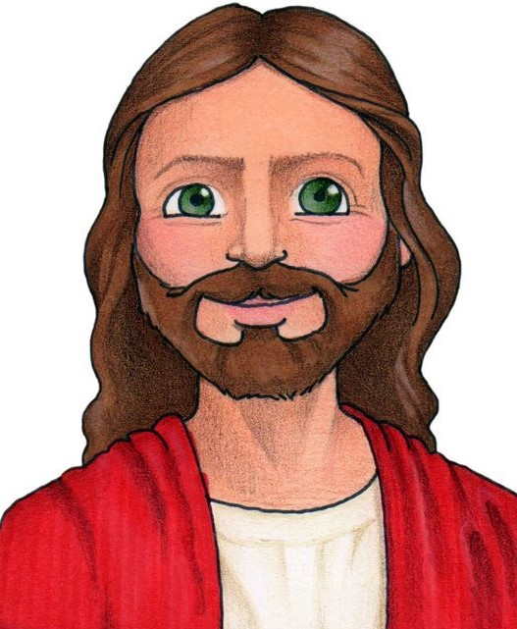
Listen to the sentences on the next page. Draw a rose if it describes a virtue, or a cactus if it describes a sin.
A Sin
A Virtue
We want to fill our hearts with virtues so Jesus will feel happy living there and so we can attract others to Him.

Slide 12
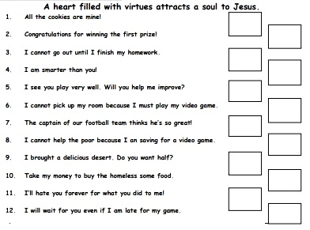

Slide 13
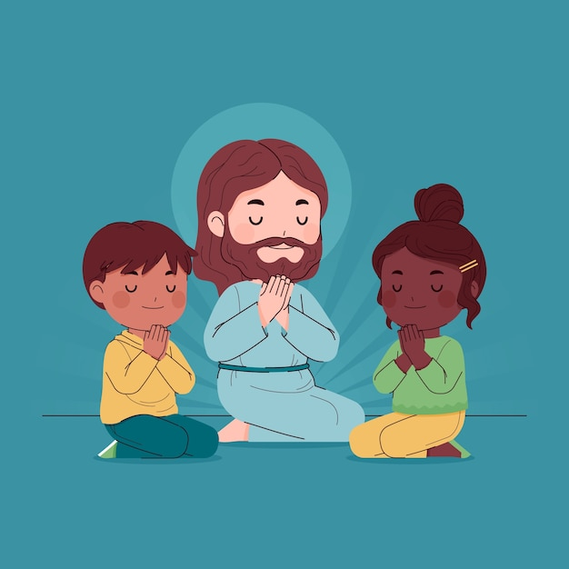
PRAYER
God, help me to avoid sin and to grow in virtue so I may take your message of love to the world and win many souls for your Kingdom.
Amen.

Slide 14
Fear Not, Ellie Holcomb, https://youtu.be/MDNlFzcqing

