Slide 1
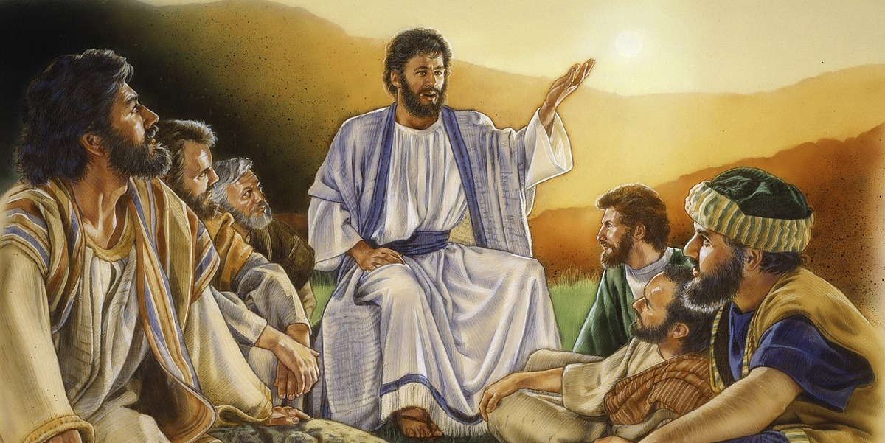
Cycle A - XII Ordinary Time-Do not be afraid. (8+ years) Matthew 10: 26-33
MINISTRY FRIENDS OF JESUS AND MARY
WWW.FCPEACE.ORG

Slide 2
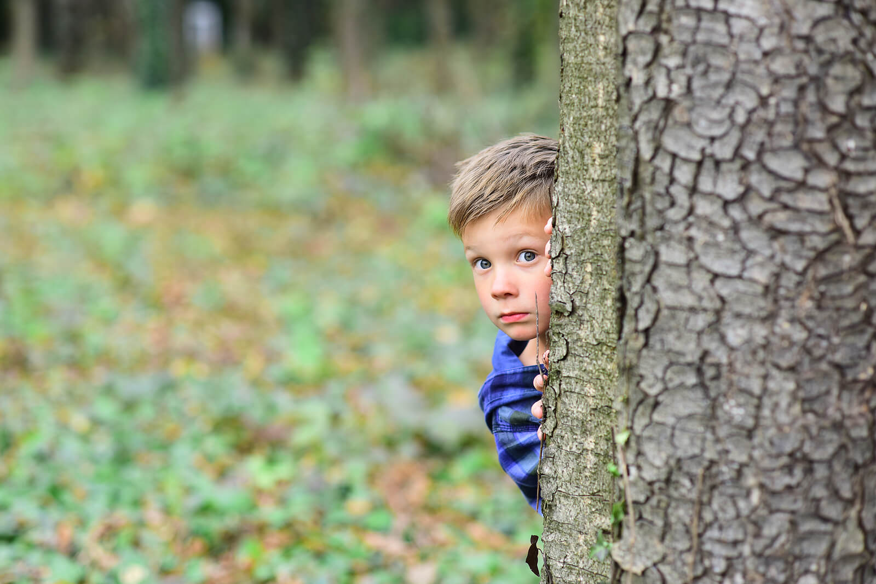
Jesus said to the Twelve: “Fear no one. Nothing is concealed that will not be revealed, nor secret that will not be known.

Slide 3
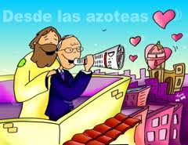
What I say to you in the darkness, speak in the light; what you hear whispered, proclaim on the housetops.

Slide 4
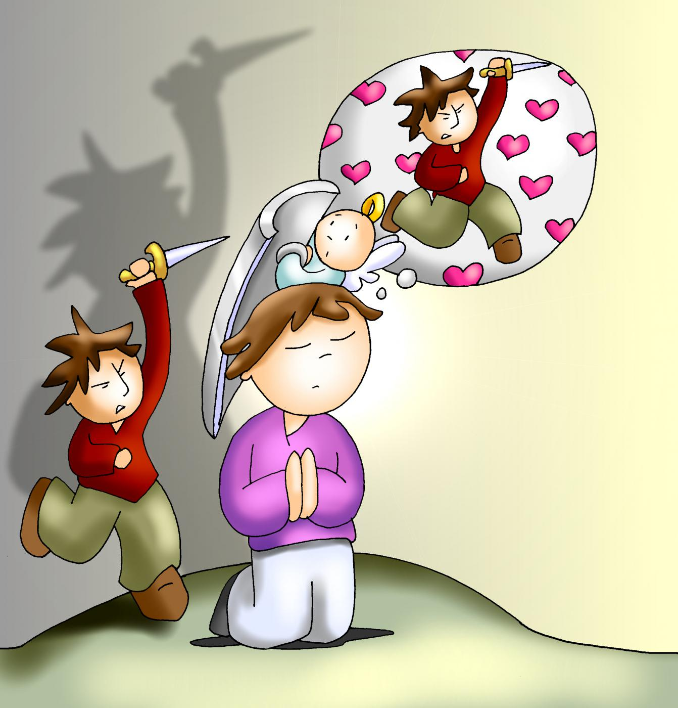
And do not be afraid of those who kill the body but cannot kill the soul;

Slide 5
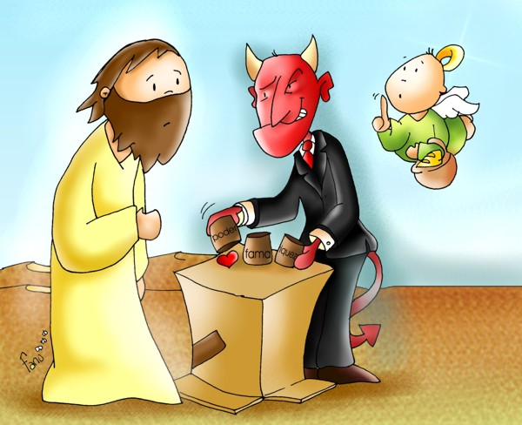
Rather, be afraid of the one who can destroy both soul and body in Gehenna.

Slide 6
Are not two sparrows sold for a small coin?
Yet not one of them falls to the ground without your Father’s knowledge.

Slide 7
Even all the hairs of your head are counted.
So do not be afraid; you are worth more than many sparrows.

Slide 8
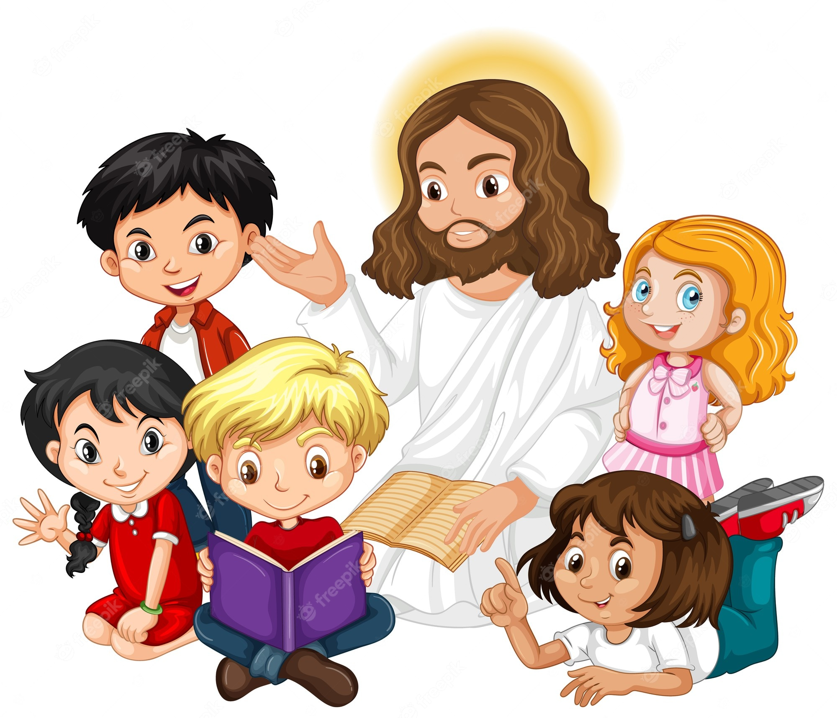
Everyone who acknowledges me before others I will acknowledge before my heavenly Father.

Slide 9
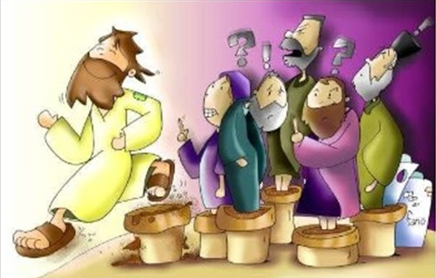
… But whoever denies me before others, I will deny before my heavenly Father.”
Praise to you Lord Jesus Christ.
The Gospel of the Lord,

Slide 10
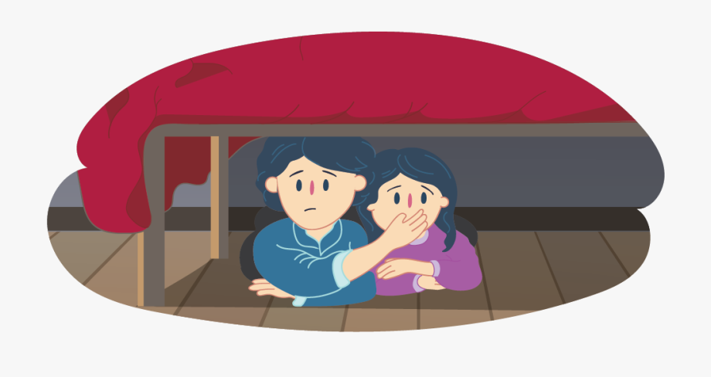
What do you do when you are afraid of something?

Slide 11
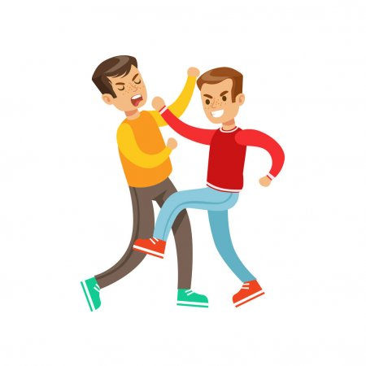
Jesus sends His apostles to share the message of God’s love and tells them… “And do not be afraid of those who kill the body but cannot kill the soul; rather, be afraid of the one who can destroy both soul and body in Gehenna. .”

Slide 12
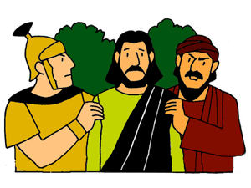
Jesus tells them, “Do not be afraid of those who kill the body but cannot kill the soul.” Who wanted to kill their bodies?
The enemies of Jesus were still looking for His followers to kill them.

Slide 13
Jesus says, “Be afraid of the one who can destroy both soul and body in Gehenna (Hell).” Who is that?
We must fear those that want to separate us from God so we will not love, pray, and obey Him. That person does not follow God but God’s Enemy and they lead us to sin.

Slide 14
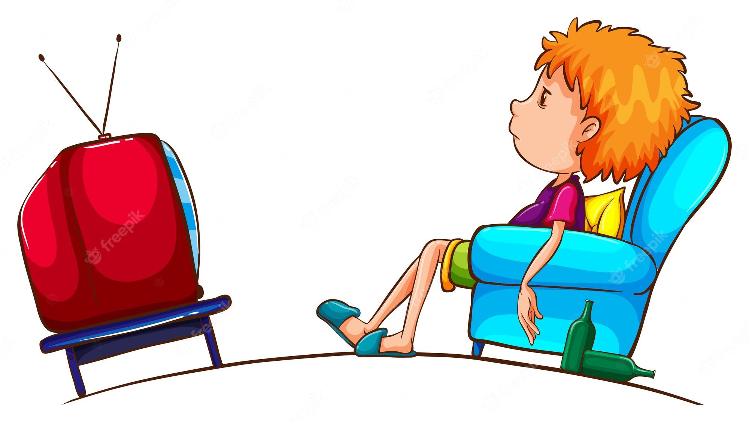
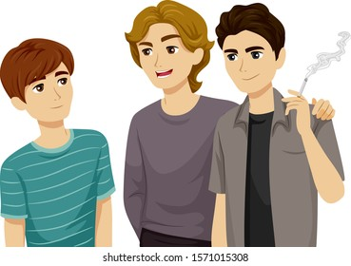
Are there people or situations that try to lead you away from God?
Or too much time playing video games or watching TV leaving little time for prayer,
Friends that influence us to disobey our parents or the 10 Commandments,
Other sins….

Slide 15
Jesus explains that God is always in control and we should not be afraid if we are following Him. What examples does He use?
Not one of them falls to the ground without your Father’s knowledge.
All the hairs on your head are counted.
So do not be afraid; you are worth more than many sparrows.

Slide 16
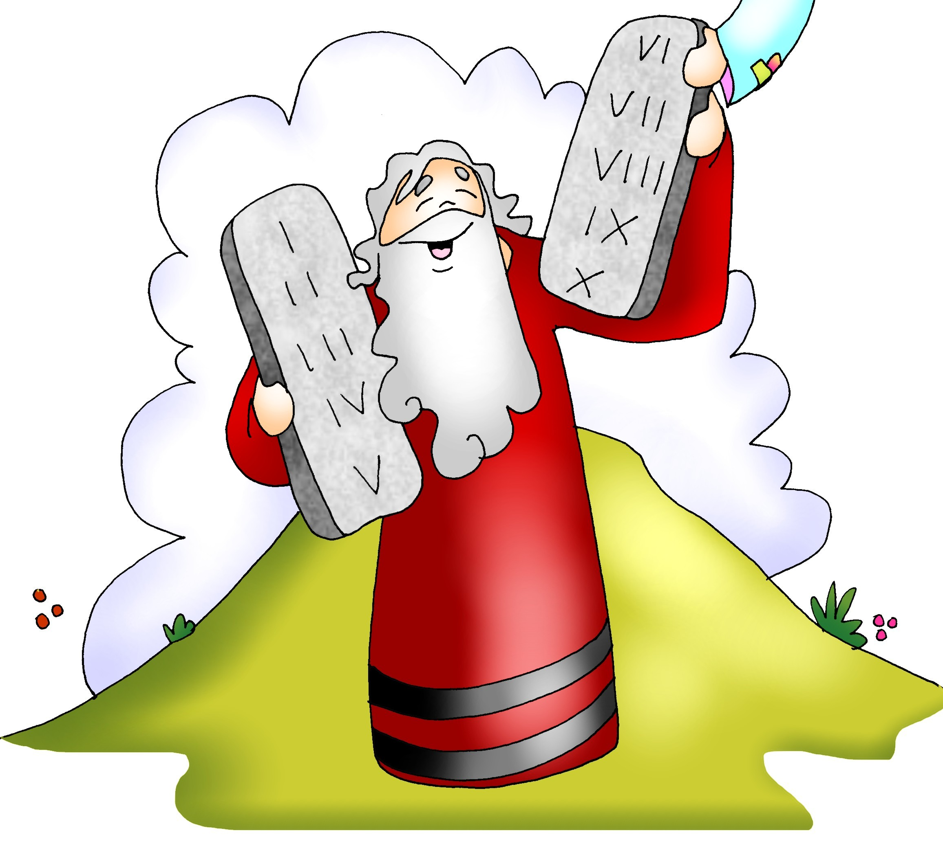
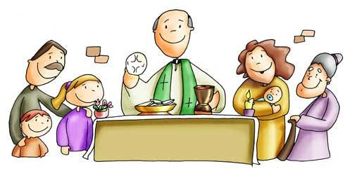
Jesus wants us to trust in God because He wants us to be His witnesses in all the world with our words, works, and behavior to save souls. How can we attract souls to Jesus?
Avoid sin,
Pray often,
Help others,
Share,
Love,
Obey,
Go to Mass,
Grow in virtue…

Slide 17
Jesus said, “Be afraid of the one who can destroy both soul and body in Gehenna.”
What destroys our soul?
Sin
¿What is sin?
It’s disobeying God and thus separating ourselves from Him.

Slide 18
There are Venial Sins (Small) which are less important and don’t separate us from God, but they cause Him pain.
And Capital or Mortal Sins (Big) kill the life of God in our heart.

Slide 19
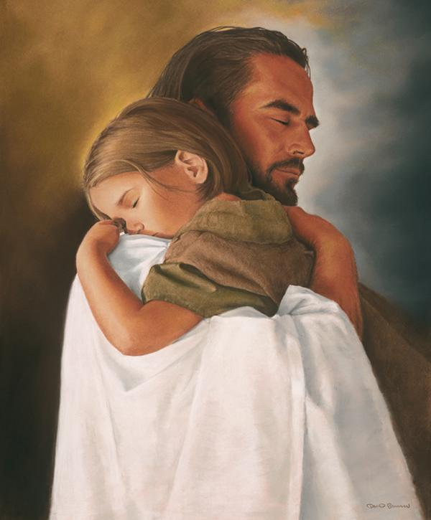
But Jesus always forgives us when we ask with a sincere heart!

Slide 20
What are the
7 Capital sins and the virtues to combat them?

Slide 21
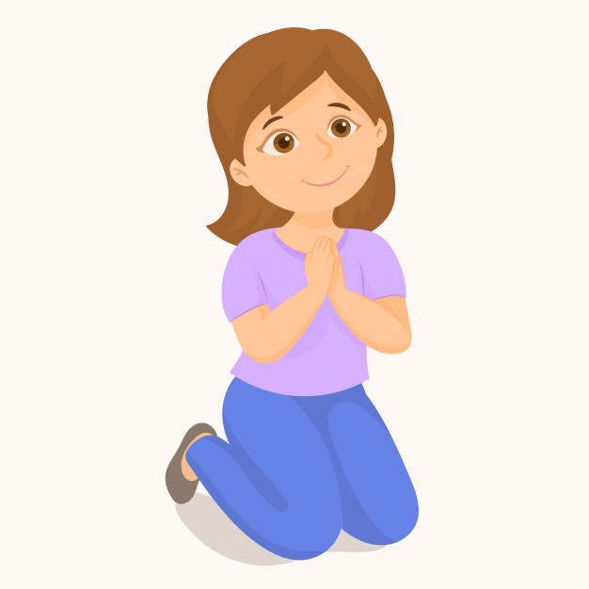
Sin: Pride
Virtue: Humility
Pride is the desire to be greater than another person with more honor and glory.

Slide 22
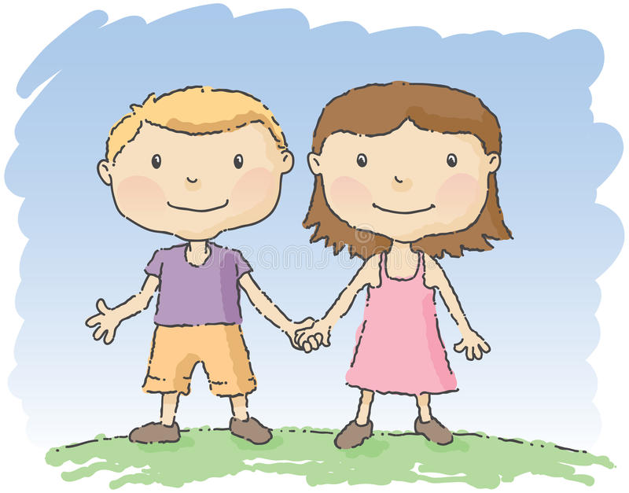
Sin: Lust
Virtue: Chastity
Lust is the vice of having excessive sexual desire.

Slide 23
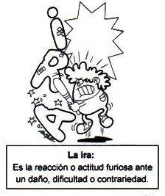
Sin: Anger
Virtue: Patience
Anger is the reaction or attitude of fury before an offence, or a difficulty.

Slide 24
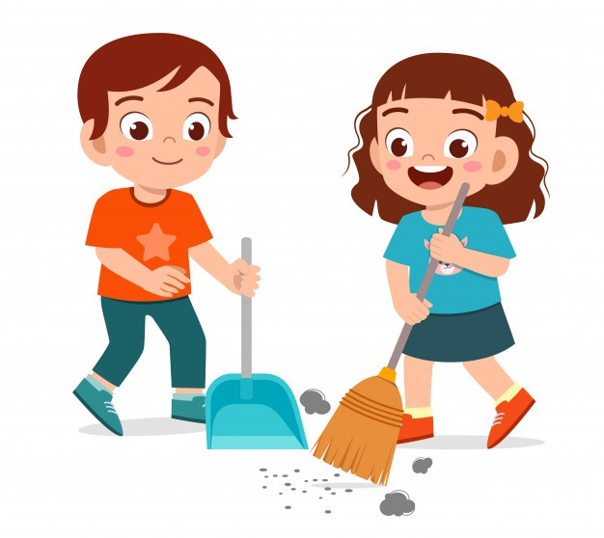
Sin: Laziness
Virtue: Diligence
Laziness is the lack of effort in obligations or in spiritual matters.

Slide 25
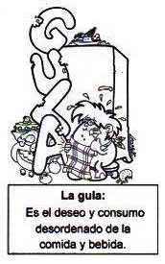
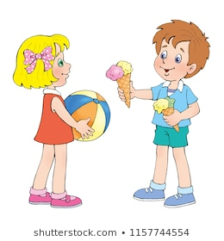
Sin: Gluttony
Virtue: Moderation
Gluttony is the excessive desire and consumption of food and drink.

Slide 26
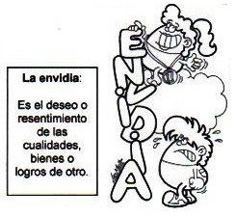
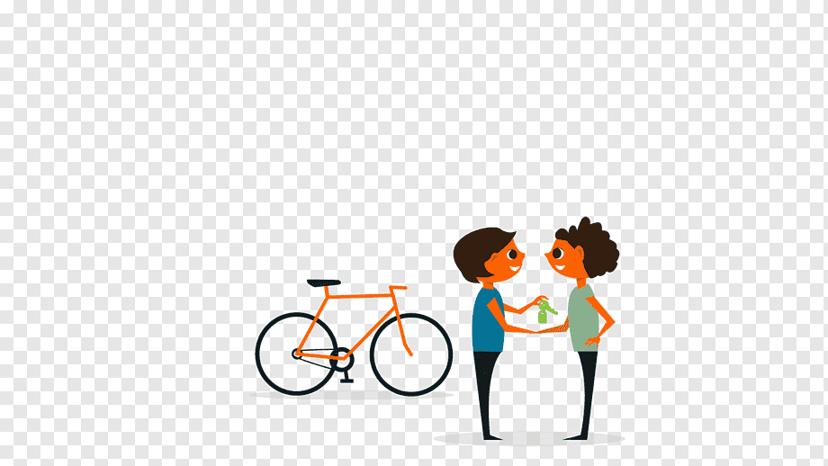
Sin: Envy
Virtue: Charity
Envy is the desire or resentment of the qualities or goods of others.

Slide 27
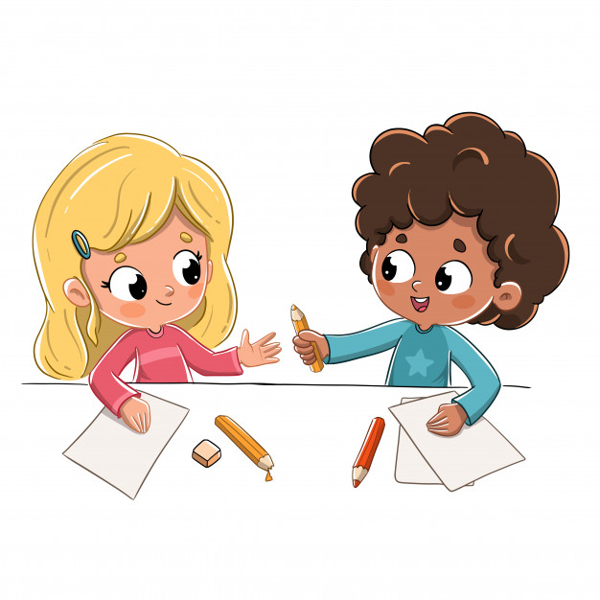
Sin: Avarice
Virtue:
Generosity
Avarice is the desire to hoard goods.

Slide 28
ACTIVITY

Slide 29
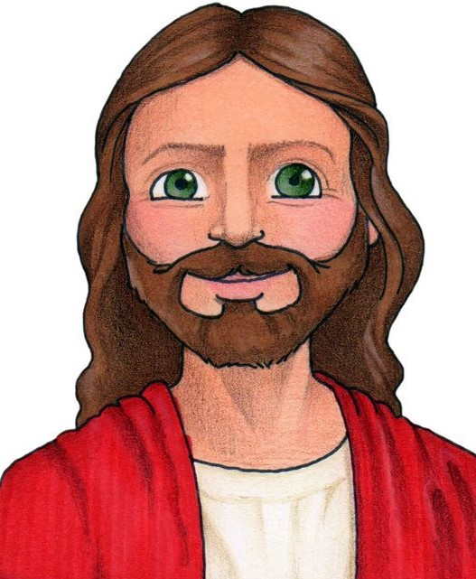
Listen to the sentences on the next page. Draw a rose if it describes a virtue, or a cactus if it describes a sin.
A Sin
A Virtue
We want to fill our hearts with virtues so Jesus will feel happy living there and so we can attract others to Him.

Slide 30
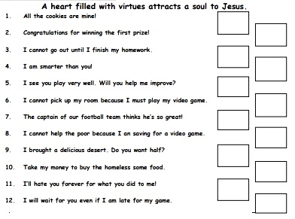

Slide 31
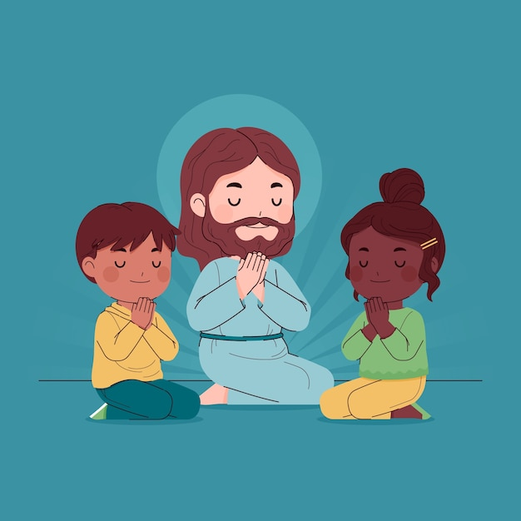
PRAYER
God, help me to avoid sin and to grow in virtue so I may take your message of love to the world and win many souls for your Kingdom.
Amen.

Slide 32
Fear Not, Ellie Holcomb, https://youtu.be/MDNlFzcqing

