Slide 1
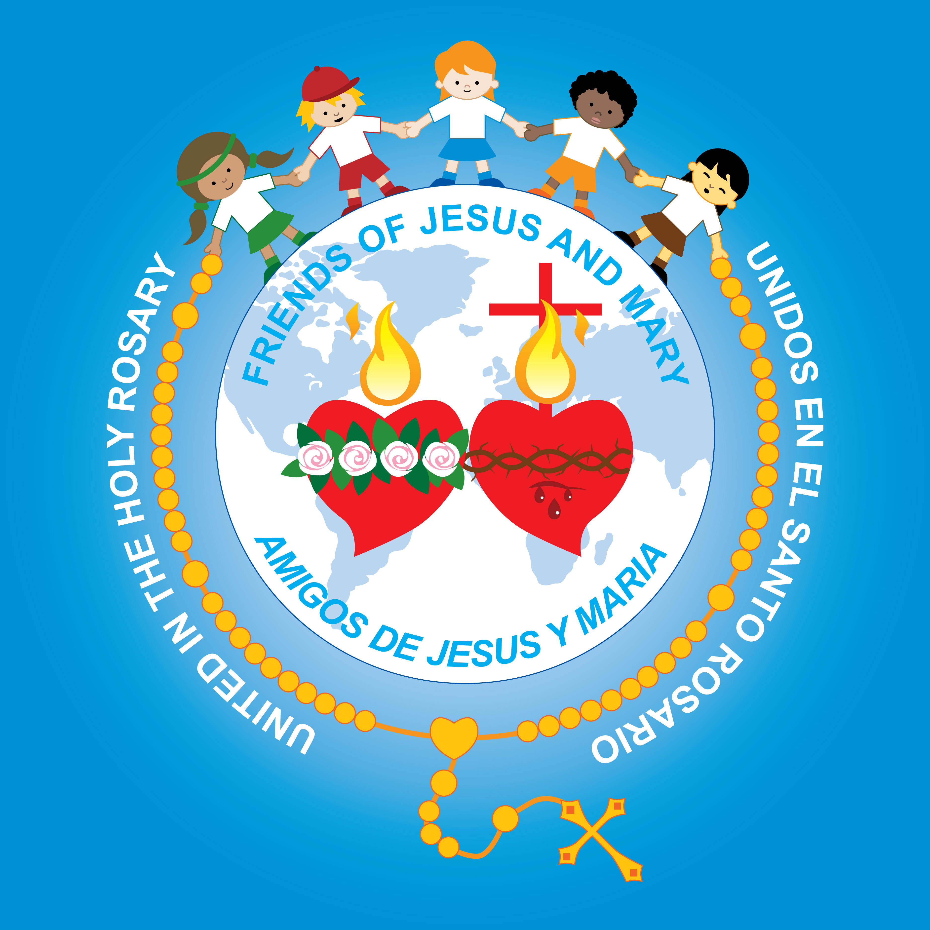
Ministry Friends of Jesus and Mary
Weekly prayer group (6-9 years)
A-XIII ordinary - Whomever loses his life for me, saves it
Mathew 10, 26-33
www.fcpeace.org

Slide 2
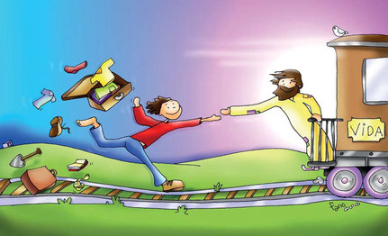
Whomever loses his life for me, save it. Matthew 10, 26-33
Jesus said to his apostles: “Whoever loves father or mother more than me is not worthy of me, and whoever loves son or daughter more than me is not worthy of me; and whoever does not take up his cross and follow after me is not worthy of me. Whoever finds his life will lose it, and whoever loses his life for my sake will find it. "Whoever receives you receives me, and whoever receives me receives the one who sent me. Whoever receives a prophet because he is a prophet will receive a prophet’s reward, and whoever receives a righteous man because he is a righteous man will receive a righteous man’s reward. And whoever gives only a cup of cold water to one of these little ones to drink because the little one is a disciple—amen, I say to you, he will surely not lose his reward.”

Slide 3
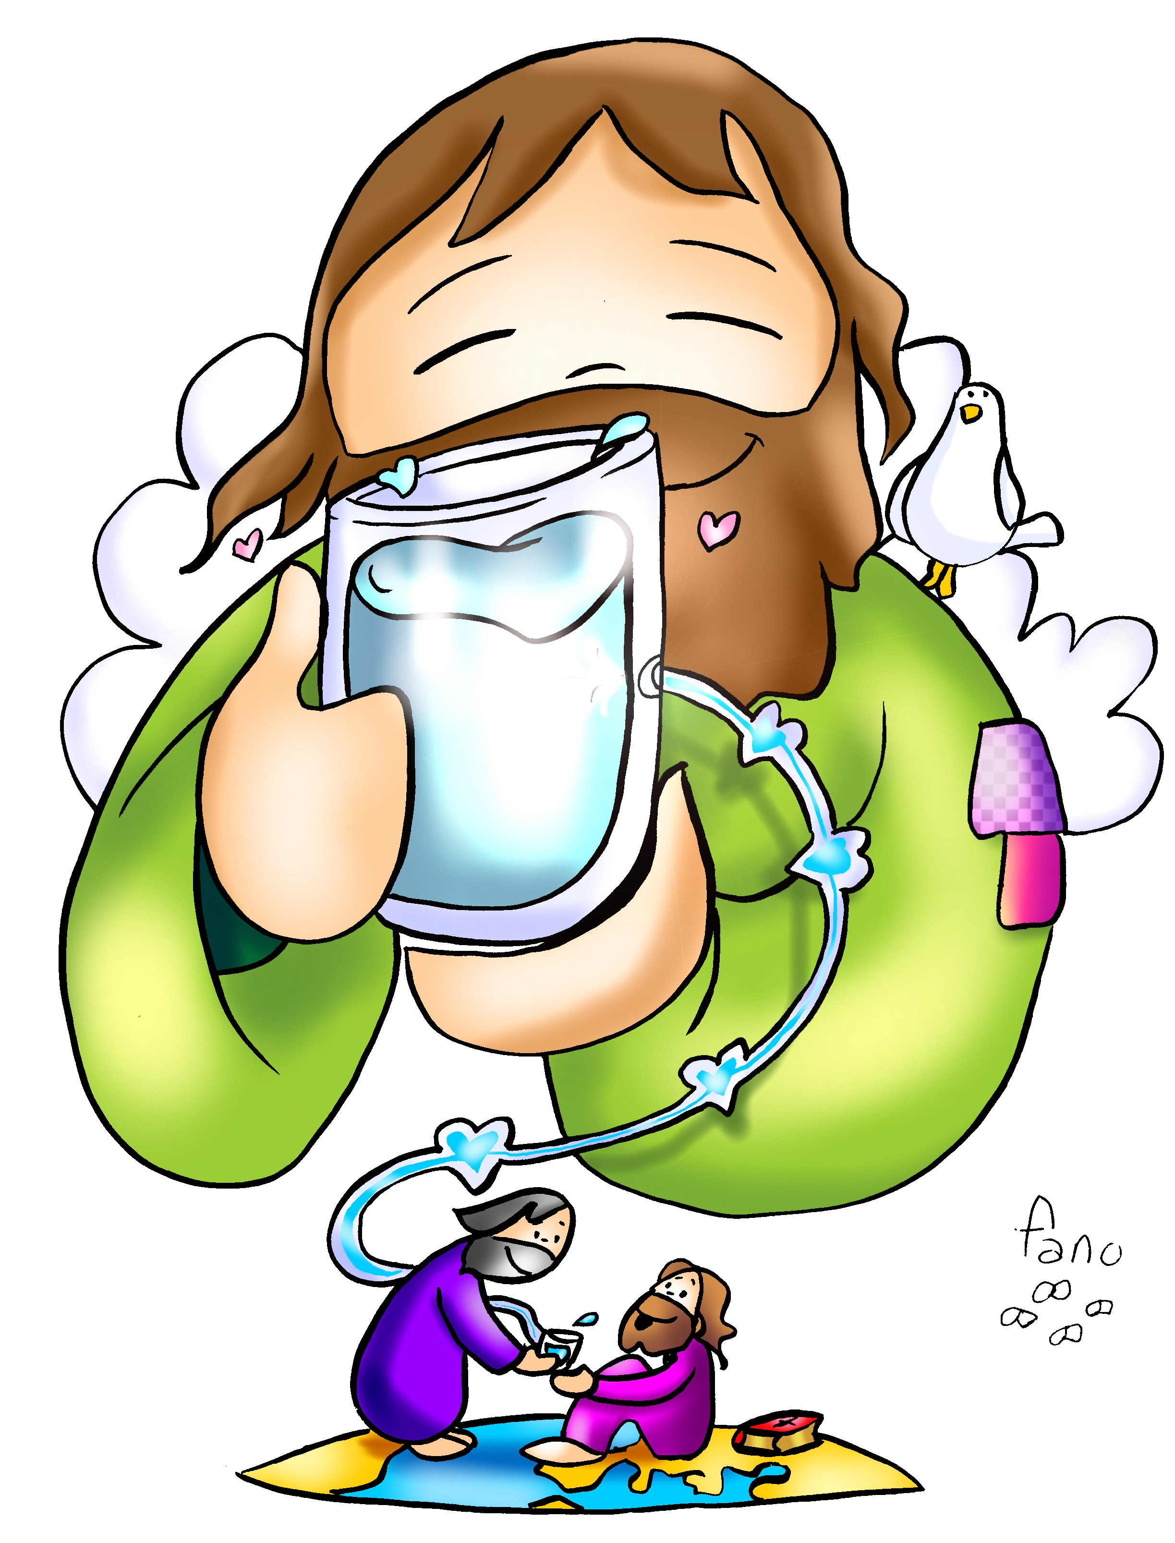
What does it mean to be worthy of Jesus?
It has to do with LOVE.
It means loving Him so much that our whole life is for Him.
Jesus asks that we put God before other people and before other things.

Slide 4
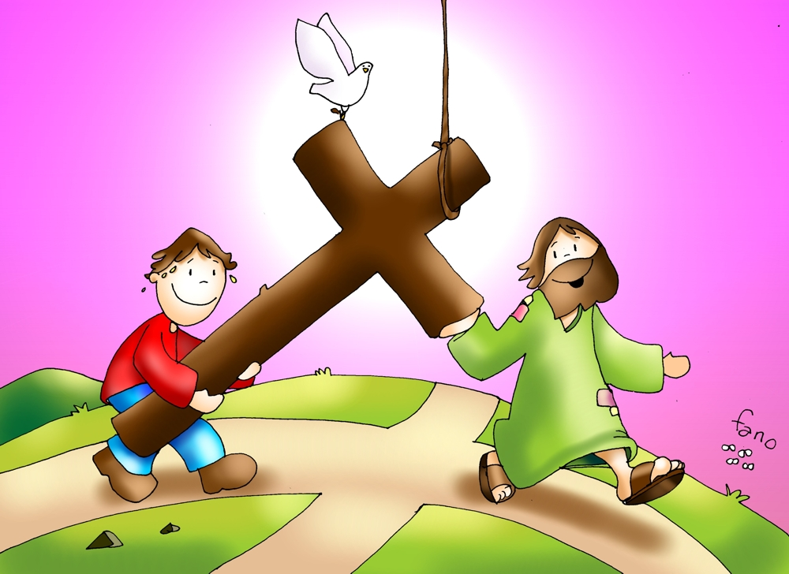
It has to do with loving as Jesus loved.
And loves God above all.
A love that surrenders,

Slide 5
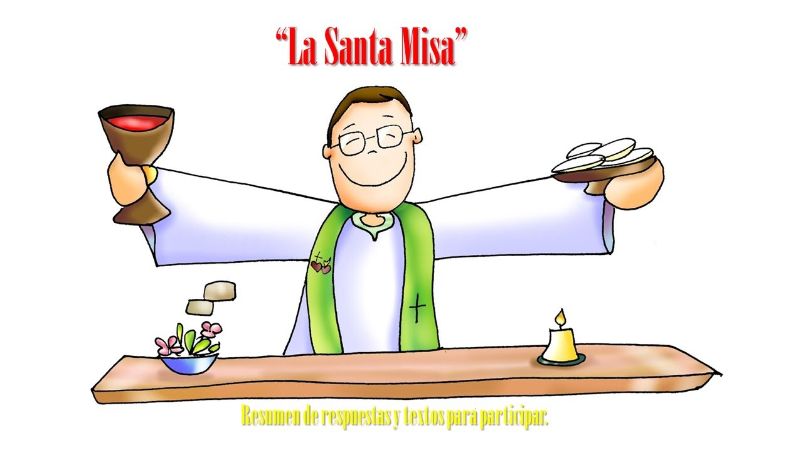


God wants us to show Him our love…
OUR
FATHER
In prayer,
In Sunday Mass,
And obeying His commandments.

Slide 6
If someone or something tries to stop us from doing this, we must say…
NO

Slide 7
Jesus says that whoever loses his life for my sake will find it.
What does this mean??

Slide 8
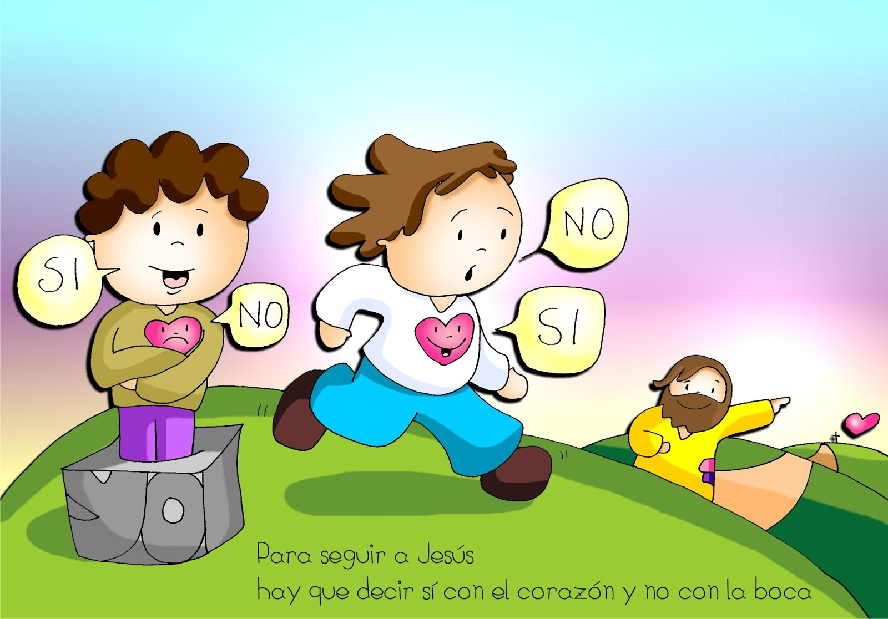
Sometimes the world tells us that we should do whatever we want to be happy, even if it is against God’s Commandments. But Jesus says if we follow God’s Commandments with love, we will be happy on earth and in Heaven.
YES
YES
We must say yes with our heart and not with our mouth.

Slide 9
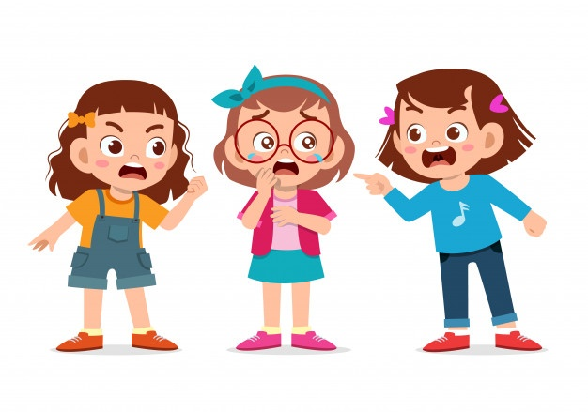
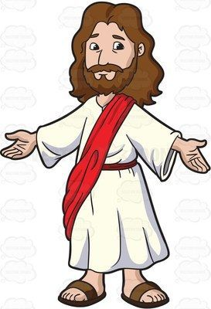
Sometimes friends want to separate us from Jesus...

Slide 10
But we must say…
NO

Slide 11
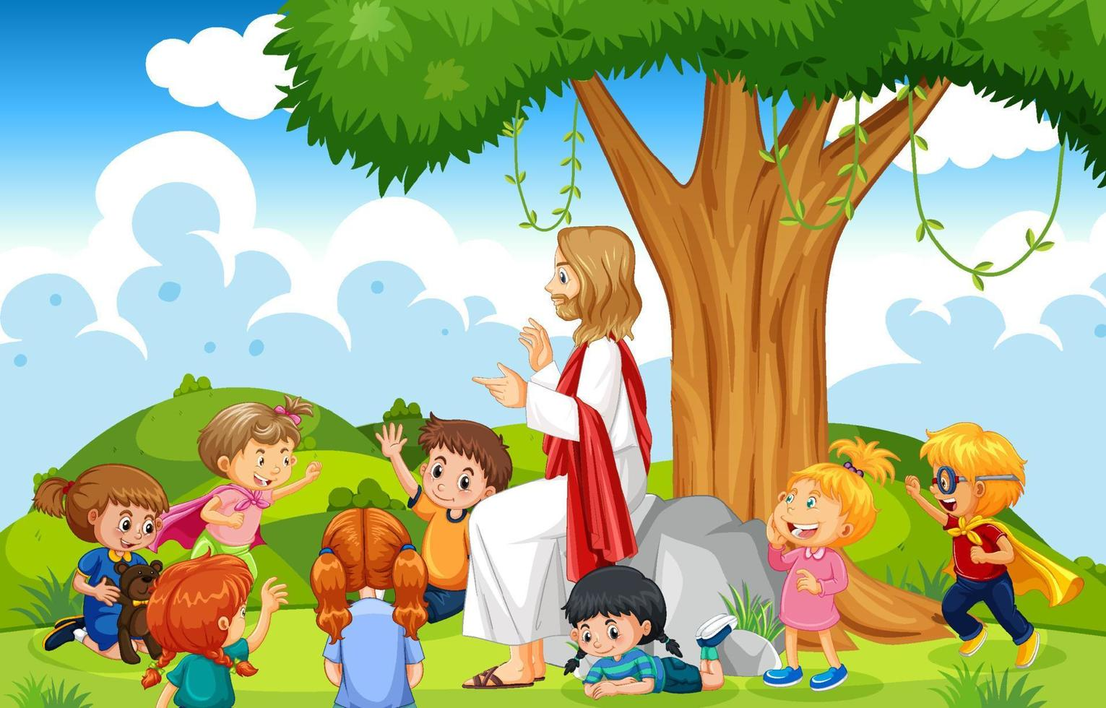
…Jesus promises us love, peace, happiness, and eternal life.

Slide 12

Activity

Slide 13
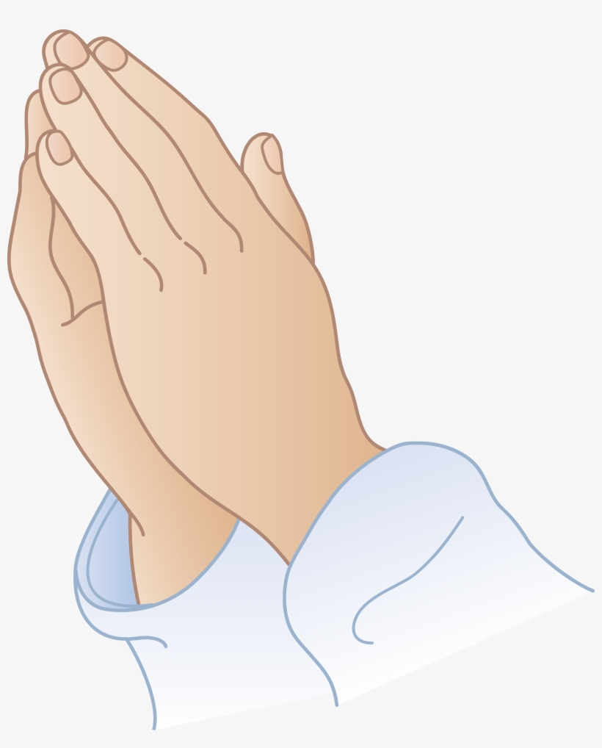
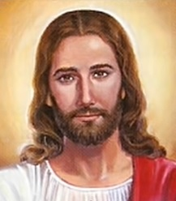


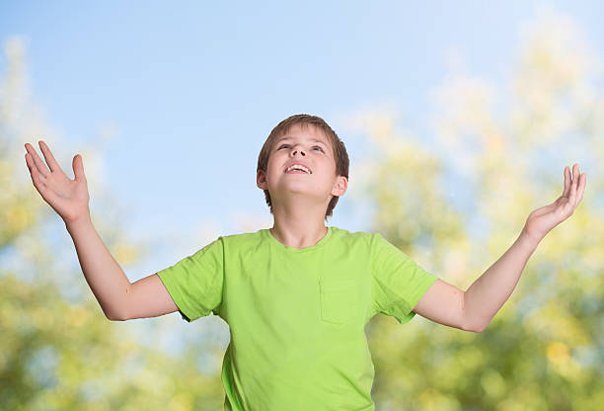
Gifts to God
Gifts from God
Prayer
His presence
Peace
Loving Him
Loving others
Eternal Life

Slide 14
PRAYER
Jesus, my God,
Help me to always place you first in my life.
Help me to be generous with my time, talents, and treasures. Thank you for all the blessings you give me every day. No one is more generous than you.
I love you very much.
Amen.
A Gift to You, KWSCM, https://youtu.be/n3iG1gkW9R0

Slide 15


