Slide 1
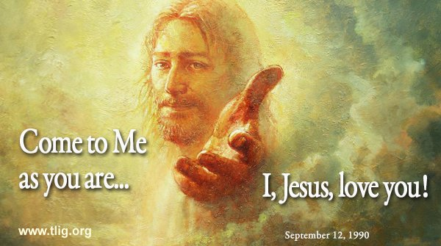
MINISTRY FRIENDS OF JESUS AND MARY
Prayer Group for Children
Cycle A - XIV Sunday in Ordinary Time
Come to me…I will give you rest. Matthew 11, 25-30
www.fcpeace.org

Slide 2
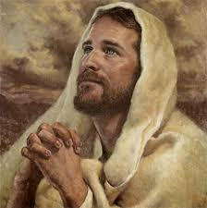
At that time Jesus exclaimed: "I give praise to you, Father, Lord of heaven and earth…

Slide 3
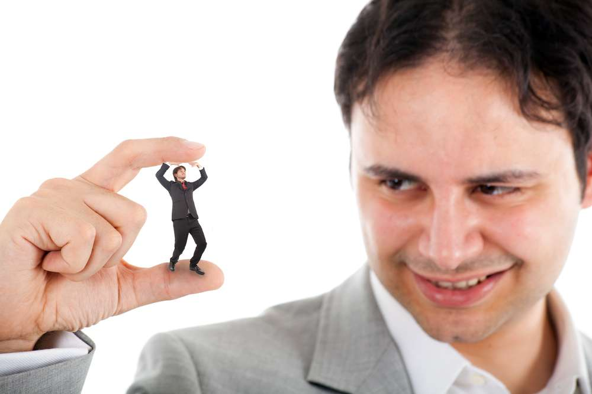
…for although you have hidden these things from the wise and the learned, you have revealed them to little ones.
Yes, Father, such has been your gracious will.

Slide 4
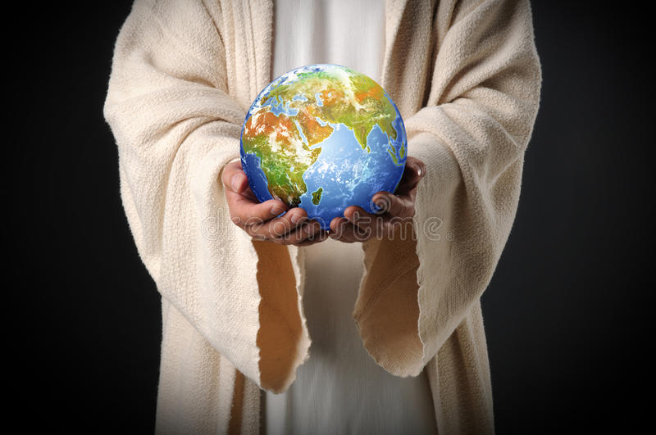
All things have been handed over to me by my Father. No one knows the Son except the Father, and no one knows the Father except the Son and anyone to whom the Son wishes to reveal him."

Slide 5
Come to me, all you who labor and are burdened, and I will give you rest.

Slide 6
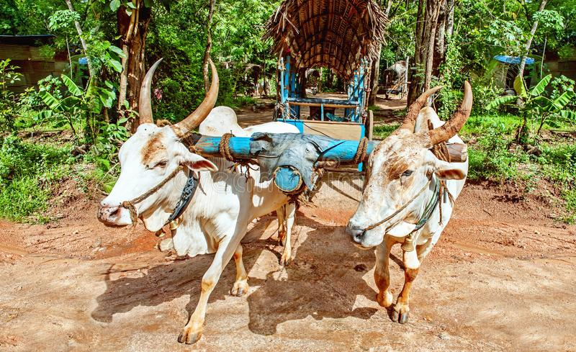
Take my yoke upon you…

Slide 7
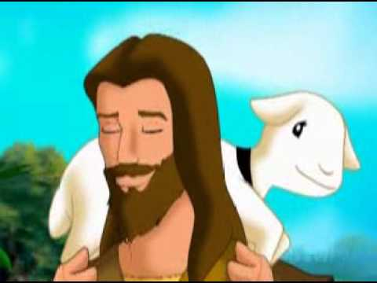
…and learn from me, for I am meek and humble of heart …
Praise to you Lord Jesus Christ.
The Gospel of the Lord,
…and you will find rest for yourselves;
for my yoke is easy, and my burden light.”

Slide 8
REFLECTION

Slide 9
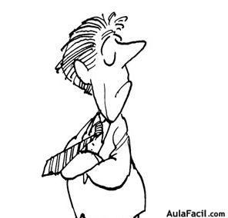
Jesus starts by praising God for revealing His truths to the little ones. Why does God reveal his truths to the little ones?
They know that they need God and they accept His truths.
The wise and learned feel that they know everything and do not need God.

Slide 10
Jesus says that God has handed him all things and He invites certain people to come to Him. Who does He invite?
He invites all who labor and are burdened.

Slide 11
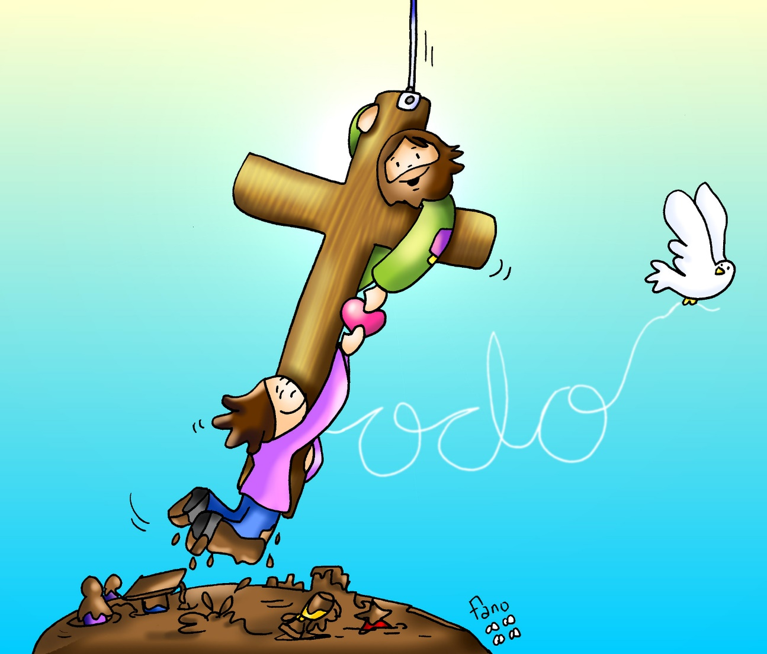
What does Jesus promise them?
He promises to give them rest.
No, Jesus promises to make the burden easier. Maybe it’s helping us to trust Him more or to get stronger.
Does Jesus take the difficulty away?

Slide 12
What does Jesus mean, “Take my yoke upon you.”
A yoke is placed on animals when they are pulling a heavy load so they move in the same direction.
Jesus gives us His commandments, the Church and the Sacraments, and the example of His life so we may imitate Him and be united in Him.
.

Slide 13
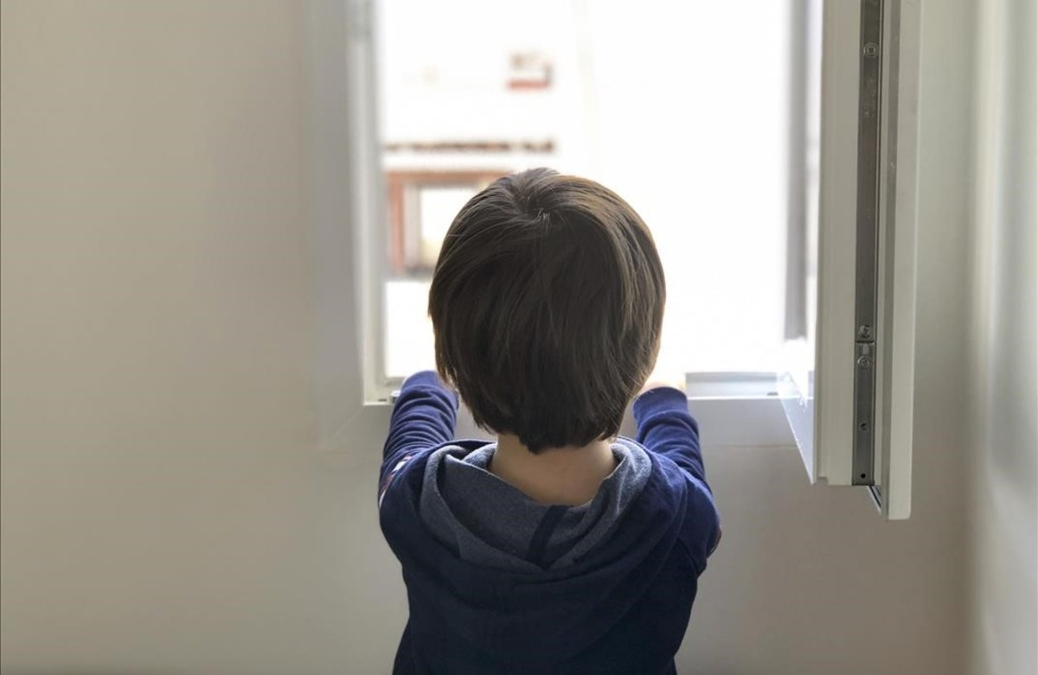
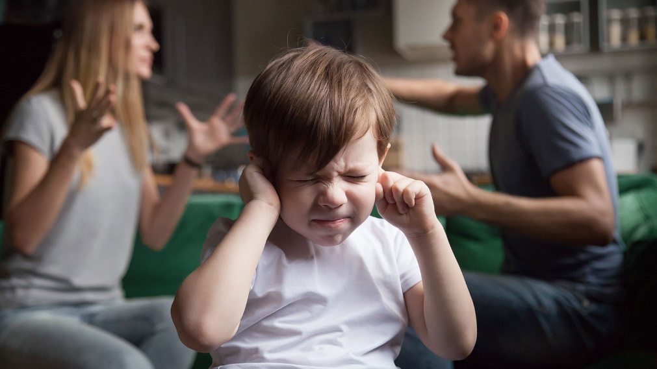
What burdens do we have that Jesus can help us carry?

Slide 14
ACTIVITY

Slide 15
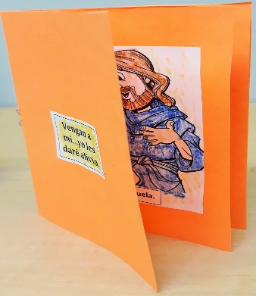
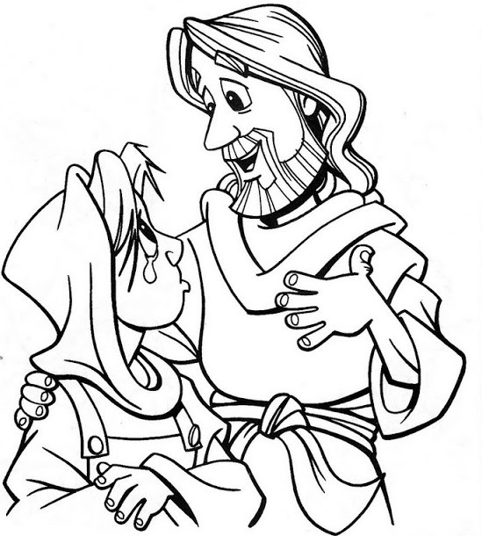
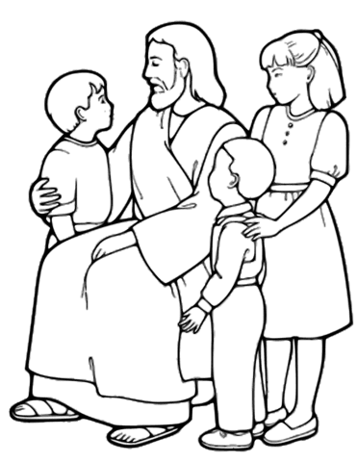
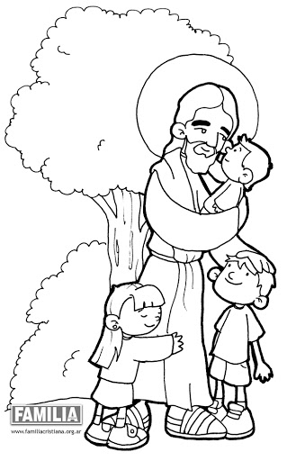
How does Jesus help us?
Jesus consoles us.
Jesus gives us advice.
Jesus loves & forgives us.

Slide 16
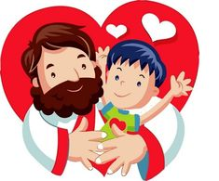
PRAYER Jesus, please make me little so I may always seek you. I need you to console me when I’m sad. I you’re your advice in all that I do. I need your love and forgiveness to be happy. Amen.

Slide 17
Twists and Turns, Christian Gravity, https://youtu.be/UBDB4aEQX4I

