Slide 1
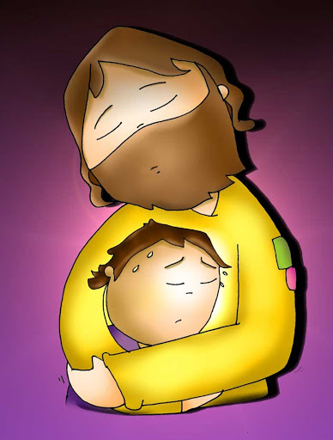
Ministry Friends of Jesus and Mary Cycle A – XIV Sunday in Ordinary Time www.fcpeace.org
“Come to me, all you who labor and are burdened,
and I will
give you rest.” Matthew 11, 25-30.

Slide 2
Gospel of Matthew 11, 25-30
At that time Jesus exclaimed:
I give praise to you, Father, Lord of heaven and earth
for although you have hidden these things from the wise and the learned,
you have revealed them to little ones.

Slide 3
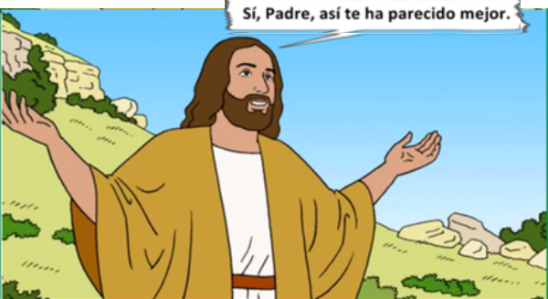
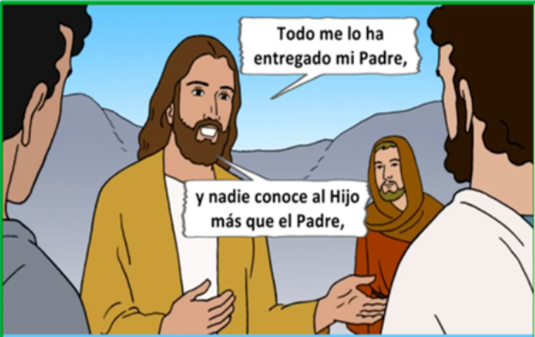
Gospel of Matthew 11, 25-30
Yes, Father, such has been your gracious will.
All things have been handed over to me by my Father.
No one knows the Son except the Father

Slide 4
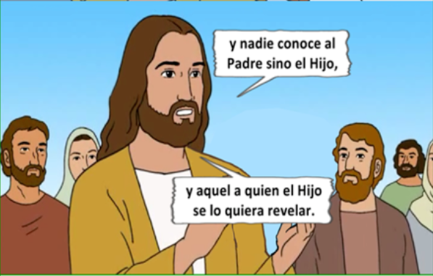
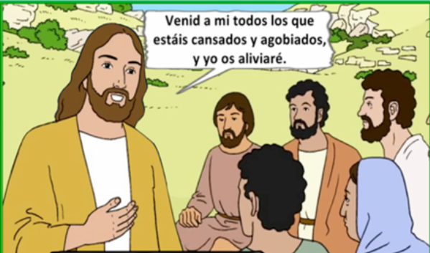
…and no one knows the Father except the Son.
and anyone to whom the Son wishes to reveal him.
Come to me, all you who labor and are burdened, and I will give you rest.

Slide 5
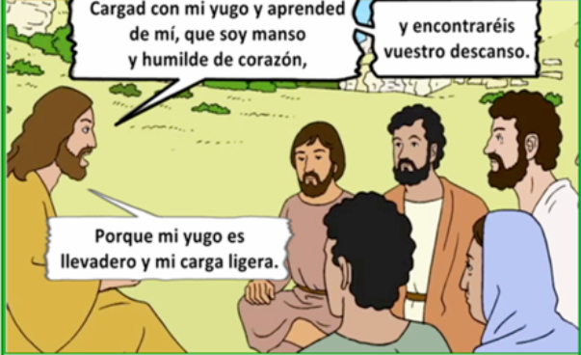
Gospel of Matthew 11, 25-30
Take my yoke upon you and learn from me, for I am meek and humble of heart;
and you will find rest for yourselves.
For my yoke is easy, and my burden light."
THE GOSPEL OF THE LORD,
PRAISE TO YOU LORD JESUS CHRIST

Slide 6
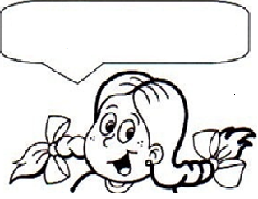
REFLECTION
¿Qué nos quiere decir Jesús en este Evangelio?
What does Jesus want to tell us in this Gospel?

Slide 7
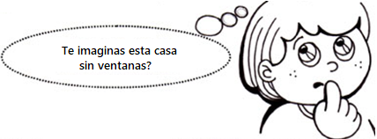
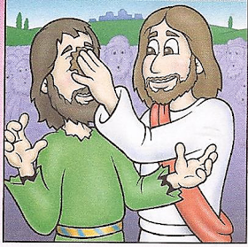
Can you imagine this house without windows?
God does not reveal himself to someone who is like a house without windows; in other words, they don’t want to hear His truths.
Jesus had done many miracles!
He had preached in many towns!
And yet their ears were still closed and their hearts were hard.

Slide 8
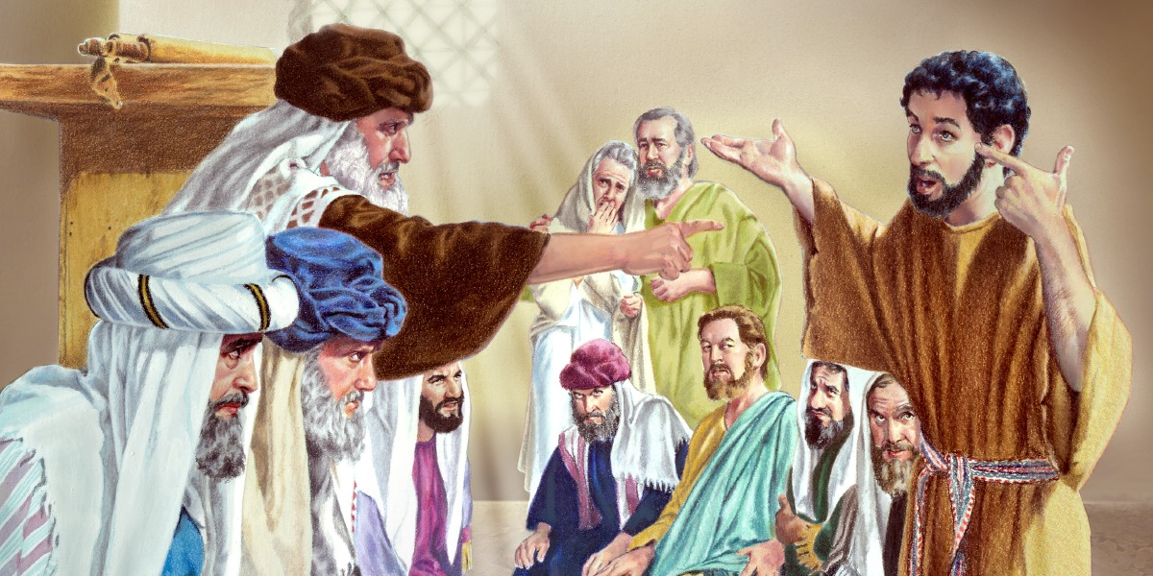
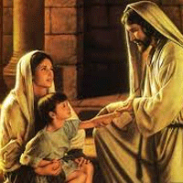
Many wise men and experts in the Word of God, could not understand Jesus’ message and they persecuted those whom Jesus healed. We see in this picture how Jesus heals a blind man and the Pharisees kick him out of the Temple.
To understand what Jesus wants to tell us, we must have an open heart, and be meek and humble towards His Word. One does not have to be a scholar to understand Jesus’ message of Love. That is why He always chose the simple; because to enter the Kingdom of God, one must be like a small child: open and trusting of Jesus’ teachings.

Slide 9
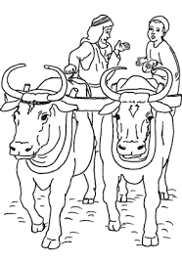
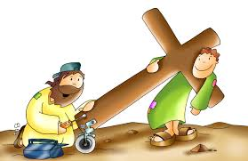
What is a yoke?
It is an instrument that goes on the neck’s of animals to direct them as they plow the land.
Life may have difficulties like studying or making friends; financial problems in the family; a loved one is sick or far away; a mean person in school…. But if we are close to Jesus, our difficulties are easier!!

Slide 10
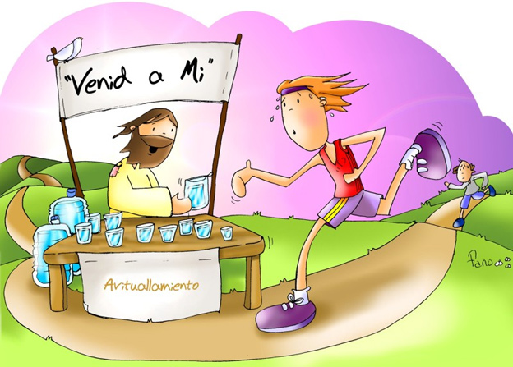
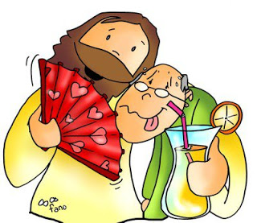
COME TO ME
Jesus invites us to get close to him when we are tired and burdened or when we are sad or worried because He will console us and give us rest.

Slide 11
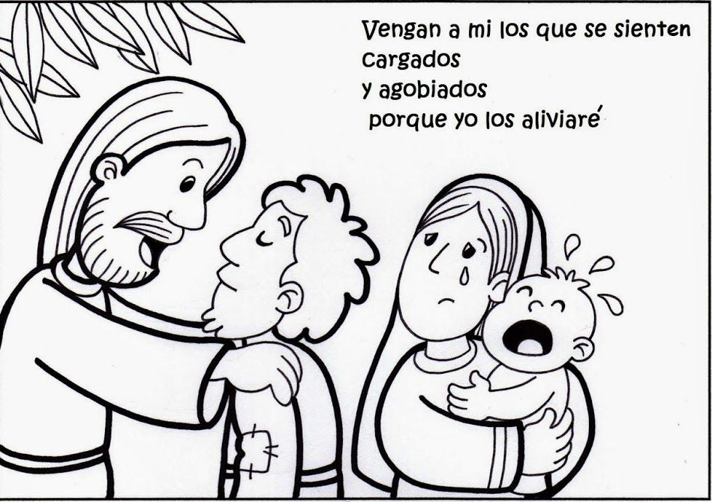
ACTIVITY
Come to me, all you who labor and are burdened, and I will give you rest.”

Slide 12
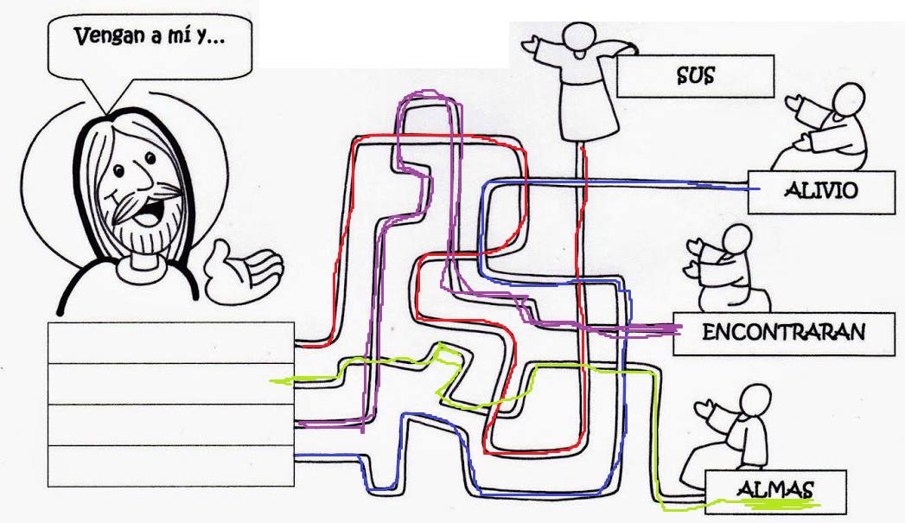
Follow the paths to Jesus and fill in the boxes with the words next to the person where you started to see Jesus’ message.
COME TO ME
YOUR
REST
YOUR
WILL FIND
SUS
ALMAS
SOULS
WILL FIND
ENCONTRARAN
REST
ALIVIO
SOULS

Slide 13
PRAYER

Slide 14
I give praise to you, Father, Lord of heaven and earth, for although you have hidden these things from the wise and the learned you have revealed them to little ones.

Slide 15
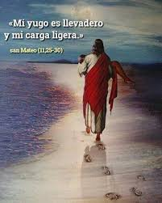
THANK YOU JESUS FOR LOVING ME SO MUCH!!!
THANK YOU JESUS because as a child, I have a special place in your heart.
THANK YOU JESUS because you always take care of me.
THANK YOU JESUS because I can rest in you.
THANK YOU JESUS because you show me how to be meek and humble of heart.
THANK YOU JESUS because you remind me every day that I am not alone.
THANK YOU JESUS because you always love me and accompany me.
“For my yoke is easy, and my burden light."

Slide 16
Twists and Turns, Christian Gravity, https://youtu.be/UBDB4aEQX4I (10+ años)

