Slide 1
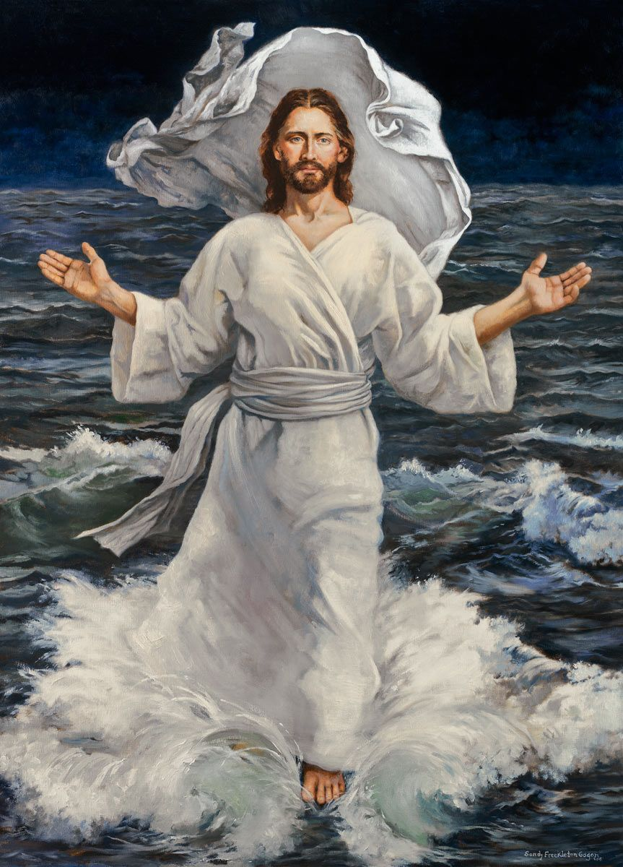
Ministry Friends of Jesus and Mary
Cycle A – XIX Sunday in Ordinary Time
Jesus Walks on Water, Matthew 14, 22-33
www.fcpeace.org

Slide 2
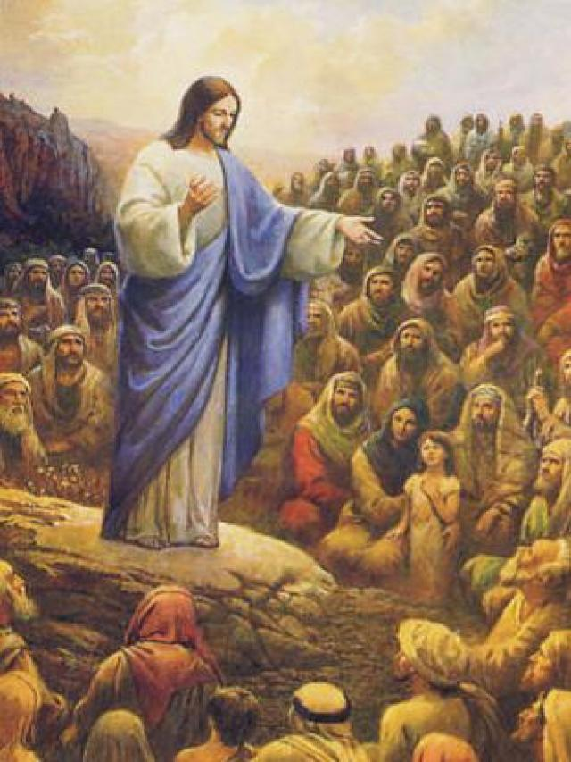
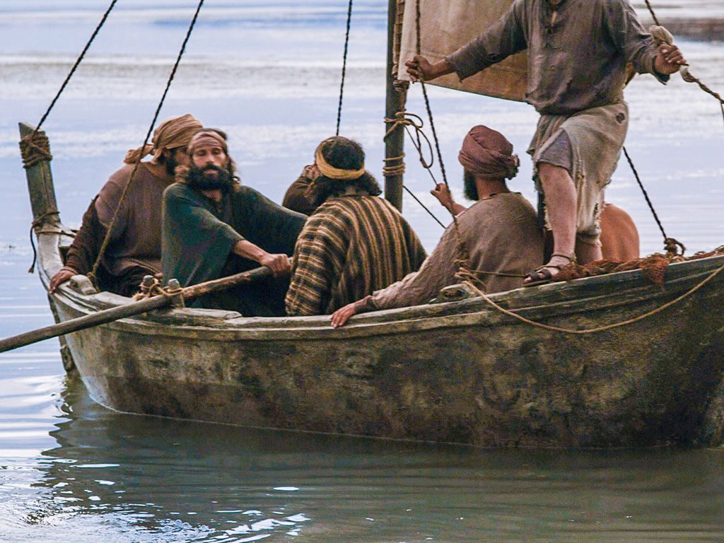
After he had fed the people, Jesus made the disciples get into a boat and precede him to the other side, while he dismissed the crowds.

Slide 3
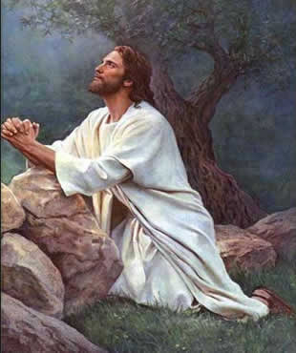
After doing so, he went up on the mountain by himself to pray. When it was evening, he was there alone.
He needed to speak to His Father.

Slide 4
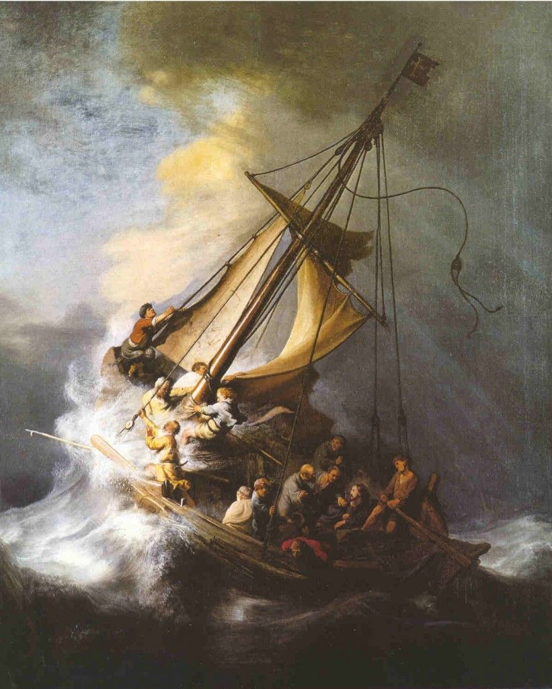
Meanwhile the boat, already a few miles offshore, was being tossed about by the waves, for the wind was against it.
During the fourth watch of the night, he came toward them walking on the sea. When the disciples saw him walking on the sea, they were terrified. “It is a ghost,” they said, and they cried out in fear.
At once Jesus spoke to them,
“Take courage, it is I; do not be afraid.”

Slide 5
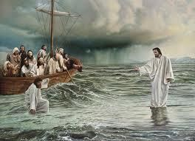
Peter said to him in reply, “Lord, if it is you, command me to come to you on the water.”
He said, “Come.”
Peter got out of the boat and began to walk on the water toward Jesus.

Slide 6
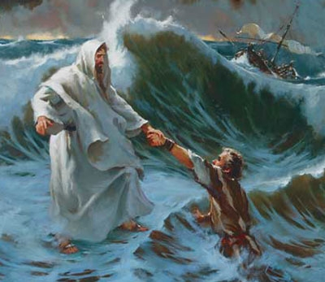
But when he saw how strong the wind was he became frightened; and, beginning to sink, he cried out, “Lord, save me!”
Immediately Jesus stretched out his hand and caught Peter, and said to him,
“O you of little faith, why did you doubt?”

Slide 7
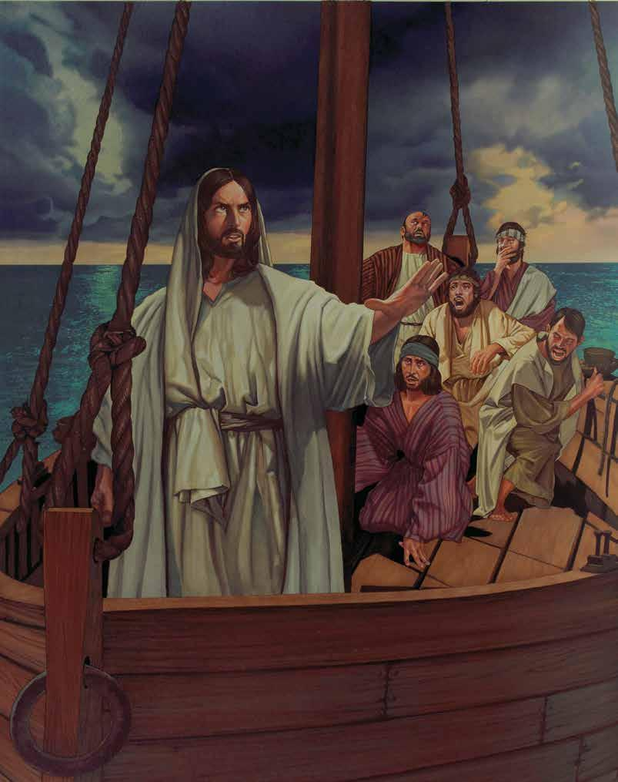
After they got into the boat, the wind died down. Those who were in the boat did him homage, saying, “Truly, you are the Son of God.”
The Gospel of the Lord,
Praise to you
Lord Jesus Christ.

Slide 8
REFLECTION

Slide 9
Which are the storms in our life?
Jesus shows us that He is stronger than any storm we may be facing.
They may be:
Difficulties in school,
Sickness in our loved ones,
Family fights,
Money problems,
Friends that may not be good…

Slide 10
Peter began with much faith when he asked Jesus to command him to walk towards Him during the storm and he began to walk... What happened to him?

Slide 11
He became afraid and started to sink yelling, Lord, save me!
At first we begin with much faith, then begin to fear.
But Jesus always has compassion when we ask Him for help.
What does Jesus tell Peter?
“O you of little faith, why did you doubt?”

Slide 12
To show them that He is God, He calmed the storm when He boarded the boat. Did they believe?
Yes, they paid Him homage saying,
“Truly, you are the Son of God.”
They saw many miracles and still had trouble having faith. We do not see these miracles.
How can we have the faith that Jesus asks?

Slide 13
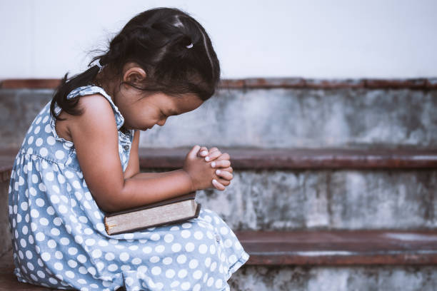
Just as Jesus prayed to His Father often, we can pray often to God to grow in love, faith, and obedience.

Slide 14
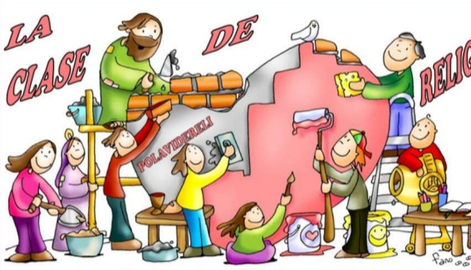
Activities

Slide 15
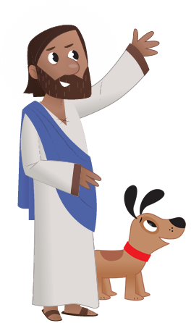
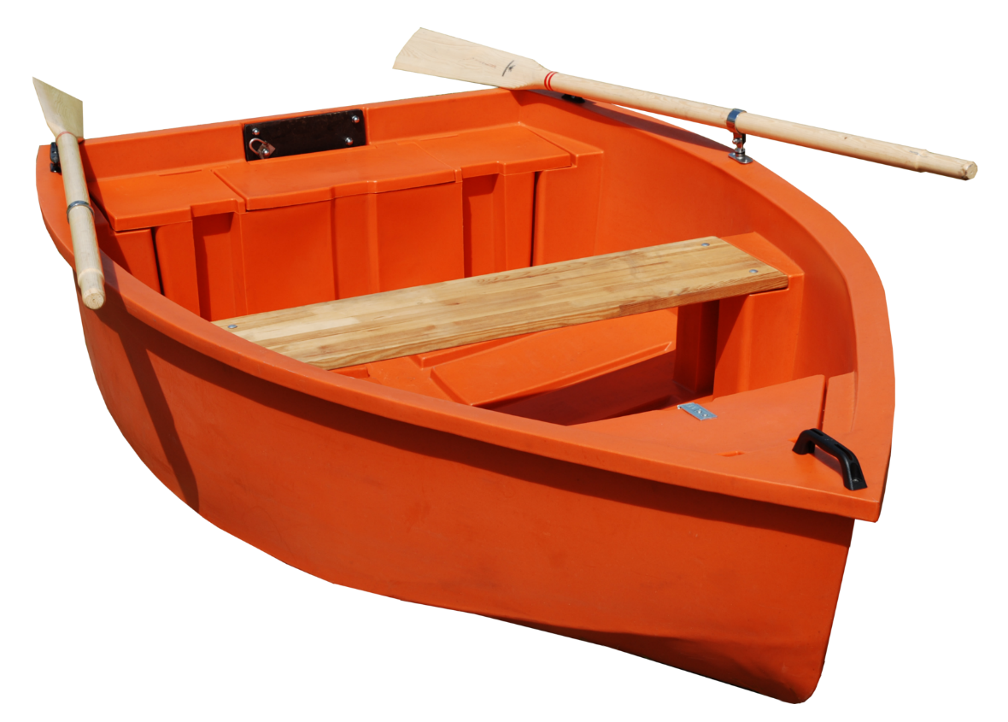
JESUS CALLS US TO HAVE FAITH.
How can we grow in faith?
Pray for faith
Obey
Read Bible
Accept Trials
Doubt
Be fearful
Go to
Sacraments
Serve others
JESUS, INCREASE MY FAITH!
Pray often
Trust in God

Slide 16
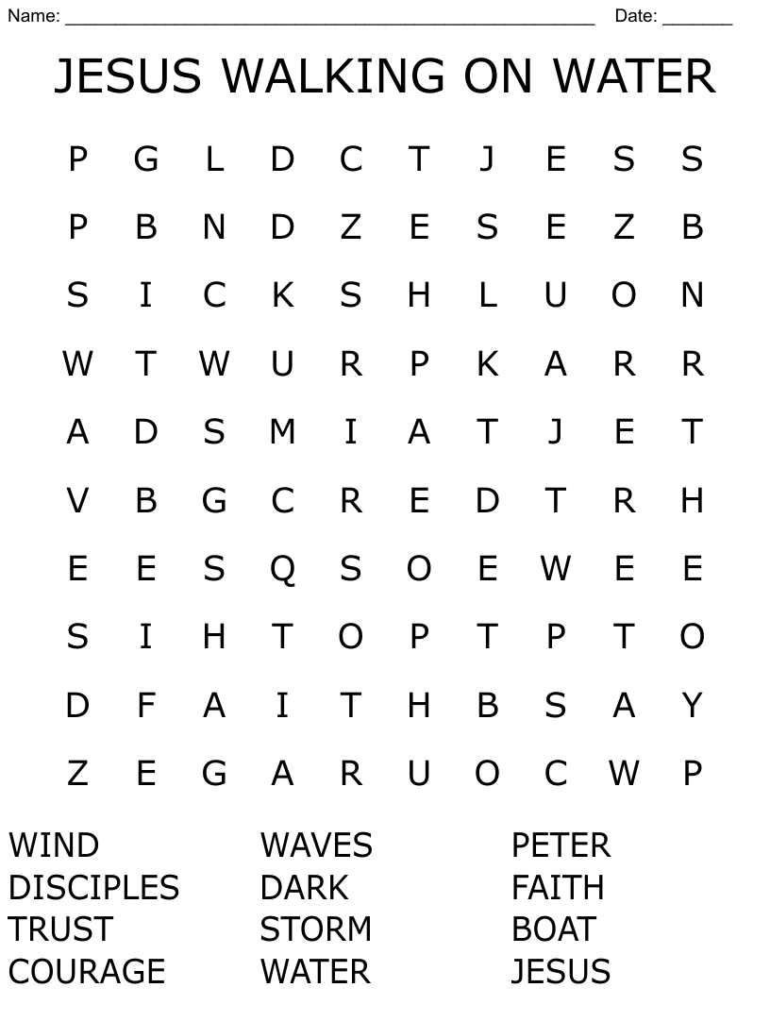

Slide 17
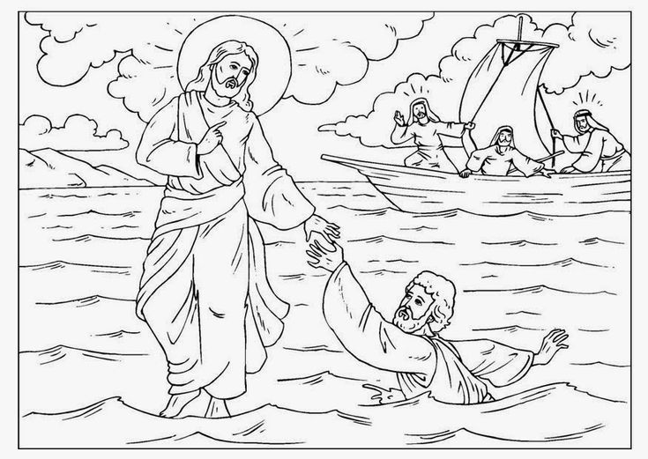
COLOR

Slide 18
CRAFT
Instructions: Cut the boat with Jesus on it and the water, and the feet. With another page, make a boat (see Youtube: https://youtu.be/cRzyHskrQb4.) Color the boat with Jesus and the water and glue to the side of the paper boat. Glue the boat onto the top, left side of a blue paper. Glue the feet from the bottom, left of the blue paper, diagonally to the top, right with the last two feet turning left towards the boat. Draw waves on the blue paper. Talk about the different ways we can increase our faith.

Slide 19
Prayer
Jesus, I believe in you. Help me when I fail and when the storms of life are too much for me. I know your hand will save me. Jesus I trust in you.
Amen.

Slide 20
Song: Footprints on the Water, Seong Jim Sing, (Ctrl Click) https://youtu.be/obC2i7l_cXA , (3-7 years)

Slide 21
Song: Walk on Water, chapelhill kids, (Ctrl Click) https://youtu.be/IzZeNVPHnig (9+ years)

