Slide 1
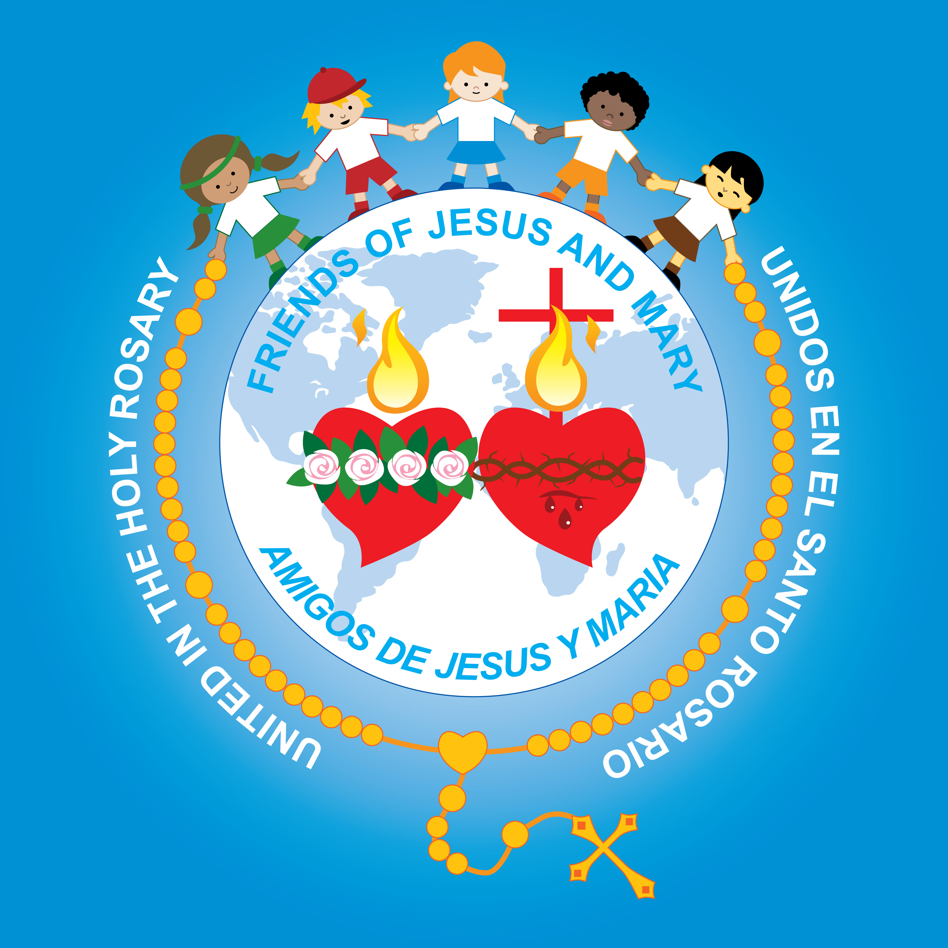
Ministry Friends of Jesus and Mary
PRAYER GROUP FOR CHILDREN
CYCLE A – XV SUNDAY IN ORDINARY TIME
THE PARABLE OF THE SOWER
www.fcpeace.org

Slide 2
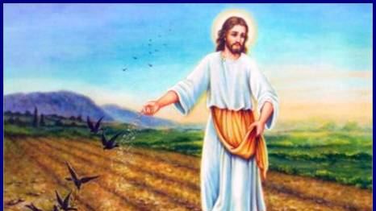
Friends of Jesus and Mary
Cycle A - XV Sunday in Ordinary Time
Isaiah 55, 10-11; Psalm 64; Romans 8, 18-23; Matthew 13, 1-23 o 1-9
The Parable of the Sower
EGOISMO

Slide 3
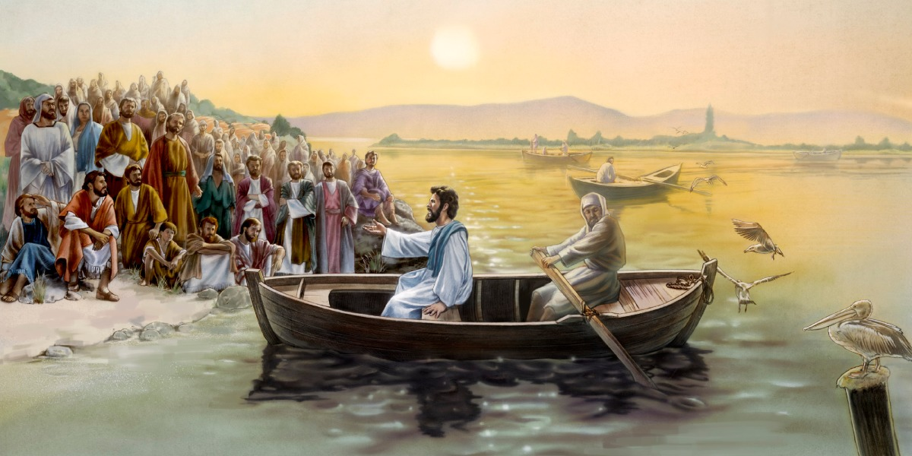
On that day, Jesus went out of the house and sat down by the sea. Such large crowds gathered around him that he got into a boat and sat down, and the whole crowd stood along the shore.
And he spoke to them at length in parables, saying:

Slide 4
"A sower went out to sow.
And as he sowed, some seed fell on the path,
and birds came and ate it up.

Slide 5
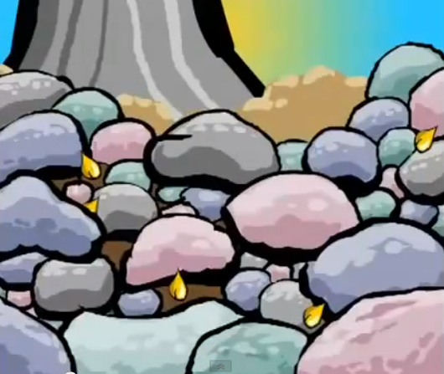
Some fell on rocky ground, where it had little soil. It sprang up at once because the soil was not deep, and when the sun rose it was scorched, and it withered for lack of roots.

Slide 6
Some seed fell among thorns, and the thorns grew up and choked it.

Slide 7
But some seed fell on rich soil and produced fruit, a hundred or sixty or thirtyfold.
The Gospel of the Lord,
Praise to You Lord Jesus Christ.
Whoever has ears ought to hear.”

Slide 8
REFLECTION

Slide 9
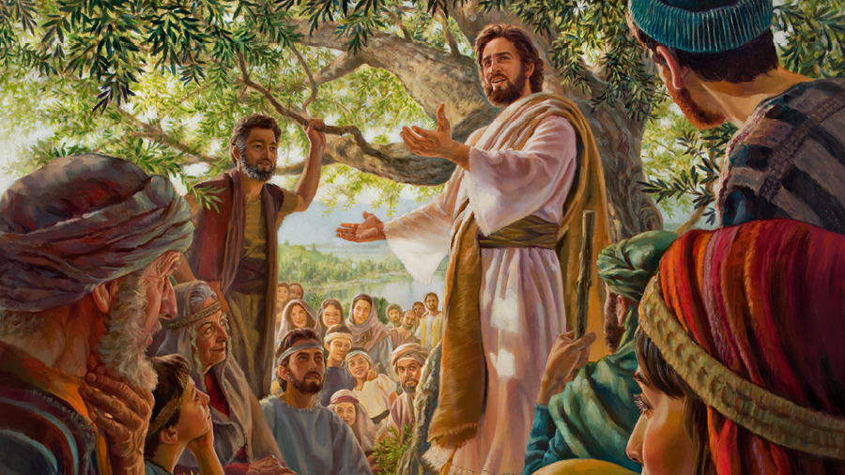
What is a Parable?
A story that uses symbols or comparisons to teach a lesson.
Jesus loved to teach with parables so people could understand better.

Slide 10
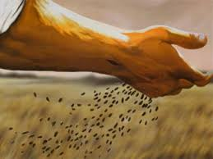
Jesus teaches us with the story of the sower who plants in 4 different types of grounds. Who does the sower represent?
God, through his Word, or through another person inviting…

Slide 11
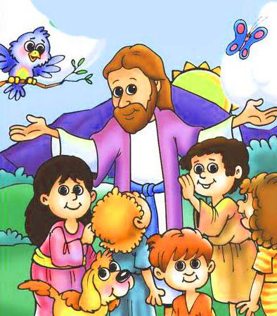
What does the seed represent?
God’s invitation to follow Him.

Slide 12
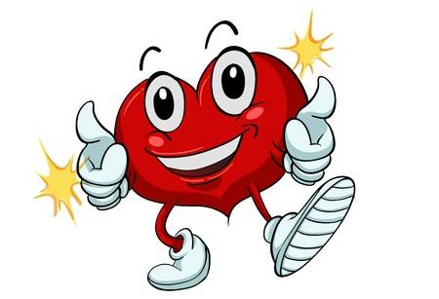
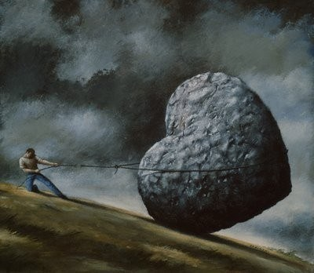
What do the different grounds represent?
Our heart, fertile or hardened to God’s invitation.

Slide 13
What happens on the path?
The ground is hard and the seed cannot enter so the birds eat it. In the same way, when our heart is hardened because we think we do not need God, we ignore His invitation.
What happens on the rocky ground?
The many rocks and little soil cause the growth to dry up with the sun. The rocks in our heart are sins like laziness, pride…At first, we are enthusiastic, but when things get difficult, we prefer to seek our pleasures rather than following God.
What happens on the thorny ground?
The strong thorns suffocate the growing plants. The thorns are our bad attitudes or sins like selfishness, laziness, anger, that suffocate the desire to follow Jesus.
What happens on the rich soil?
The rich soil represents a heart that changes bad attitudes to follow Jesus, recognizing that only Jesus gives life. A heart that wants to share that life, giving fruit for God’s Kingdom.

Slide 14
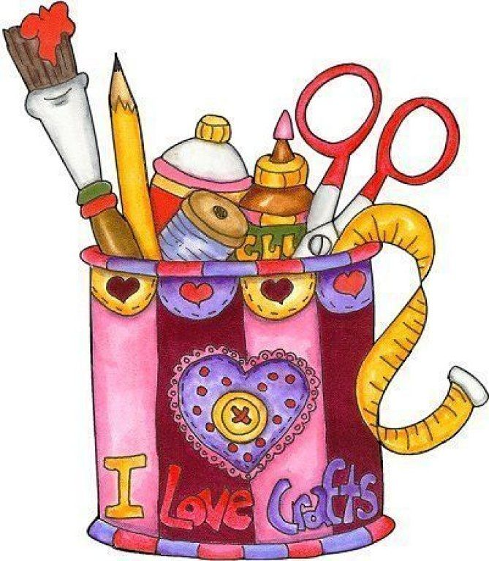
Activity

Slide 15
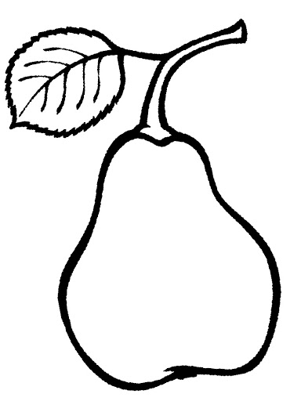
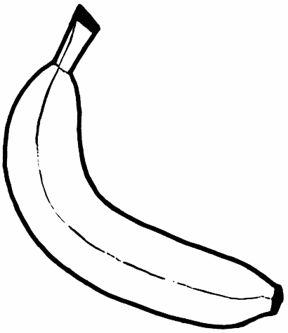
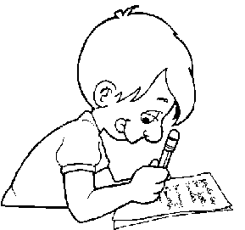
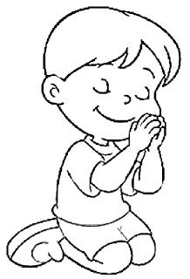
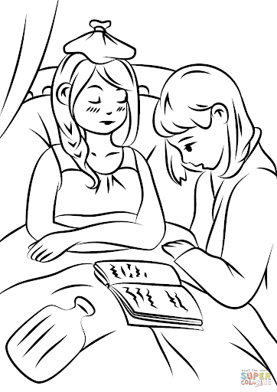
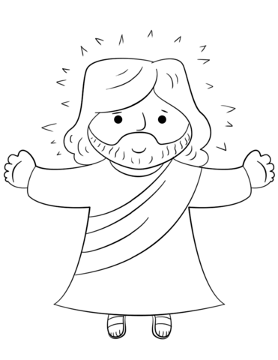
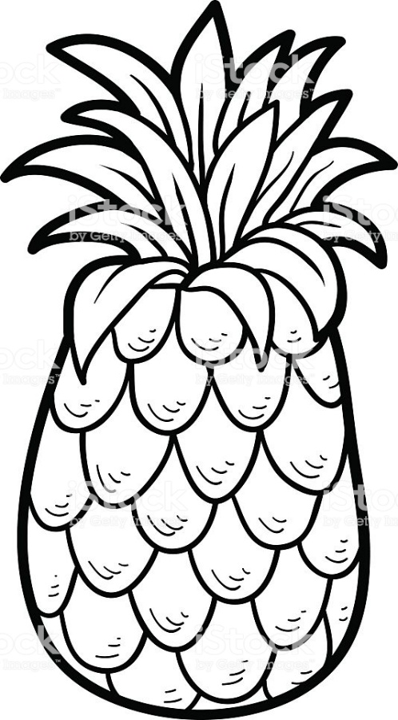
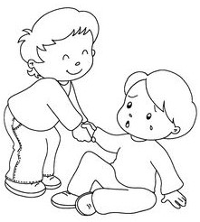
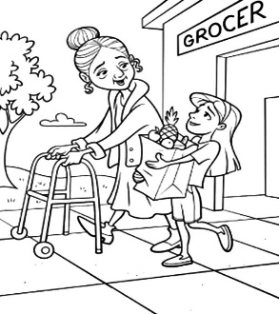
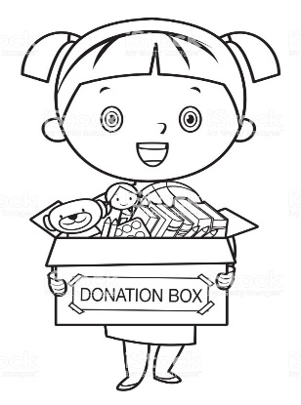
How do we give fruit with Jesus in our heart?

Slide 16
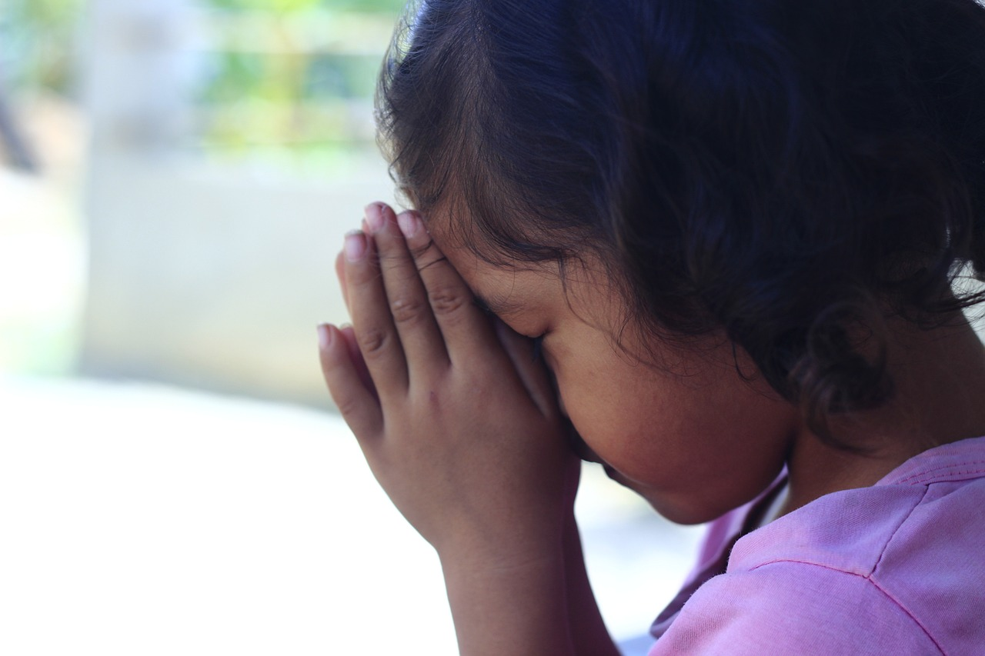
PRAYER
Oh, Good Jesus, enter my heart and make it fertile so I may give much fruit for your Kingdom. I love you very much.
Amen.

Slide 17
Song: I Wanna Bear Fruit, CJ and Friends, https://youtu.be/xdKj8pntC2Q (3-8 yrs.)

Slide 18
Song: Every Move I Make, CJ and Friends, https://youtu.be/MPvnZILn6EY(9+ years)

