Slide 1
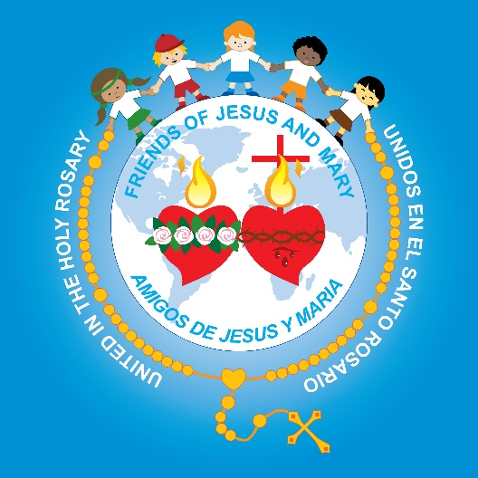
Friends of Jesus and Mary
Prayer Group for Children
Cycle A - XVI Sunday in Ordinary Time, Matthew 13, 24-43 o 24-30
www.fcpeace.org
THE PARABLE
Of the Wheat and the Weeds

Slide 2
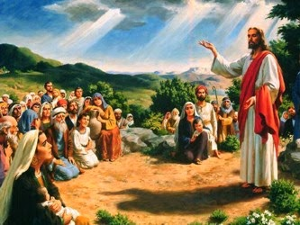
Jesus proposed another parable to the crowds, saying:

Slide 3
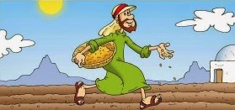
"The kingdom of heaven may be likened to a man who planted good seed in his field.

Slide 4
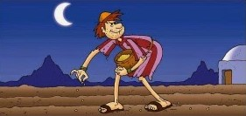
While everyone was asleep his enemy came and planted weeds all through the wheat, and then went off. When the crop grew and bore fruit, the weeds appeared as well.

Slide 5
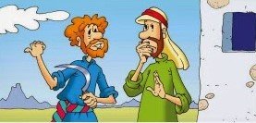
The slaves of the householder came to him and said, 'Master, did you not plant good seed in your field? Where have the weeds come from?'
He answered, 'An enemy has done this.' His slaves said to him, 'Do you want us to go and pull them up?' He replied, 'No, if you pull up the weeds you might uproot the wheat along with them.

Slide 6
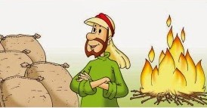
Let them grow together until harvest; then at harvest time I will say to the harvesters, "First collect the weeds and tie them in bundles for burning; but gather the wheat into my barn."'"
THE GOSPEL OF THE LORD, PRAISE TO YOU LORD JESUS CHRIST

Slide 7
REFLCTION

Slide 8
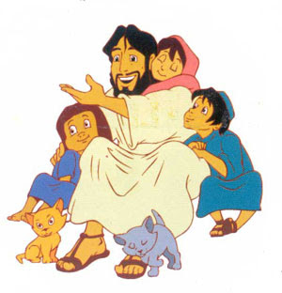
Jesus teaches about the Kingdom of God with a parable, a story that uses symbols and comparisons to reveal a truth.
Jesus who plants the desire to know and love Him through the scripture, prayer, or another person…
Who does the planter represent?

Slide 9
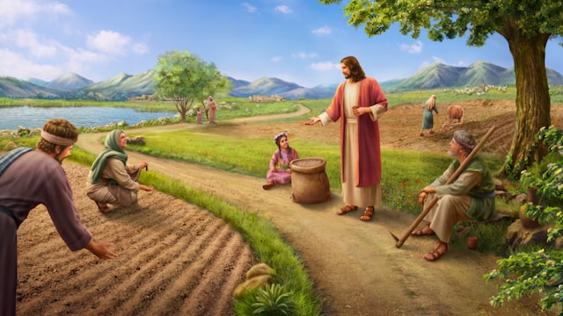
What does the field represent?
The Kingdom of God which are the people who let Jesus be the King of their hearts.

Slide 10
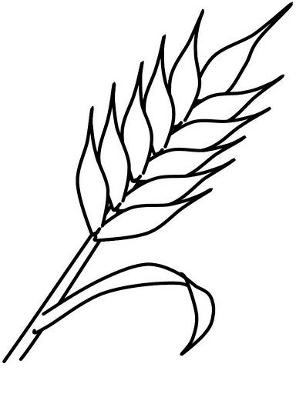
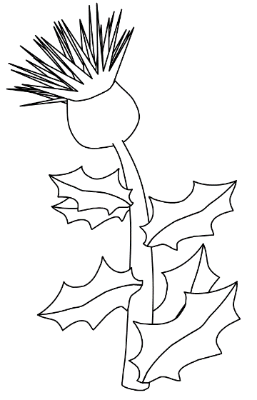
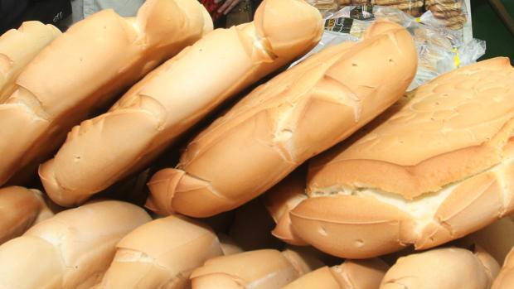
Wheat and weeds grew together in the field. What does each represent?
Wheat is used to make bread which nourishes our body.
The weed hurts the wheat and must be burned.
Also, during Mass, bread becomes the Body of Christ which nourishes our soul.
The wheat represents the person that follows Jesus and grows in love thus spreading the Kingdom of God.
The weed represents the person that rejects Jesus and destroys love with their selfishness and hate.

Slide 11
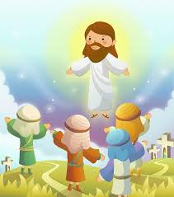
The master wanted to wait until the time of harvest to separate the wheat from the weed.
What does the harvest represent?
At the end of time, God will separate those who have accepted and shared Jesus’ love from those who have rejected and tried to destroy His Kingdom. The first will stay with Jesus…
…and the others will burn.

Slide 12
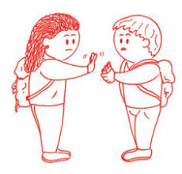
Even though we see that others do not follow Jesus, we must follow Him to have happiness here and eternally in Heaven.

Slide 13
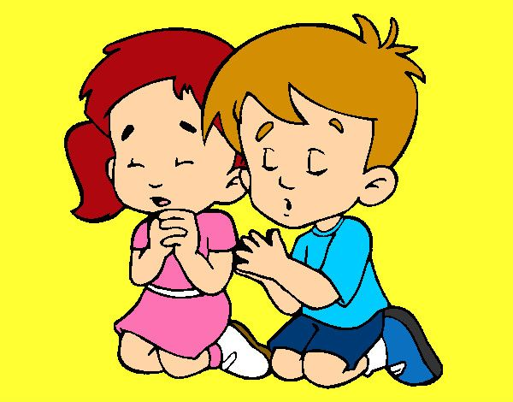
Our Blessed Mother asks us to pray and sacrifice for the conversion of sinners so everyone will have Eternal Life.

Slide 14
PRAYER Jesus, fill my heart with your love so I may help to build your Kingdom. Help me to always follow you. I pray for the conversion of all that reject you so everyone may love you and have Eternal Life. Amen.

Slide 15
Activity

Slide 16
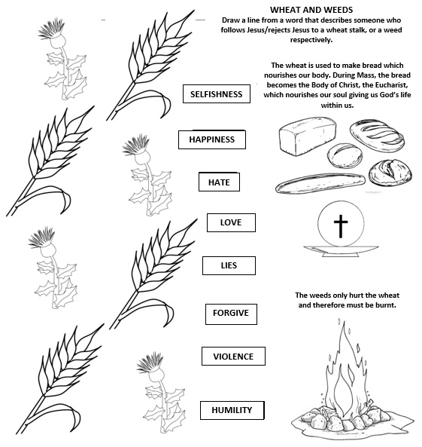

Slide 17
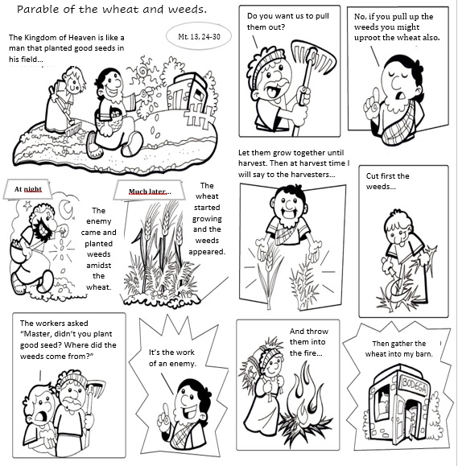
COLOR

Slide 18
I have decided, CJ and Friends, https://youtu.be/G_fZfiuONi0 (3-8 yrs.)

Slide 19
I have decided to follow Jesus, Ximdrake Asidore https://youtu.be/B4aX8uU4PCg (9+ yrs.)

