Slide 1
Ministry Friends of Jesus and Mary
Cycle A - XVII Sunday in Ordinary Time
The Parables of the Found Treasure-Matthew 13, 44-52 (9+ yrs.)
www.fcpeace.org

Slide 2
THE PARABLES OF JESUS

Slide 3
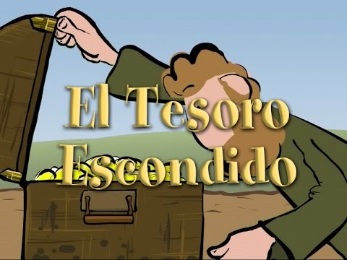
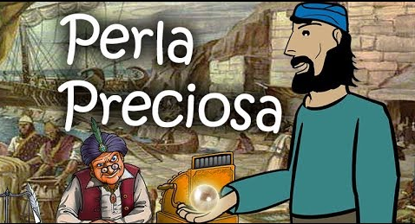
WHAT IS A PARABLE?
A short story that uses symbols and comparisons so we may better understand a truth that Jesus wants to teach us.
THIS WEEK JESUS BRINGS US 2 PARABLES:
THE
PRICELESS
PEARL
THE HIDDEN TREASURE

Slide 4
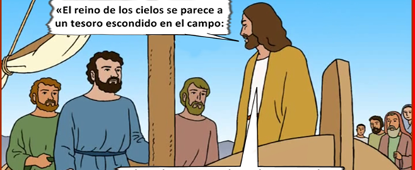
THE HIDDEN TREASURE AND THE PRICELESS PEARL MATTHEW 13, 44-52
Jesus said to his disciples:
"The kingdom of heaven is like a treasure buried in a field,

Slide 5
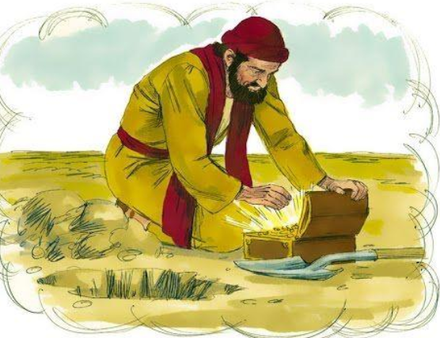
…which a person finds and hides again, and out of joy goes and sells all that he has and buys that field.

Slide 6
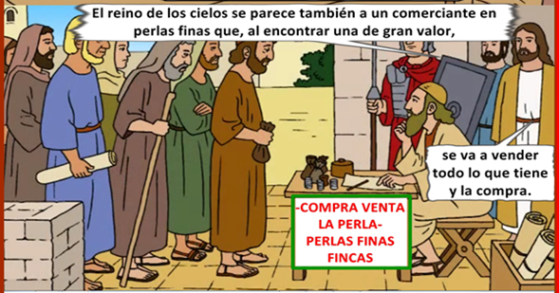
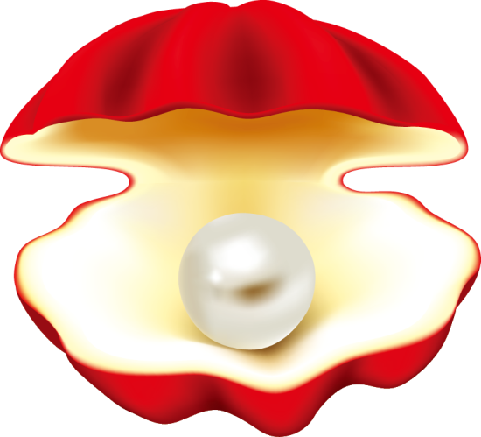
Again, the kingdom of heaven is like a merchant searching for fine pearls.
BUY/SELL
FINE PEARLS

Slide 7
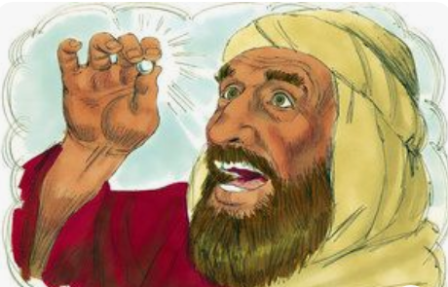
When he finds a pearl of great price, he goes and sells all that he has and buys it."
The Gospel of the Lord.
Praise to you Lord Jesus Christ.

Slide 8
REFLECTION

Slide 9
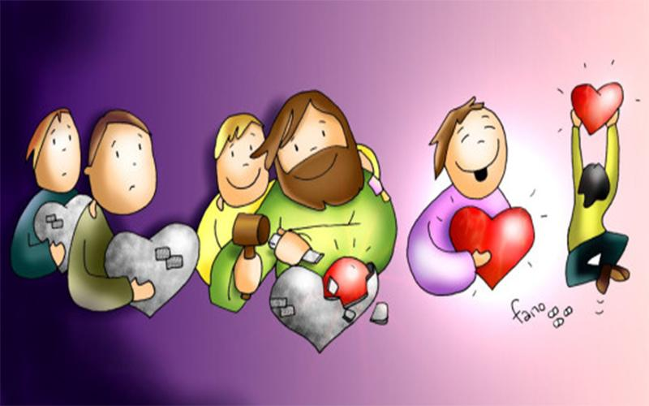
What is the Kingdom of Heaven?
The presence of Jesus in our heart: a heart attentive to God’s voice, a heart that knows the difference between good and evil, a heart that wants to do His Holy will.

Slide 10
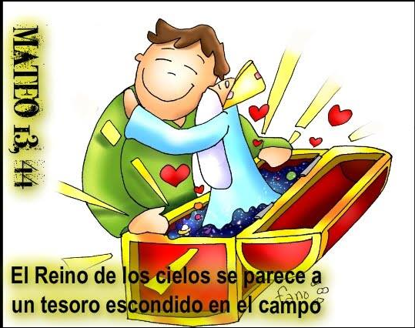
The Kingdom of Heaven is so VALUABLE AND MARVELOUS, that upon discovering it, we would do anything to be a part of it.
It is the Kindom of eternal happiness! If we realized this great gift, we would try with our whole life to attain it.
The Kingdom of Heaven is like a treasure hidden in a field

Slide 11
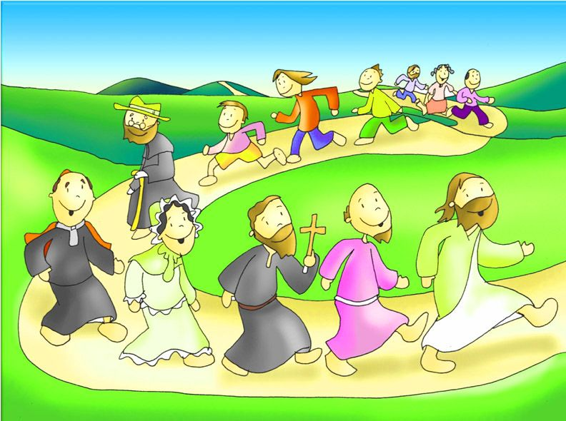
If Jesus is in our heart, we have everything we need to be happy on earth and in Heaven.
Jesus protects us, guides us, gives us peace, love, joy, and everything we need to help build God’s Kingdom.

Slide 12
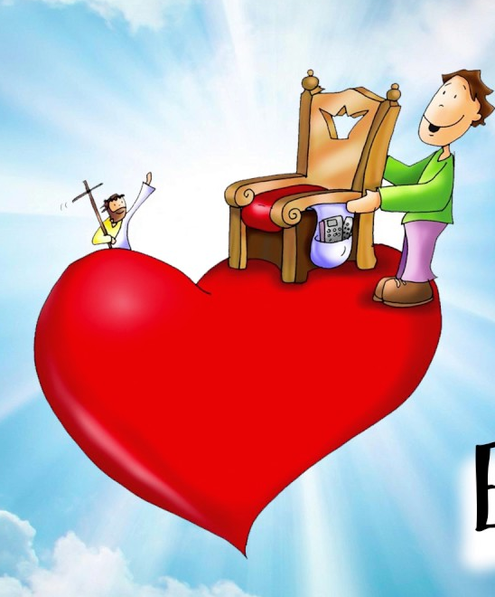
Finding the Kingdom of Heaven is a very special PRIVILEGE but it is also a GOAL.
Just like the man in the parable sold all that he had to get the MOST VALUABLE TREASURE, to enter into the Kingdom of Heaven, we must strive to be more like Jesus.

Slide 13
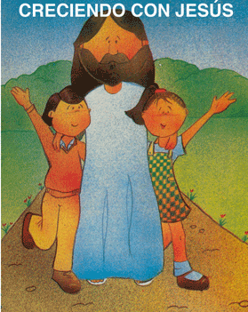
We must place Jesus first in our life.

Slide 14
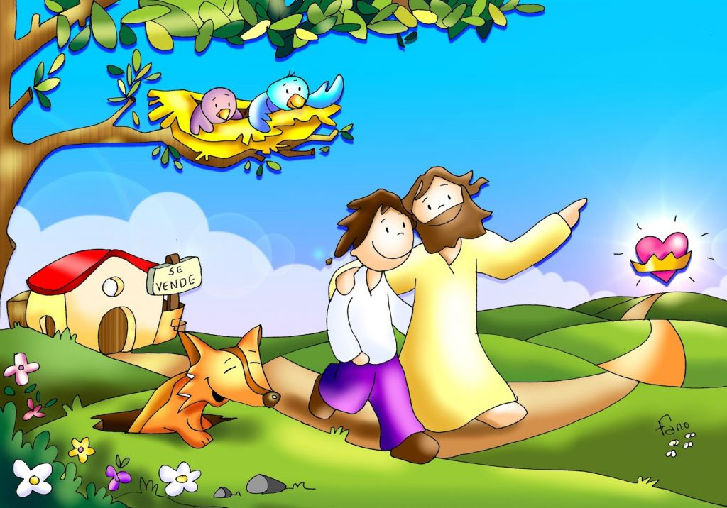
How do we put Jesus first?
Praying with Jesus every day.
Doing good to others.
Obeying and respecting our parents.
Participating in Mass and all the Sacraments.

Slide 15
ACTIVITY

Slide 16
HEAVEN
BURIED
FIELD
FINDS
SELLS
MERCHANT
PEARLS
PRICE

Slide 17
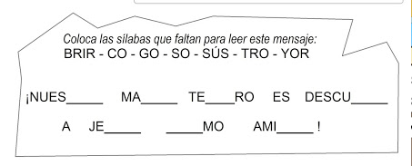
Insert the syllables or words to complete the following message:
BEST JE URE ING EST
OUR GREAT___ TREAS___ IS FIND___ __SUS AS OUR ____ FRIEND.
TRO
YOR
SO
BRIR
EST
URE
ING
JE
SUS
CO
GO
BEST

Slide 18
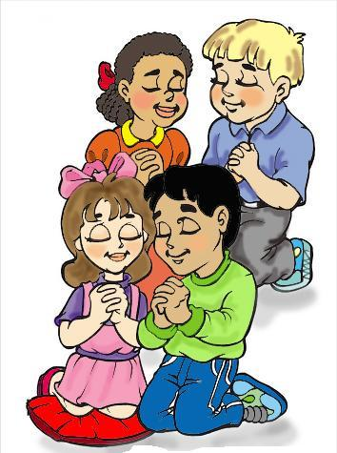
PRAYER
Jesus,
Enter into my heart. I want you to be my best friend. Thank you for all the gifts you give me every day. Help me to imitate you so I may be another Jesus on earth.
Amén

Slide 19
I Found a Treasure, Austin Stone Worship, https://youtu.be/IbARUaX4frc (9+ yrs.)

