Slide 1
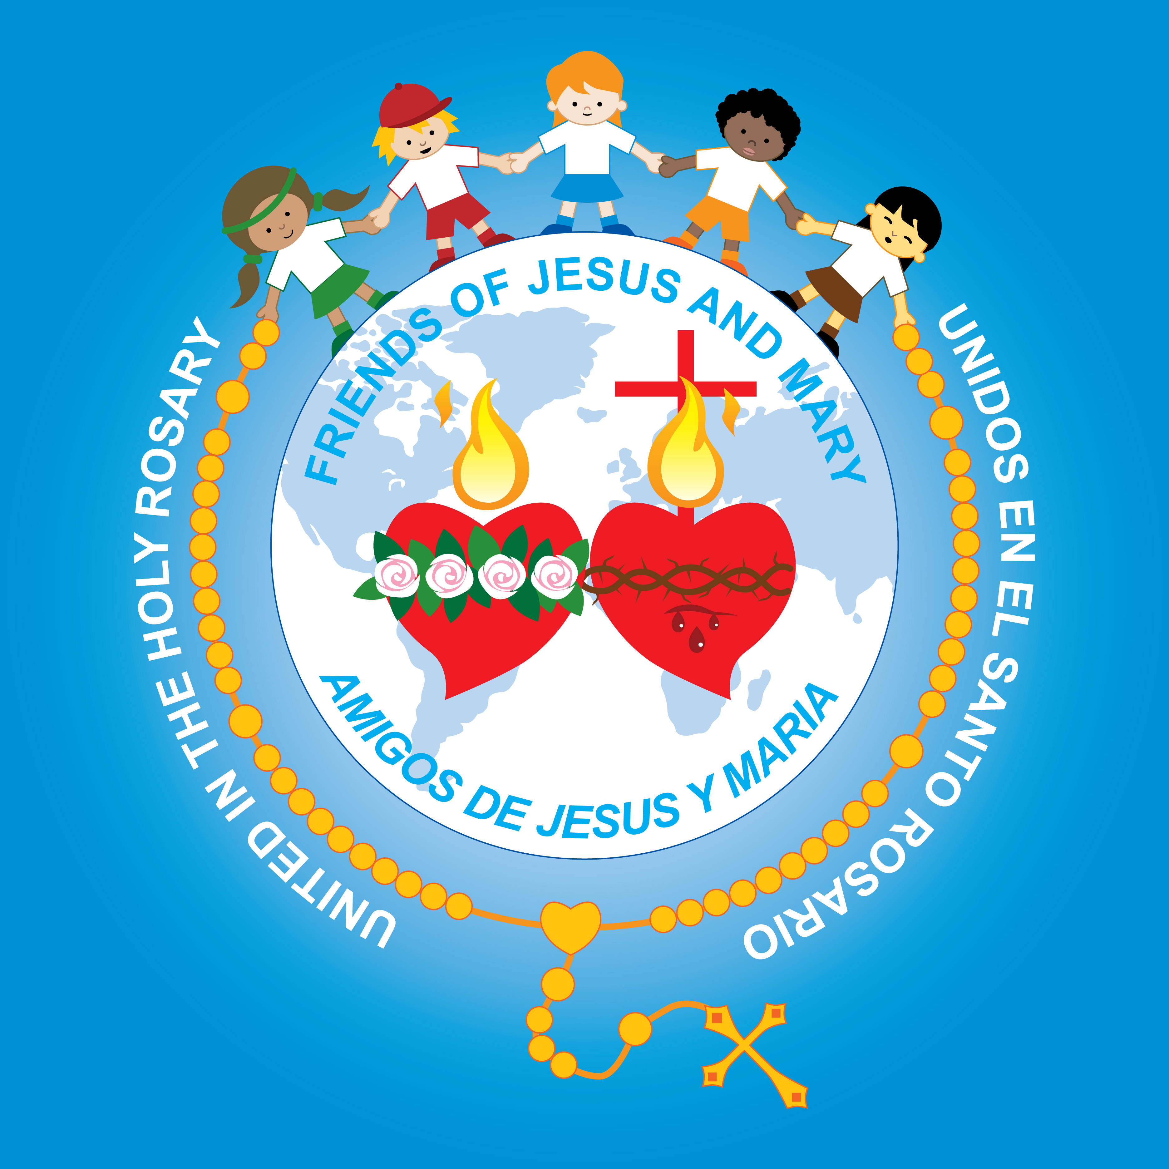
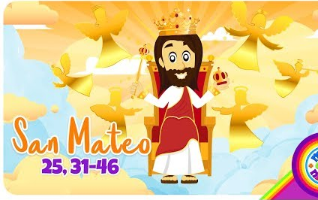
Ministry Friends of Jesus and Mary
Cycle A – XVIII Sunday in Ordinary Time
Mateo 25:31-46
MATTHEW
www.fcpeace.org

Slide 2
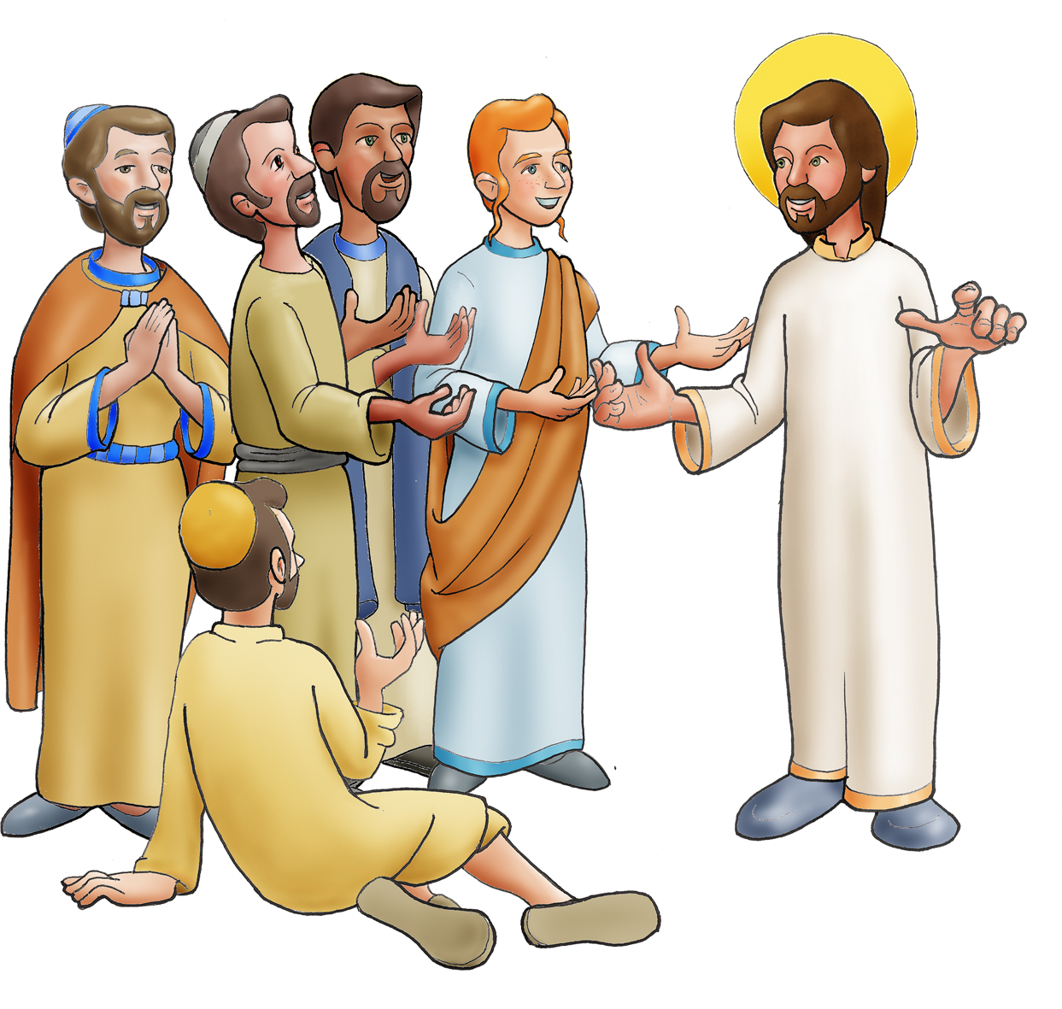
Jesus said to his disciples:

Slide 3

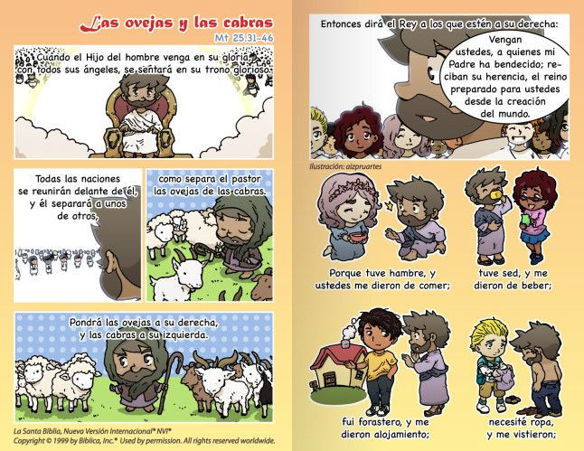
"When the Son of Man comes in his glory, and all the angels with him, he will sit upon his glorious throne,

Slide 4
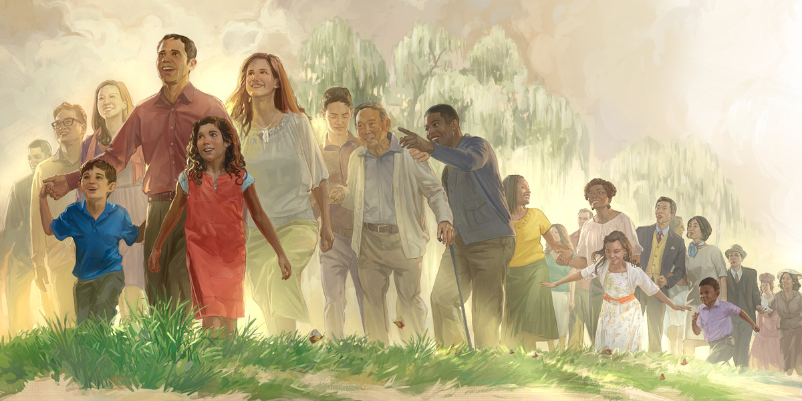
And all the nations will be assembled before him. And he will separate them one from another,.

Slide 5
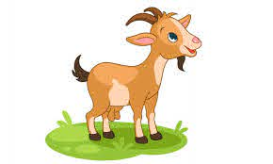
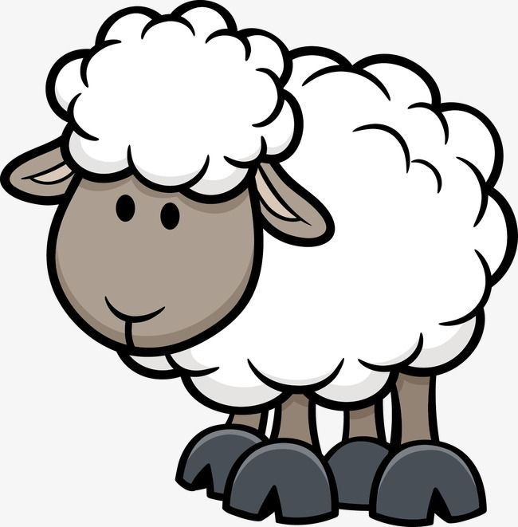
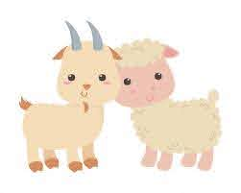
as a shepherd separates the sheep from the goats.

Slide 6
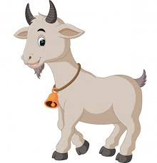
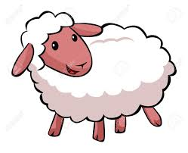
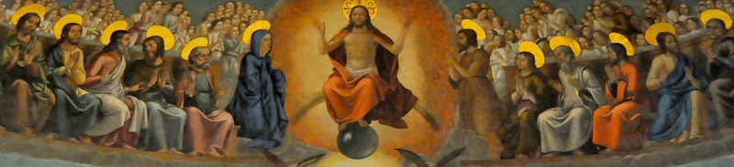
He will place the sheep on his right and the goats on his left.
Then the king will say to those on his right,
'Come, you who are blessed by my Father. Inherit the kingdom prepared for you from the foundation of the world.

Slide 7
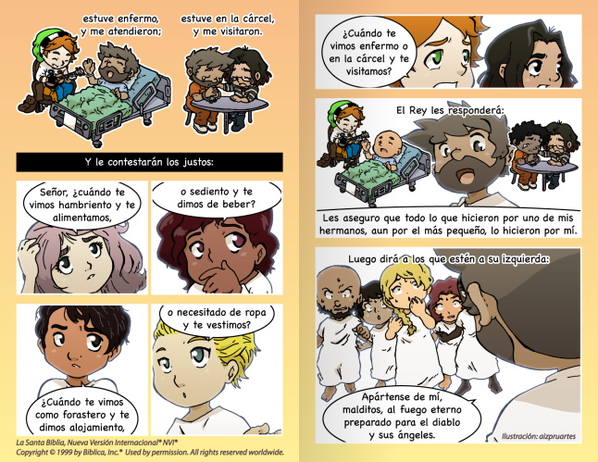
I was thirsty and you gave me drink
a stranger and you welcomed me
For I was hungry and you gave me food,
ill and you cared for me
in prison and you visited me
naked and you clothed me

Slide 8
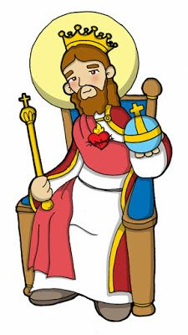
Then the righteous will answer him and say,
Lord, when did we see you hungry and feed you
or thirsty and give you drink?
or naked and clothe you?
When did we see you a stranger and welcome you,
When did we see you ill or in prison, and visit you?

Slide 9
And the king will say to them in reply,
Amen, I say to you, whatever you did for one of the least brothers of mine, you did for me.

Slide 10
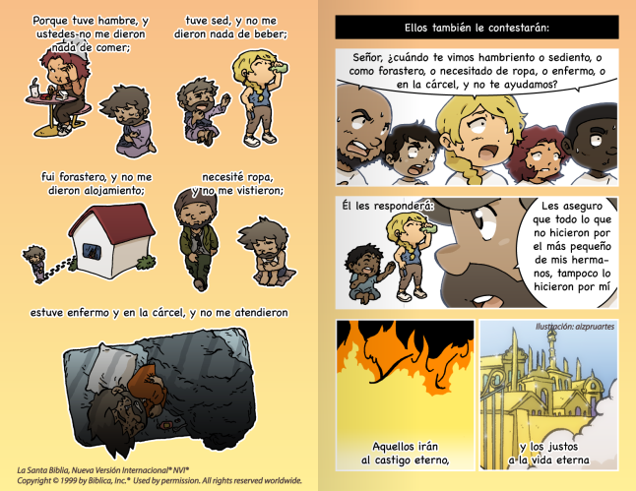
For I was hungry and you gave me no food
I was thirsty and you gave me no drink
Then he will say to those on his left,
a stranger and you gave me no welcome
naked and you gave me no clothing
ill and in prison, and you did not care for me.
'Depart from me, you accursed, into the eternal fire prepared for the devil and his angels.

Slide 11
Amen, I say to you, what you did not do for one of these least ones,
you did not do for me.
He will answer them,
Then they will answer and say,
Lord, when did we see you hungry or thirsty or a stranger or naked or ill or in prison, and not minister to your needs?
And these will go off to eternal punishment
but the righteous to eternal life.

Slide 12
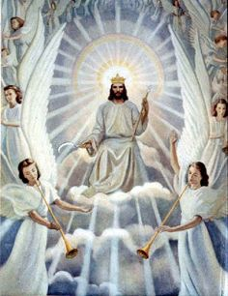
Reflection
Jesus speaks to His disciples of His second coming.
He promises to return in glory, surrounded by His angels, seated in a throne to separate the good people from the evil ones.

Slide 13
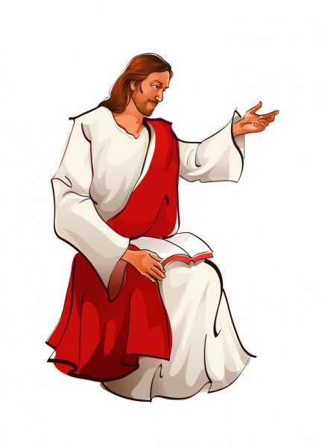

How does He choose the Good ones?
He said, “I was hungry and you gave me to eat, thirsty and you gave me to drink, I was homeless and you housed me, naked and you dressed me, sick and you visited, imprisoned and you went to see me.”

Slide 14
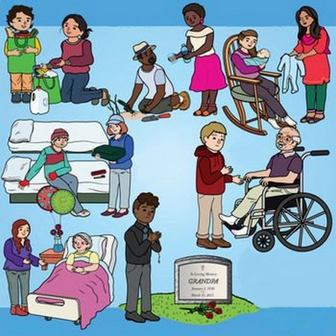
What did Jesus mean by this?
When we help the needy, we are really helping Jesus. God created everyone, loves everyone, and we are all His children. If someone helps your family, you become very happy. In the same way, God gets happy when someone helps His family. It also hurts Him if someone chooses not to help them, as much as if it was Himself they were not helping.

Slide 15
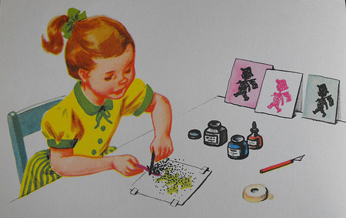
Activity

Slide 16
Say the name of the action that helps get you to Heaven?
Visit the lonely.
Help someone in need.
Share your blessings with joy.
Console the suffering.
Come, blessed by my Father; take possession of the Kingdom… Truly I tell you, when you did it for the least of my brethren, you did it for me.
Mathew 25, 31-46
Be kind to others.
Visit the sick.

Slide 17
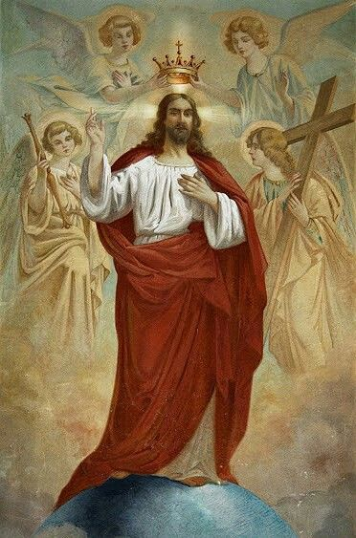
PRAYER
Jesus, King of my heart, fill me with love so I may want to help those in need. Help me to be generous with my time, talents, and treasures. Help me see you in the smallest of your children. Amen.
SONG: Love One Another, Dakota Pyle, (Ctrl Click) https://youtu.be/LYlkcoAfLU4

