Slide 1
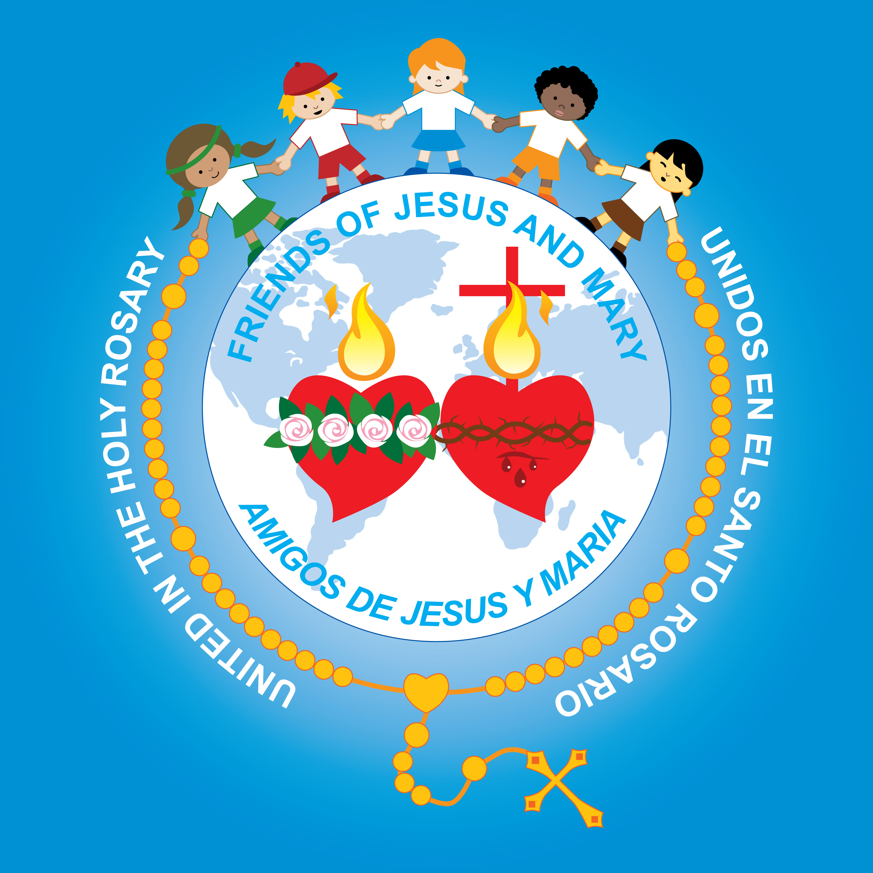
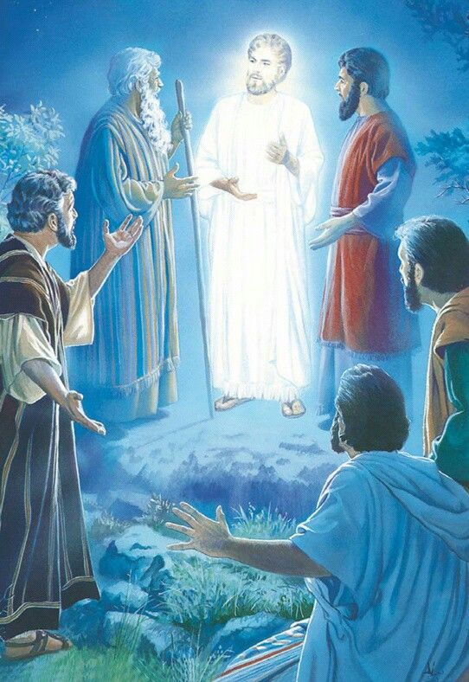
MINISTRY FRIENDS OF JESUS AND MARY FEAST OF THE TRANSFIGURATION CYCLE A – xviii SUNDAY IN ORDINARY TIME Matthew 17: 1-9 www.fcpeace.org

Slide 2
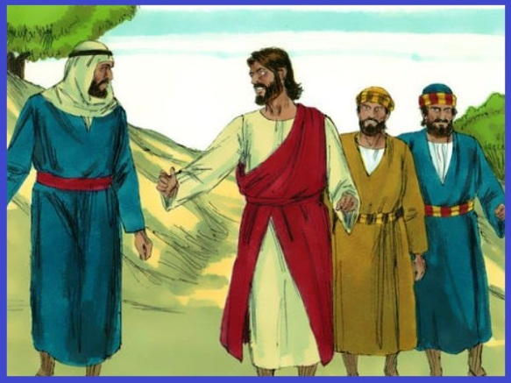
THE TRANSFIGURATION
Jesus took Peter, James, and his brother, John, and led them up a high mountain by themselves.

Slide 3
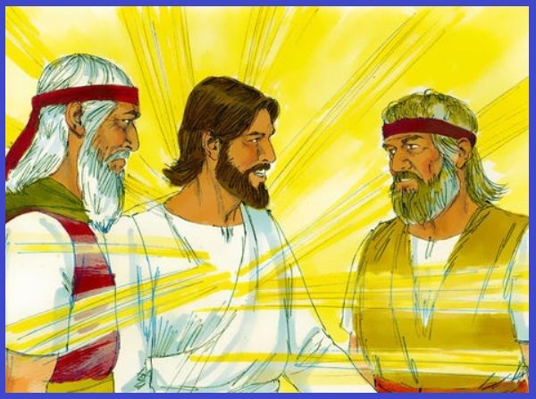
And he was transfigured before them; his face shone like the sun and his clothes became white as light. And behold, Moses and Elijah appeared to them, conversing with him.

Slide 4
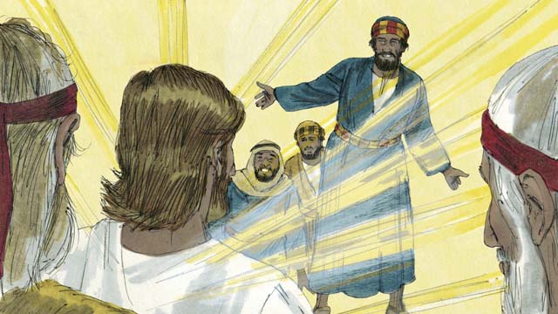
Then Peter said to Jesus in reply, "Lord, it is good that we are here. If you wish, I will make three tents here, one for you, one for Moses, and one for Elijah."

Slide 5
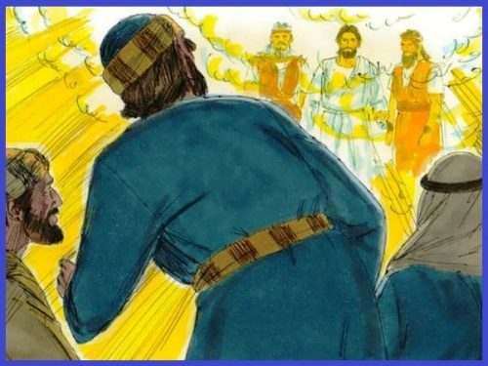
While he was still speaking, behold, a bright cloud cast a shadow over them, then from the cloud came a voice that said, "this is my beloved son, with whom I am well pleased; listen to him." When the disciples heard this, they fell prostrate and were very much afraid.

Slide 6
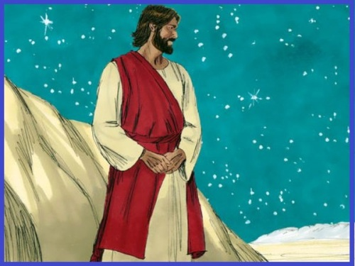
But Jesus came and touched them, saying, "Rise, and do not be afraid." And when the disciples raised their eyes, they saw no one else but Jesus alone. As they were coming down from the mountain, Jesus charged them, "Do not tell the vision to anyone until the Son of Man has been raised from the dead."
THE GOSPEL OF THE LORD, PRAISE TO YOU LORD JESUS CHRIST.

Slide 7
RefleCTIOn

Slide 8
Before entering Jerusalem for the last time, when Jesus would suffer and die, He went up a mountain with the apostles James, Peter, and John to pray. There, His appearance transformed and His face and clothes became dazzling white as if He were in Heaven.
How do you think the apostles felt upon seeing this?
Surprised, happy…
What hope does it give us for the future?
Heaven is a glorious and happy place.

Slide 9
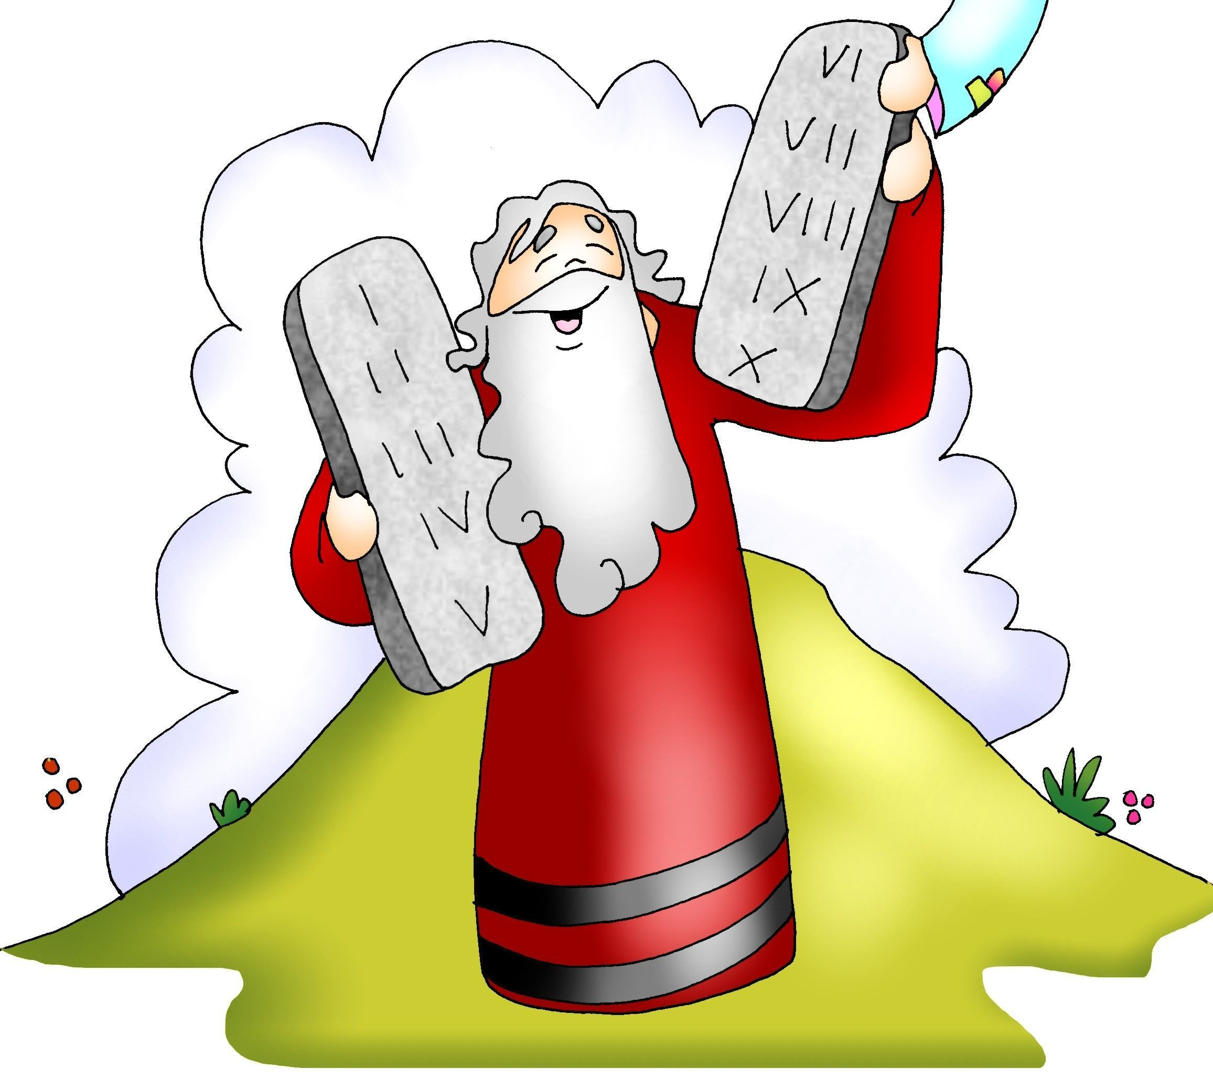
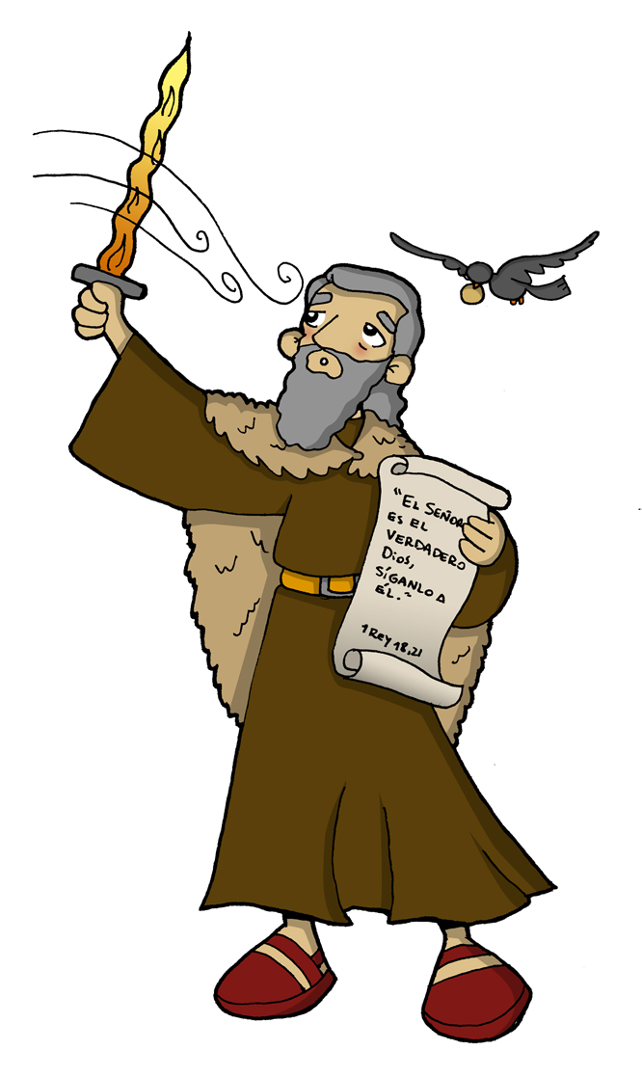
Moses and Elijah from the old testament appeared talking with Jesus.
Why was Moses important?
Moses received the 10 commandments from God after he freed the Israelites from slavery in Egypt; then he led them to the promised land. Likewise, Jesus, with His passion, death, and resurrection freed us from the slavery of our sins so we may live forever with God in Heaven.
Why was elijah important?
He represents the prophets of the Old Testament which asked for conversion and faithfulness to God to prepare for the coming of the Messiah.
Their presence reveals that Jesus is the Messiah God’s people awaited.

Slide 10
Why does Peter want to stay on the mountain?
He feels happy seeing the glory of God.
Why does god speak to them?
He wants to confirm that Jesus is His Son, the promised Savior, and we must listen to Him.
HOW WOULD THIS VISION HELP THEM DURING JESUS’ PASSION?
They would know God is with Jesus and His suffering is part of God’s plan.

Slide 11
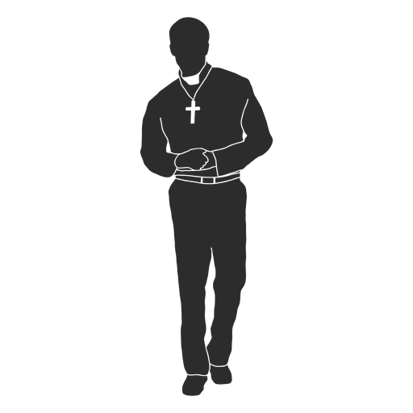
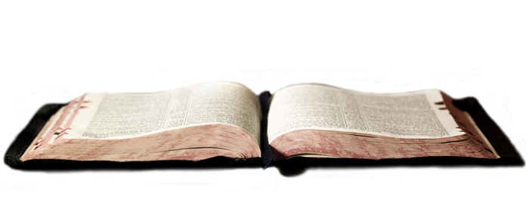
How do we listen to jesus?
in the Gospel;
priests,
In prayer;
in nature…
through our parents,
teachers;

Slide 12
activities

Slide 13
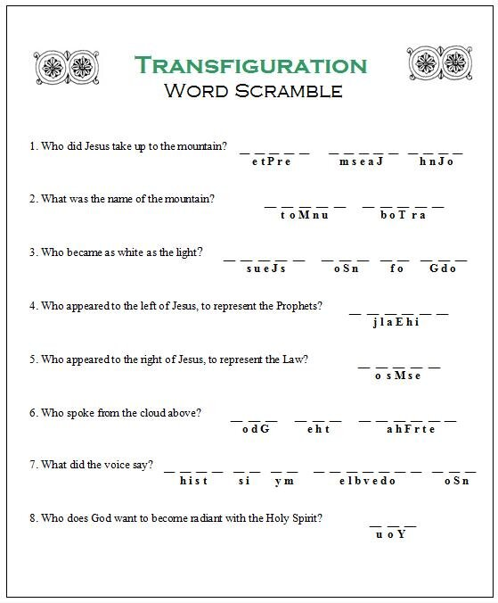
Peter
James
John
Mount
Tabor
Jesus
of
God
Son
Elijah
Moses
God
the
Father
This
is
my
beloved
Son
You

Slide 14
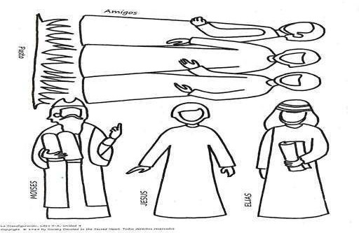
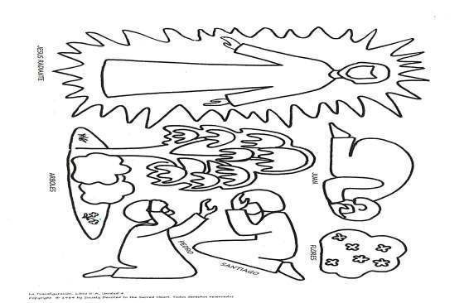
Cut and color. Take turns reenacting the events of the Transfiguration

Slide 15
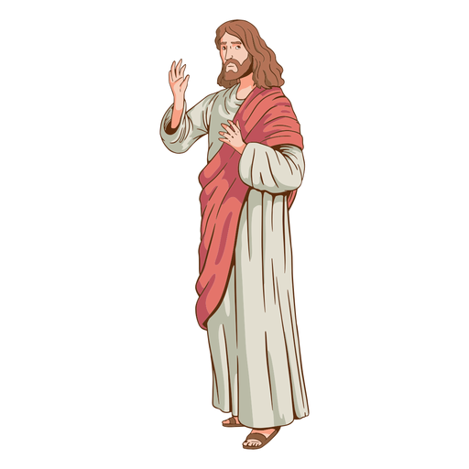
Prayer
Lord, help me to always listen to and follow Jesus. Help me to always have hope in in the happiness of Heaven, despite difficulties and sadness in this world. Amen.

Slide 16
Shine, Jesus, Shine, vbtyree, https://youtu.be/cVnMrCIAeMw (3-7yrs.)

Slide 17
I can only Imagine, Brentwood Benson: https://youtu.be/rUYj_duHMoA

Slide 18
See you next week.
Don’t forget to pray every day.

