Slide 1
Ministry Friends of Jesus and Mary www.fcpeace.org
Cycle A – XXI Sunday in Ordinary Time
The Primacy of Peter, (Mathew 16, 13-20)
YouTube: https://youtu.be/O9hQwDR3ZjI

Slide 2
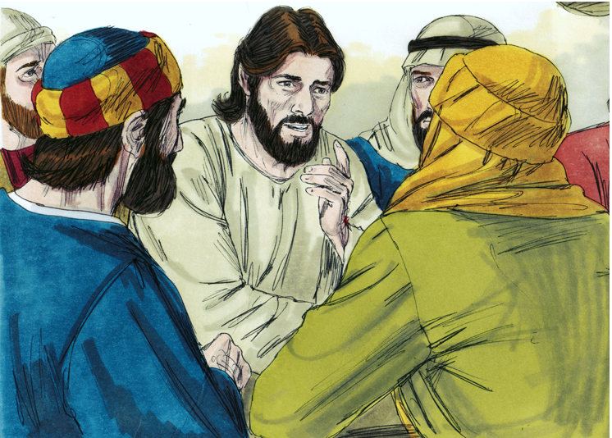
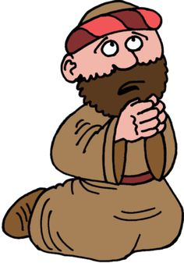
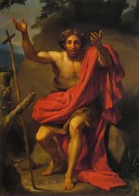
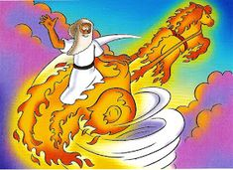
Jesus went into the region of Caesarea Philippi and he asked his disciples, “Who do people say that the Son of Man is?”
They replied, “Some say John the Baptist, others Elijah, still others Jeremiah or one of the prophets.”

Slide 3
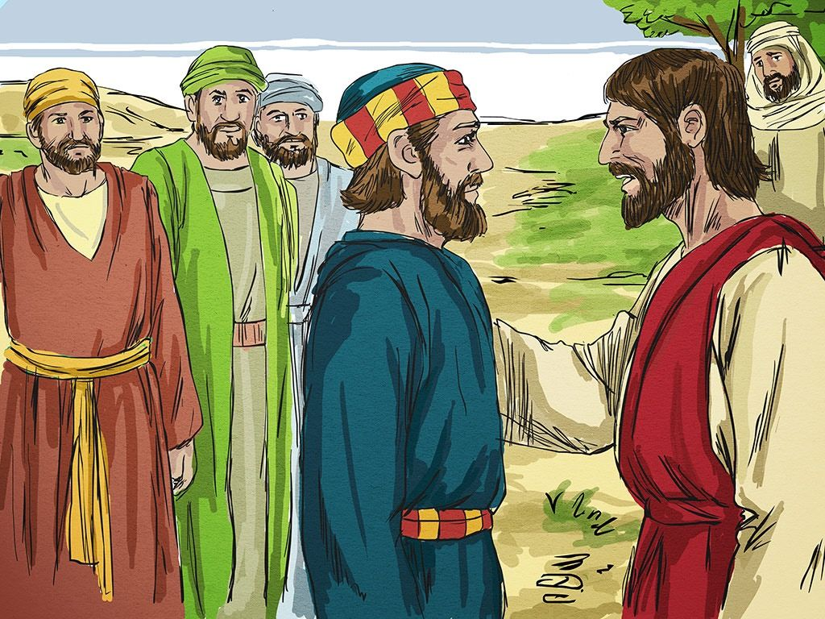
He said to them, “But who do you say that I am?”
Simon Peter said in reply, “You are the Christ, the Son of the living God.”
Jesus replied, “Blessed are you, Simon son of Jonah. For flesh and blood has not revealed this to you, but my heavenly Father.

Slide 4
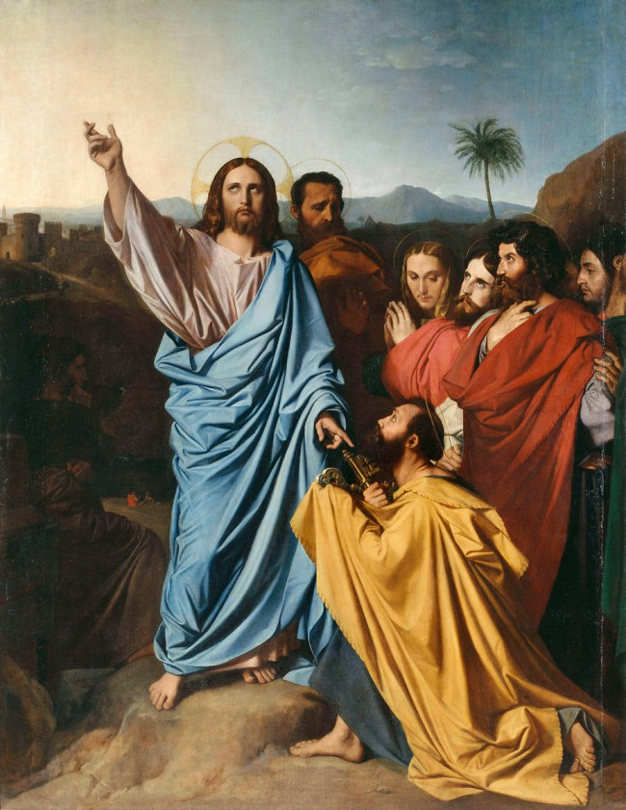
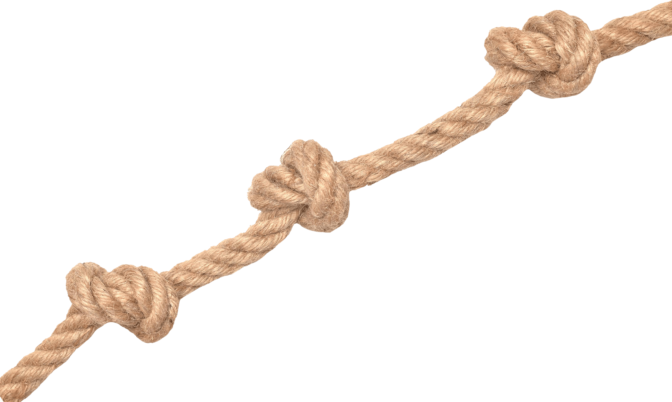
And so I say to you, you are Peter, and upon this rock I will build my church, and the gates of the netherworld shall not prevail against it. I will give you the keys to the kingdom of heaven.
Whatever you bind on earth shall be bound in heaven; and whatever you loose on earth shall be loosed
in heaven.
Then he strictly ordered his disciples to tell no one that he was the Christ.
The Gospel of the Lord
Praise to You Lord Jesus Christ

Slide 5
Jesus leaves the city to ask the disciples an important question. What does He ask them?
“Who do people say that the Son of Man is?”
Jesus expected a precise response from the men that were always with Him.

Slide 6
“You are the Christ, the Son of the living God.”
Simon Peter responded immediately.
Who was the only disciple who
answered clearly and definitively?
What did he say?
Jesus knew that that response did not come from himself, but from God.

Slide 7
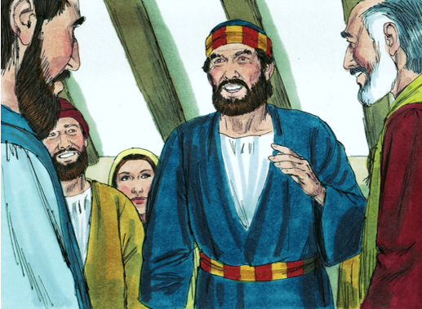
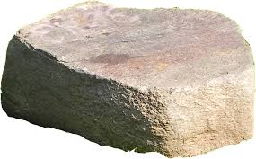
Jesus then gives Simon a new name. What was it?
He changes his name from Simon to Peter.
What does Peter mean?
“Rock”.
In the Old Testament, God had changed the names of several prophets, like Abraham or Jacob, to give them a mission.

Slide 8
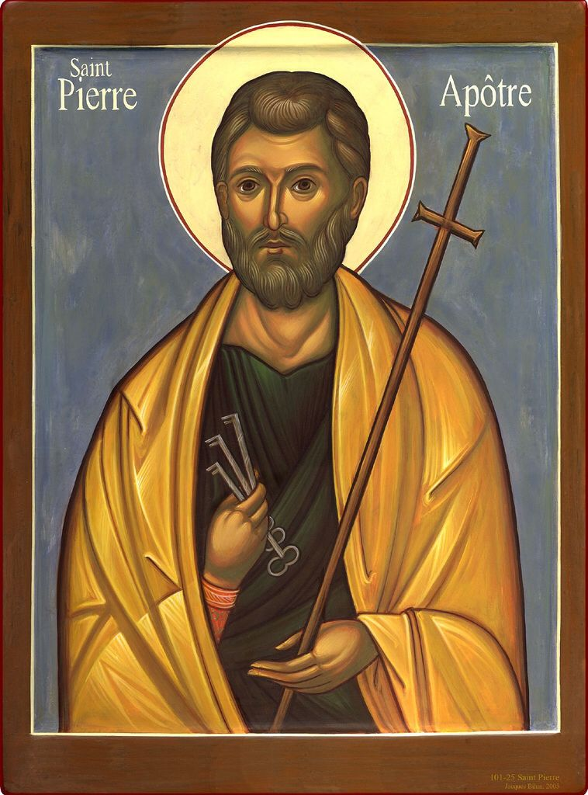
Peter will be the rock upon which he will build His Church. Peter is the visible head of a community that wants to live with Jesus forever (the Church).
What is the mission that Jesus gives Peter?
The head of the Church
is the Pope.
Jesus promises that the powers of Hell will never prevail over her.
The Church will Triumph!

Slide 9
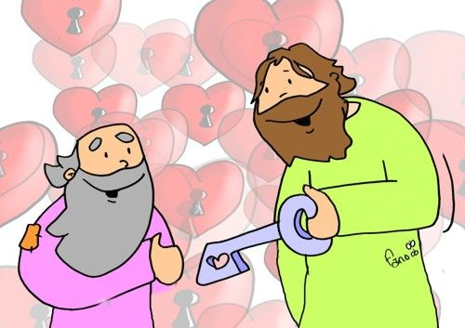
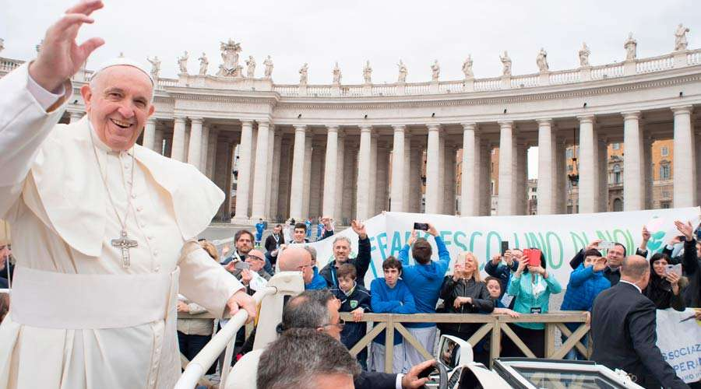
What else does Jesus give Peter?
He gives him the keys of the Kingdom of Heaven.
Peter receives the authority to guide the Church, helping its members get to Heaven.
Peter was the first Pope.
The Bishops and Priests, the successors of the apostles, help the Pope to complete his mission.
When Peter died, the keys passed to his successor.
Who is our Pope today?

Slide 10
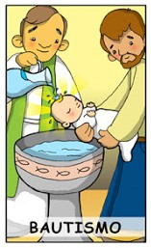
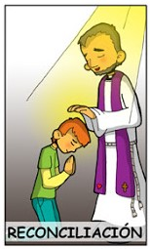
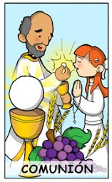
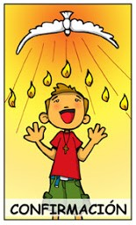
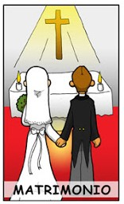
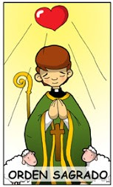
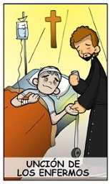
How does the Church help us to enter the Kingdom of Heaven?
Jesus becomes present in the Sacraments
so we may live in Him on earth and in Heaven.
The Seven
Sacraments
Baptism
Reconciliation
Communion
Confirmation
God erases original sin and takes us into His family.
God forgives our sins and helps us to not sin again.
Jesus becomes present in the bread and wine to be with us.
The Holy Spirit enters our heart in a special way.
Matrimony
Holy Orders
Annointing of the Sick
God helps the married couple to live their vocation.
God helps the priests and deacons in their vocation.
God gives His forgiveness and grace to heal or help the sick person get to Heaven.

Slide 11
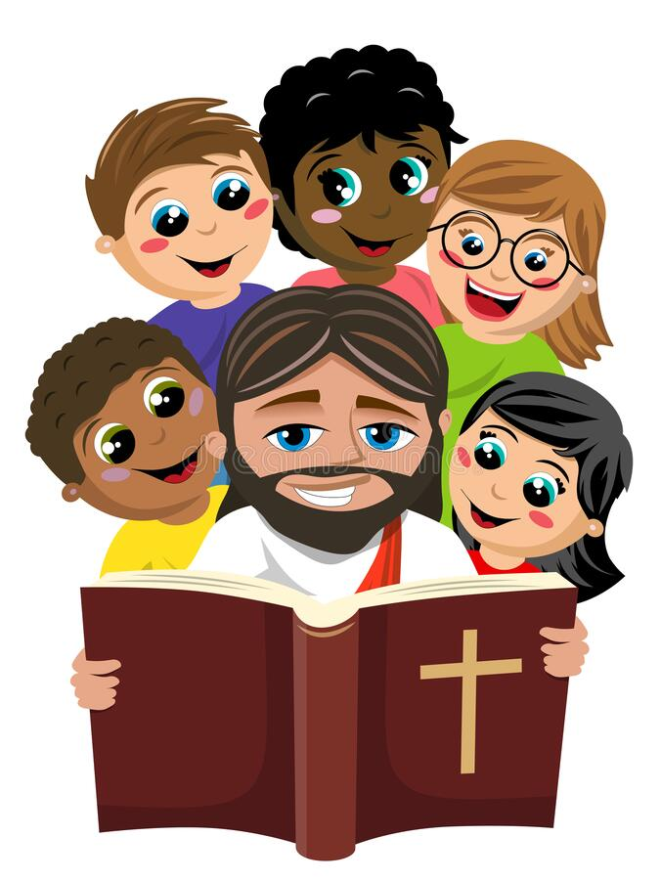
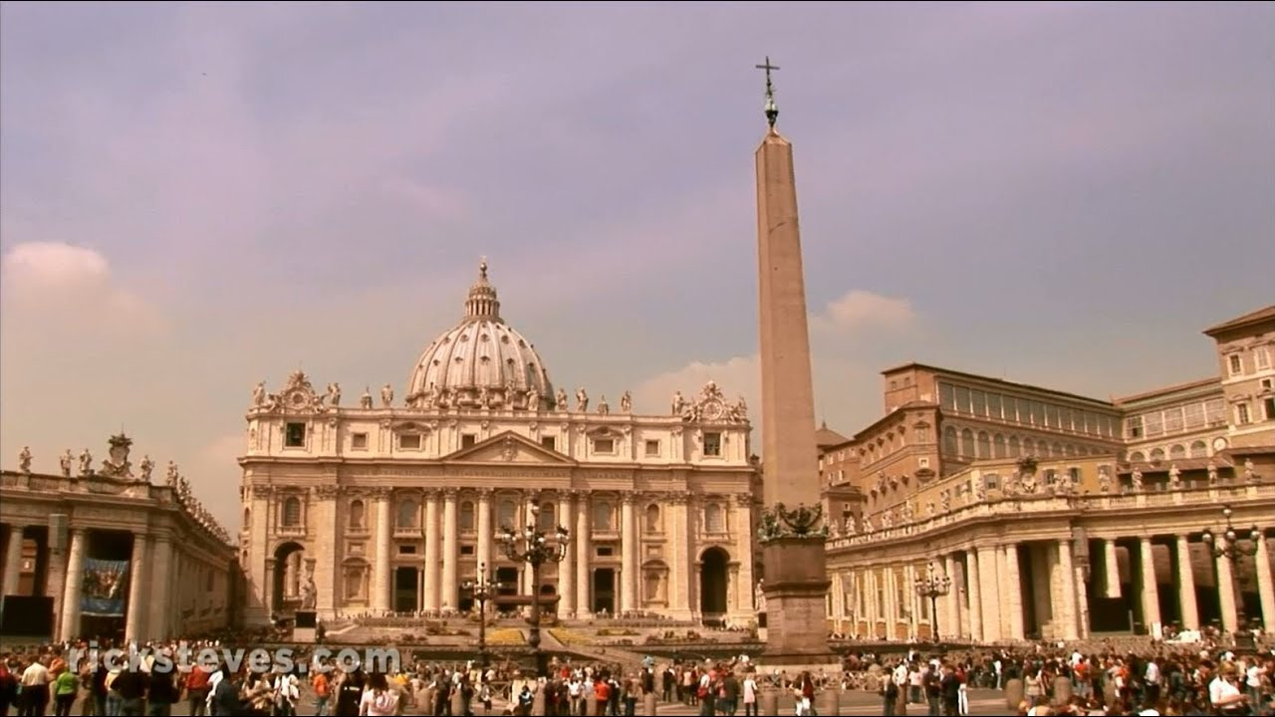
The Church teaches us the Tradition, the revealed Word of God that is not in Sacred Scripture, but was passed down from the apostles to their successors.
The Church, inspired by the Holy Spirit, interprets for us Sacred Scripture.
Our Catholic Faith is a great Treasure
that Jesus left to help us be happy
on earth and in Heaven!

Slide 12
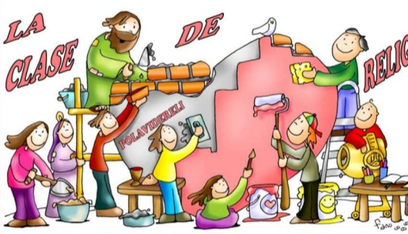
Activity

Slide 13
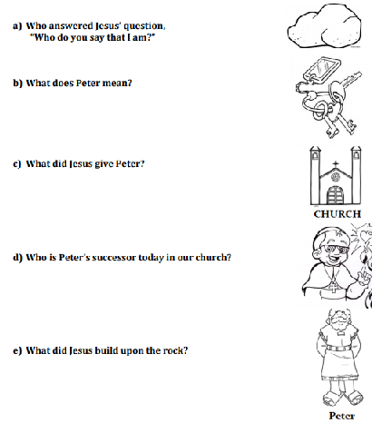

Slide 14
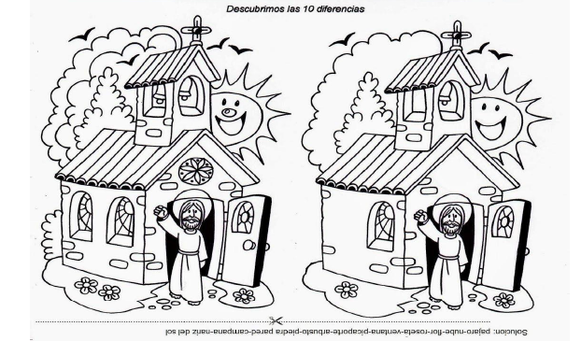
Find the 10 differences
1
2
3
4
5
6
7
8
9
10

Slide 15
Prayer
Oh Jesus, you wanted the Church to be constructed under the direction of Peter, the first Pope. Please bless our Pope Francis so that he may always be guided by the Holy Spirit and guide us to heaven. Take care of him and protect him always. Amen

Slide 16
You are Peter, Catholic Songs for kids, https://www.youtube.com/watch?v=-Z1Dx2ZBMgY (3-7 yrs.)

Slide 17
Peter’s Song, Michael O’Brien, https://youtu.be/xznM-v8fkYI?si=pBCylzVTi6NuDH9O (8+ yrs.)

