Slide 1
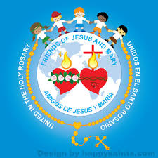
Ministry Friends of Jesus and Mary
Ciclo A -XXII Sunday in Ordinary Time
Take Your Cross and Follow Me - Matthew 16, 21-27
www.fcpeace.org

Slide 2
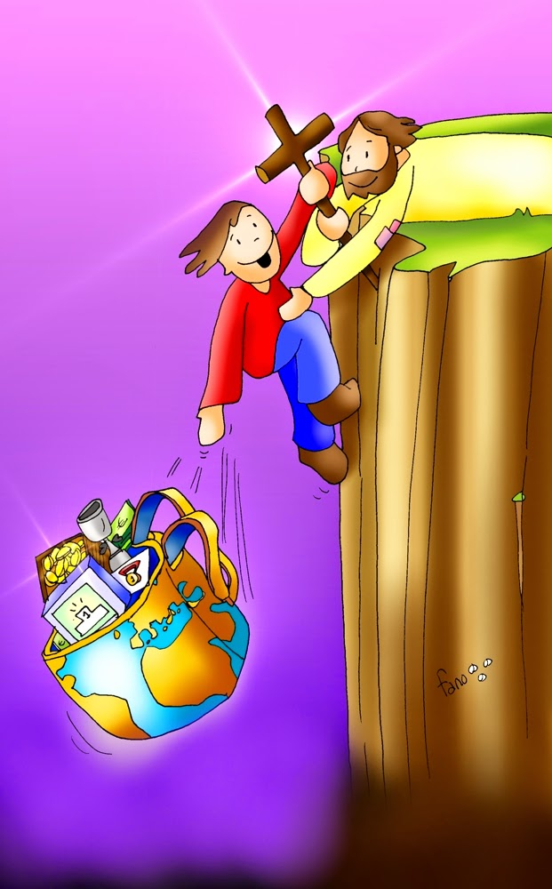
Matthew 16, 21-27
Take Your Cross and Follow Me

Slide 3
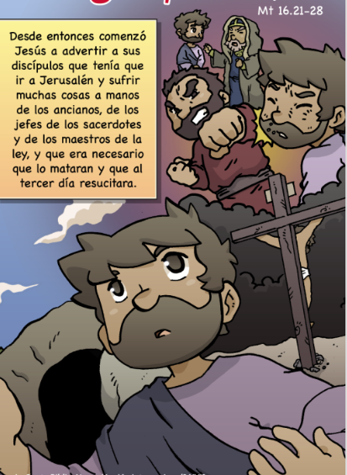
MATTHEW 16, 21-27
Jesus began to show his disciples that he must go to Jerusalem and suffer greatly from the elders, the chief priests, and the scribes, and be killed and on the third day be raised.

Slide 4
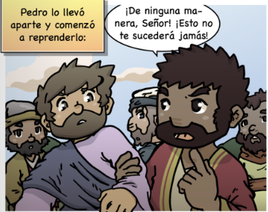
MATTHEW 16, 21-27
Then Peter took Jesus aside and began to rebuke him,
“God forbid, Lord! No such thing shall ever happen to you.“

Slide 5
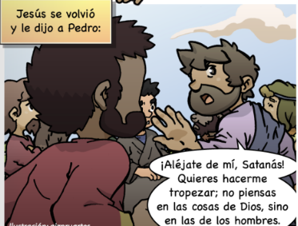
MATTHEW 16, 21-27
He turned and said to Peter,
“Get behind me, Satan! You are an obstacle to me. You are thinking not as God does, but as human beings do.”

Slide 6
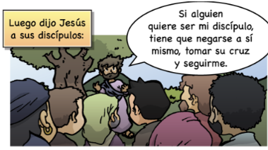
MATTHEW 16, 21-27
Whoever wishes to come after me must deny himself, take up his cross, and follow me.
Then Jesus said to his disciples,
The Gospel of the Lord, Praise to you, Lord Jesus Christ.

Slide 7
REFLECTION

Slide 8
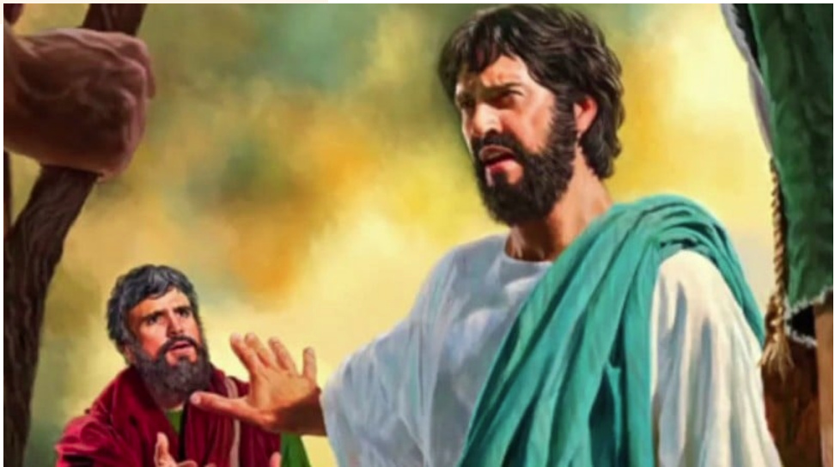
Jesus announces His death and Peter exclaims:
“No such thing can happen to you!”
Why did Peter say this?
Because watching Jesus suffer and die was very sad for him. Also, Jesus is God and does not deserve such a painful death.
Why does Jesus get upset?
Peter is thinking as men think, which is how to avoid suffering. But Jesus thinks about doing God’s will and God thinks instead of how to love and save us.
Peter did not understand Jesus’ mission was to sacrifice Himself so that God would forgive our sins, an act of GREAT LOVE for us.

Slide 9
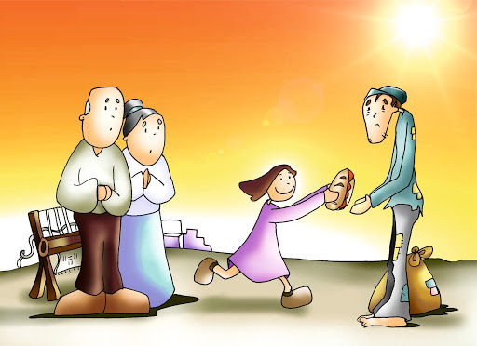
Jesus said, “Whoever wishes to come after me must deny himself, take up his cross, and follow me.”
What did He mean by deny himself?
He means we must leave our comfort and desires to go do God’s will. God wants us to think of others not ourselves.

Slide 10
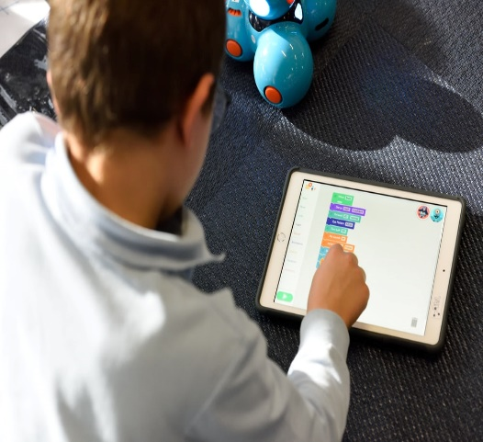
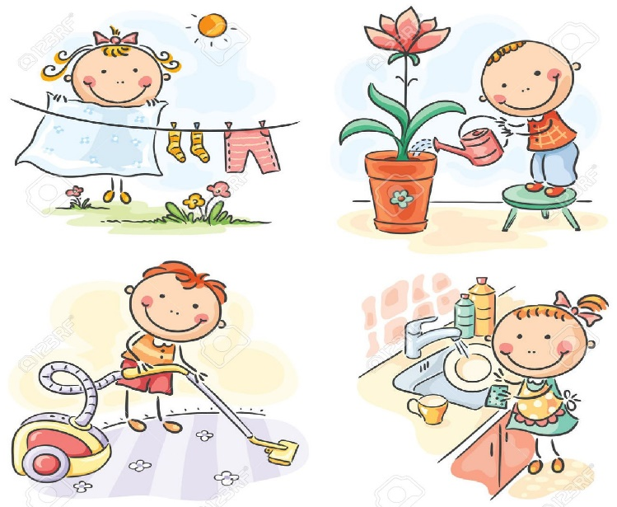
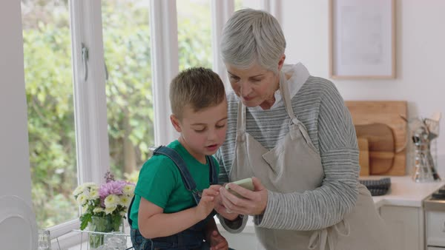
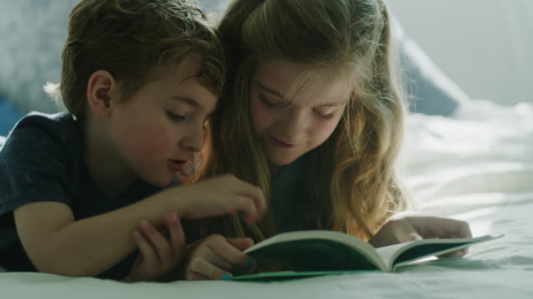
How can we deny ourselves?
For example, instead of playing on my phone or i-pad all day, I can…
Help with the housework…
Or spend time with my grandmother…
Or help my little brother or sister…
It means to think of others,
not only myself.

Slide 11
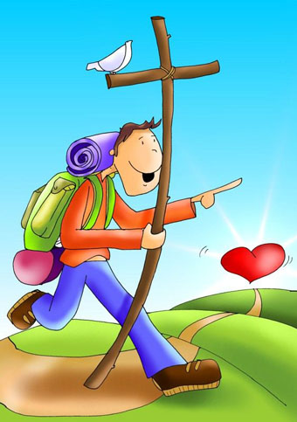
What does it mean to carry our cross and follow Jesus?
It means to place God first,
always loving and obeying Him, and not placing our toys, games, or friends first…
It means to give up our comfort and pleasure to help others.

Slide 12
God made us
And a spirit.
A body

Slide 13
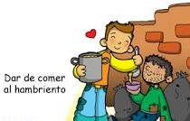
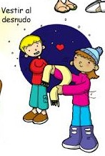
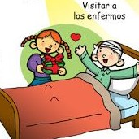
We can help others with needs of their body…
Feed the hungry,
Give water to the thirsty
Give clothes to the naked.
Care for the sick,

Slide 14
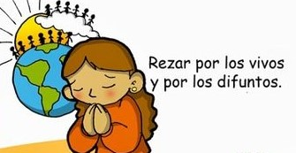
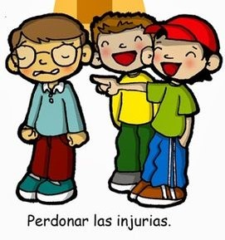
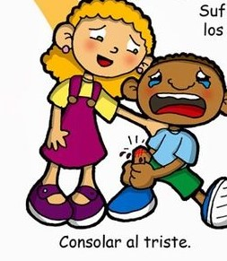
We can also help others with the needs of their spirit...
Pray for the living and the dead
Instruct the ignorant.
Forgive offenses
Comfort the sorrowful

Slide 15
ACTIVITY

Slide 16
Choose wether you are helping the body or the spirit?
Instruct the ignorant,
Forgive offenses,
Give water to the thirsty,
Clothe the naked,
Feed the hungry,
Pray for the living and the dead,
Care for the sick,
Comfort the sorrowful

Slide 17
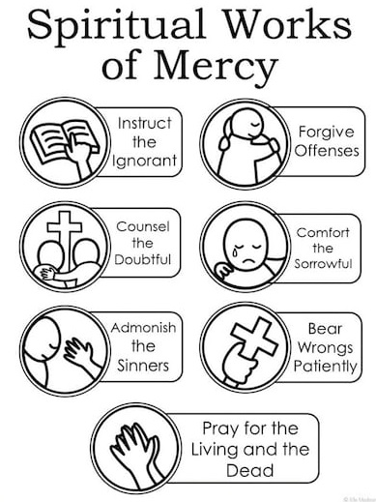
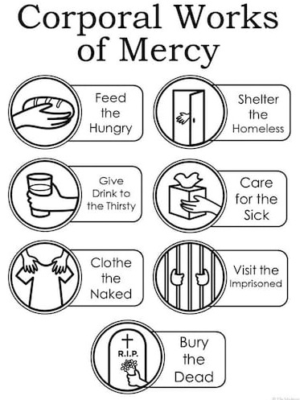

Slide 19
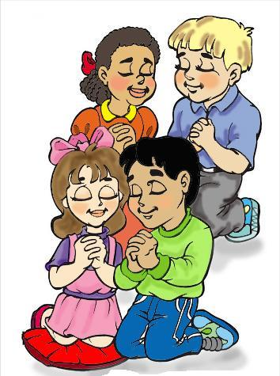
PRAYER
Jesus,
Fill my heart with your love so that I can think, act , and feel just like you did; especially I ask for peace of mind so that I can stop worrying about my own problems, and instead start thinking about others. Amen.

Slide 20
Song: A Gift to You, Angel 911, https://youtu.be/J_g76phMf5E?si=FpgNDvBQxnue0ekk (3-7 yrs.)

Slide 21
Song: Put God’s Work First, CJ and friends, https://youtu.be/IZfNBzZ5L-M?si=cwNgZiF5Ickn4P0Z (8+ yrs.)

