Slide 1
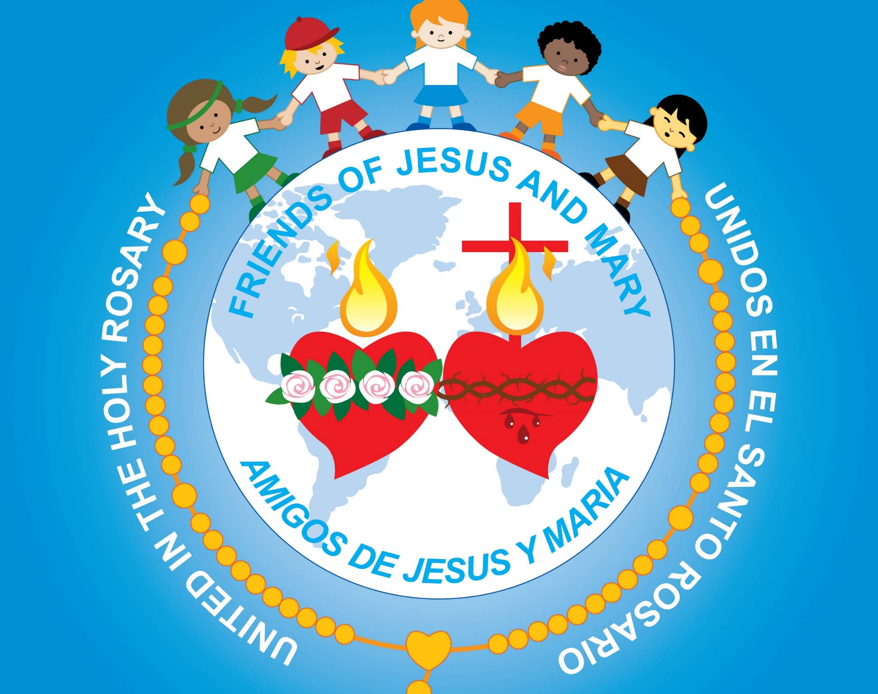
Ministry Friends of Jesus and Mary
Cycle A - XXIII Sunday in Ordinary Time
Correcting our Neighbor
Matthew 18, 15-20
www.fcpeace.org

Slide 2
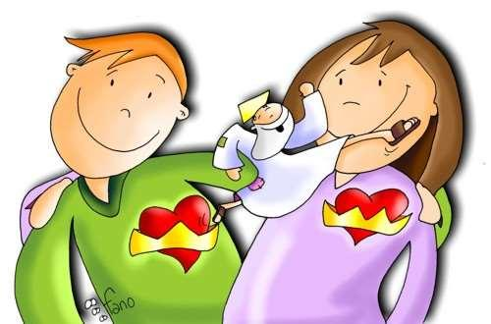
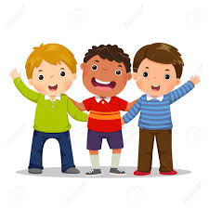
Matthew 18, 15-20 - Correcting our Neighbor
Jesus said to his disciples: “If your brother sins against you, go and tell him his fault between you and him alone. If he listens to you, you have won over your brother.
If he does not listen, take one or two others along with you, so that ‘every fact may be established on the testimony of two or three witnesses.’

Slide 3
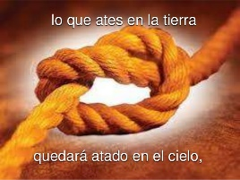
Matthew 18, 15-20 - Correcting our Neighbor
If he refuses to listen to them, tell the church. If he refuses to listen even to the church, then treat him as you would a Gentile or a tax collector.
Amen, I say to you, whatever you bind on earth shall be bound in heaven, and whatever you loose on earth shall be loosed in heaven.

Slide 4
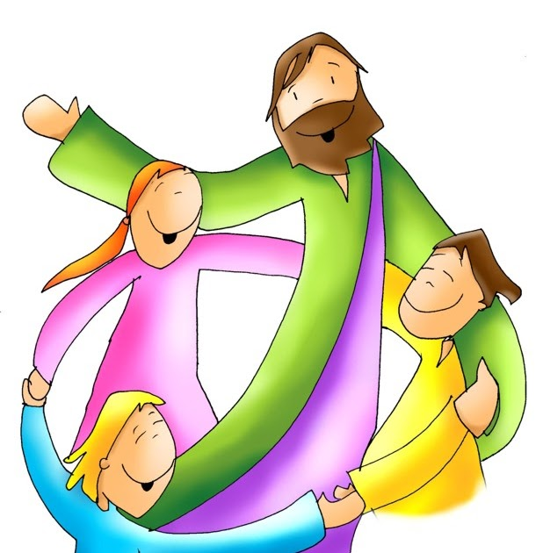
Matthew 18, 15-20 - Correcting our Neighbor
Again, amen, I say to you, if two of you agree on earth about anything for which they are to pray, it shall be granted to them by my heavenly Father. For where two or three are gathered together in my name, there am I in the midst of them.”
THE GOSPEL OF THE LORD
PRAISE TO YOU
LORD JESUS CHRIST

Slide 5
REFLECTION

Slide 6
Jesus wants us to love our neighbor and to desire their salvation. He gives us steps to help them realize their sin.
What is the
1st step?
Go and tell him/her the fault between you and your neighbor alone. If (s)he listens to you, you have won over your neighbor.

Slide 7
What happens if (s)he doesn’t listen?
Take one or two others along with you, so that ‘every fact may be established on the testimony of two or three witnesses.
(S)He is more likely to believe two or more persons than just one.

Slide 8
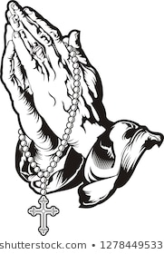
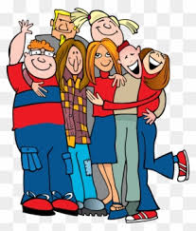
What happens if (s)he still doesn’t listen?
Then tell the community so they can help convince them.
The community can pray for them.
The community can receive them.
…If they still don’t listen, treat them as though they are a gentile or a tax collector.

Slide 9
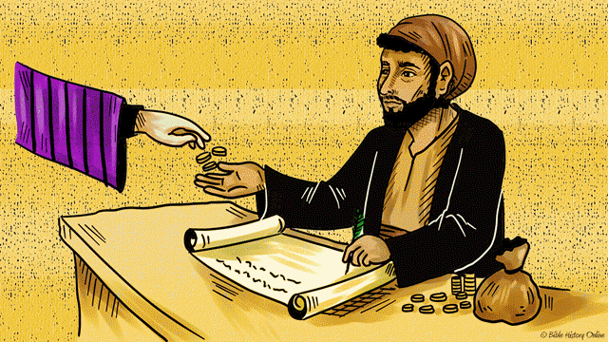
A gentile did not love God or follow His commandments; a tax collector robbed people to make themselves rich and were hated.
God wanted them to separate from the gentiles and tax collectors so they would not be tempted to follow their bad habits.
In the same way, if we see someone doing bad things, we should separate from them so we are not tempted to imitate them and thus to sin.

Slide 10
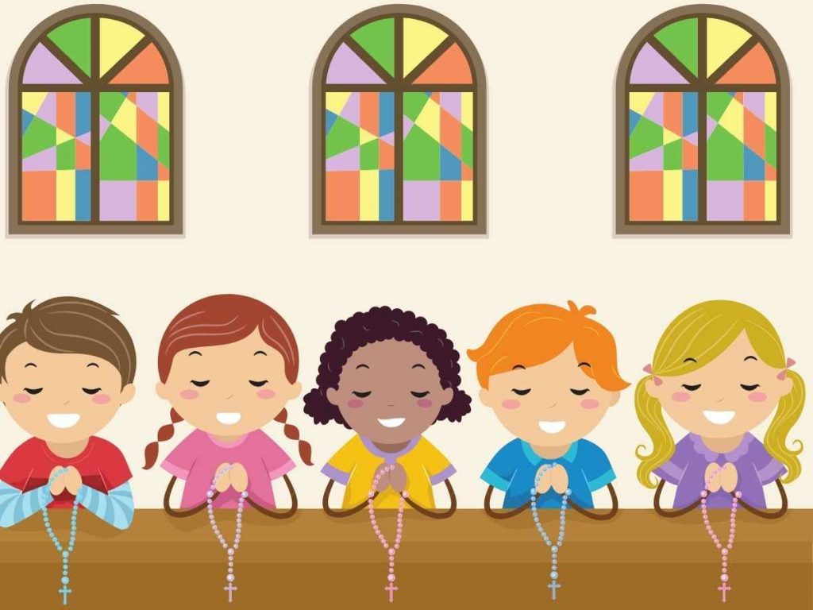
But since we want to save others, God gives us hope. What else can we do?
We can pray for them. Jesus said: “If two of you agree on earth about anything for which they are to pray, it shall be granted to them by my heavenly Father. For where two or three are gathered together in my name, there am I.” GOD LISTENS!

Slide 11
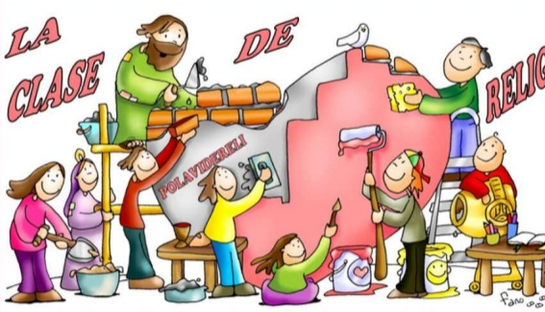
Activity

Slide 12
C
H
U
R
C
H
B
R
O
T
H
E
R
F A T E
L
I
S
T
E
N
S S T E
W O
N
A
M
E
G R E

Slide 13
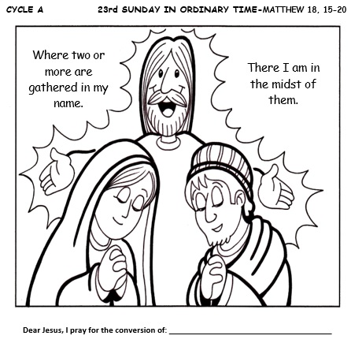

Slide 14
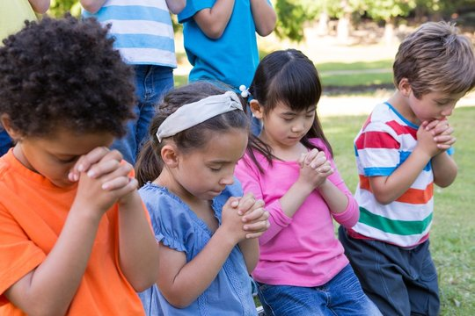
Prayer
Jesus, I pray that when correcting someone, you help me do it with goodness and love as you would. When someone corrects me, I pray that I may receive it with humility, trusting that they love me and desire my salvation.
Amen

Slide 15
God is Listening, Lifetree Kids, https://youtu.be/i2gi2omSqus?si=sox-AKA67B2FXMiz

Slide 16
God Who Listens, Chris Tomlin, https://youtu.be/MbWOM4wc9bo?si=z73zEXulQgS32AuU (8+ yrs.)

