Slide 1
Friends of Jesus and Mary
www.fcpeace.org
Cycle A - XXIV Sunday in Ordinary Time
Forgive 70 x 7 times- Matthew 18, 21-35

Slide 2
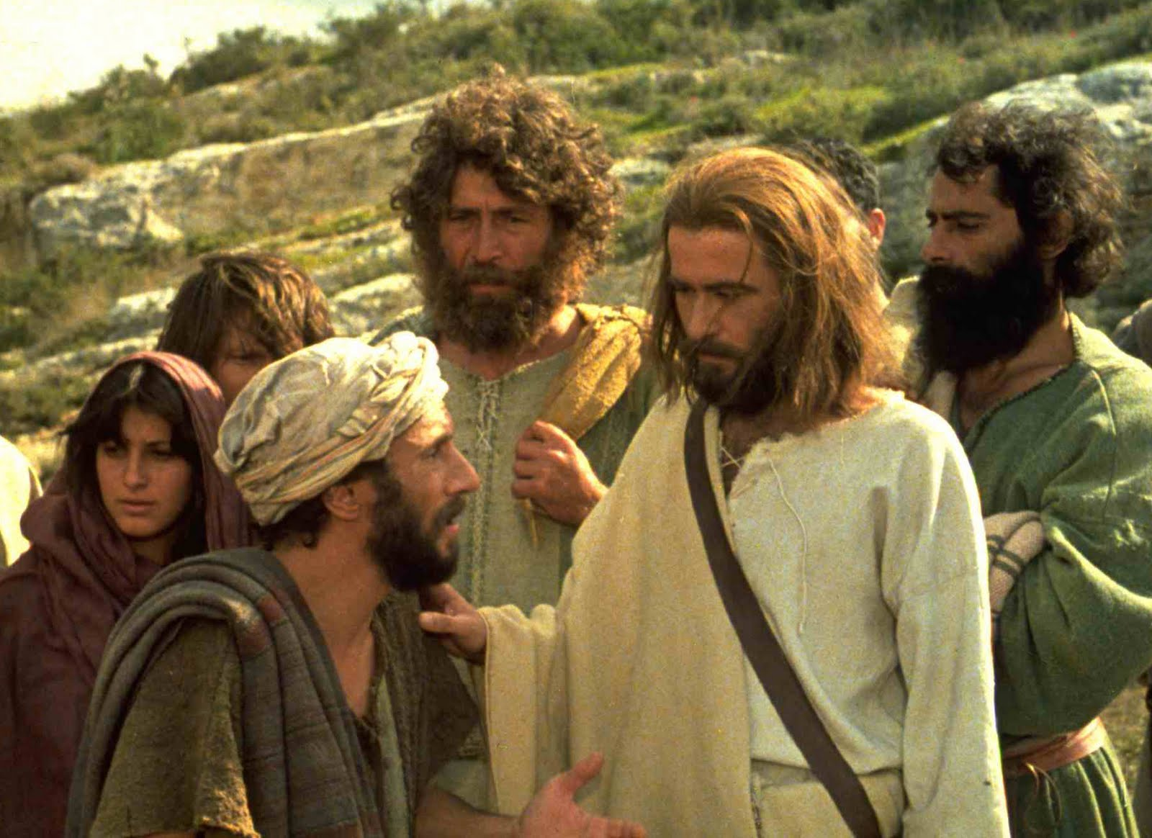
Peter approached Jesus and asked him, “Lord, if my brother sins against me, how often must I forgive? As many as seven times?”
Jesus answered, “I say to you, not seven times but seventy-seven times.”

Slide 3
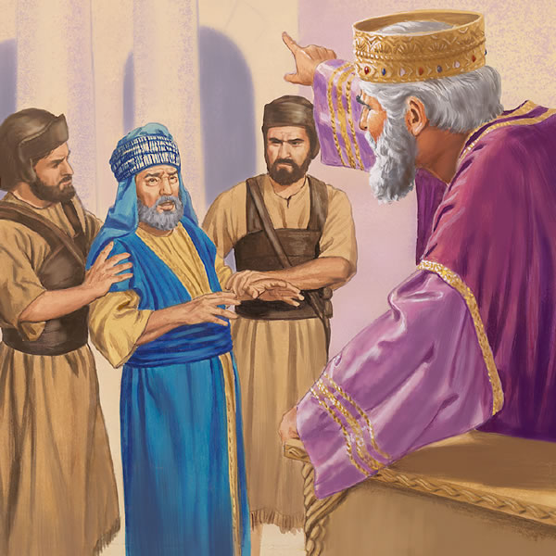
That is why the kingdom of heaven may be likened to a king who decided to settle accounts with his servants.
When he began the accounting, a debtor was brought before him who owed him a huge amount.
Since he had no way of paying it back, his master ordered him to be sold, along with his wife, his children, and all his property, in payment of the debt.

Slide 4
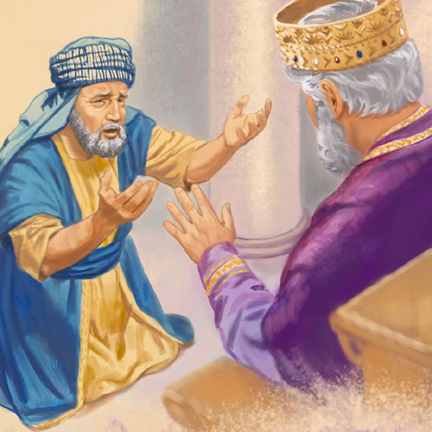
At that, the servant fell down, did him homage, and said, ‘Be patient with me, and I will pay you back in full.’ Moved with compassion the master of that servant let him go and forgave him the loan.

Slide 5
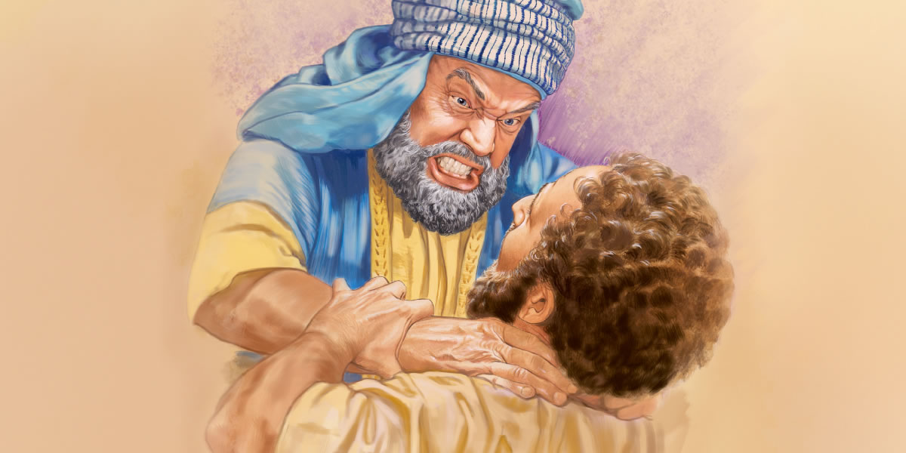
When that servant had left, he found one of his fellow servants who owed him a much smaller amount.
He seized him and started to choke him, demanding, ‘Pay back what you owe.’

Slide 6
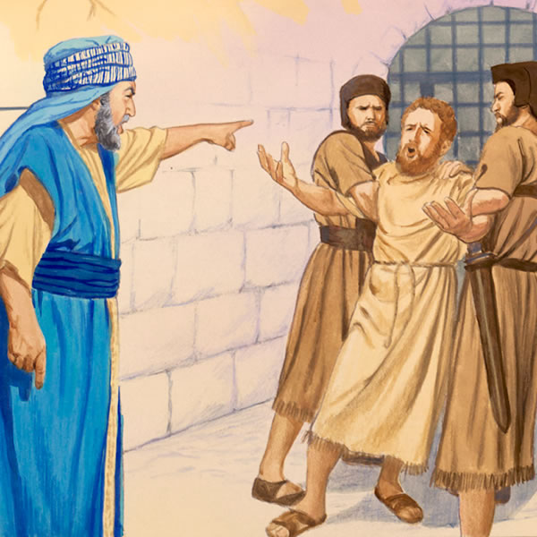
Falling to his knees, his fellow servant begged him, ‘Be patient with me, and I will pay you back.’
But he refused. Instead, he had the fellow servant put in prison until he paid back the debt.

Slide 7
Then in anger his master handed him over to the torturers until he should pay back the whole debt.
Now when his fellow servants saw what had happened, they were deeply disturbed, and went to their master and reported the whole affair.
His master summoned him and said to him, ‘You wicked servant! I forgave you your entire debt because you begged me to. Should you not have had pity on your fellow servant, as I had pity on you?’

Slide 8
So will my heavenly Father do to you, unless each of you forgives your brother from your heart.”
The Gospel of the Lord,
Praise to you Lord Jesus Christ.

Slide 9
REFLEXION

Slide 10
Peter asks Jesus how many times he must forgive. Seven times? What does Jesus answer?
Jesus answers, “I say to you, not seven times but seventy-seven times.”
The number seven in the bible means perfection. To be perfect, we must always forgive.

Slide 11
Jesus teaches the importance of forgiving with a parable about the Kingdom of God. (The Kingdom of God is made up of those that accept Jesus as the King of their hearts).
In the Parable, who does the King represent?
God
Who does the servant represent?
A Sinner
Why does the king forgive the servant’s debt?

Slide 12
The King felt sorry for him when he fell before him begging and promising to repay.
When we sin, what should we do to receive God’s forgiveness?
Repent from the heart and ask for forgiveness. Also forgive others who hurt us.
What did the servant do after he was forgiven?

Slide 13
He sent a fellow servant to jail for not repaying a small debt he owed him.
How did the king react when he heard of this?
?

Slide 14
He sent him to jail until he repaid his debt because he was not equally compassionate as the king had been to him.
What does God want from us?

Slide 15
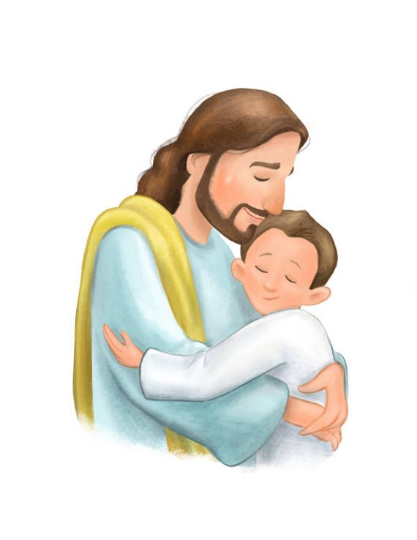
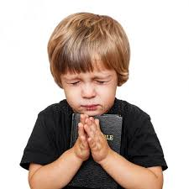
God wants us to forgive those who hurt us, just as He forgives us when we are sorry for our sins.
It is not easy, but we can ask Him to help us with his Grace.

Slide 16
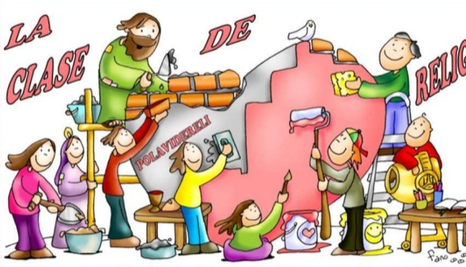
Activity

Slide 17
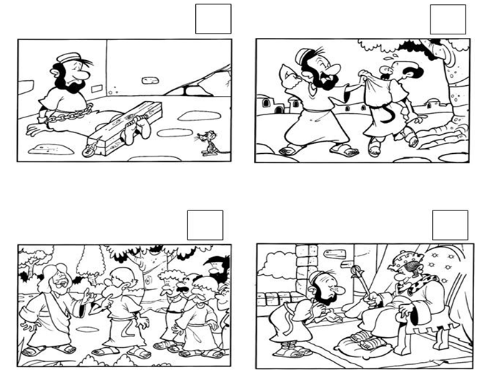
3
2
4
1

Slide 18
Prayer
Good and merciful God, who cannot ignore a contrite heart, help me to repent of my sins; and help me to always forgive, especially______.

Slide 19
Song: Forgive One Another, We Are United, (Ctrl Click) https://youtu.be/kZ_wCZ1gPN4, (3-7 yrs.)

Slide 20
Song: A Heart that Forgives, fontz2001, https://youtu.be/iUV5T9JIJZ0?si=ciUW_kVUtKIqVHBj (8+ yrs.)

