Slide 1
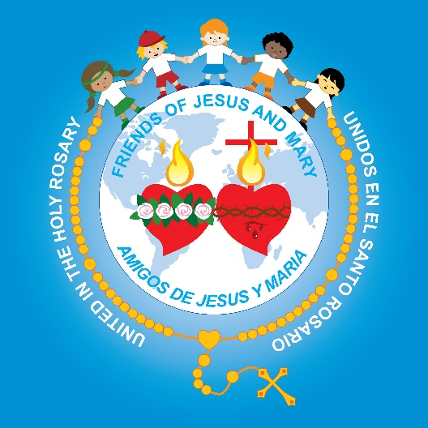
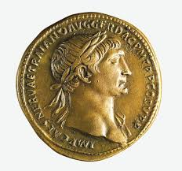
Friends of Jesus and Mary
Prayer Group for Children
Cycle A – XXIX Sunday in Ordinary Time
Give to Caesar What is Caesar's, Mathew 22, 15-21
www.fcpeace.org

Slide 2
Repay to Caesar what belongs to Caesar and to God what belongs to God.
The Gospel - Mathew 22, 15-21, CCTNtv
https://youtu.be/lN5YCmoa7jM

Slide 3
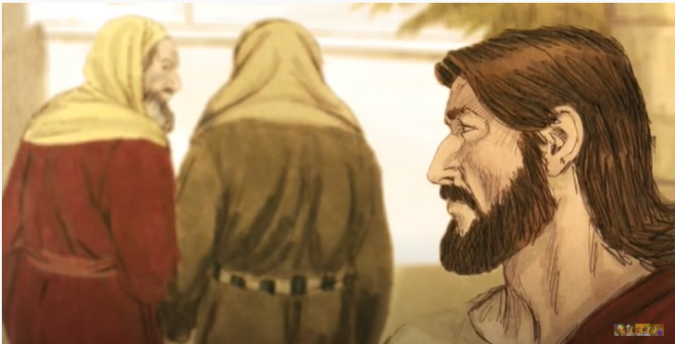
Jesus had told the high priests and elders of God’s people that God would take away their authority because they were not guiding them well. They did not listen to God’s prophets nor to Jesus either. They were furious and wanted to kill Him. They did not recognize that Jesus was God because of their stony hearts.

Slide 4
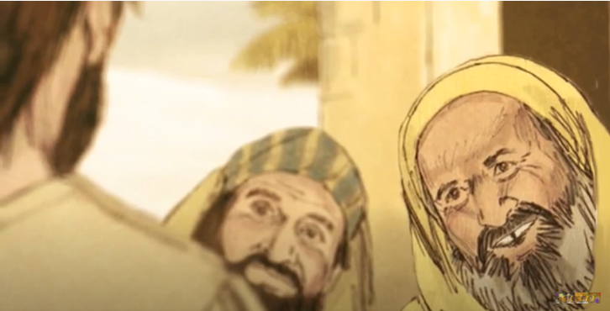
They planned to ask him a question which He could not answer correctly. But Jesus knew what they were up to (God knows everything.)
What did they ask?
Is it lawful to pay the census tax to Caesar or not?

Slide 5
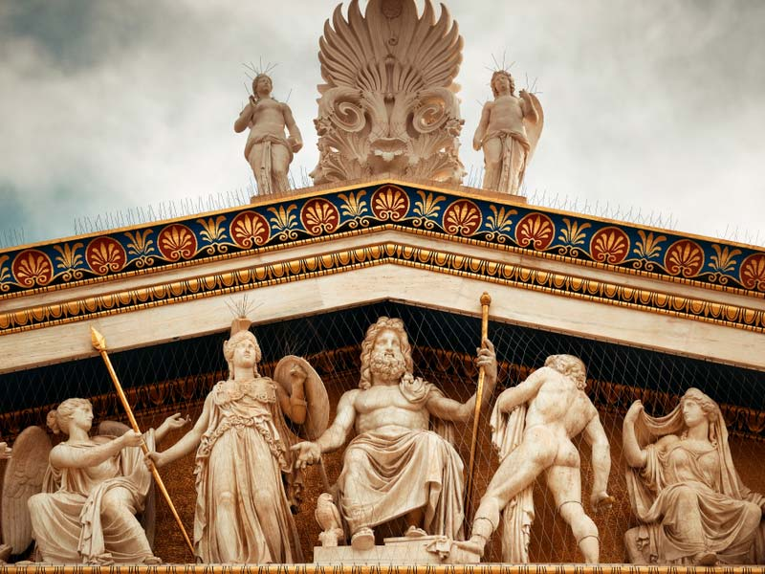
The Jews were oppressed by the Romans who charged excessive taxes and resented having to pay them. Also, the Roman Emperor, Caesar, believed he was God and had to be adored.

Slide 6
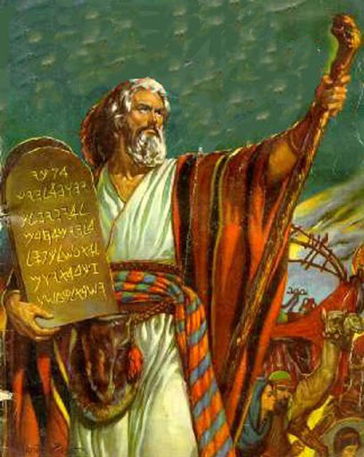
The Jews worshipped only the one God. This was required by God in the 1st of the 10 Commandments given to Moses at Mount Sinai.
You shall love the Lord, your God, with all your heart, with all your soul, and with all your mind.
They felt paying the tax was a violation of the 1st Commandment.

Slide 7
If Jesus answered yes they should pay, the Jews would be upset.
If He answered no they should not pay, the Romans, there represented by the followers of Herod, would accuse Him of treason and could put Him in jail or even kill Him.

Slide 8
How did Jesus respond?
He asked to see a coin asking them whose image was on it.
When they answered Caesar, Jesus said, “Then repay to Caesar what belongs to Caesar and to God what belongs to God.

Slide 9
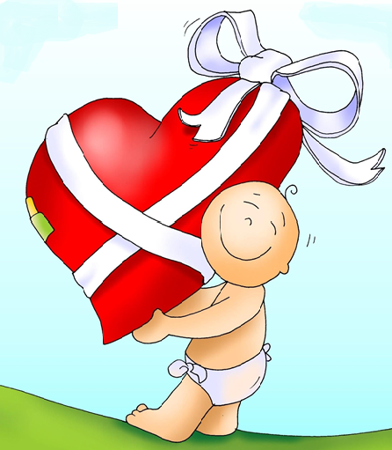
What does God want from us?
He wants our heart,
full of love,
obedient to His commandments,
and willing to serve.

Slide 10
Activity

Slide 11
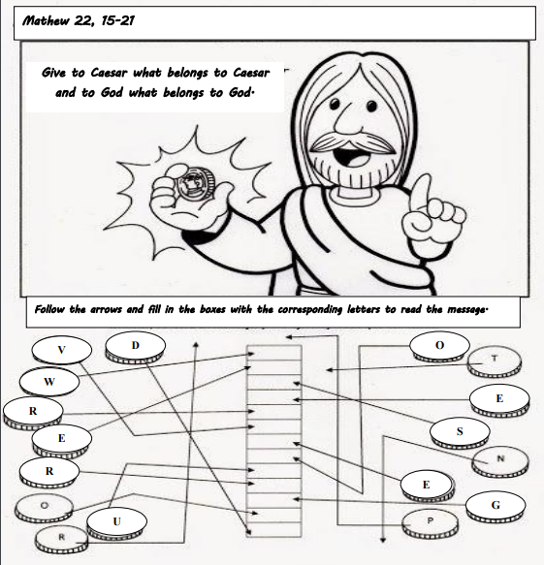
W
E
S
E
R
V
E
O
U
R
G
O
D

Slide 12
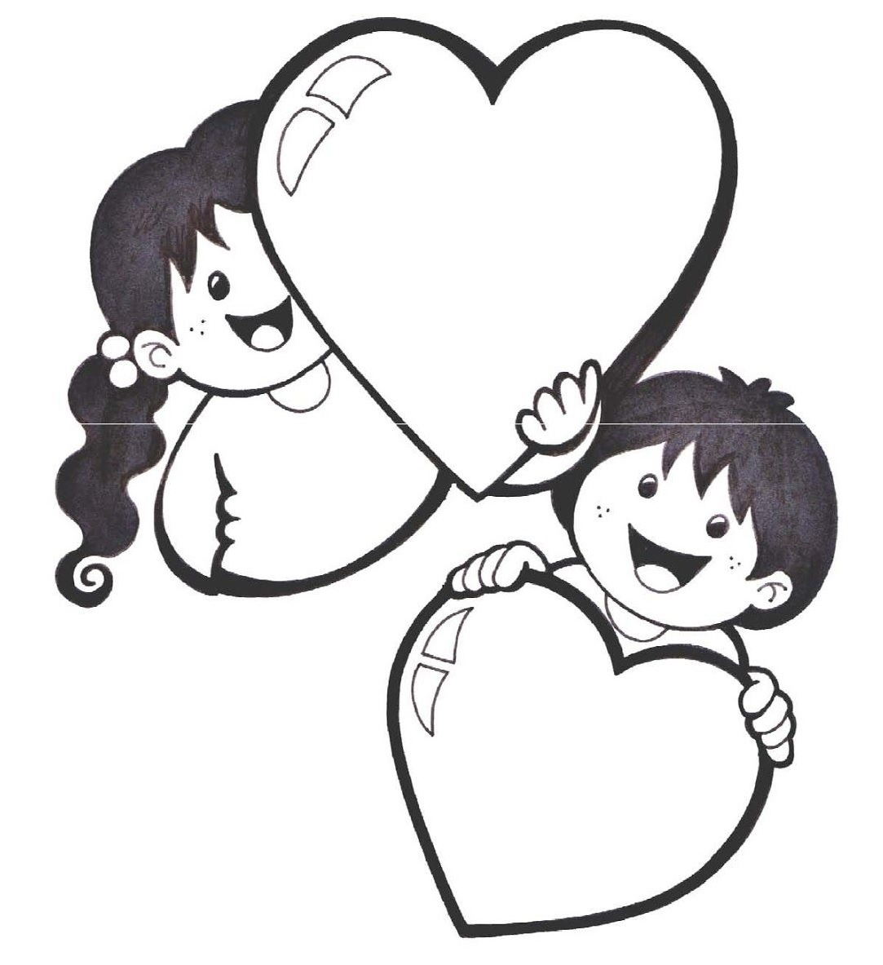
God wants our heart, full of love and obedience to His commandments and willing to serve.
Write or draw in the hearts how you will love or serve Jesus this week.

Slide 13
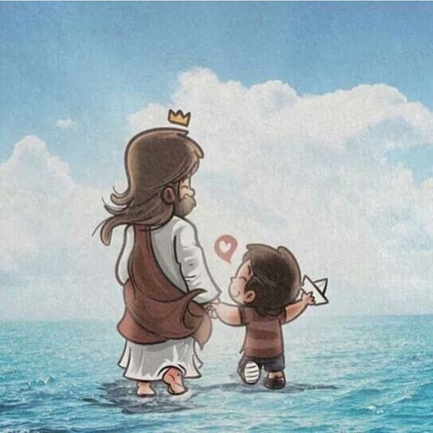
PRAYER My Jesus, I give you my heart, full of love for you. Help me to always be obedient and to seek to serve you by loving and serving others. Amen.

Slide 14
Song: I Give You my Heart, Hillsong Kids

Slide 15
Blessed among us:
St. Therese of the Child Jesus,
Feast Day, October 2
https://youtu.be/n_Lq73KVVvQ
“Jesus does not look so much at the greatness of our works, not even their difficulty, but at the love with which these works are done.”
“I Will spend my Heaven doing Good on earth.”
“After my death, I will let fall a shower of roses.”

