Slide 1
Friends of Jesus and Mary
Cycle A – XXV Sunday in Ordinary Time
THE LAST SHALL BE FIRST
Mathew 20, 1-16
Feast of the Exaltation of the Cross

Slide 2
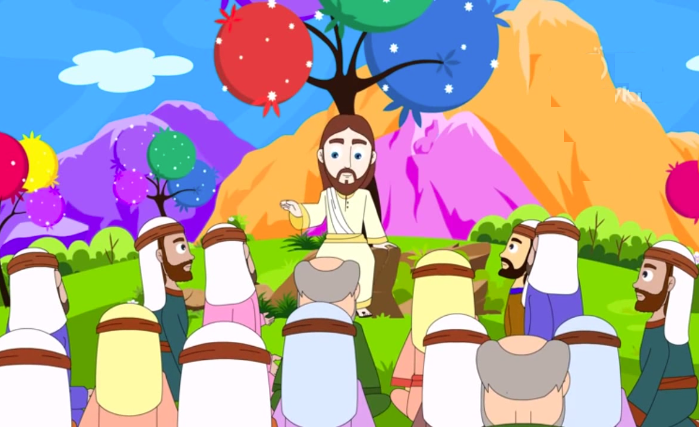
GOSPEL Mathew, 20: 1-16
Jesus told his disciples this parable:

Slide 3
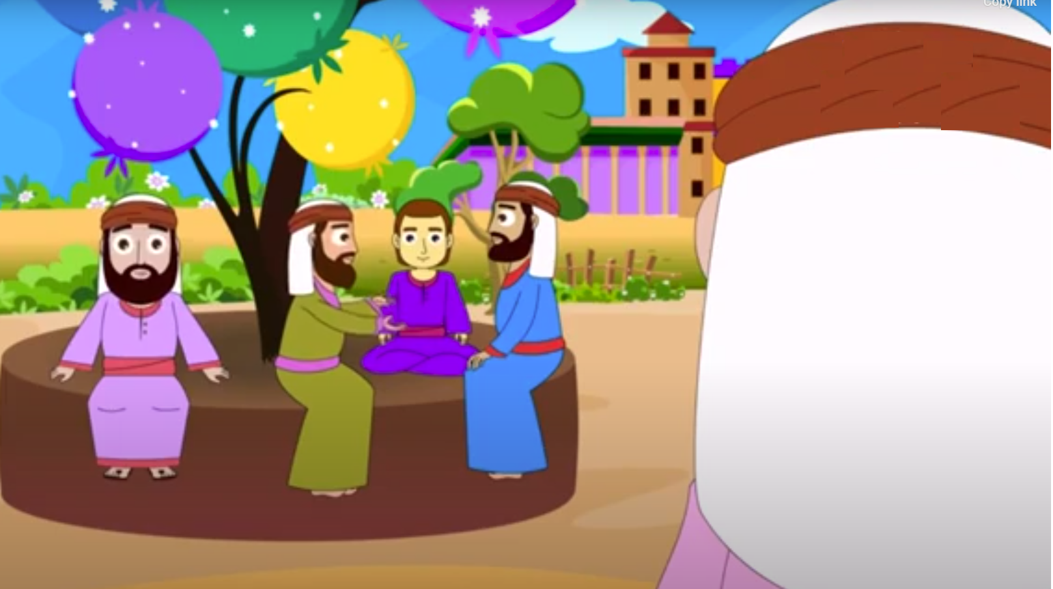
“The kingdom of heaven is like a landowner who went out at dawn to hire laborers
for his vineyard.

Slide 4
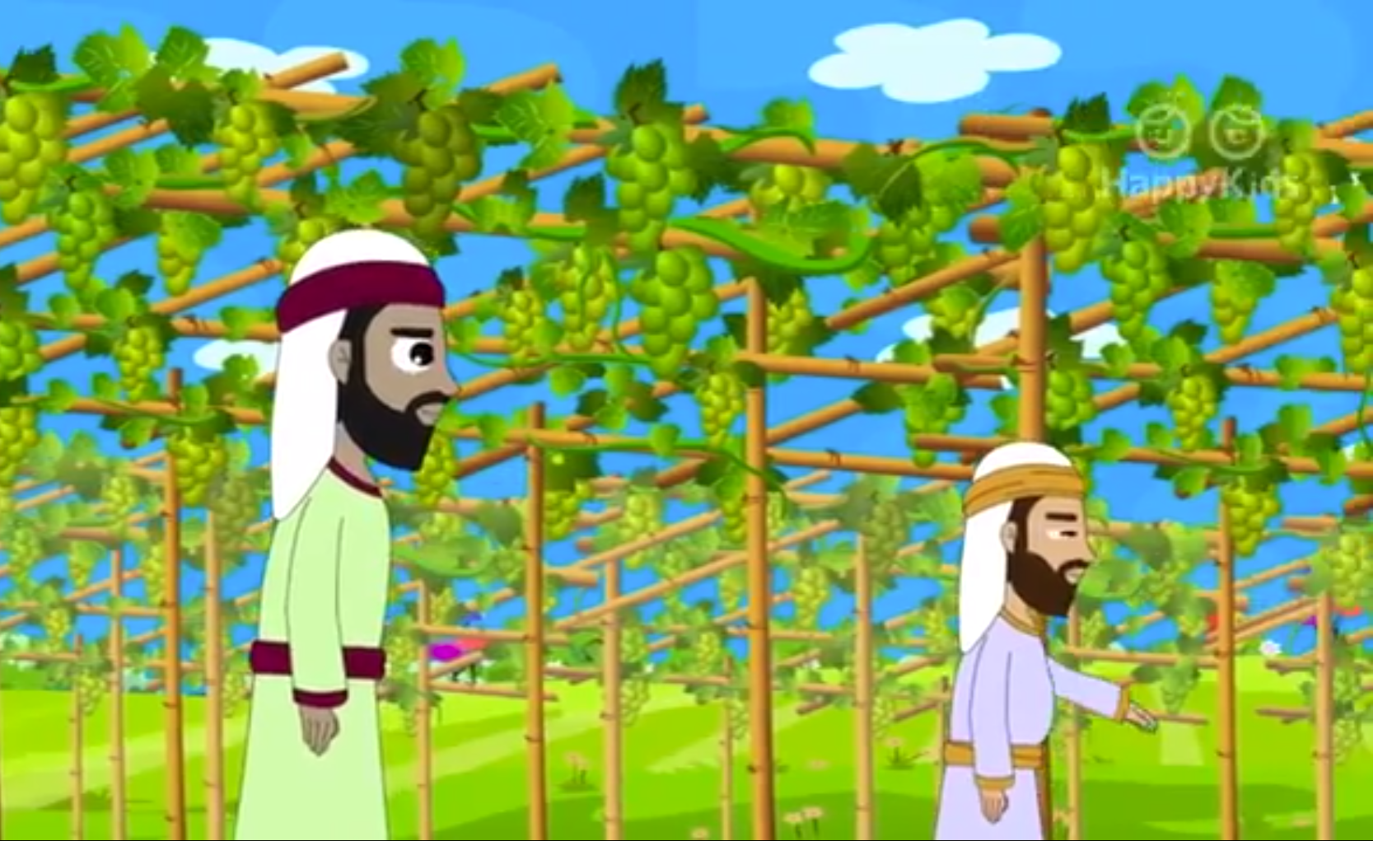
After agreeing with them for the usual daily wage, he sent them into his vineyard.

Slide 5
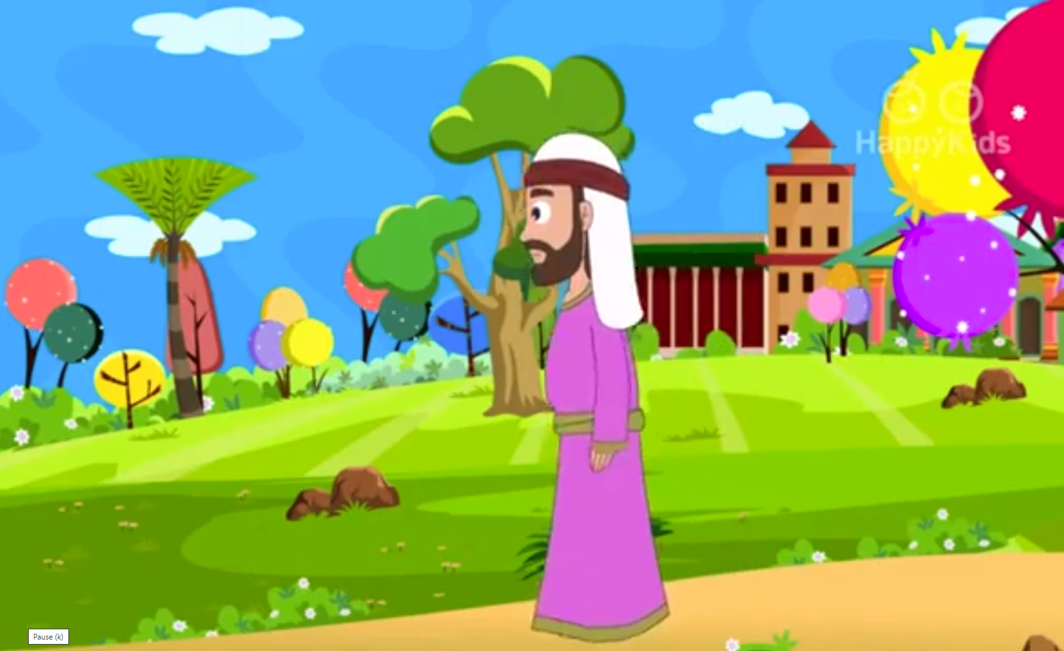
Going out about nine o’clock,

Slide 6
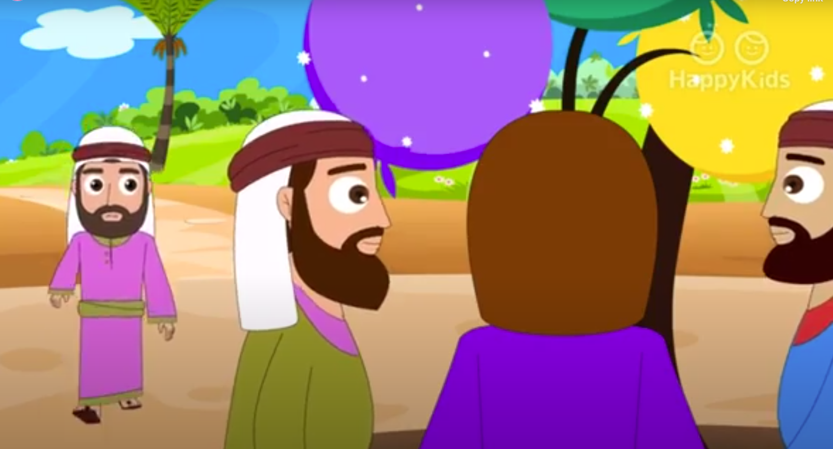
the landowner saw others standing idle in the marketplace, and he said to them, ‘You too go into my vineyard, and I will give you what is just.’

Slide 7
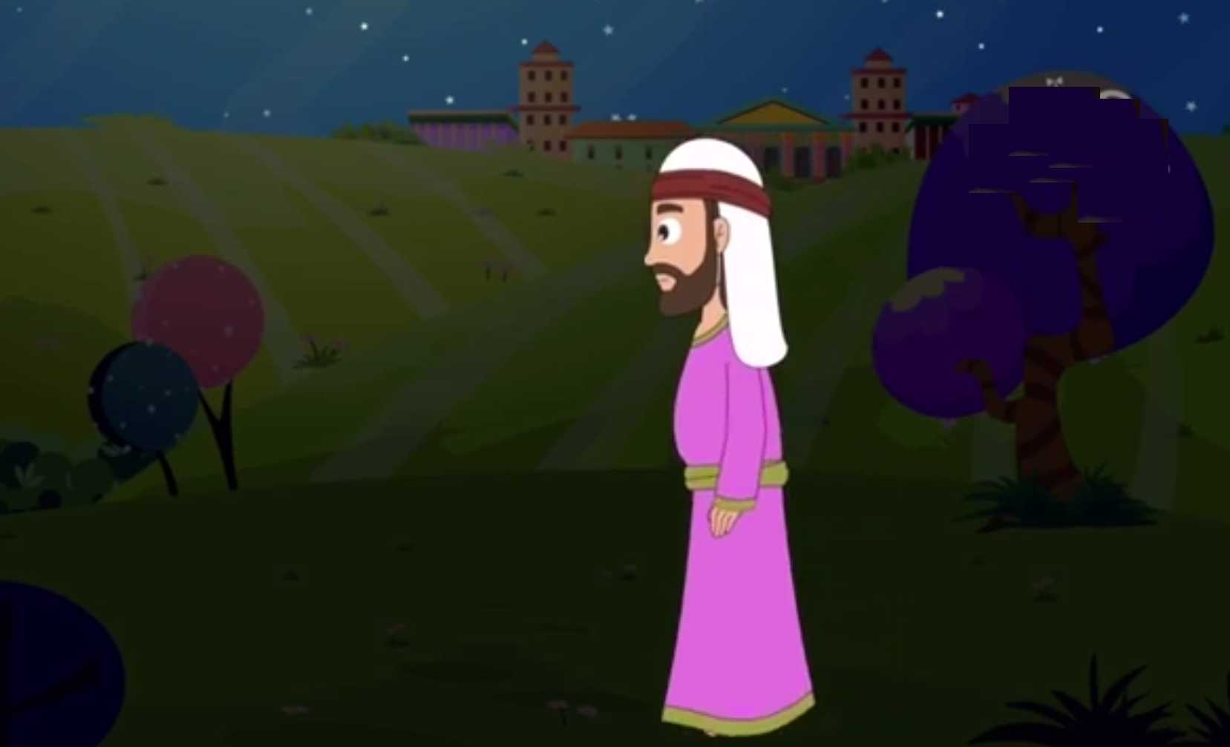
So they went off. And he went out again around noon, and around three o’clock, and did likewise. Going out about five o’clock,

Slide 8
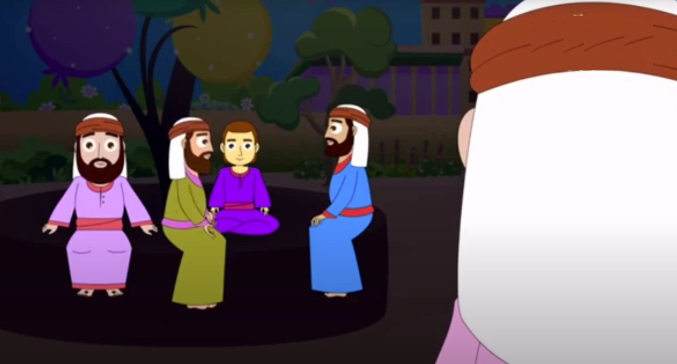
the landowner found others standing around, and said to them, ‘Why do you stand here idle all day?’ They answered, ‘Because no one has hired us.’

Slide 9
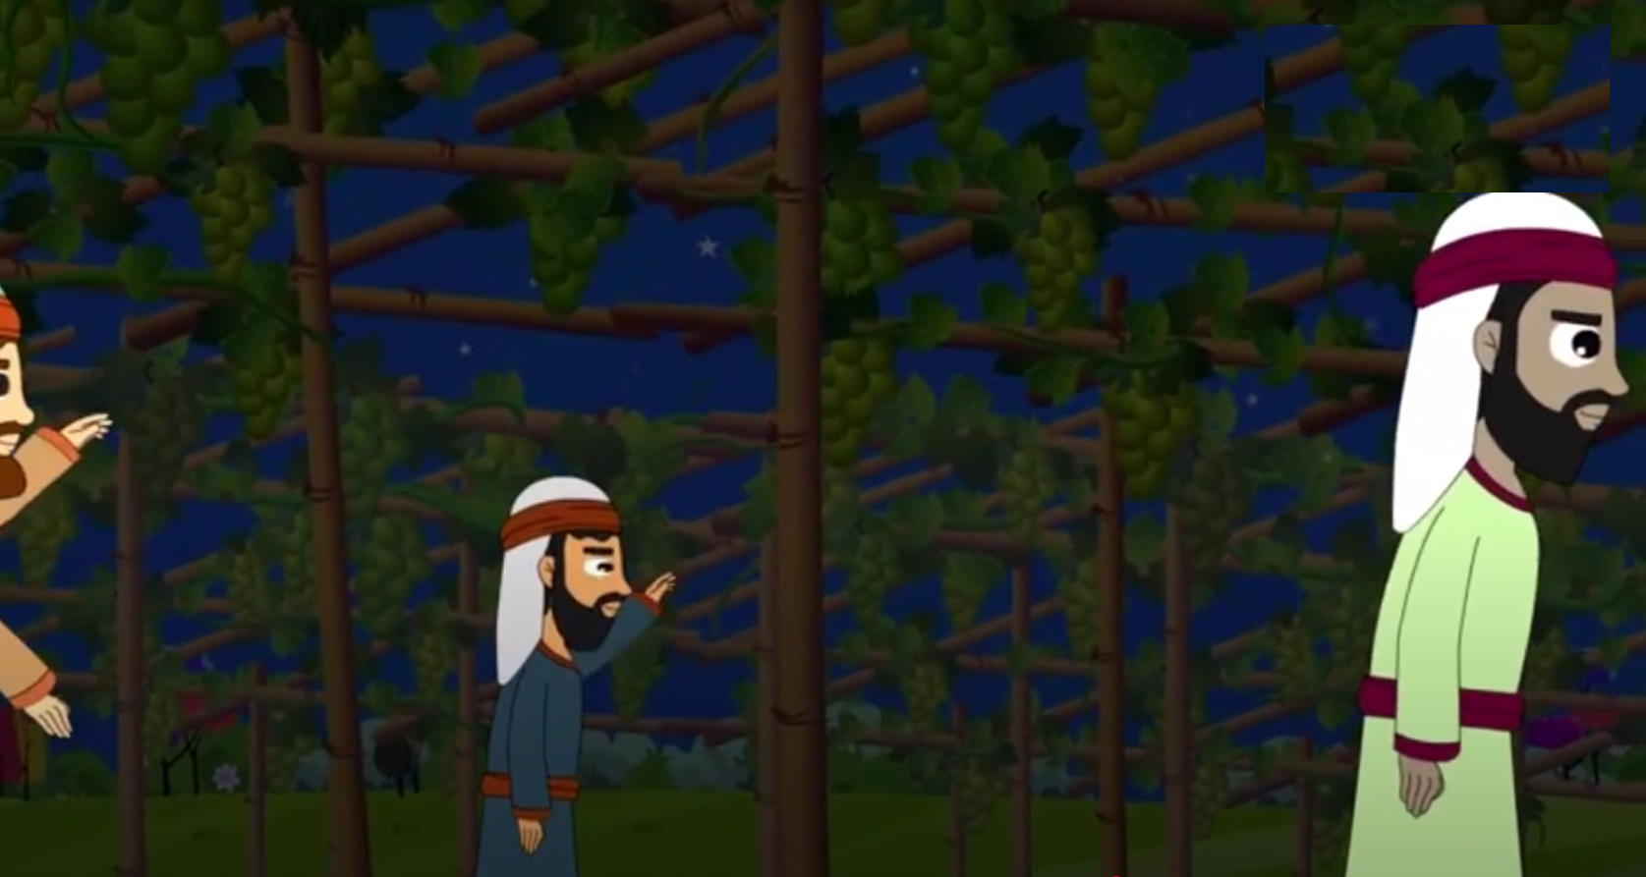
He said to them, ‘You too go into my vineyard.’ When it was evening the owner of the vineyard said to his foreman, ‘Summon the laborers and give them their pay,

Slide 10
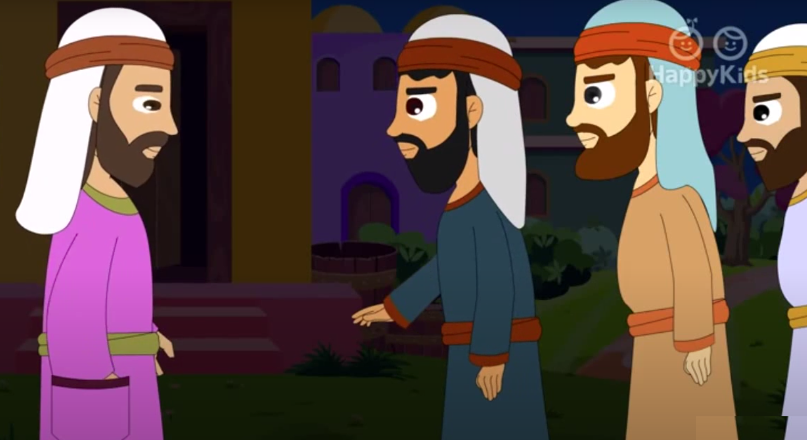
…beginning with the last and ending with the first.’ When those who had started about
five o’clock came, each received
the usual daily wage.

Slide 11
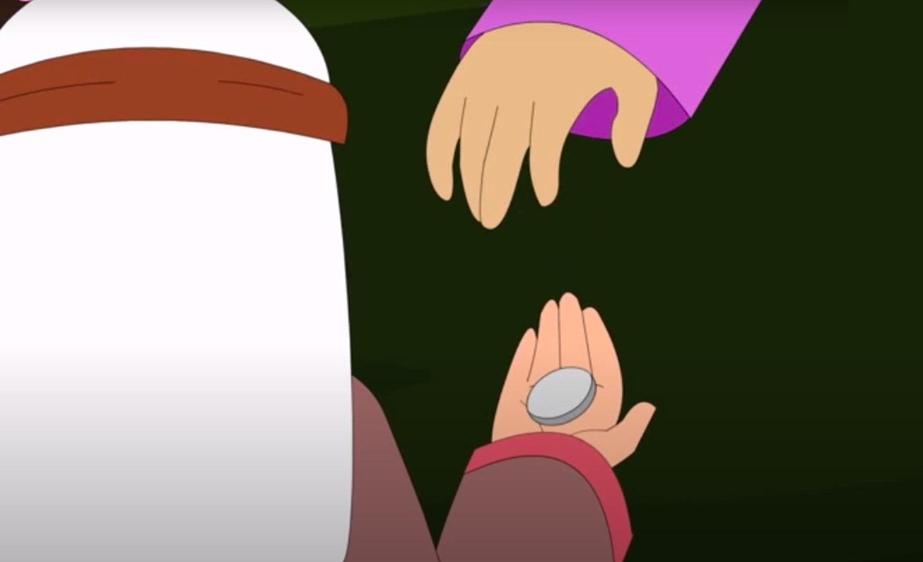
So when the first came, they thought that they would receive more, but each of them also got the usual wage.

Slide 12
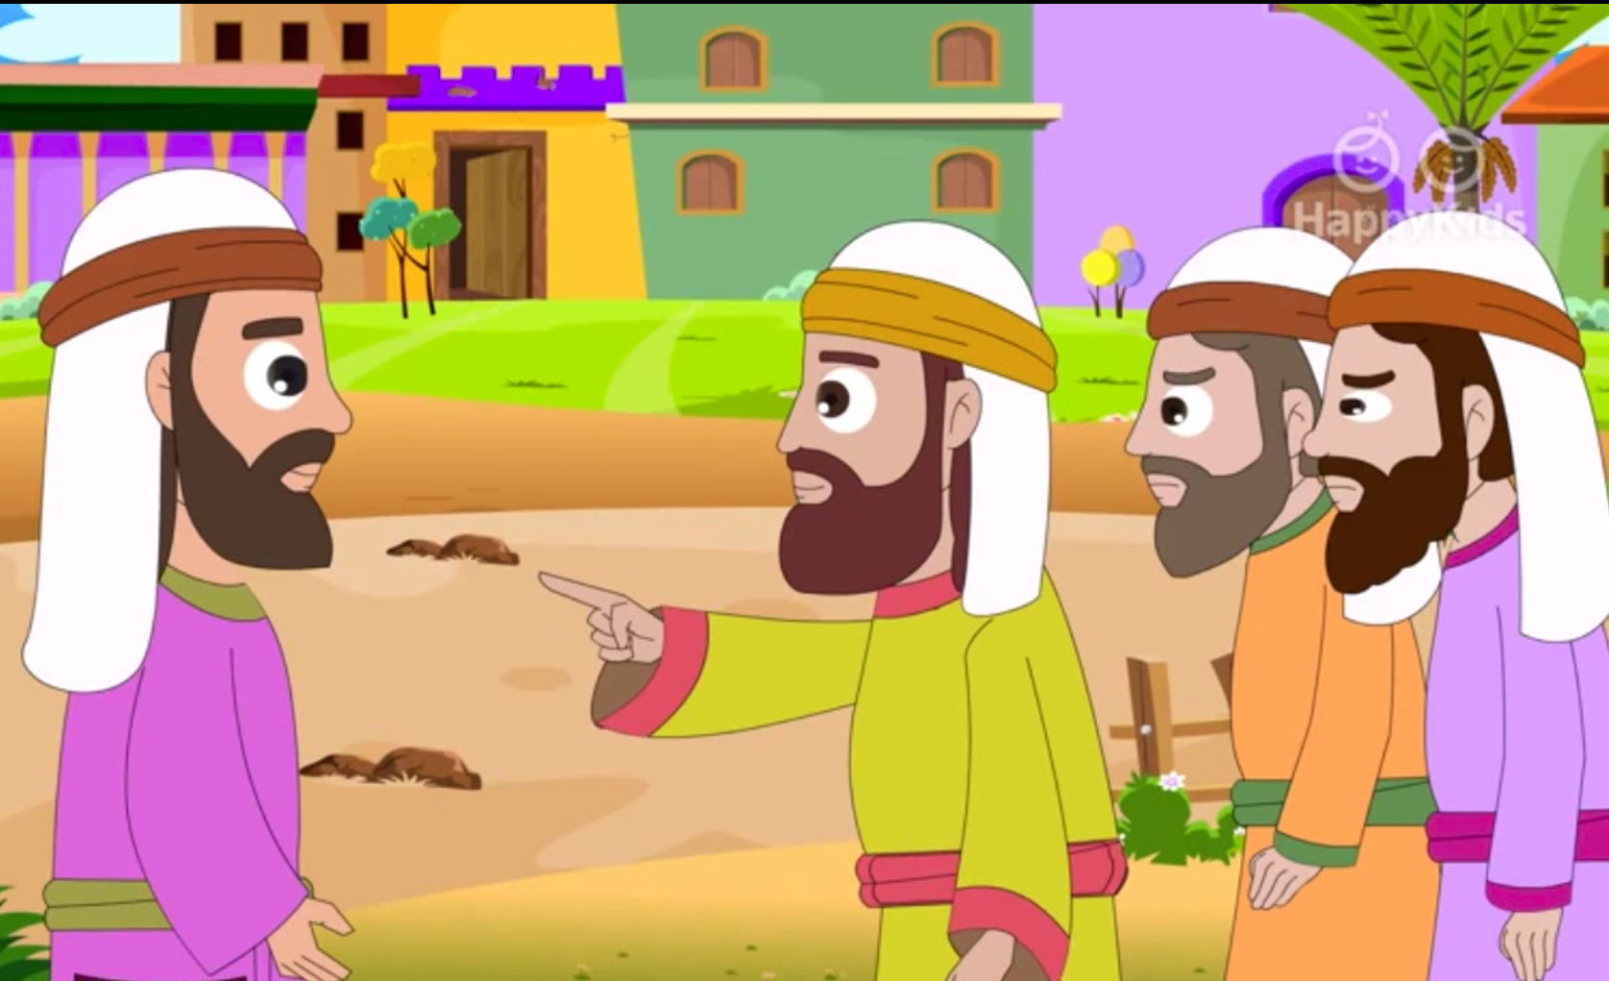
And on receiving it they grumbled against the landowner, saying, ‘These last ones worked only one hour, and you have made them equal to us, who bore the day’s burden and the heat.’ He said to one of them in reply :

Slide 13
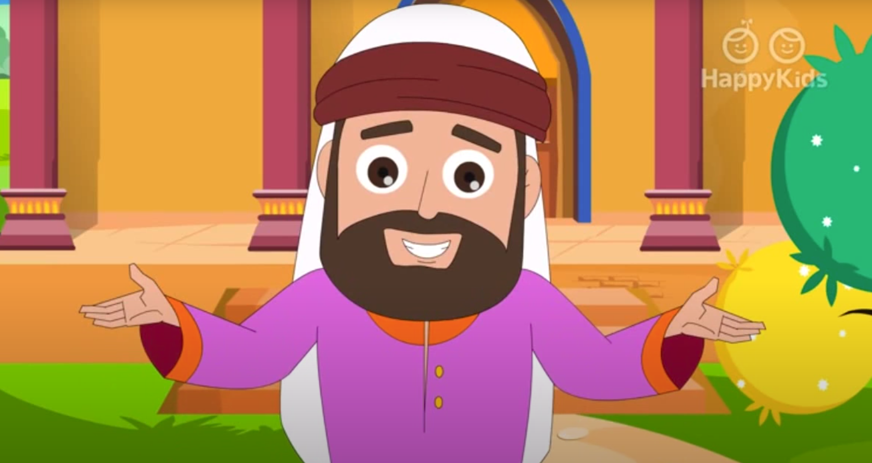
‘My friend, I am not cheating you. Did you not agree with me for the usual daily wage? Take what is yours and go. What if I wish to give this last one the same as you? Or am I not free to do as I wish with my own money? Are you envious because I am generous?’ Thus, the last will be first, and the first will be last.”
THE GOSPEL OF THE LORD PRAISE TO YOU LORD JESUS CHRIST

Slide 14
REFLECTION

Slide 15
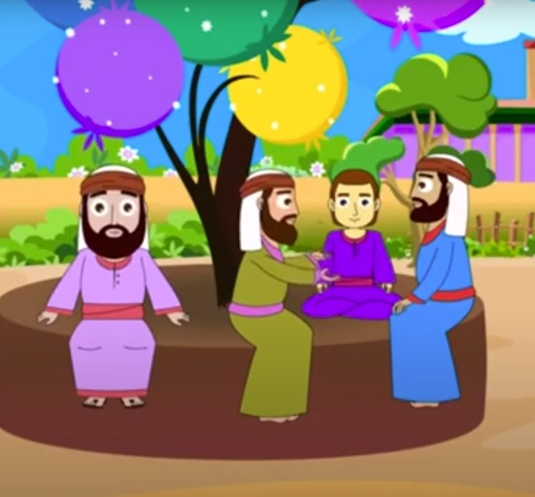
Who does the landowner represent?
God
Who do the workers represent?
The followers of Jesus
Why do some workers get upset?
Because the ones that arrived at the end of the day and worked only one hour received the same pay as those that worked a full day.

Slide 16
What does the landowner respond?
He had paid them the amount they had agreed upon so he had been fair.
What does Jesus call us to do?
He invites us to follow Him and to work to build His Kingdom loving God and loving our neighbor.
What does it mean that the last shall be first?
It doesn’t matter WHEN you decide to follow Jesus, whether as a child or later in life. If you truly love and follow Him, God will reward you with eternal life.

Slide 17
ACTIVITY
ACTIVIDAD

Slide 18
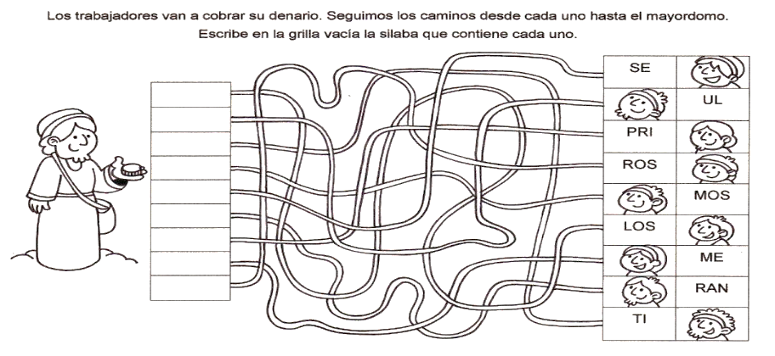
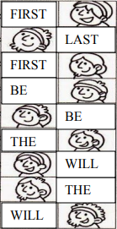
The workers get paid. Follow the paths from each worker to the foreman. Which word goes in each space? What sentence is formed?
The
Last
Will
Be
First
The
First
Will
Be
Last

Slide 19
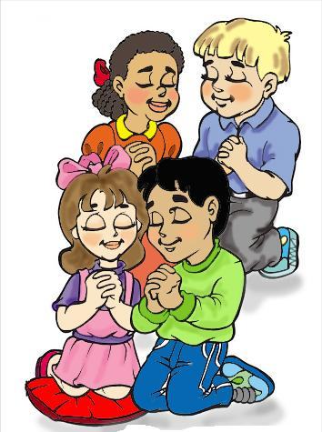
PRAYER
Jesus,
Help me to love as You love,
and to serve as You serve,
So I may help to build the
Kingdom of Heaven.
Amen

Slide 20
Song: Denarius Rap Song, Kyle Jones, https://youtu.be/cLouA3KytUQ

