Slide 1

Friends of Jesus and Mary
Prayer Group for Children
Cycle A – XXVI Sunday in Ordinary Time
The Parable of the Two Sons
(3-7 years old)

Slide 2
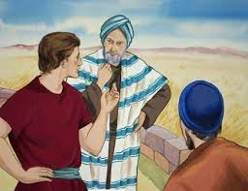
Mathew 21: 28-32 The Parable of the Two Sons
Jesus said to the high priests and elders of the people: “What is your opinion?

Slide 3
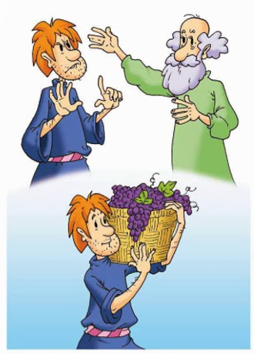
A man had two sons. He came to the first and said, ‘Son, go out and work in the vineyard today.’
He replied, ‘I will not,’ but afterwards he changed his mind and went.

Slide 4
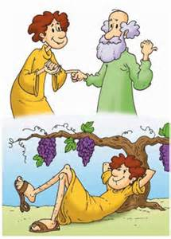
The man came to the other son and gave the same order.
He replied, ‘Yes, sir,’ but did not go.

Slide 5
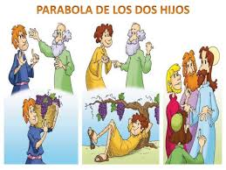
Which of the two did his father’s will?”
They answered: “The one that went”.
The Gospel of the Lord,
Praise to you Lord Jesus Christ

Slide 6
REFLECTION

Slide 7
Jesus teaches us with a parable: a father tells his two sons to go work in the vineyard….
What does the first son respond?
He says yes, but then does NOT go.

Slide 8

What does the second son respond?
He says he will not go, but later repents and DOES go to work in his father’s vineyard.

Slide 9
Which of the two did the father’s will?
The one that said no, but repented and went to work.

Slide 10
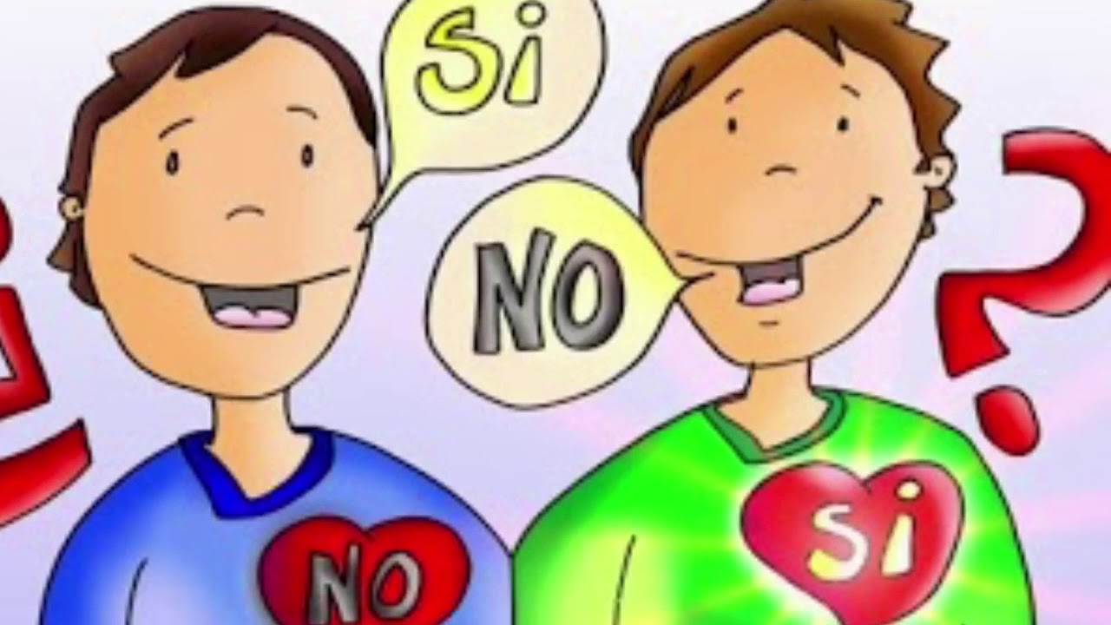

What does Jesus want to teach us?
God wants us to be obedient to His commandments of Love.
In this way, we show Him that we love Him.

Slide 11

God appreciates our GOOD WORKS,
Not empty words!

Slide 12

Prayer:
Jesus, help me to always obey you and to show you by loving and serving others.
Amen
Will of God
My Will

Slide 13

Activity

Slide 14


The Church needs help making sandwiches for the homeless.
STOP, LOOK AND LISTEN TO GOD.
My grandmother needs help getting her food.
My friends are talking bad about someone at school.
SLOW, THINK, WHAT WOULD JESUS DO?
My Dad asked me to help pick up leaves, but my movie is very good.
GO! GLORIFY GOD WITH YOUR LOVE!
Martha wants me to steal candy from the 7-Eleven.
I broke the vase and my mom is asking who did it.
Choose which color light (red, yellow, or green) would shine when deciding what to do in each situation. Color the arrow the same color.

Slide 15
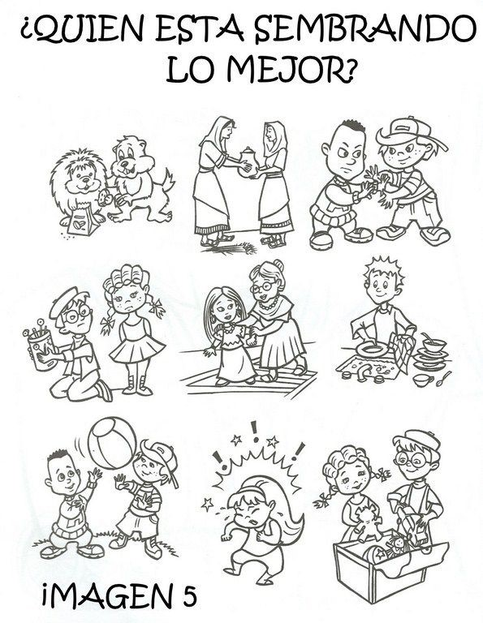


Who is doing
God’s will?

Slide 16
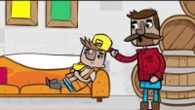
Story - Parable of the Two Sons, Saddleback Kids https://youtu.be/pEz1rkZj7dU

Slide 17

Song: Obey the Lord, Claudine Macaso, https://youtu.be/F3So4hsx0BI?si=zY3hJ7L0sx-tZPiD (3-7 yrs.)

