Slide 1
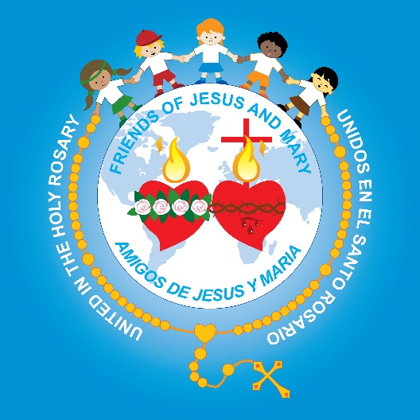
Friends of Jesus and Mary
Prayer Group for Children
Cycle A – XXVI Sunday in Ordinary Time
The Parable of the Two Sons
(8-12 years old)

Slide 2
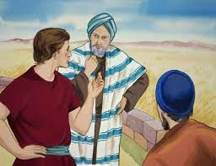
Mathew 21: 28-32 The Parable of the Two Sons
Jesus said to the high priests and elders of the people: “What is your opinion?

Slide 3
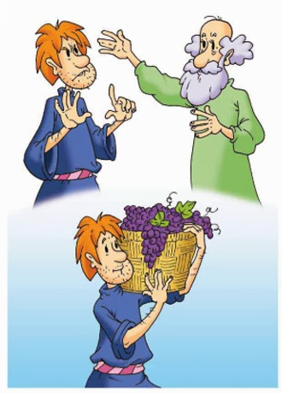
A man had two sons. He came to the first and said, ‘Son, go out and work in the vineyard today.’
He replied, ‘I will not,’ but afterwards he changed his mind and went.

Slide 4
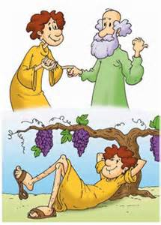
The man came to the other son and gave the same order.
He replied, ‘Yes, sir,’ but did not go.

Slide 5
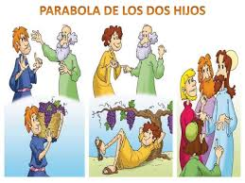
Which of the two did his father’s will?”
They answered: “The one that went”.

Slide 6
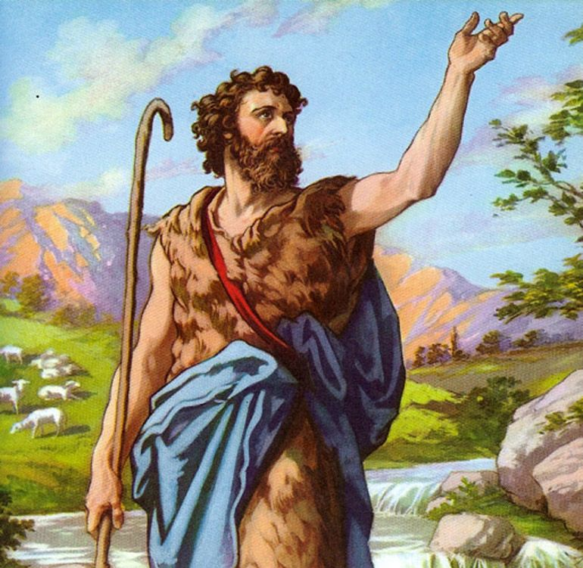
Jesus said to them, “Amen, I say to you, tax collectors and prostitutes are entering the kingdom of God before you.
When John came to you in the way of righteousness, you did not believe him; but tax collectors and prostitutes did.
Yet even when you saw that, you did not later change your minds and believe him.
THE GOSPEL OF THE LORD
PRAISE TO YOU LORD JESUS CHRIST

Slide 7
REFLECTION

Slide 8
Jesus teaches us with a parable: a father tells his two sons to go work in the vineyard….
What does the first son respond?
He says yes, but then does NOT go.

Slide 9

What does the second son respond?
He says he will not go, but later repents and DOES go to work in his father’s vineyard.

Slide 10
Which of the two did the father’s will?
The one that said no, but repented and went to work.

Slide 11
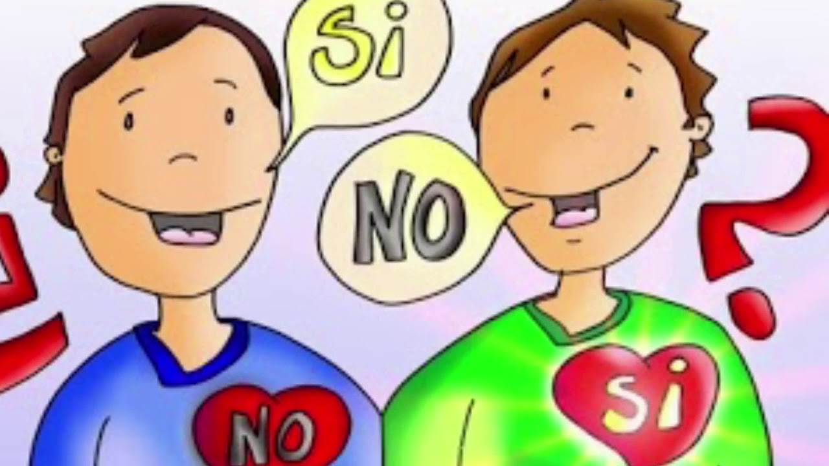
What does Jesus want to teach us?
Some people say they love God so others will admire them, but they do not obey Him, like the Pharisees during that time.
Other people truly love God, even though they may have been great sinners in the past, but later repented, changed their life and started obeying God.
In the same way, the good son in the parable first told his father no, then changed and obeyed him and went to work in the vineyard.

Slide 12
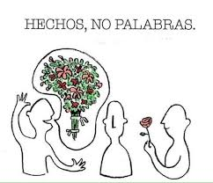
The parable shows us that God wants us to show our love for Him with repentence for our sins, humility, and service to others.
God wants to see our love with WORKS, not just hear empty WORDS.
WORKS, NOT WORDS

Slide 13

Activity

Slide 14
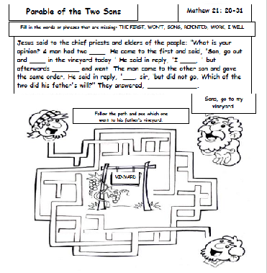
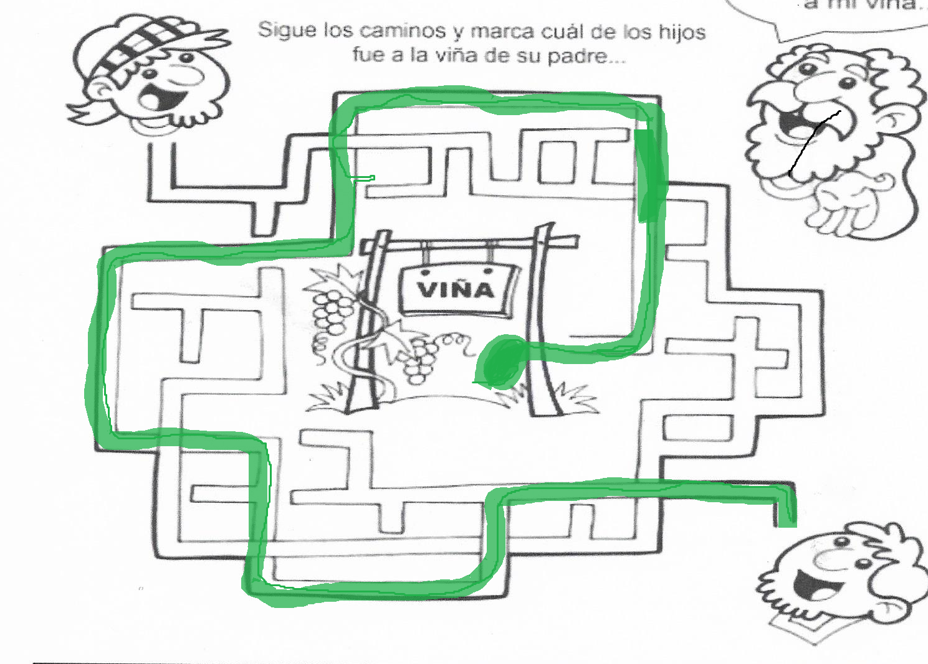
SONS
WORK
WON’T
REPENTED
I WILL
THE FIRST

Slide 15


The Church needs help making sandwiches for the homeless.
STOP, LOOK AND LISTEN TO GOD.
My grandmother needs help getting her food.
My friends are talking bad about someone at school.
SLOW, THINK, WHAT WOULD JESUS DO?
My Dad asked me to help pick up leaves, but my movie is very good.
GO! GLORIFY GOD WITH YOUR LOVE!
Martha wants me to steal candy from the 7-Eleven.
I broke the vase and my mom is asking who did it.
Choose which color light (red, yellow, or green) would shine when deciding what to do in each situation. Color the arrow the same color.

Slide 16

Prayer:
Jesus, show me the way I must follow to always do your will, not only with my words, but also with my works.
Amen
Will of God
My Will

Slide 17
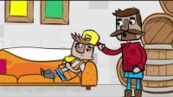
Story - Parable of the Two Sons, Saddleback Kids https://youtu.be/pEz1rkZj7dU

Slide 18
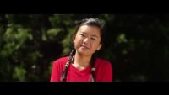
I will Follow You, Roy RNVideo: https://youtu.be/jpVuBcbZ24c?si=kMamUAYqRsMGBiSw (8+ yrs.)

