Slide 1
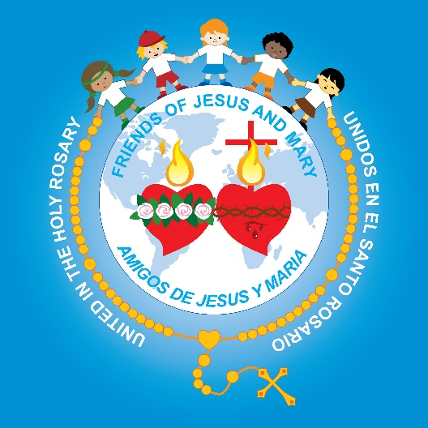
Friends of Jesus and Mary
Prayer Group for Children
Cycle A – XXVII Sunday in Ordinary Time
Parable of the Murderous Tenants, Mathew 21, 33-43
www.fcpeace.org

Slide 2
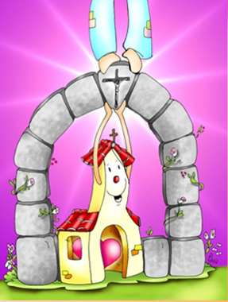
Mathew 21, 33-43 The stone the builders rejected has become the cornerstone. Parable of the Murderous Tenants
Who is the Stone the builders rejected?

Slide 3
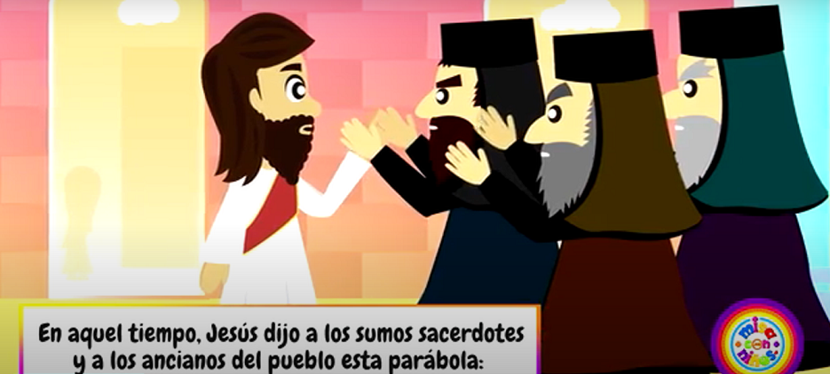
Jesus said to the chief priests and the elders of the people: "Hear another parable.”
THE GOSPEL ACCORDING TO MATTHEW 21, 33-43:

Slide 4
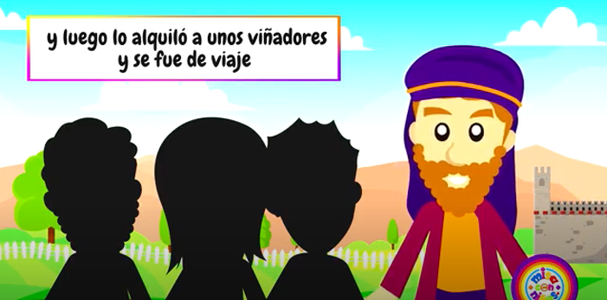
There was a landowner who planted a vineyard, put a hedge around it, dug a wine press in it, and built a tower. Then he leased it to tenants and went on a journey.

Slide 5
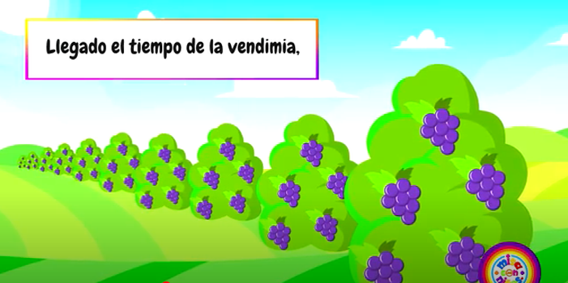
When vintage time drew near, he sent his servants to the tenants to obtain his produce.

Slide 6
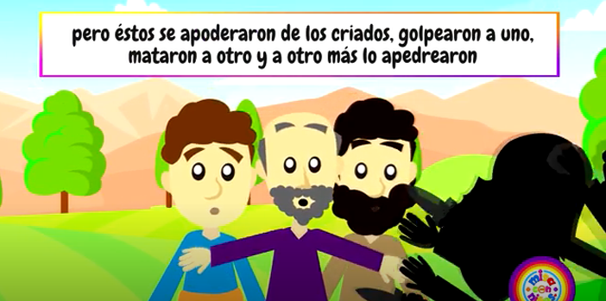
But the tenants seized the servants and one they beat, another they killed, and a third they stoned.

Slide 7
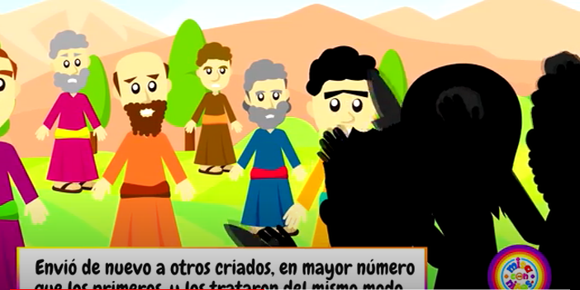
Again he sent other servants, more numerous than the first ones, but they treated them in the same way.

Slide 8
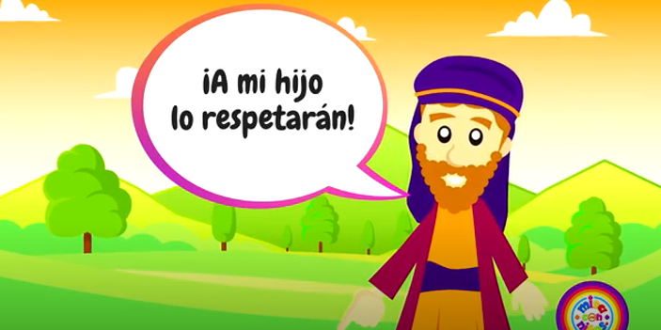
Finally, he sent his son to them, thinking,
They will respect my son.

Slide 9
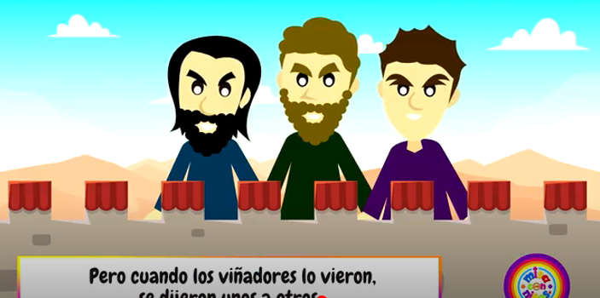
But when the tenants saw the son, they said to one another, 'This is the heir. Come, let us kill him and acquire his inheritance.’

Slide 10
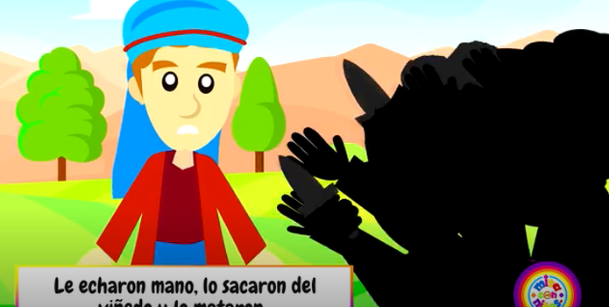
They seized him, threw him out of the vineyard, and killed him.

Slide 11
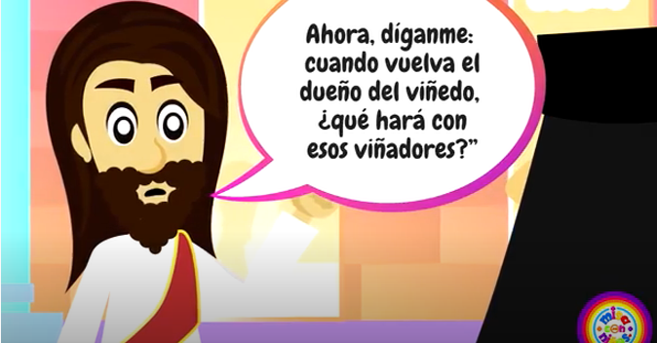
What will the owner of the vineyard do to those tenants when he comes?"

Slide 12
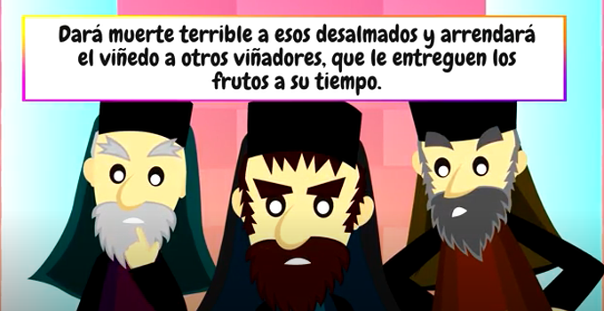
They answered him, "He will put those wretched men to a wretched death and lease his vineyard to other tenants who will give him the produce at the proper times."

Slide 13
Jesus said to them, "Did you never read in the Scriptures: The stone that the builders rejected has become the cornerstone; by the Lord has this been done, and it is wonderful in our eyes?

Slide 14
Therefore, I say to you, the kingdom of God will be taken away from you and given to a people that will produce its fruit.
THE GOSPEL OF THE LORD,
PRAISE TO YOU LORD JESUS CHRIST

Slide 15
REFLECTION

Slide 16
Who does the landowner represent in the parable?
The high priests and elders of the people
GOD
Who do the tenants represent?
The people of God
What does the vineyard represent?
God had given the high priests and elders the authority to guide His people, but they were not doing it well.

Slide 17
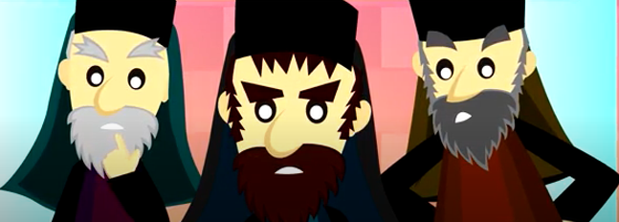
The high priests and elders of God’s people were guiding them with strict laws, but they did not have God in their hearts.
They did not listen to God’s prophets, the last which was John the Baptist; they also did not listen to Jesus.

Slide 18
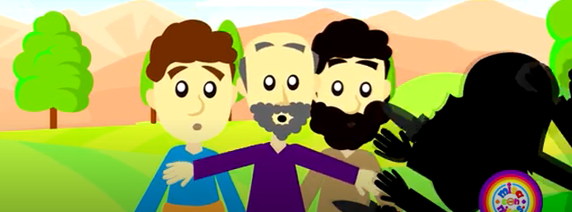
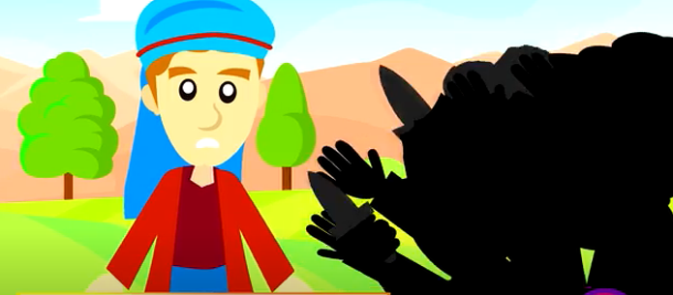
What did the tenants do when the landowner sent his servants and his son to collect the fruits of the vineyard?
Who do the landowner’s servants and son who tried to
collect his portion of the fruits represent?
God’s prophets
Twice they mistreated them, even killing them so they could keep the vineyard for themselves.
God’s Son,
Jesus

Slide 19
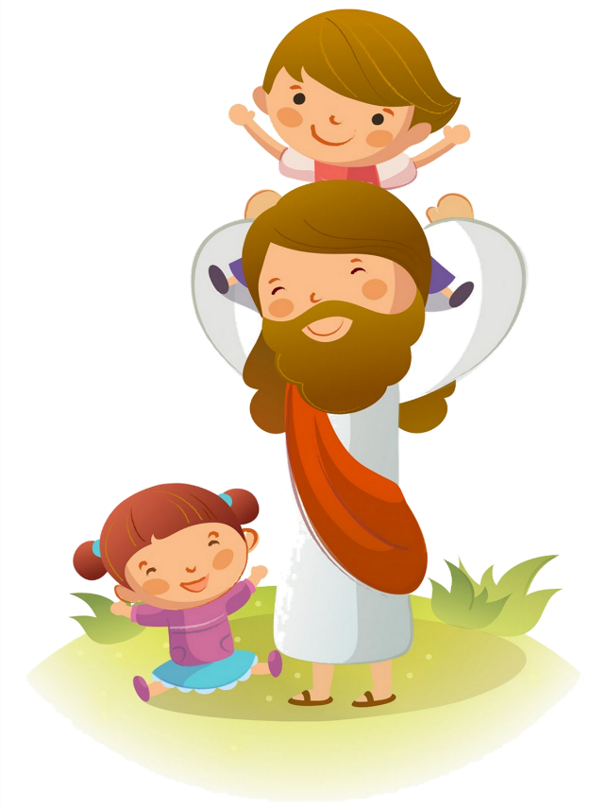
Jesus said: “The stone that the builders rejected has become the cornerstone.”
The cornerstone supports the weight of a building. Without it, in those times, they could not complete construction.
JESUS
Who is the Stone that builders rejected? The cornerstone of our Church that sustains us?

Slide 20
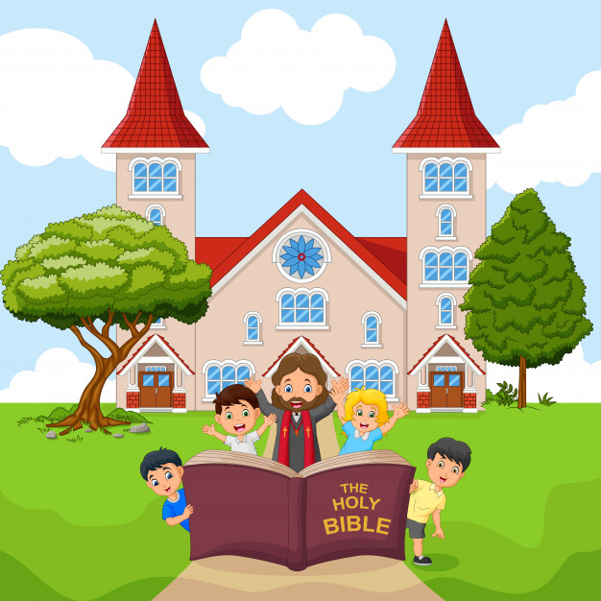
They did not recognize Jesus, the Messiah of God so they rejected Him.
How can we recognize Jesus in our life and follow Him?

Slide 21
Activity

Slide 22
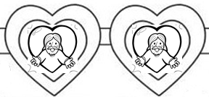
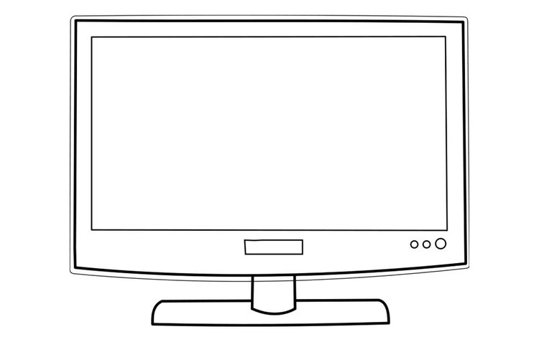
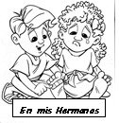
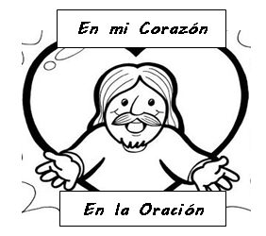
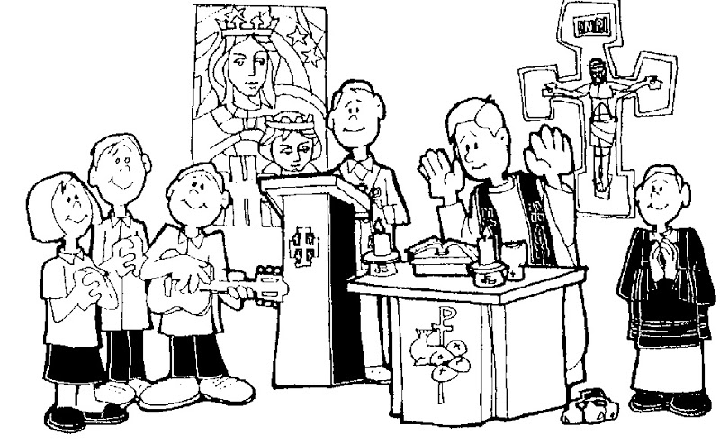
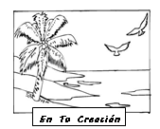
Jesus, I want to see you!
CHOOSE WHERE WE CAN SEE JESUS.
In the Bible
In those in need
On TV
In my heart
When I pray
In Mass
In creation
In video games

Slide 23
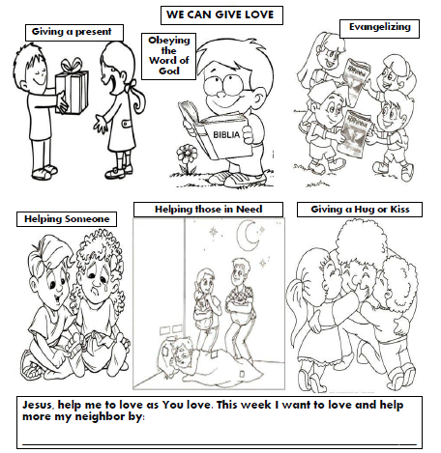
We follow Jesus when we give love.

Slide 24
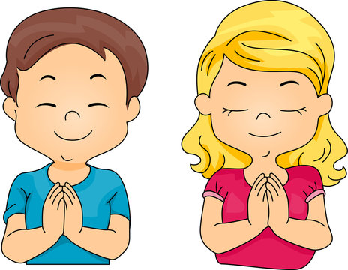
Prayer Jesus, help me to always see you with the eyes of my heart,in the love of those around me, in the beauty of your creation, and in all the events of my life. I always want to see you and follow you. Amen.

Slide 25
Open the Eyes of my Heart Lord, idcm kids, https://youtu.be/LVoQR9Vj0Zg?si=dRRmjFIpB4GiZNt0 (3-7 yrs.)

Slide 26
Song: Open the Eyes of my Heart Lord, https://youtu.be/-OwXh9qgxz8?si=QOmDQVZzSwIxqPyh (8+ years)

Slide 27
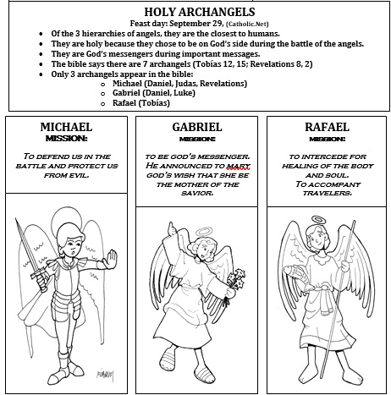

Slide 28
https://youtu.be/goIQnHKK7wQ?si=KkwLFDZcbXFn0CWD

