Slide 1
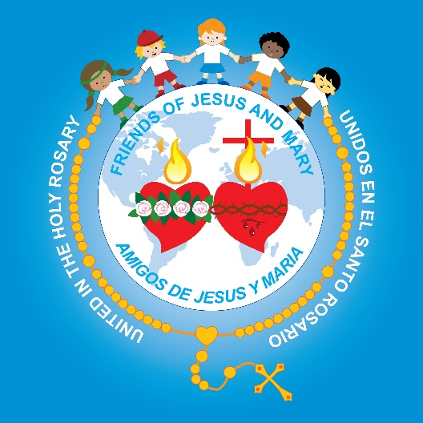
Friends of Jesus and Mary
Prayer Group for Children
Cycle A - XXVIII Sunday in Ordinary Time
Parable of the Wedding Banquet - Matthew 22: 1-10
www.fcpeace.org

Slide 2
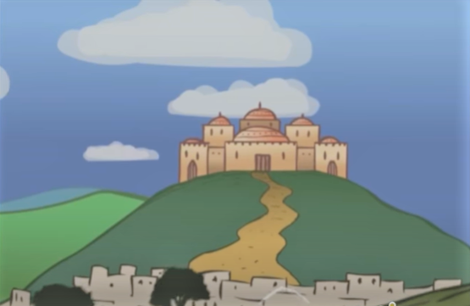
Mathew 22, 1-10 The Parable of the Wedding Banquet

Slide 3
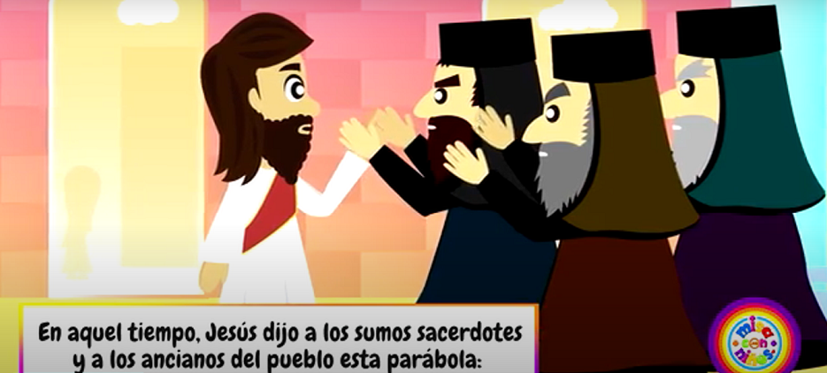
Jesus again in reply spoke to the chief priests and elders of the people in parables, saying:

Slide 4
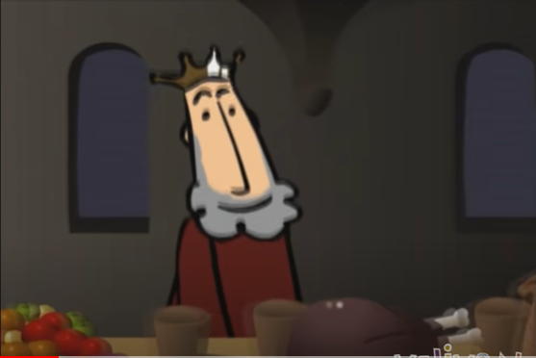
"The kingdom of heaven may be likened to a king who gave a wedding feast for his son. .

Slide 5
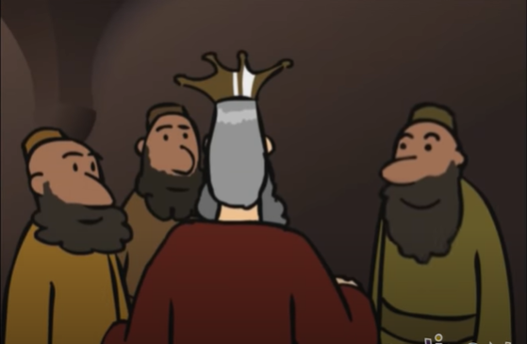
He dispatched his servants to summon the invited guests to the feast, but they refused to come. .

Slide 6
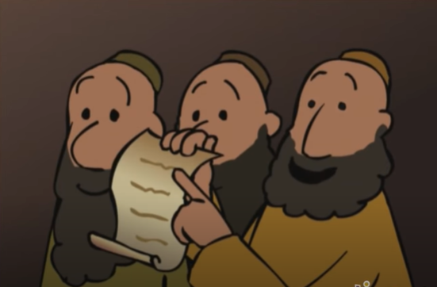
A second time he sent other servants, saying, 'Tell those invited: "Behold, I have prepared my banquet, my calves and fattened cattle are killed, and everything is ready; come to the feast”.’

Slide 7
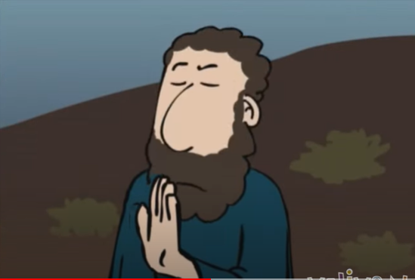
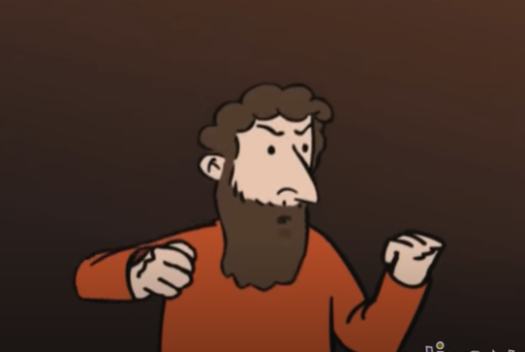
Some ignored the invitation and went away, one to his farm, another to his business. The rest laid hold of his servants, mistreated them, and killed them.

Slide 8
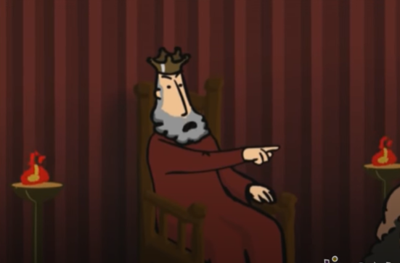
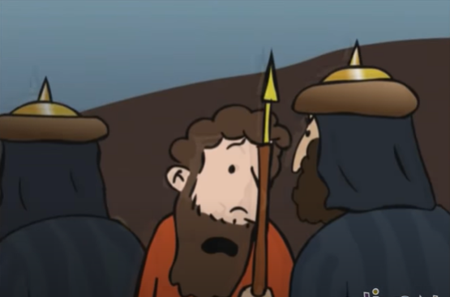
The king was enraged and sent his troops, destroyed those murderers, and burned their city.

Slide 9
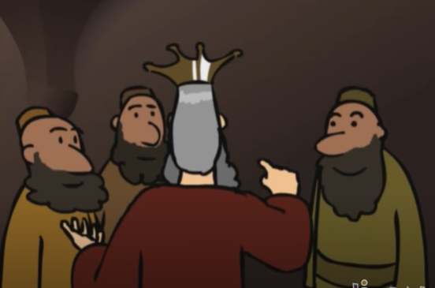
Then he said to his servants, 'The feast is ready, but those who were invited were not worthy to come. Go out, therefore, into the main roads and invite to the feast whomever you find.’ ’.

Slide 10
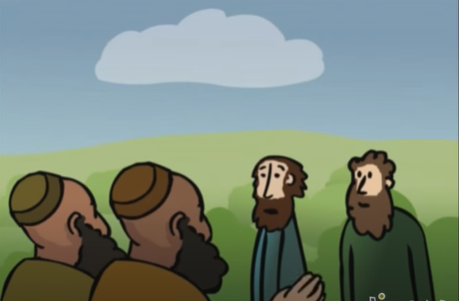
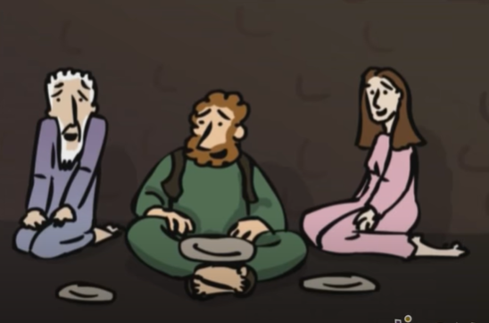
The servants went out into the streets and gathered all they found, bad and good alike...

Slide 11
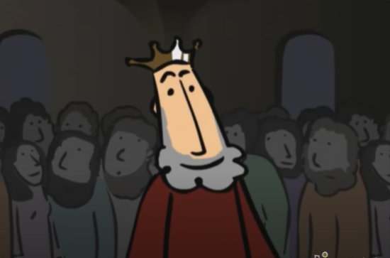
And the hall was filled with guests.
Gospel of the Lord. Praise to you Lord Jesus Christ.

Slide 12
REFLECTION

Slide 13
Who does the King represent?
In the parable
(a story with a lesson)…
GOD
Who do the servants represent?
God’s prophets; God’s messengers.
Who are God’s
messengers today?
The priests, deacons, religious, catechists, our parents…everyone who teaches us about God’s love.

Slide 14
Who are those invited to the wedding banquet?
All that receive the invitation to know, love, and follow Jesus.

Slide 15
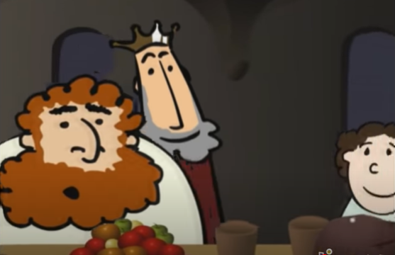
What does the wedding banquet represent?
The banquet in Heaven that God prepares for those who love and follow Jesus.
and
The Eucharistic banquet at mass where Jesus makes himself present in the bread and wine.

Slide 16
How did the invited guests respond?
Some ignored the invitation and went away, one to his farm, another to his business.
The rest laid hold of his servants, mistreated them, and killed them.
The humble happily accepted the invitation.

Slide 17
How did the King feel?
Sad and mad that they had killed his servants.

Slide 18
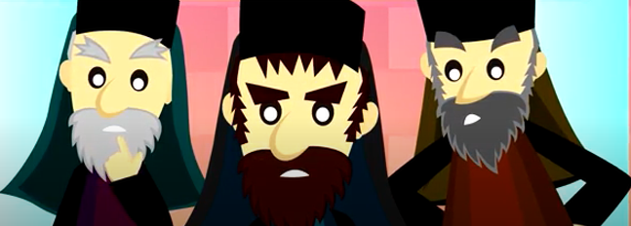
The chief priests and elders of the people of God are the first invited guests. They did not listen to the prophet John the Baptist and they killed Jesus.
Because of their rejection, God opened up the invitation to love Him to the whole world, not just the Jews.
Jesus is telling them that they have rejected the invitation to love and follow His Son and, therefore, they will not enter the banquet of Heaven.

Slide 19
Jesus invites us to love and follow Him. He guides us to the Heavenly banquet.

Slide 20
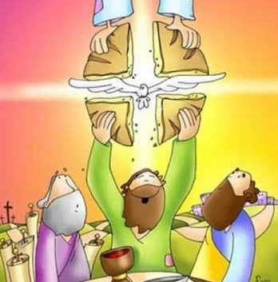
Jesus invites us to His Sunday Banquet; Heaven comes down to adore Jesus, present in the Eucharist.
Jesus wants to be with us to help us get to Heaven, the eternal banquet.

Slide 21
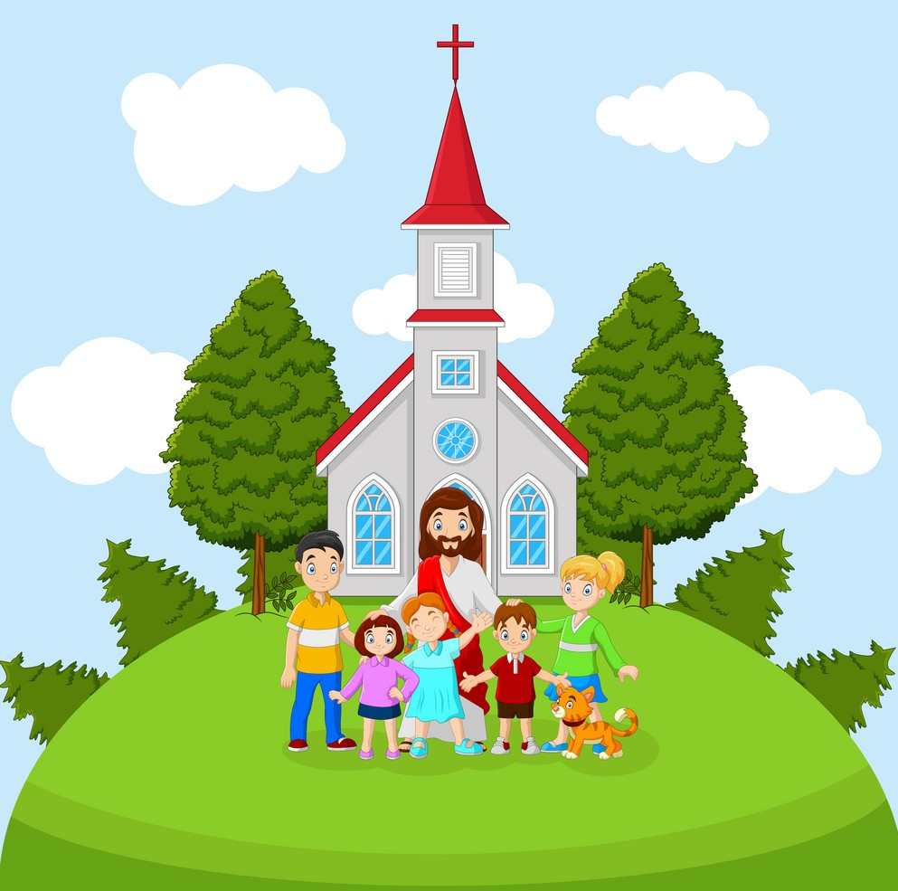
Do we ever make excuses to not participate in the banquet of the mass?
How do you think Jesus feels?

Slide 22
Activity

Slide 23
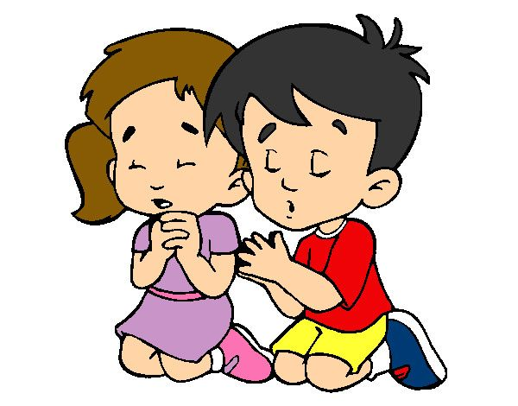
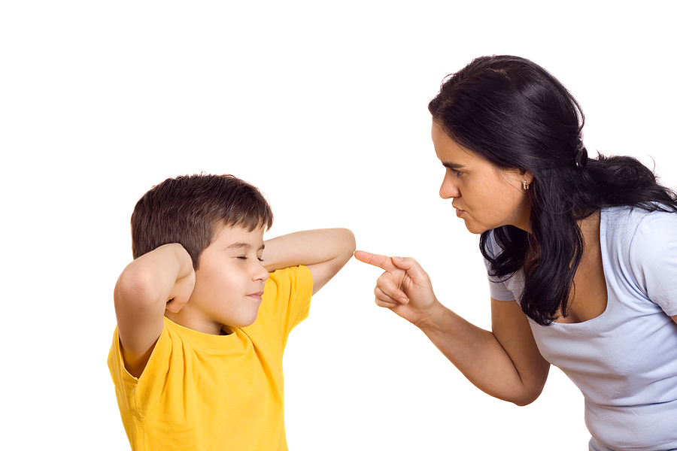
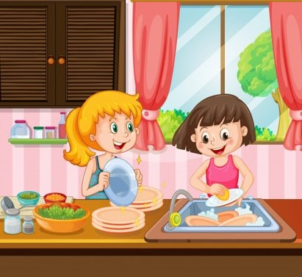
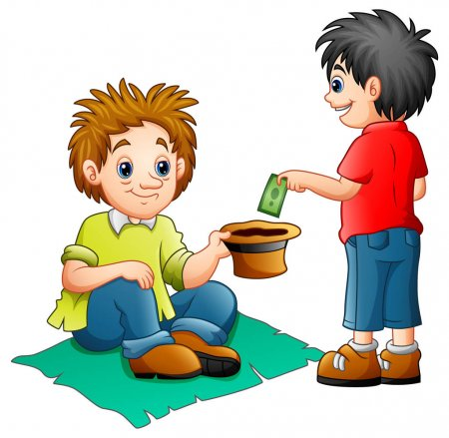
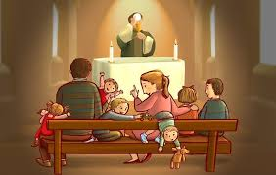
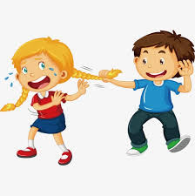
How do we enter the Banquet in Heaven?

Slide 24
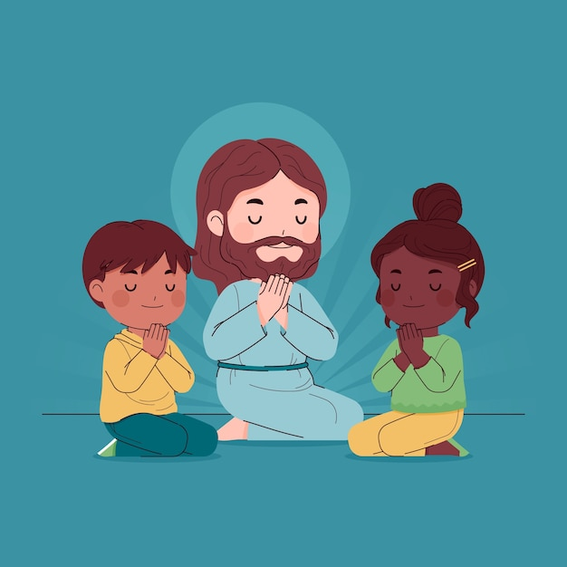
Prayer Jesus, Enter my heart and help me to always say yes to you. I pray for the conversion of all souls so everyone can partake of the banquet in Heaven. Amen

Slide 25
Song - The E-U-C-H-A-R-I-S-T Song, Susan Collins, https://youtu.be/_GEqnKMN1zE?si=-Zt-bej5i5dGMqD0 (3-7 yrs.)

Slide 26
Song Come to the Banquet, Fay White, https://youtu.be/czRLWLOoqj8?si=HCwN2bqBxBw6eDLN (8+ yrs.)

