Slide 1
Friends of Jesus and Mary
Prayer Group for Children
Cycle A – XXX Sunday in Ordinary Time
The Great Commandment of Love
Mathew 22, 34-40
www.fcpeace.org

Slide 2
GOSPEL OF MATHEW 22: 34-40
When the Pharisees heard that Jesus had silenced the Sadducees, they gathered together.

Slide 3
And one of them, a scholar of the law tested him by asking:

Slide 4
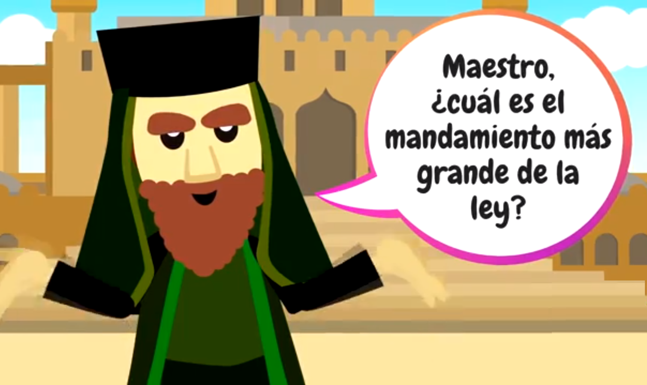
Teacher, which commandment in the law is the greatest?

Slide 5
You shall love the Lord, your God, with all your heart, with all your soul, and with all your mind.

Slide 6
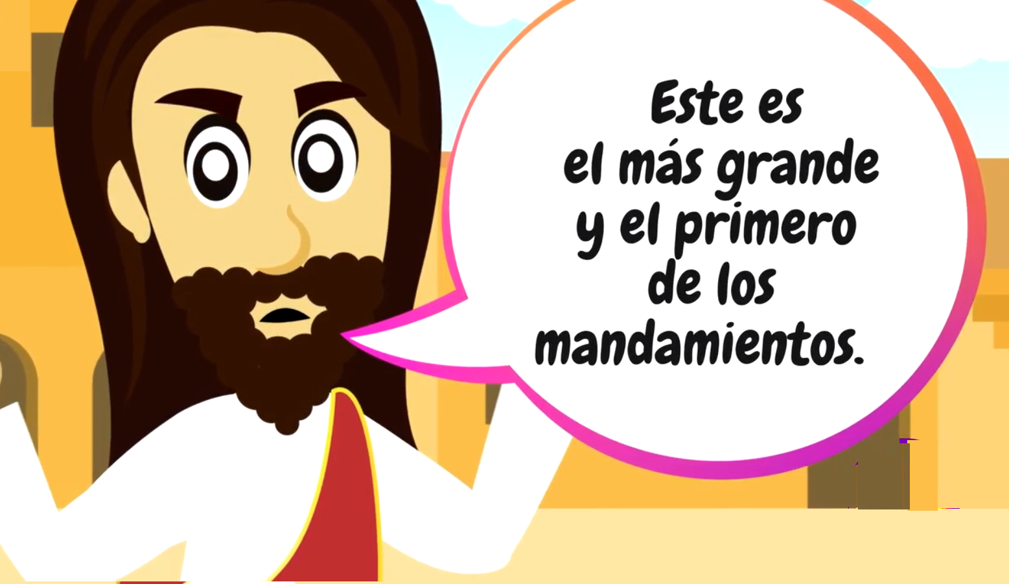
This is the greatest and the first commandment

Slide 7
The second is like it: You shall love your neighbor as yourself.

Slide 8
The whole law and the prophets depend on these two commandments.
THE GOSPEL OF THE LORD,
PRAISE TO YOU LORD, JESUS CHRIST

Slide 9
REFLECTION

Slide 10
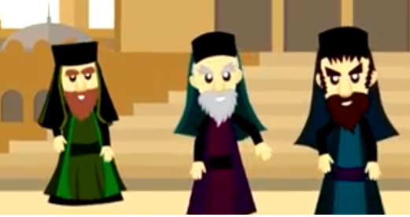
Who were the Sadducees?
They were a high and powerful class, who were very materialistic and did not believe in the resurrection. Jesus had reprimanded them saying He was the God of the living.
Who were the Pharisees?
A powerful Jewish sect, who enforced the laws strictly, yet did not follow them themselves. They did not recognize Jesus as God because they lacked love in their hearts.
During that time, they derived more than 600 rules from the Law that the Pharisees and elders enforced. Jesus reprimanded them for misleading His people and they were furious.
What did they ask Jesus to test Him?

Slide 11
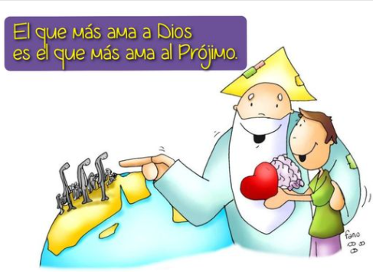
“You shall love the Lord, your God, with all your heart, with all your soul, and with all your mind. This is the greatest and the first commandment. The second is like it: You shall love your neighbor as yourself. The whole law and the prophets depend on these two commandments."
He who loves God the most,
Loves his neighbor the most.

Slide 12
Jesus summarizes all the laws in one word!
Love God, with all your heart, with all your soul, and with all your mind.
2. Love your neighbor as yourself.

Slide 13
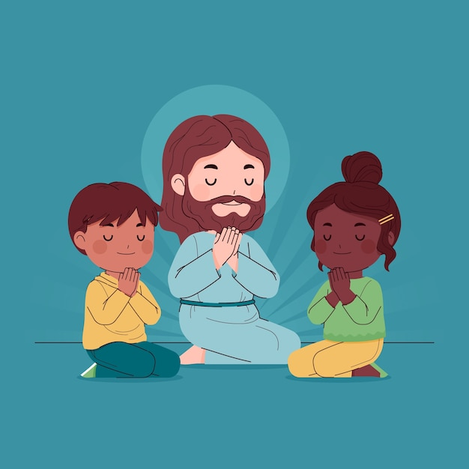
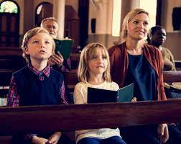
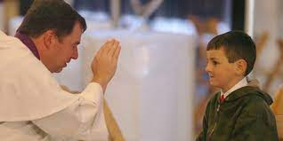
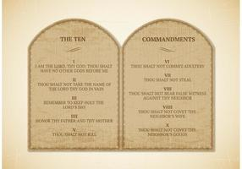
How can we get closer to God and love Him more dearly?

Slide 14
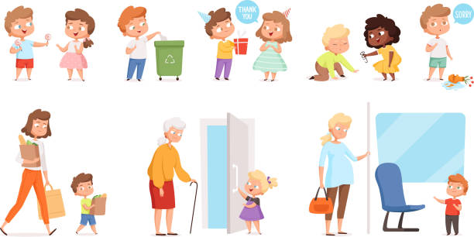
How does Jesus want us to love others?
As much as we love ourselves. We would never want someone to hurt us, but only to love, forgive, and help us.

Slide 15
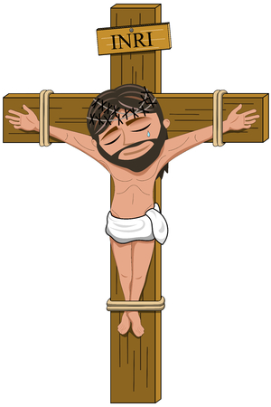
Jesus showed us this love on the Cross.
The vertical wood unites heaven with earth; it shows us God’s love for mankind and invites us to love Him back.
And the horizontal wood sustains Jesus’ arms, forming an embrace that hugs us and unites us as family, touching all with His great love and calling us to love in the same way.

Slide 16
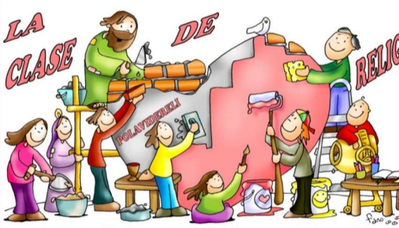
ACTIVITY

Slide 17
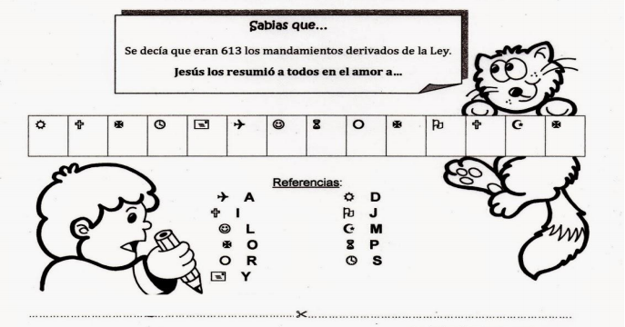
Did you know…
There were more than 600 rules derived from the Law of Moses.
Jesus summarized them with LOVE OF…
G
O
D
A
N
D
N
E
I
G
H
B
O
R
G
D
G
O
H
N
O
D
E
I
A
N
G
R
B

Slide 18
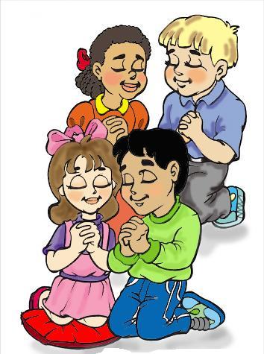
PRAYER
Lord,
Help me to love as you love, extending my heart to the two horizons you show us. Show me how to love a little more each day, and so help build your Kingdom.
Amen

Slide 19
Love One Another, Dakota Pyle, (Ctrl Click), https://youtu.be/LYlkcoAfLU4 (3-7 yrs.)

Slide 20
Song: Love the Lord | CJ and Friends https://youtu.be/vdMIxCdlY-c (8+ yrs)

Slide 21
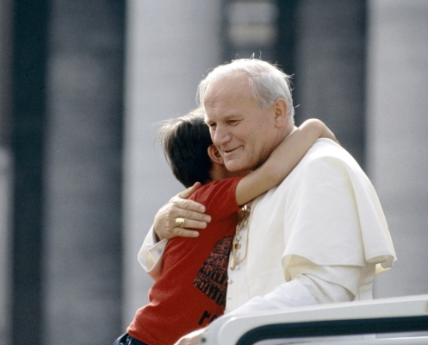
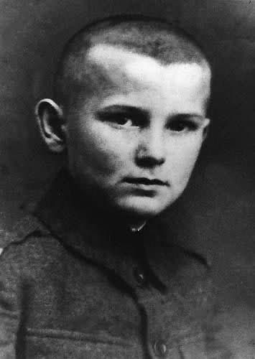
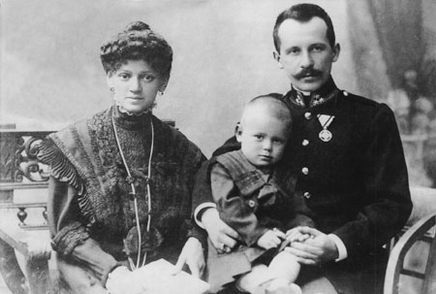
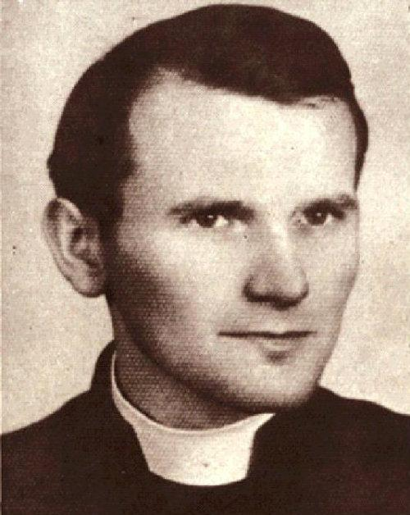
FEAST OF SAINT JOHN PAULII
OCTOBER 22
Karol Wojtila was born on May 18, 1920 (100 years ago) in Wadowice, un a city in Poland close to Cracovia.
He was the youngest of 3 children. His mother was a fervent Catholic who died when he was 9 years old. His father, an officer of the Polish army, always guided him in the way of faith and Christian love.
He started studying Drama at the University, but because of a military invasion, he was forced to work in the quarry. He secretly joined the seminary and was ordained a priest 3 years later in Cracovia.

Slide 22
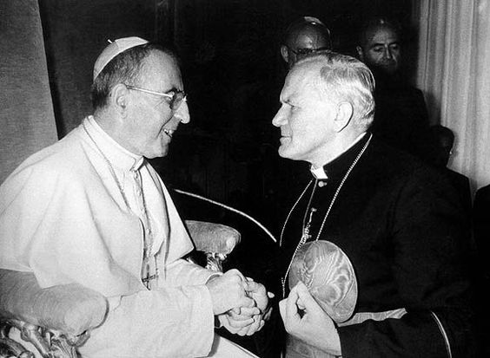
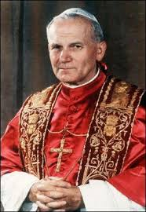
FEAST OF SAINT JOHN PAULII
OCTOBER 22
He was a Cardinal by the time he was 47 years old, one of the youngest of his time. In 1978, when Pope John Paul I died, Karol is named his successor at only 58 years old and adopts his name.
He visited 129 different countries, some several times. He always loved the youth, married couples, and the family. He started restoring Peace and always expressed complete love for Our Blessed Mother Mary. He died April 2, 2005 and was canonized April 27, 2014. St. John Paul II, Pray for us.
Movie: John Paul II, The Life of a Holy Pope.
https://youtu.be/y9lYvkmY874

