Slide 1
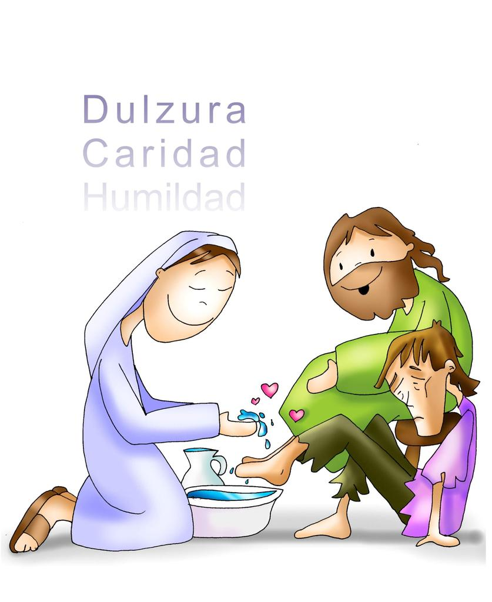
Friends of Jesus and Mary
Sweetness
Charity
Humility
Prayer Group for Children
Cycle A - XXXI Sunday in Ordinary Time
The Greatest must Serve-Matthew 23, 1-12
www.fcpeace.org

Slide 2
Jesus spoke to the crowds and to his disciples, saying,

Slide 3
The scribes and the Pharisees have taken their seat on the chair of Moses.

Slide 4
Therefore, do and observe all things whatsoever they tell you, but do not follow their example. For they preach but they do not practice..

Slide 5
They tie up heavy burdens hard to carry and lay them on people's shoulders, but they will not lift a finger to move them.

Slide 6
All their works are performed to be seen.

Slide 7
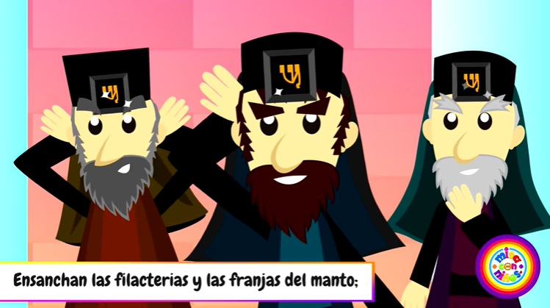
They widen their phylacteries and lengthen their tassels,

Slide 8
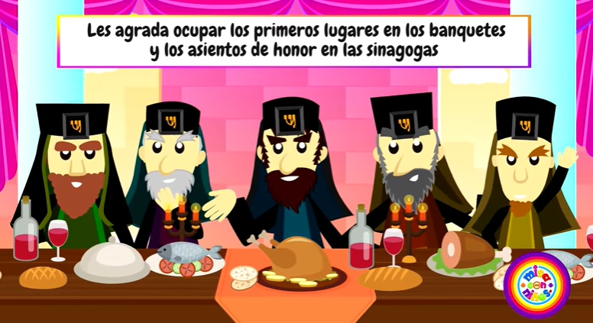
They love places of honor at banquets, seats of honor in synagogues,

Slide 9
…greetings in marketplaces, and the salutation 'Rabbi.'

Slide 10
As for you, do not be called 'Rabbi.' You have but one teacher, and you are all brothers...

Slide 11
Call no one on earth your father; you have but one Father in heaven. ..

Slide 12
Do not be called 'Master'; you have but one master, the Christ.

Slide 13
The greatest among you must be your servant. .

Slide 14
Whoever exalts himself will be humbled; but whoever humbles himself will be exalted."
THE GOSPEL OF THE LORD PRAISE TO YOU LORD JESUS CHRIST

Slide 15
REFLECTION

Slide 16
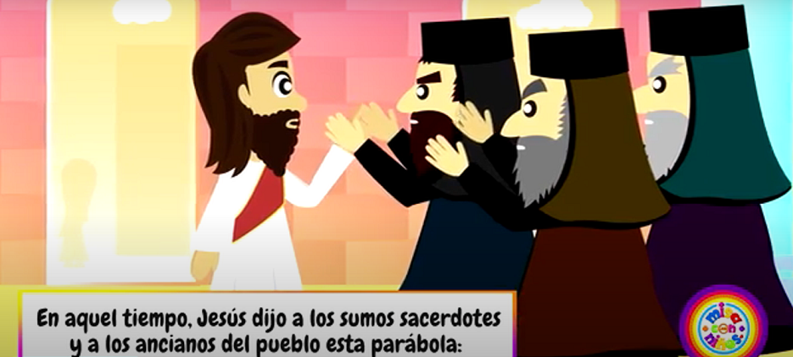
The scribes were experts in the law of Moses, but they derived many additional laws that were difficult to follow. The Pharisees were leaders of the Jewish people that spoke of the importance of following the laws, but did not do so themselves. They did not recognize Jesus as God because they lacked love.
Jesus speaks of the scribes and the Pharisees. Who were they?

Slide 17
What does Jesus say about them?
Do not follow their example. For they preach but they do not practice..

Slide 18
Jesus says they tie up heavy burdens on the people’s shoulders. What is He referring to?
They require the people to follow more than 600 laws, yet do not follow them themselves.

Slide 19
Why does Jesus say they do this?
They love power.
They love places of honor at banquets, seats of honor in synagogues,
…greetings in marketplaces, and the salutation 'Rabbi.'

Slide 20
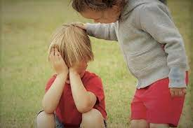
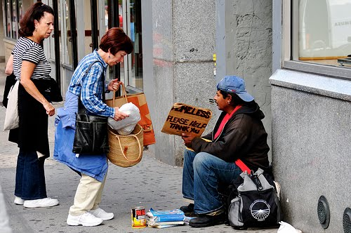
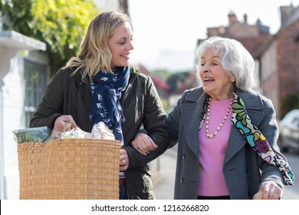
In the eyes of Jesus, who is the greatest?
The person who serves others.

Slide 21
Jesus says that whoever exalts himself will be humbled; but whoever humbles himself will be exalted. What did He mean?
Sweetness
Charity
Humility
God wants us to be humble and serve others, not to try to be more important.

Slide 22
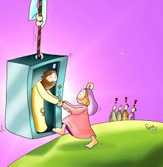
God will reward the humble servant in Heaven.

Slide 23
How can we serve God and our neighbor better? Share.

Slide 24
Activity

Slide 25
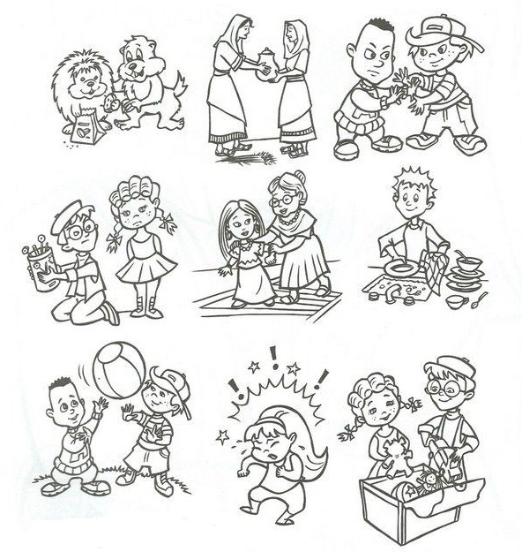
WHO IS SERVING GOD AND OTHERS?

Slide 26
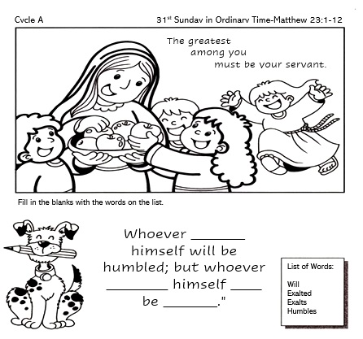
exalts
humbles
will
exalted

Slide 27
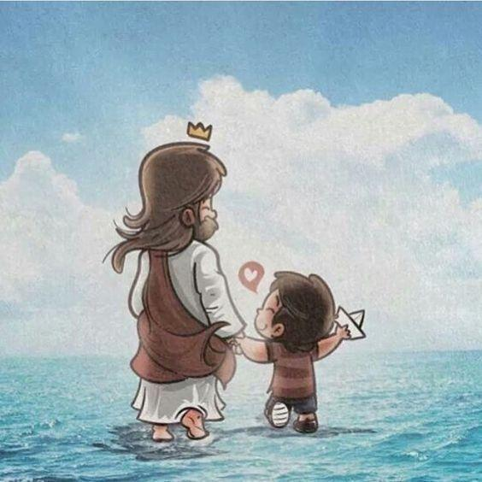
PRAYER Jesus, I always want to follow you. Help me to be humble. Help me to imitate you serving God and my neighbor thus helping to build your Kingdom. I love you. Amen.

Slide 28
Make me a Servant, The Asidors, https://youtu.be/zw_FNbF1LrU?si=5X-oqZhEXxTLbkc4 (3-7 yrs.)

Slide 29
The Servant Song, servantofthelion, https://youtu.be/kdmgpMfnjdU?si=utkB1M6Cv6oahiwx (8+ yrs.)

