Slide 1
Friends of Jesus and Mary
Prayer Groups for Kids
Cycle A - XXXII Sunday in Ordinary Time
Parable of the Lamps, Mathew 25: 1-13
www.fcpeace.org

Slide 2
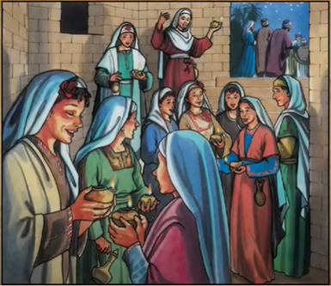
Jesus told his disciples this parable: "The kingdom of heaven will be like ten virgins who took their lamps and went out to meet the bridegroom.
Five of them were foolish and five were wise.

Slide 3
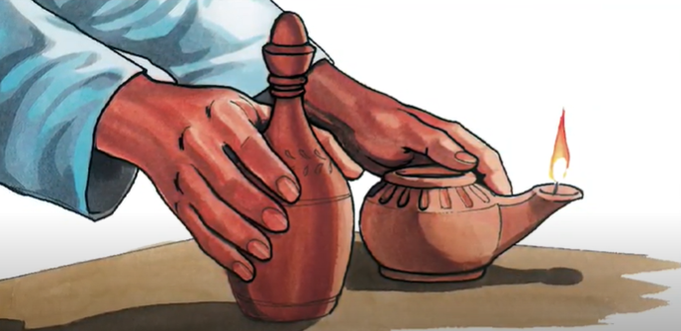
The foolish ones, when taking their lamps, brought no oil with them, but the wise brought flasks of oil with their lamps.

Slide 4
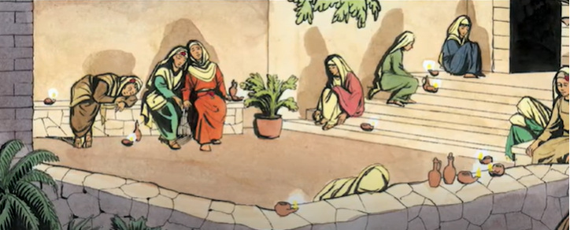
Since the bridegroom was long delayed, they all became drowsy and fell asleep.

Slide 5
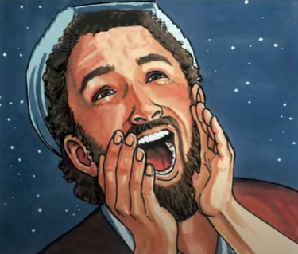
At midnight, there was a cry, ‘Behold, the bridegroom! Come out to meet him!’

Slide 6
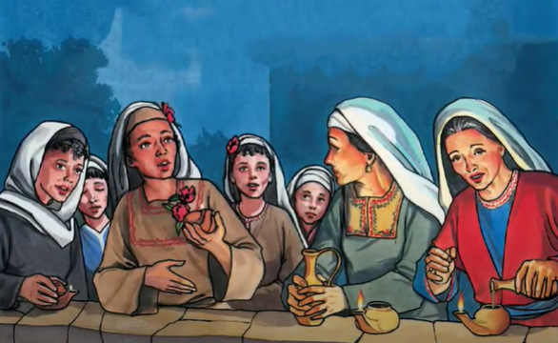
Then all those virgins got up and trimmed their lamps. The foolish ones said to the wise, ‘Give us some of your oil, for our lamps are going out.’

Slide 7
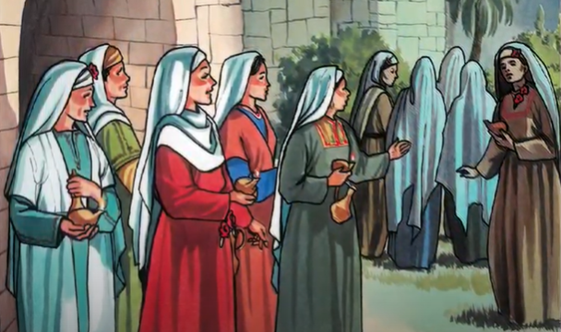
But the wise ones replied, 'No, for there may not be enough for us and you. Go instead to the merchants and buy some for yourselves.’

Slide 8
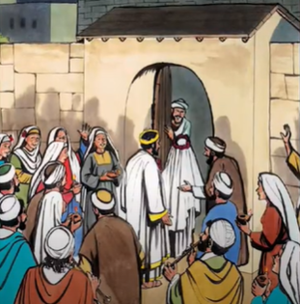
While they went off to buy it, the bridegroom came and those who were ready went into the wedding feast with him. Then the door was locked.

Slide 9
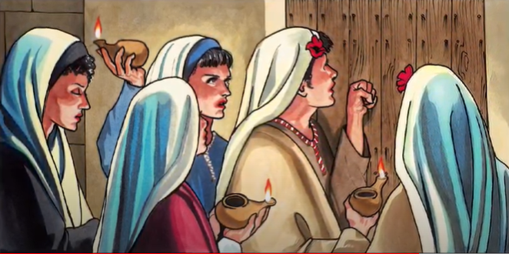
Afterwards the other virgins came and said, ‘Lord, Lord, open the door for us!’

Slide 10
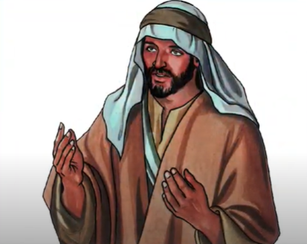
But he said in reply, ‘Amen, I say to you, I do not know you.’
The Gospel of the Lord
Praise to You Lord Jesus Christ
Therefore, stay awake, for you know neither the day nor the hour."

Slide 11
Jesus teaches us about the Kingdom of God with a Parable. What is a Parable?
A story with a teaching

Slide 12
Who do the ten brides with their lamps represent?
Us, God’s people, on our journey to Heaven

Slide 13
Who does the bridegroom represent?
Jesus who receives us in Heaven.

Slide 14
What do the lamps represent?
Our soul or spiritual heart.
What does the oil that lights the lamps represent?
Our prayers and Good Works that cause love to increase in our world; they make Jesus’ light shine all around us.

Slide 15
What did the foolish brides do when they realized they had run out of oil and the bridegroom had arrived?
They asked the wise brides to give them some of their oil, but they said no because they might run out themselves.

Slide 16
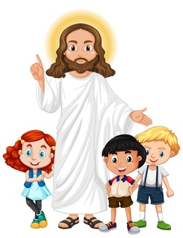
What does Jesus want to teach us?
We must be prepared for when Jesus calls us to Heaven.
Our heart must be full of Jesus’ love and shining with our Good Works of service to our neighbor.

Slide 17
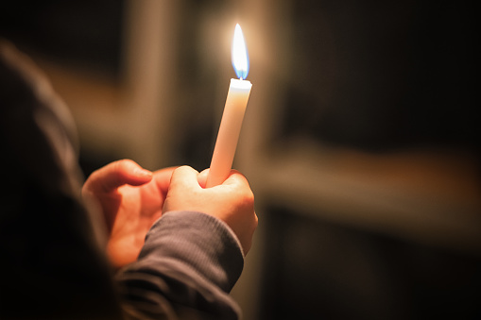
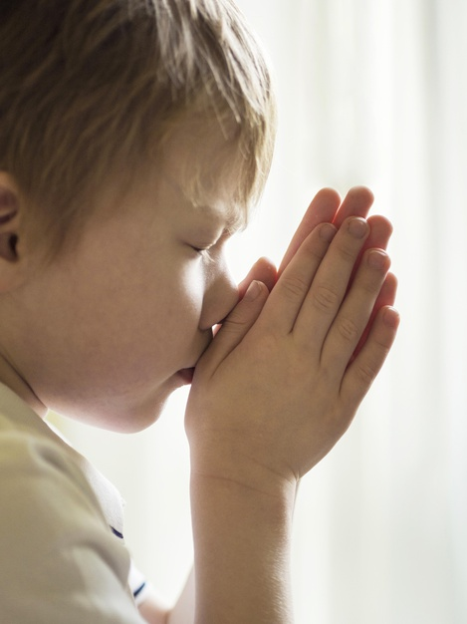
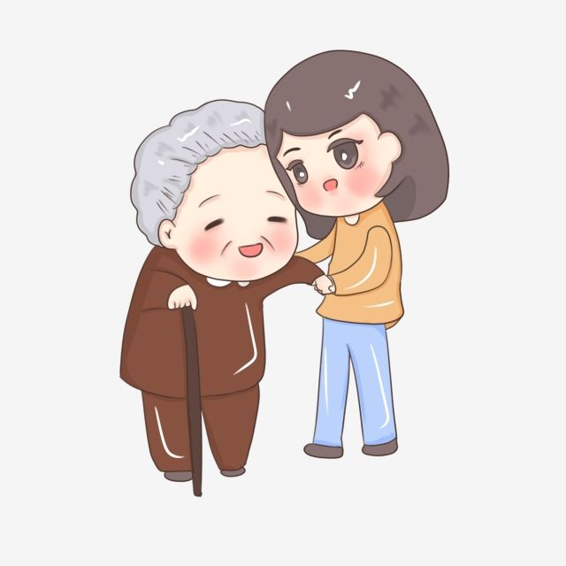
This cannot be transferred to another person like the foolish brides suggested.
Each person must shine with their own prayers and good works.

Slide 18
Activity

Slide 19
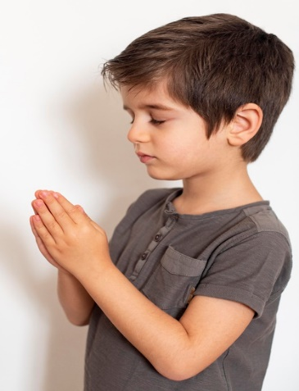
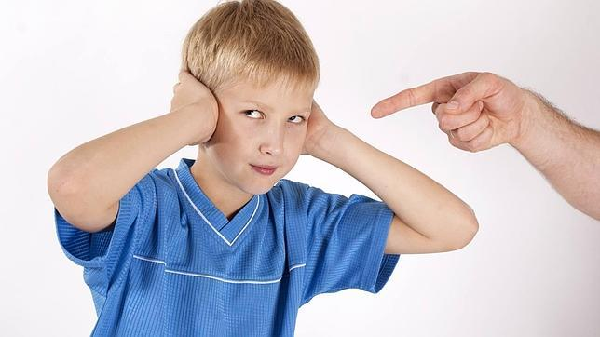
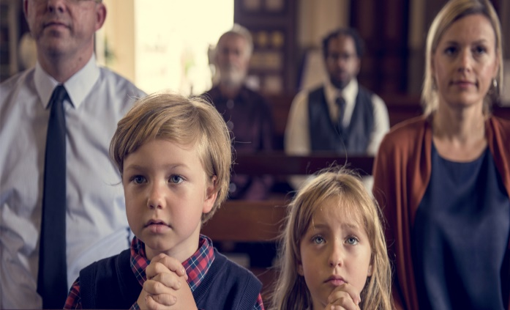
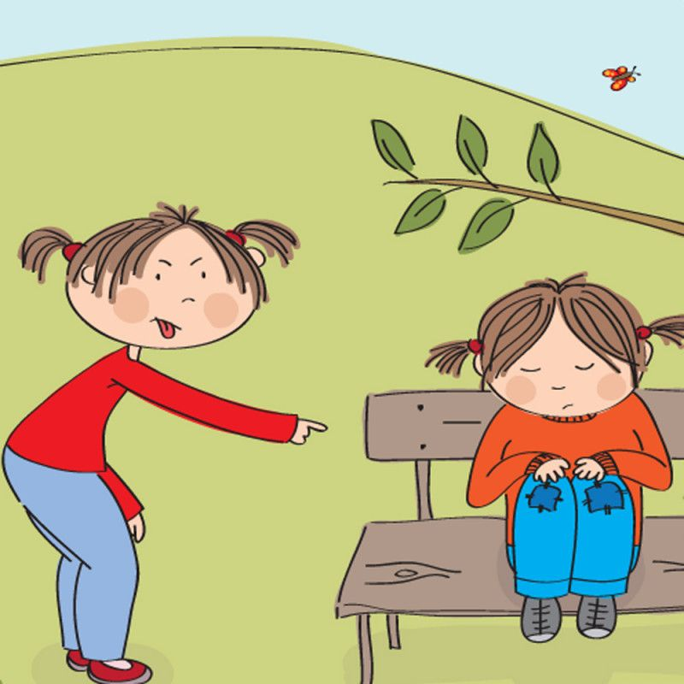
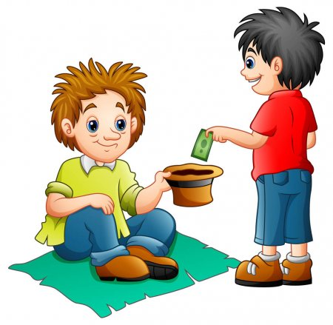
Lights or blows out our lamp?

Slide 20
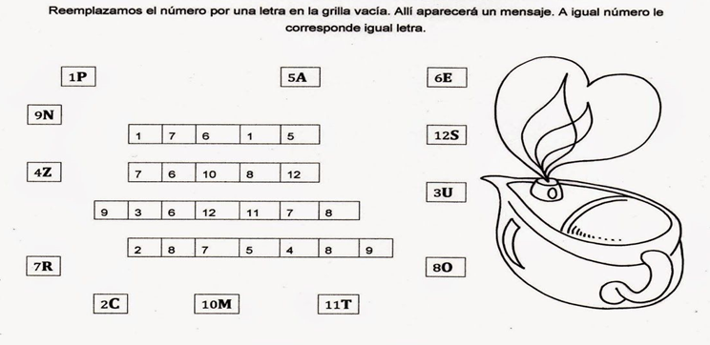
Replace the number in the boxes with the letter that corresponds with the number. Read the message.
9H
P
R
E
P
A
R
6
7
E
10
8
U
Y
O
R
3
7
H
E
A
R
T
6
5
7
10Y

Slide 21
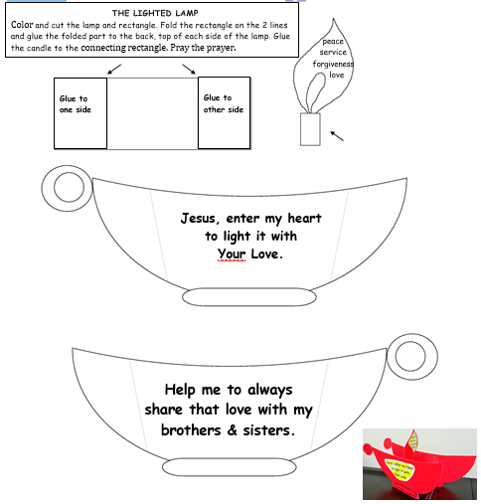
www.fcpeace.com
www.fcpeace.org

Slide 22
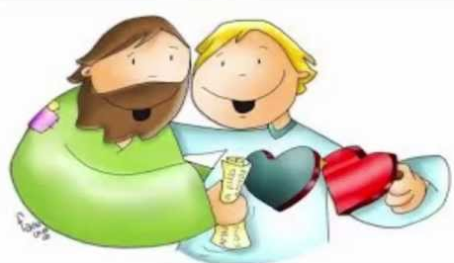
Prayer Jesus, enter my heart and light it with your love; help me to always share your love with my brothers and sisters. Amen. Song: This Little Light of Mine, Lifetree Kids https://youtu.be/ty9bZXN4uWA

Slide 23
Song:This Little Light of Mine, Cedermont Kids, https://youtu.be/yRhDi2aK5ac?si=PQ3NdaUckUgTJ41Y (3-6 yrs)

Slide 24
Song: Shine Jesus Shine, vbtyree, https://youtu.be/cVnMrCIAeMw?si=yOWqVKaPhVXnFwOI (7+ yrs)

