Slide 1
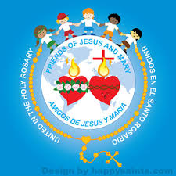
Friends of Jesus and Mary
Cycle A - XXXIII Sunday in Ordinary Time
The Parable of the Talents
Mathew 25: 14-30
www.fcpeace.org

Slide 2
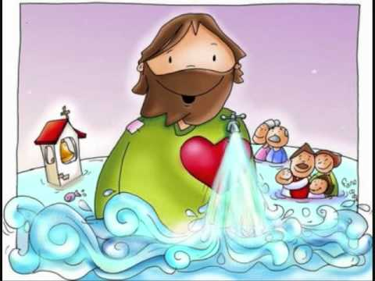
GOD’S LOVE IS WONDERFUL!

Slide 3
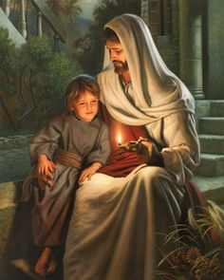
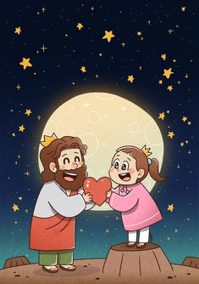
THE LOVE OF JESUS
Jesus loves us intensely and wants the best for us. He especially loves children because their hearts are open to His Love.
Love is a gift Jesus gives to each of us along with His mercy.
Mercy is to feel much love and compassion for others; even if they make a mistake and do something wrong, mercy forgives and gives another chance. Thus is Jesus’ love for us, Large and, Wonderful.

Slide 4
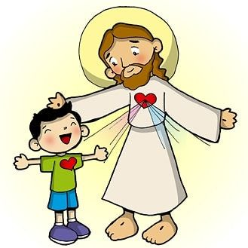
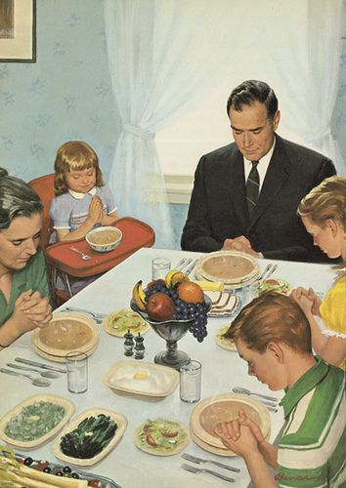
THE LOVE OF JESUS
We can feel Jesus’ love in our family when our Mom or Dad hug us, when our favorite dinner is served, when we’re lying in our cozy bed at night, all gifts from Jesus…
When we feel Jesus’ great love for us, our heart jumps for joy.
In each sunrise that God gives us, in the trees and flowers, in the oxygen we breathe, and in the flowing rivers, in all of nature!
In our friends at school or in our neighborhood…

Slide 5
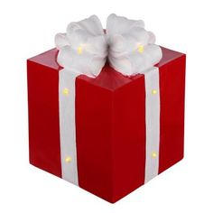
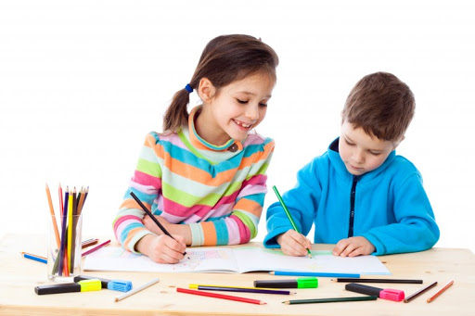
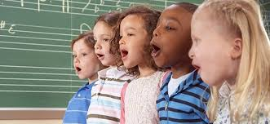
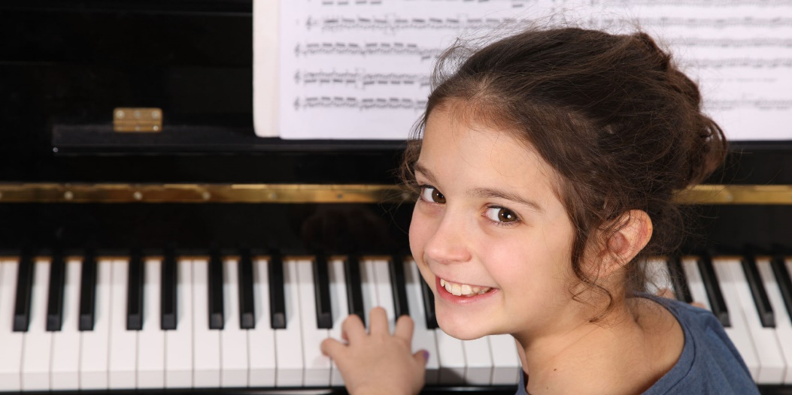
THE LOVE OF JESUS
Jesus also gives us certain abilities, and talents.
For example:
Maybe you can draw well!
Maybe you have a beautiful singing voice.
Or maybe you learn instruments easily.
All this reflects Jesus’ generous LOVE.

Slide 6
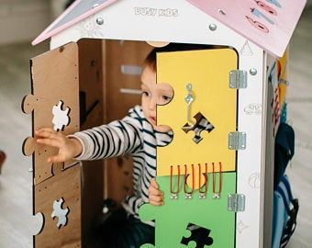
THE LOVE OF JESUS
We should appreciate and be grateful for Jesus’ gifts of LOVE and share them with others.
Can you imagine hiding your gifts for yourself only? This would be like not returning Jesus’ great love.
LET’S SEE WHAT JESUS SAYS ABOUT THIS SUBJECT!!

Slide 7
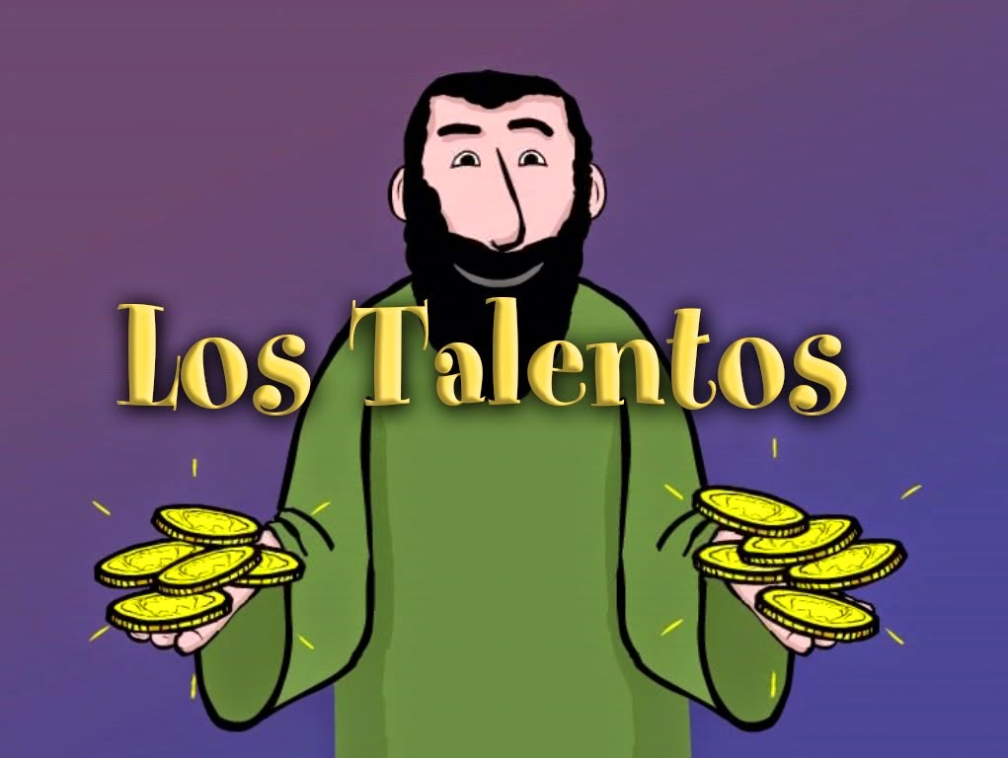
The
s

Slide 8
GOSPEL OF MATHEW 25: 14-30
Jesus told his disciples this parable: A man going on a journey ...

Slide 9
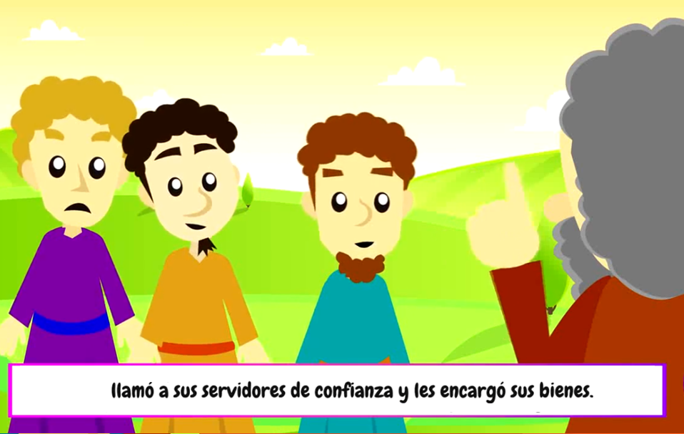
…called in his servants and entrusted his possessions to them.

Slide 10
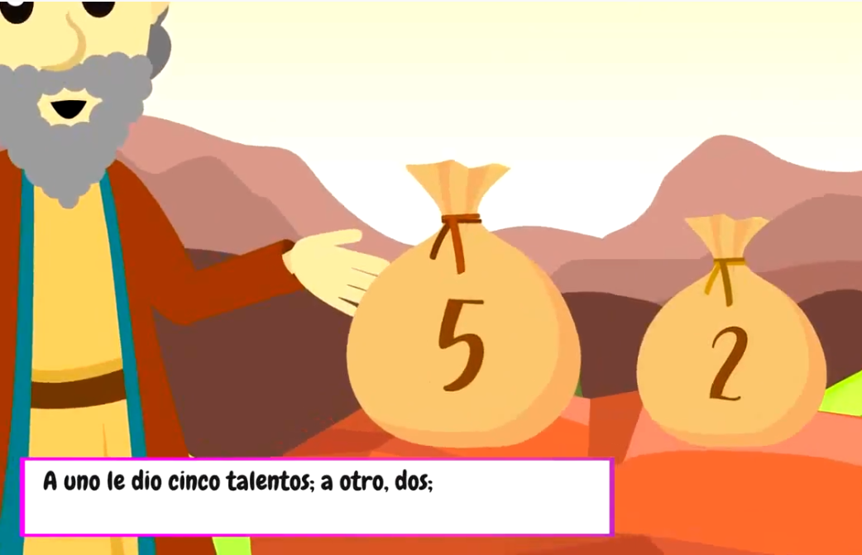
To one he gave five talents; to another, two

Slide 11
to a third, one--to each according to his ability.

Slide 12
Immediately the one who received five talents went and traded with them, and made another five.

Slide 13
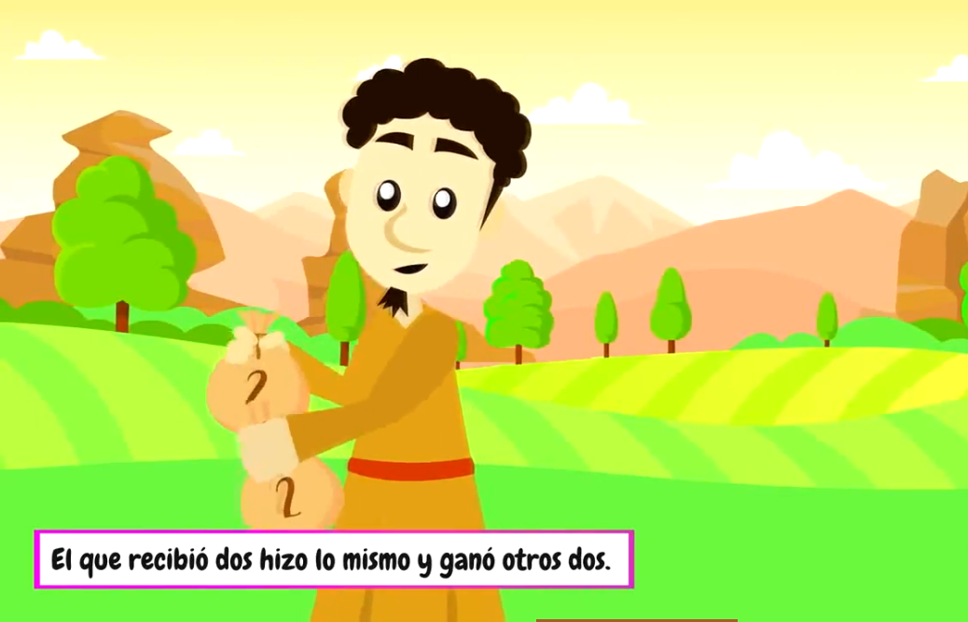
Likewise, the one who received two made another two.

Slide 14
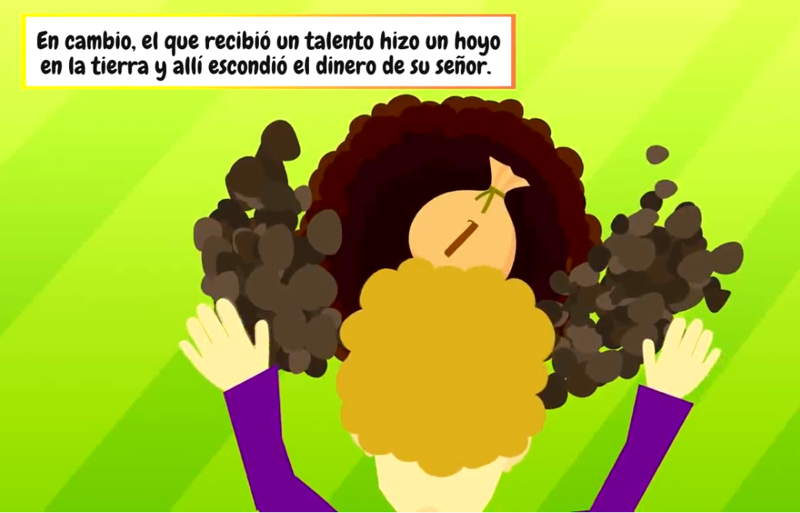
But the man who received one went off and dug a hole in the ground and buried his master's money.

Slide 15
After a long time, the master of those servants came back and settled accounts with them.
The one who had received five talents came forward bringing the additional five.

Slide 16
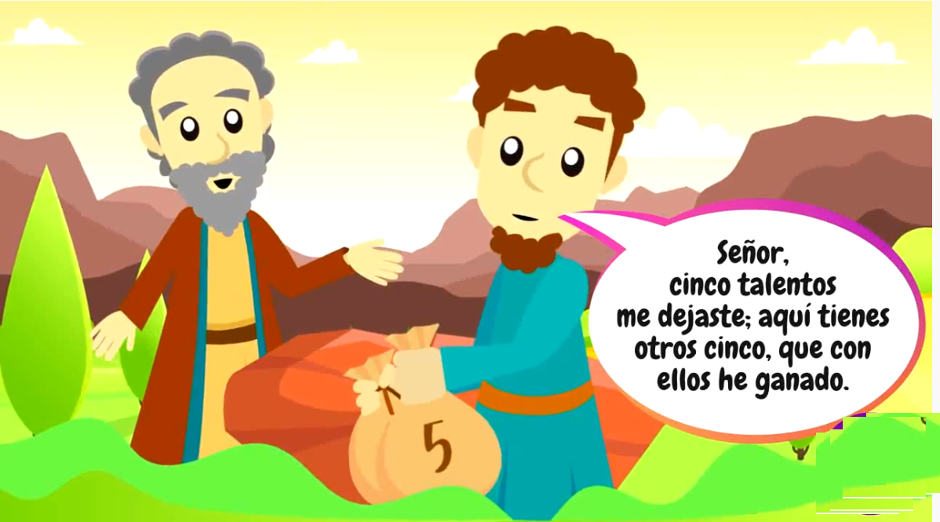
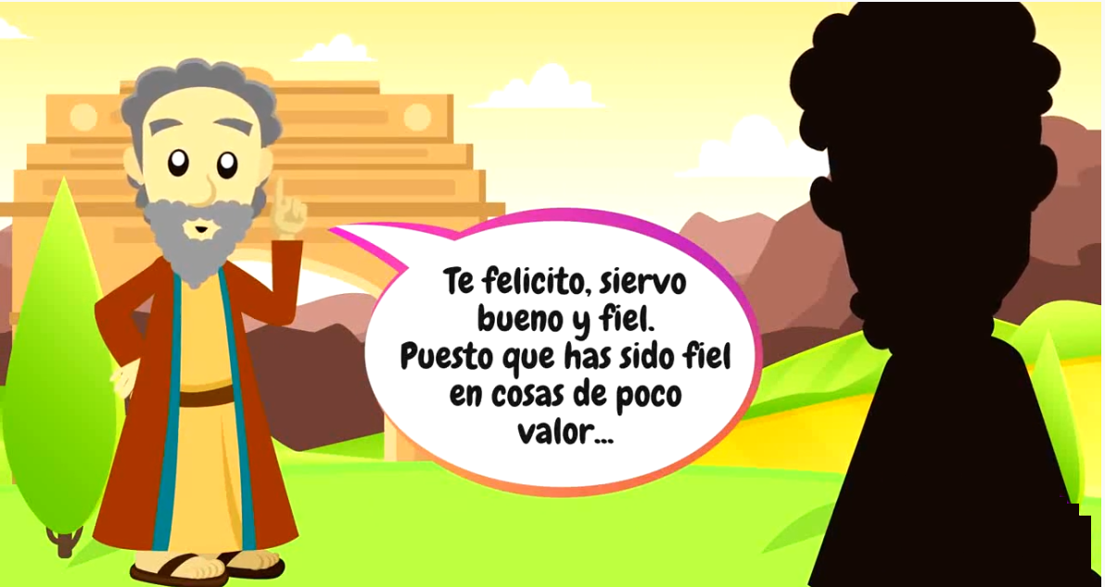
His master said to him:
He said, 'Master, you gave me five talents. See, I have made five more.
Well done, my good and faithful servant. Since you were faithful in small matters,

Slide 17
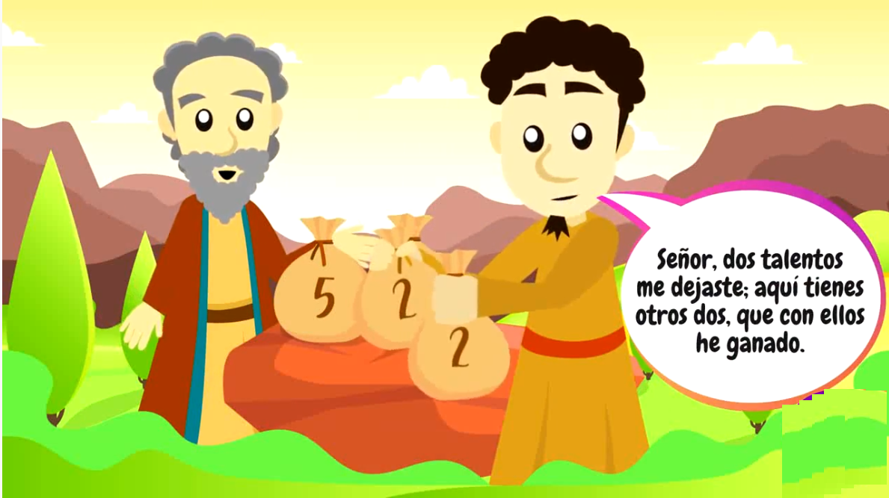
Then the one who had received two talents also came forward and said,
I will give you great responsibilities. Come, share your master's joy.
'Master, you gave me two talents. See I have made two more.

Slide 18
His master said to him:
Well done, my good and faithful servant. Since you were faithful in small matters,
I will give you great responsibilities. Come, share your master's joy.

Slide 19
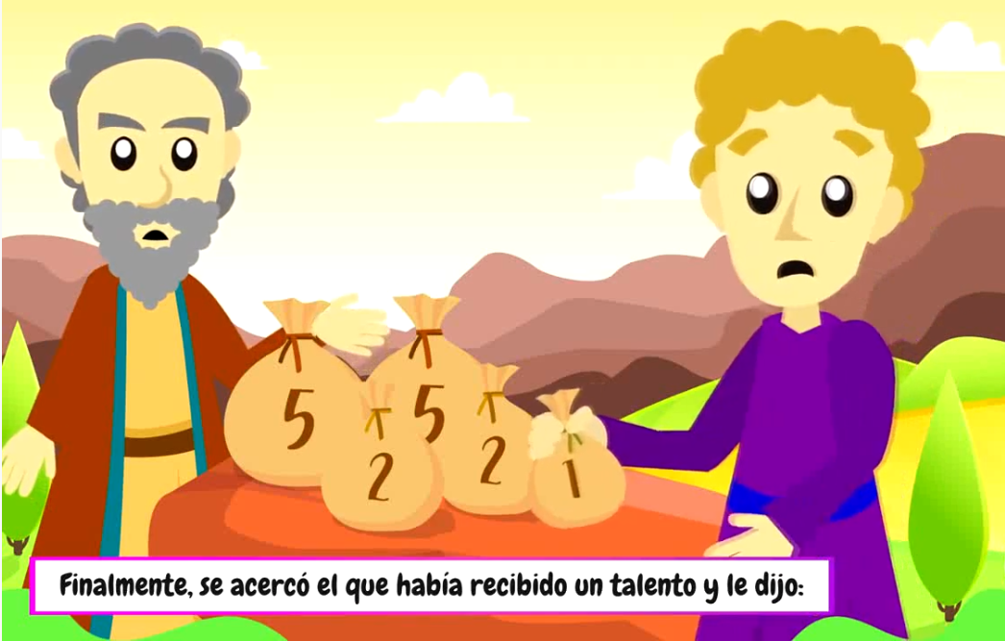
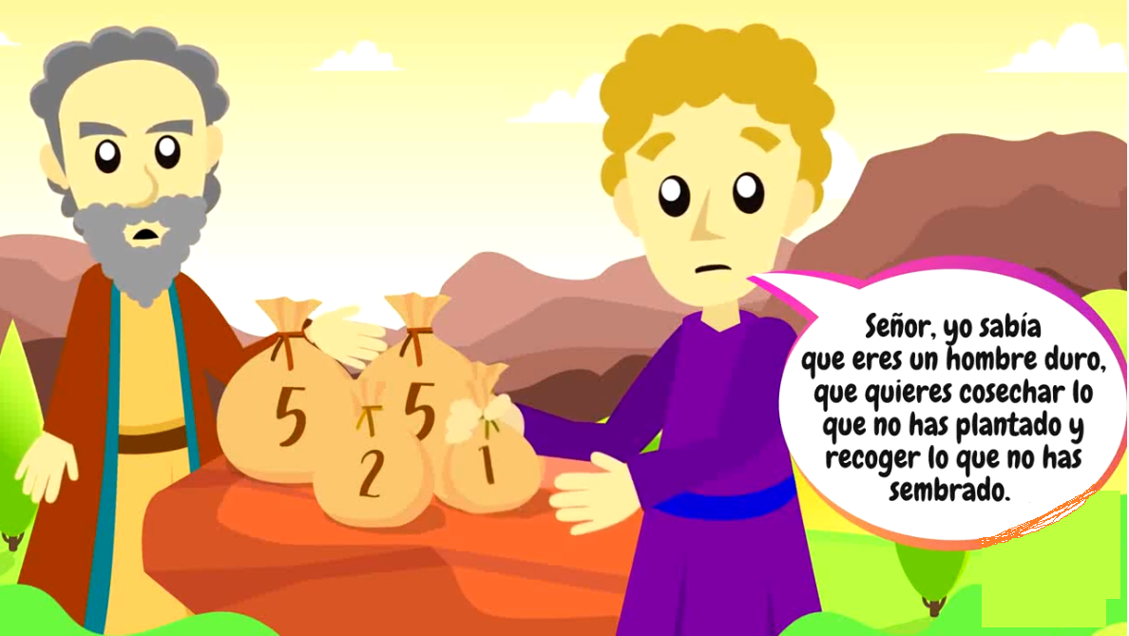
Then the one who had received the one talent came forward and said,
Master, I knew you were a demanding person, harvesting where you did not plant and gathering where you did not scatter;

Slide 20
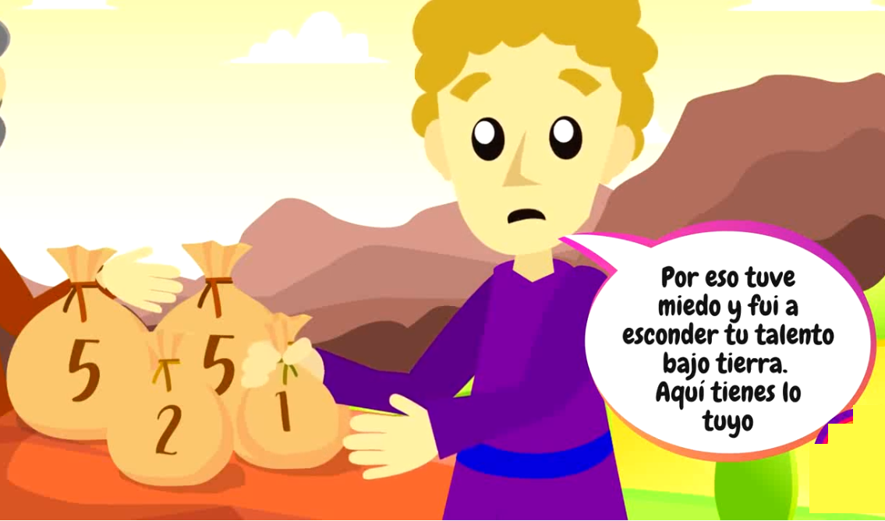
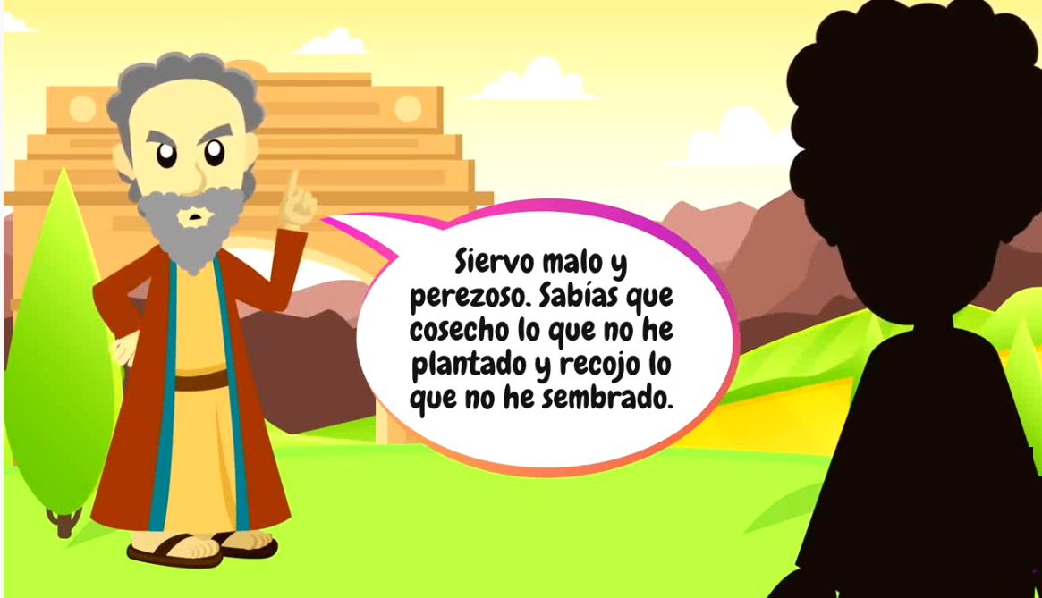
so out of fear I went off and buried your talent in the ground. Here it is back.
'You wicked, lazy servant! So you knew that I harvest where I did not plant and gather where I did not scatter?
The Master responded:

Slide 21
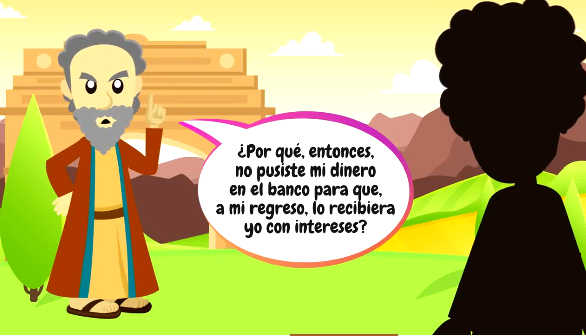
Should you not then have put my money in the bank so that I could have got it back with interest on my return?
Take the talent from him and give it to the one with ten. For to everyone who has, more will be given and he will grow rich; but from the one who has not, even what he has will be taken away.
His master said to him in reply:

Slide 22
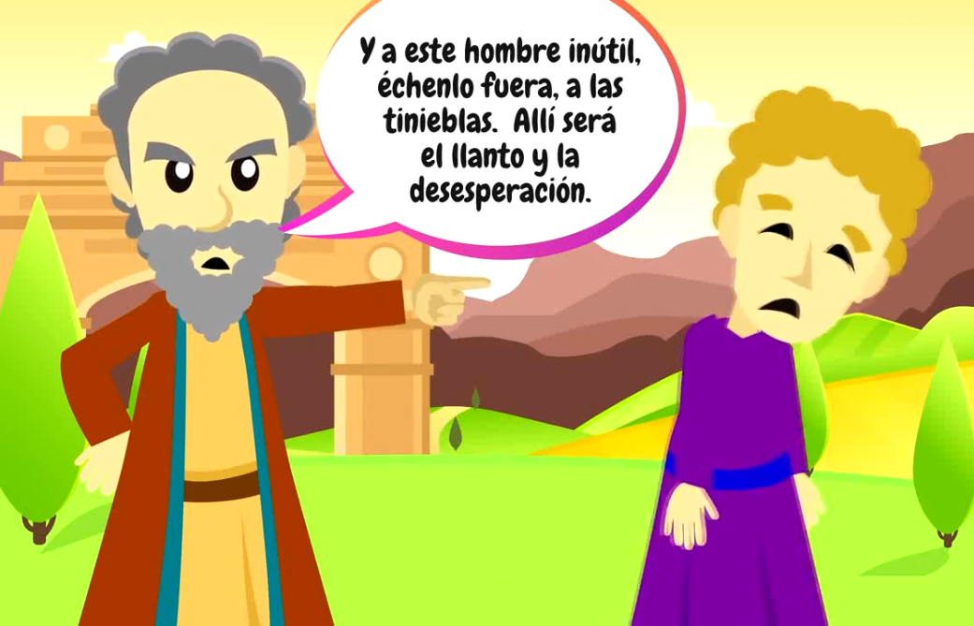
And throw this useless servant into the darkness outside, where there will be wailing and grinding of teeth.
The Gospel of the Lord:
Praise to you Lord Jesus Christ.

Slide 23
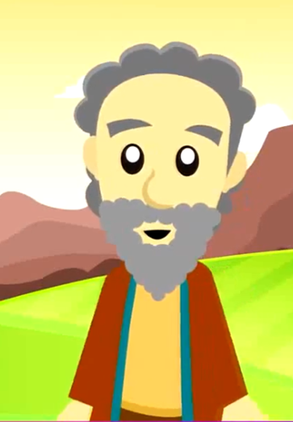
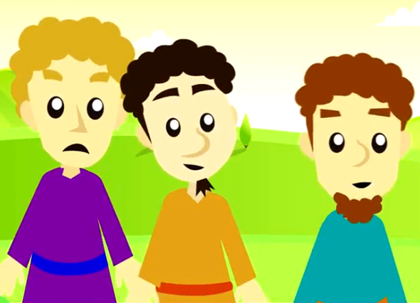
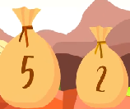
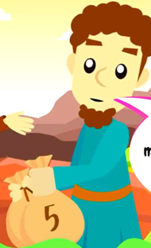
Who does the man that left on a trip represent?
He represents God.
Who do the servants represent?
The followers of Jesus
What do the talents he left them represent?
The talents and blessings that God gives each person.
How does the master react when his servants doubled the money given them?
He praises them and invites them to enter the happiness of the Lord.

Slide 24
What does he tell the servant that buried his money for fear of losing it?
He is rejected and he takes his talent away.
What does Jesus want to teach us?
He wants us to use our talents and gifts to help others, thus helping Him build God’s Kingdom. If we don’t use them because of laziness, fear, or selfishness, they could decrease or be lost.
What talents do I have?
Am I using it well?
Or am I wasting it?

Slide 25
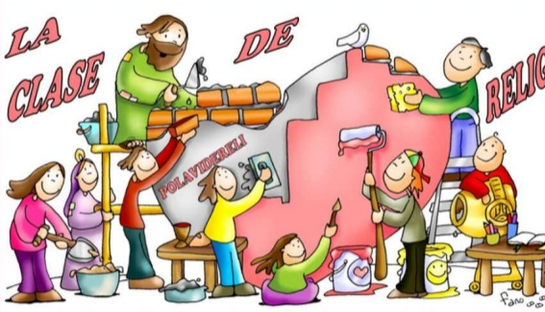
ACTIVITY

Slide 26
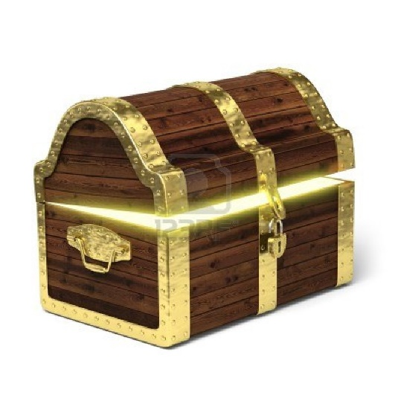
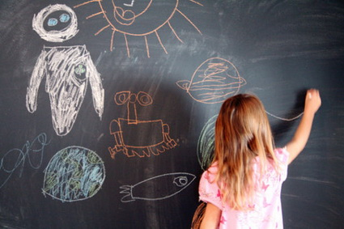
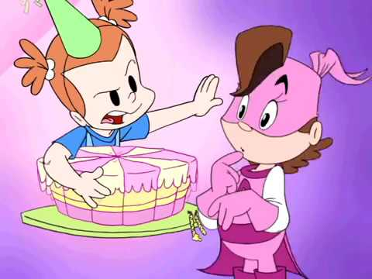
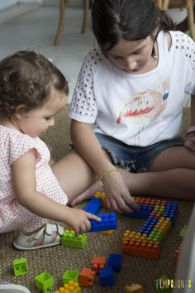
God has given you various talents. Identify if they are being used to honor God or being hidden. We will put a checkmark if it’s being used to honor God.
If the talent is being wasted, we will put a
Mary draws beautifully and prepares a great surprise for her teacher and her class.
She does not want to share her cake.
Joe is very smart, but he stayed up late playing video games and falls asleep in class.
Big sister uses her patience to play with her sister.

Slide 27
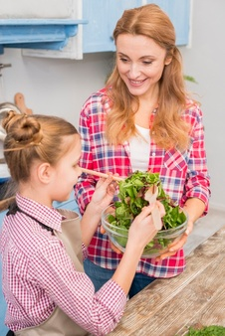
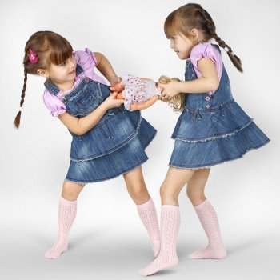
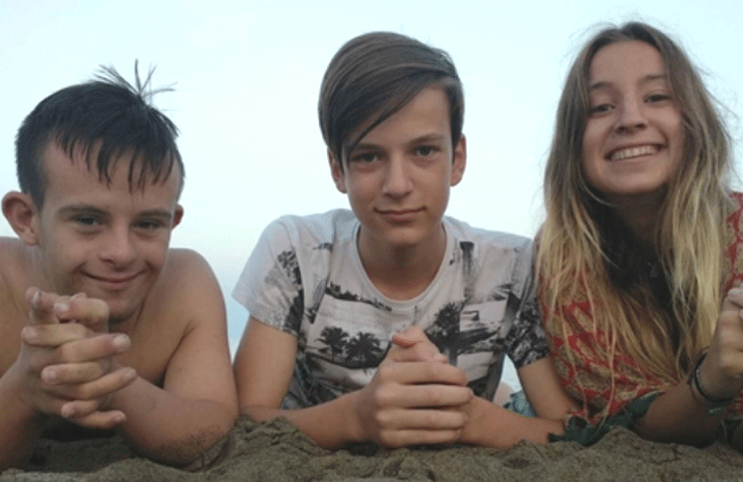
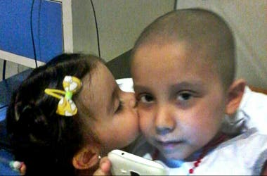
Elena, has all the books of the collection but no one can ask her to borrow one. She gets annoyed.
Camila, loves to cook and help mom make lunch.
A sister lost her doll and doesn’t feel like looking for her own so she take’s her sister’s doll.
Ana is very joyful and makes everyone smile, even those who are sad.
With only a year old, Susan visits her cousin in the Hospital and takes him drawings and covers him with kisses.

Slide 28
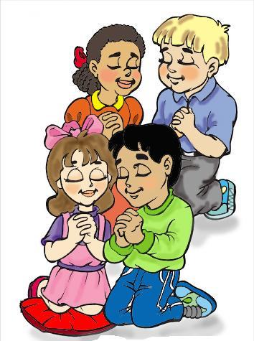
PRAYER
Jesus,
Thank you for all the blessings and talents you give us. Help me to be generous and brave so I may use my talents to help others. I love you.
Amen

Slide 29
A Gift to You, KWSCM, https://youtu.be/qbyPbh-NmX8?si=mnZUCqnjLmRCYfM4

