Slide 1
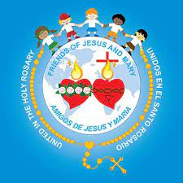
Ministry Friends of Jesus and Mary
Prayer Group for Kids
Cycle A - II Sunday of Advent
A Voice Crying Out in the Desert – Matthew 3, 1-12

Slide 2
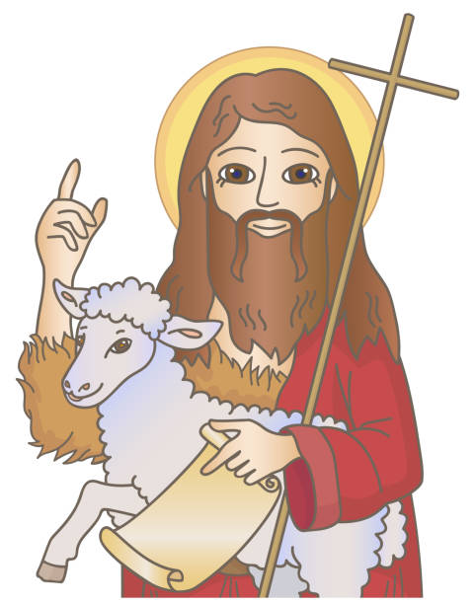
John the Baptist appeared, preaching in the desert of Judea and saying, "Repent, for the kingdom of heaven is at hand!" It was of him that the prophet Isaiah had spoken when he said: “A voice of one crying out in the desert, Prepare the way of the Lord, make straight his paths.” John wore clothing made of camel's hair and had a leather belt around his waist. His food was locusts and wild honey.

Slide 3
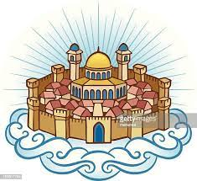
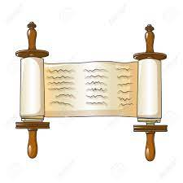
At that time Jerusalem, all Judea, and the whole region around the Jordan were going out to him and were being baptized by him in the Jordan River as they acknowledged their sins. When he saw many of the Pharisees and Sadducees coming to his baptism, he said to them, "You brood of vipers! Who warned you to flee from the coming wrath?

Slide 4
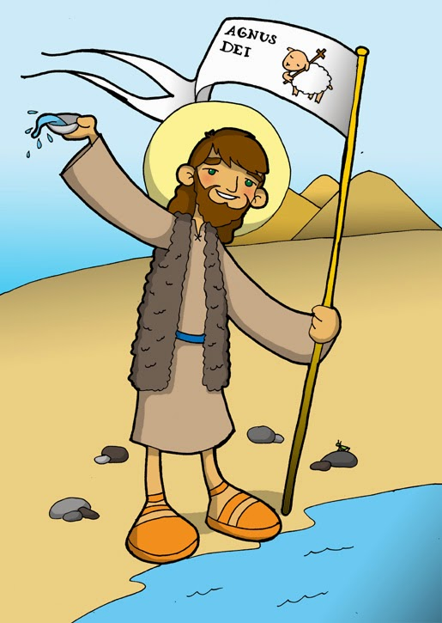
Produce good fruit as evidence of your repentance. And do not presume to say to yourselves, 'We have Abraham as our father.' For I tell you, God can raise up children to Abraham from these stones. Even now the ax lies at the root of the trees. Therefore, every tree that does not bear good fruit will be cut down and thrown into the fire. I am baptizing you with water, for repentance, but the one who is coming after me is mightier than I. I am not worthy to carry his sandals.

Slide 5
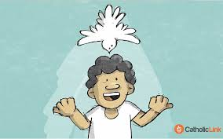
He will baptize you with the Holy Spirit and fire. His winnowing fan is in his hand. He will clear his threshing floor and gather his wheat into his barn, but the chaff he will burn with unquenchable fire."
The Gospel of the Lord,
Praise to You Lord, Jesus Christ.

Slide 6
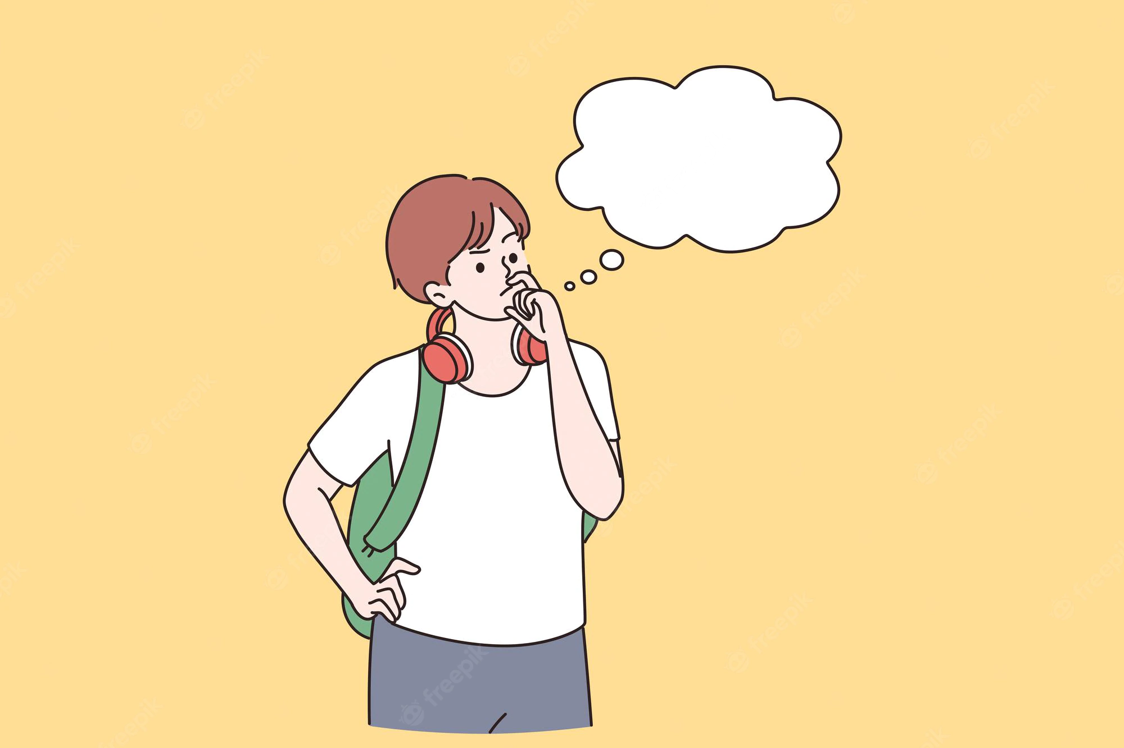
Reflection…

Slide 7
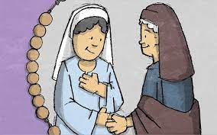
Who was John the Baptist?
Jesus’ cousin, son of St. Elizabeth and the priest, St. Zachariah.

Slide 8
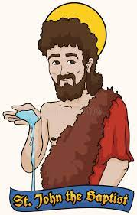
Why did he wear clothing of camel’s hair with a leather belt and ate locust and wild honey?
He did not care about his appearance; he dedicated all of his life to getting closer to God, praying and sacrificing and later preaching to all to prepare the way of the Savior.

Slide 9
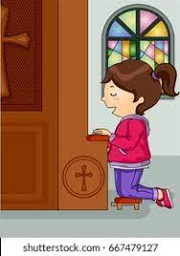
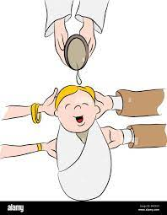
How does he tell them to prepare?
He tells them to confess their sins and be baptized. When we sincerely confess our sins, God forgives us and cleanses our heart to receive Jesus, our King, with love.

Slide 10
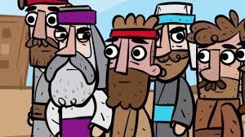
Why did he speak so harshly to the Sadducees and Pharisees?
Even though they were leaders of the Jewish faith, their hearts were full of sin.

Slide 11
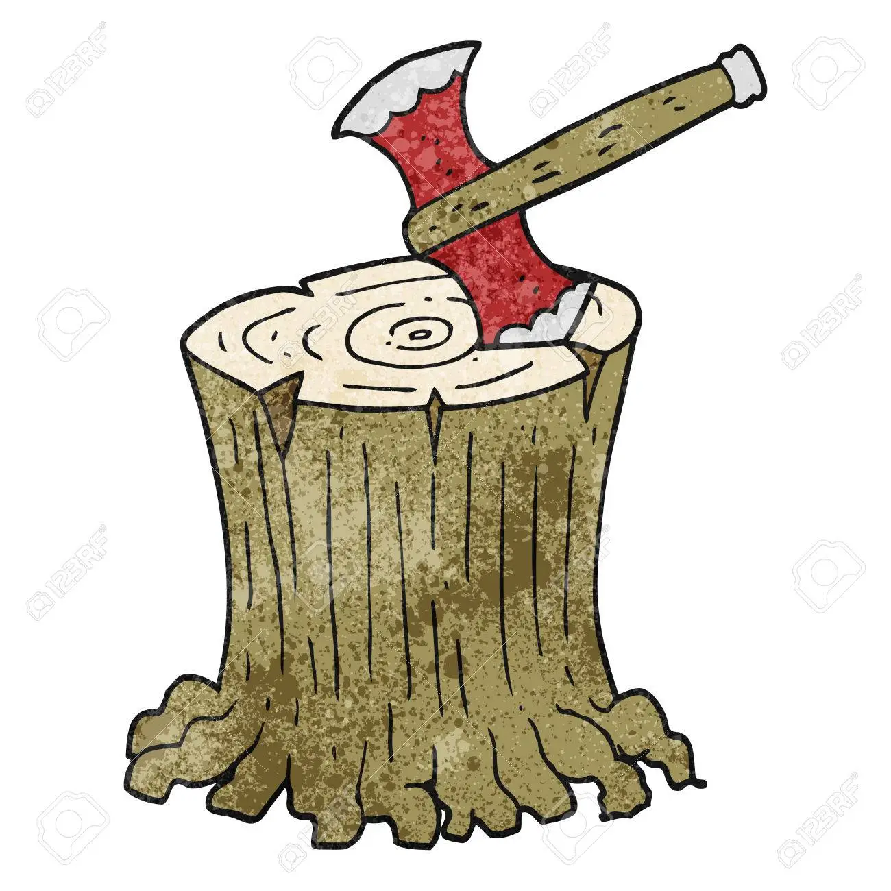
What did he mean by, “Even now the ax lies at the root of the trees…”?
God would soon remove them as spiritual leaders of his chosen people and extend the invitation to enter in relationship with Himself to the whole world, not just the Jewish people.

Slide 12
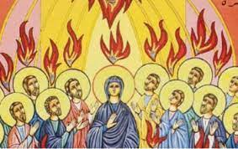
Why does he say, “I am baptizing you with water…He will baptize you with the Holy Spirit and fire?
John the Baptist’s baptism was solely symbolic of conversion, but Jesus, our Savior’s baptism had the power to forgive our sins and give us Eternal Life.

Slide 13
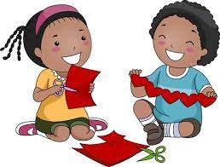
Activities

Slide 14
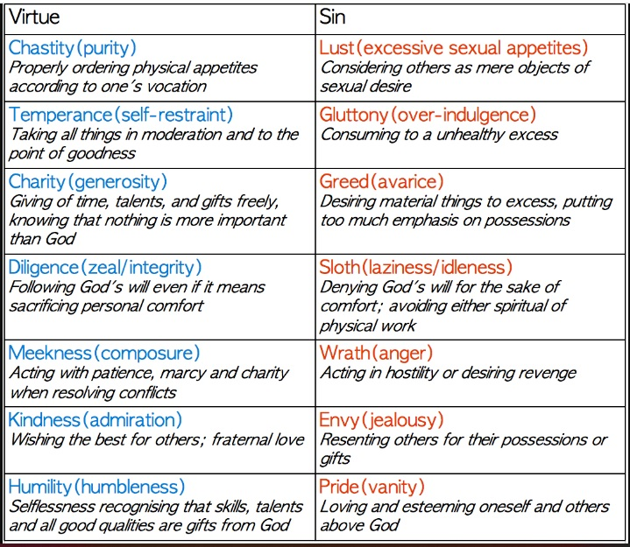
Review Virtues and Sins

Slide 15
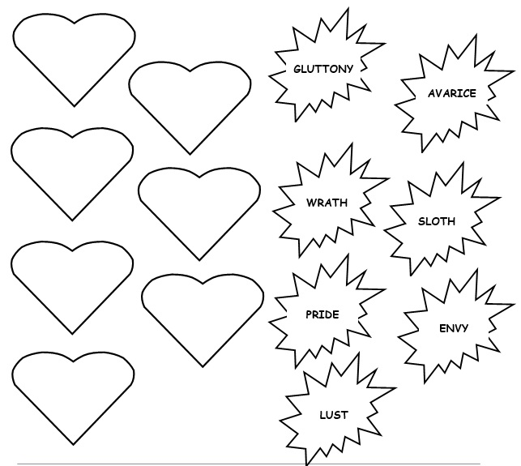
“"Repent, for the kingdom of heaven is at hand!"
Temperance
Charity
Instructions: Write the virtues in the hearts which are opposite the capital sins on the opposite side of the page.
Charity
Chastity
Meekness
Kindness
Temperance
Diligence
Humility
Meekness
Diligence
Humility
Kindness
Chastity

Slide 16
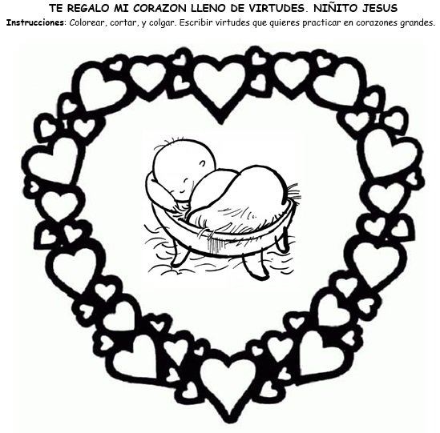
I GIVE YOU MY HEART FULL OF VIRTUES, BABY JESUS
Instructions: Color, cut, and write in the large hearts the virtues you want to practice this Advent.
Charity
Chastity
Meekness
Kindness
Temperance
Diligence
Humility

Slide 17
Prayer Lord, give me the grace of repentance of my sins and the desire to only want to please you and love you. Help me to forgive those that hurt me as you always did. Amen.

Slide 18
A Gift to You, https://youtu.be/qbyPbh-NmX8 (3-7 years)

Slide 19
I Wanna Do Right, https://youtu.be/RlxxuTV-5vk (8+ years)

