Slide 1
Ministry Friends of Jesus and Mary
Cycle B – I Sunday of Easter-The Resurrection
John 20, 1-9
www.fcpeace.org

Slide 2
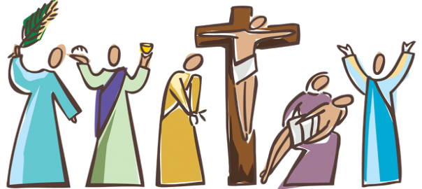
Easter Triduum
What is the Easter Triduum?
For Catholics, the most important days of the year are composed of the Easter Triddum, especially Resurrection Sunday.

Slide 3
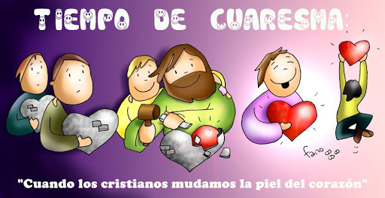
Lent begins with Ash Wednesday and ends on nightfall of Holy Thursday.
What is the Easter Triduum?
LENTEN TIME
When Christians prepare their heart for Jesus.
Then we begin to relive the Passion, Death, and Resurrection of our Lord Jesus Christ during the Easter Triduum.

Slide 4
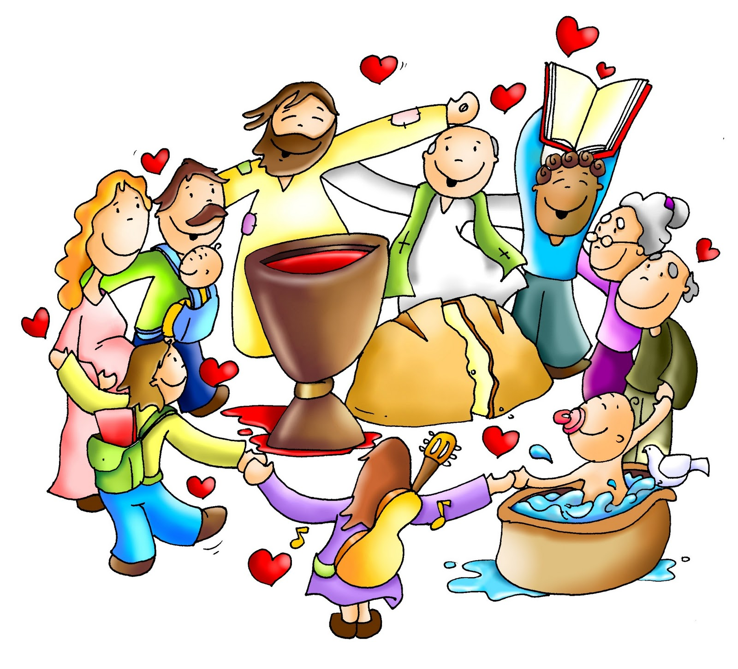
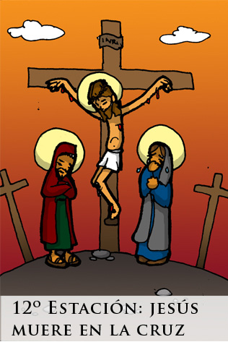
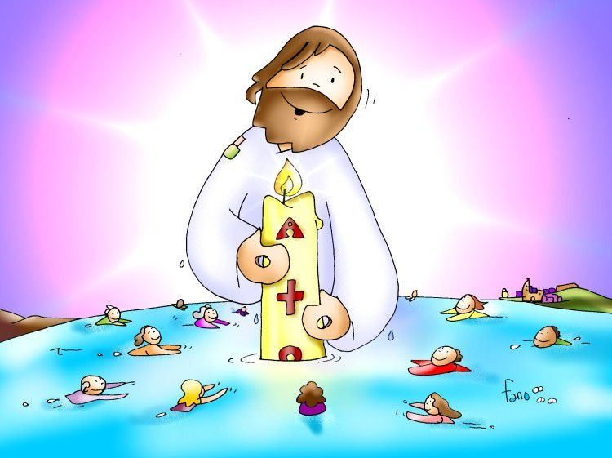
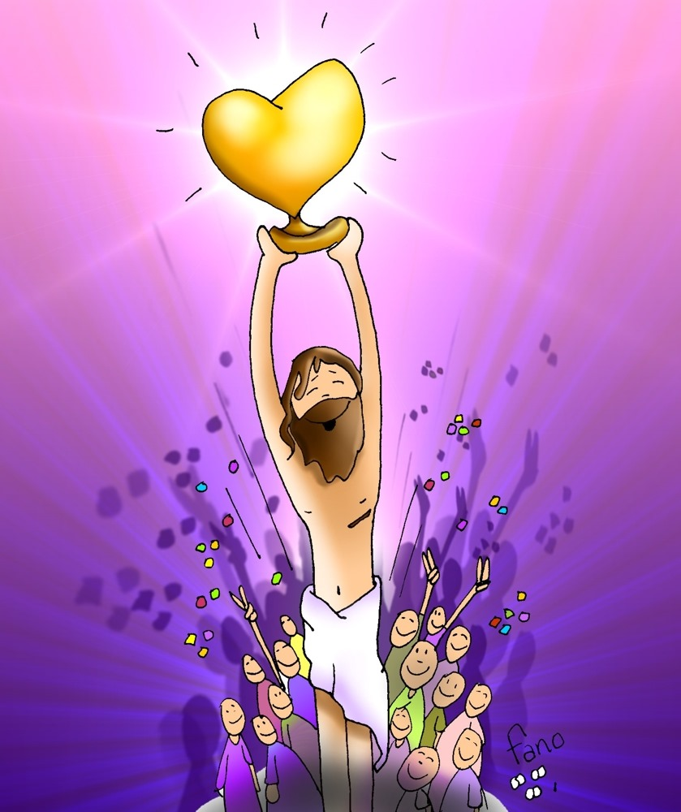
What is the Easter Triduum?
The Step
Holy Thursday
Good Friday
Holy Saturday
The Arrival
Resurrection Sunday

Slide 5
What Happens on Holy Thursday?
Holy Thursday
This day, during the Chrism Mass, the oils are blessed which are used during the year for the Sacraments of Baptism, Confirmation, Holy Orders, and Anointing of the Sick.
In the evening, we remember the LAST SUPPER when Jesus instituted the Sacraments of the Eucharist and the Priesthood.
During the Mass, the priest washes the feet of 12 people, as Jesus did with His 12 apostles. This is called the Washing of the feet.

Slide 6
What Happens on Good Friday?
Good Friday
Good Friday, we remember the Passion and Death of our Lord Jesus Christ.
No Mass is celebrated, only a prayer service. The priest wears red, we hear the Liturgy of the Word, and we Venerate the Cross by kissing it. Jesus is taken out of the tabernacle and the linens are removed from the church.
Traditionally we do the 14 Stations of the Cross, where we remember the road to Calvary, when Jesus carried His heavy cross, died, and was burried.

Slide 7
What Happens on Holy Saturday?
Holy Saturday
On Holy Saturday, we remember the time Jesus spent in the tomb, his descent to the dead, and we await His Resurrection.
During the day, no Mass is celebrated until the evening Vigil Mass when we first celebrate Christ’s Resurrection.
The priest wears white and he lights the Paschal Candle, which represents the light of the Risen Christ entering the world.
Catechumens receive the Sacrament of Baptism, First Communion, and Confirmation for the first time.

Slide 8
What Happens on Easter Sunday?
Easter Sunday is the most important day for the Church. We remember that Christ triumphed over Death and opened the gates of Heaven for us.
On Easter Sunday begins Easter Season. We remember how Jesus remained with the apostles for 50 days before ascending into Heaven.
The celebration culminates with the Liturgy of the Eucharist, the most important event of our Spiritual Life.
Easter Sunday

Slide 9
God's Story: Easter, Crossroads Kid’s Club

Slide 10
Reflection

Slide 11
Jesus died and resurrected because, for love of His people, God had promised to save them from death.
Who introduced death into the world and how?
Adam and Eve disobeyed God eating from the forbidden tree.

Slide 12
As a result, they were forced to leave Paradise where they lived in eternal communion with God.
Because of their sin, they died after many years.

Slide 13
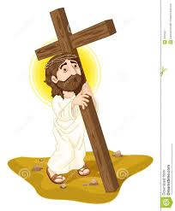
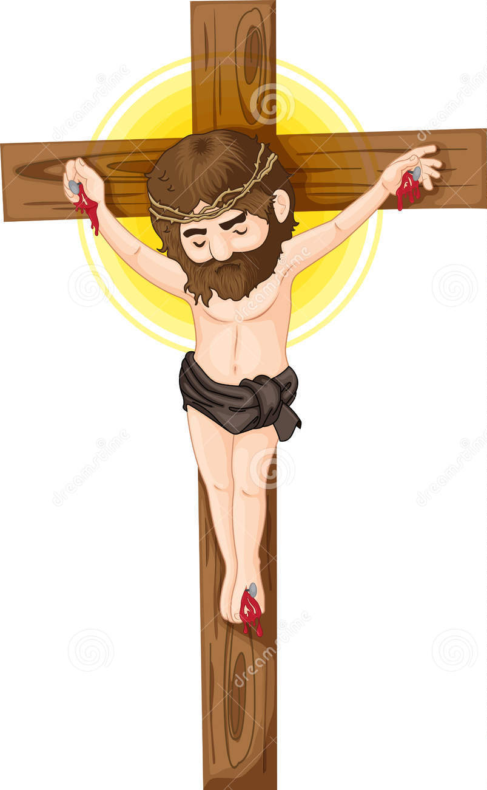
How did Jesus defeat death and open the gates of Heaven for us?
Jesus willingly obeyed God until death on the cross, paying for our sins and opening Heaven for us.

Slide 14
Who first discovered the Resurrection?
Jesus is not here.
He has Resurrected!
Mary Magdalene, who they mistreated for being a sinner before her conversion, first receives the news.

Slide 15
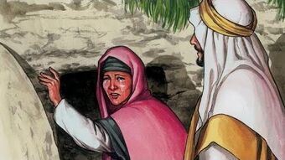
She was grateful for Jesus’ mercy and loved Him very much. She went to the tomb, despite the danger posed from the persecutors of Jesus’ followers.
Jesus came to save sinners like Mary Magdalene.

Slide 16
Share
Are you grateful for what Jesus did for you?
How do you show it?
Do you seek Jesus every day, even if your friends don’t or they make fun of you?

Slide 17
Activity

Slide 18
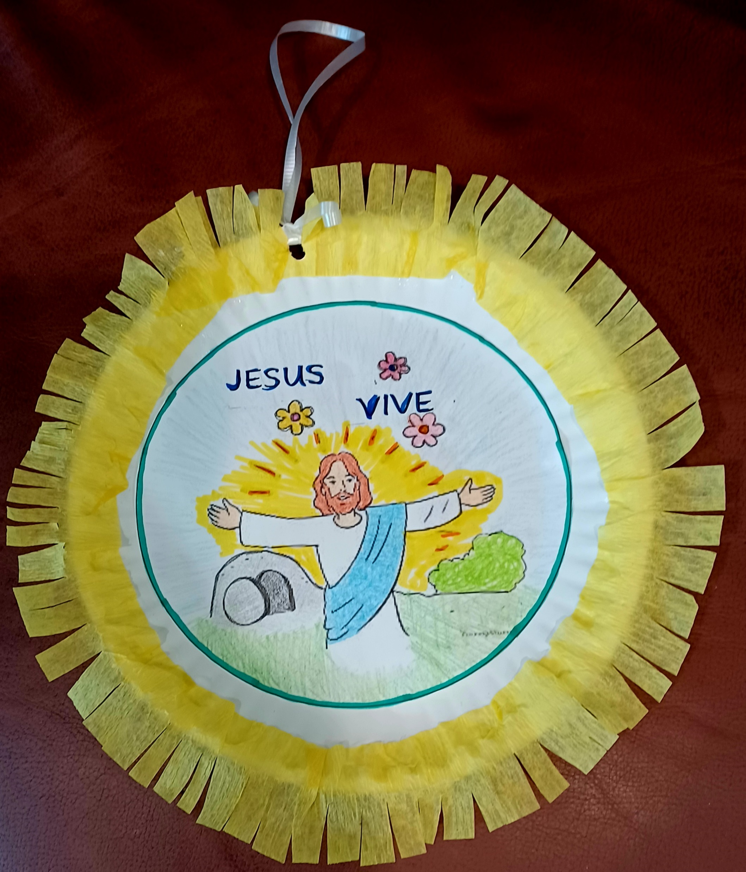
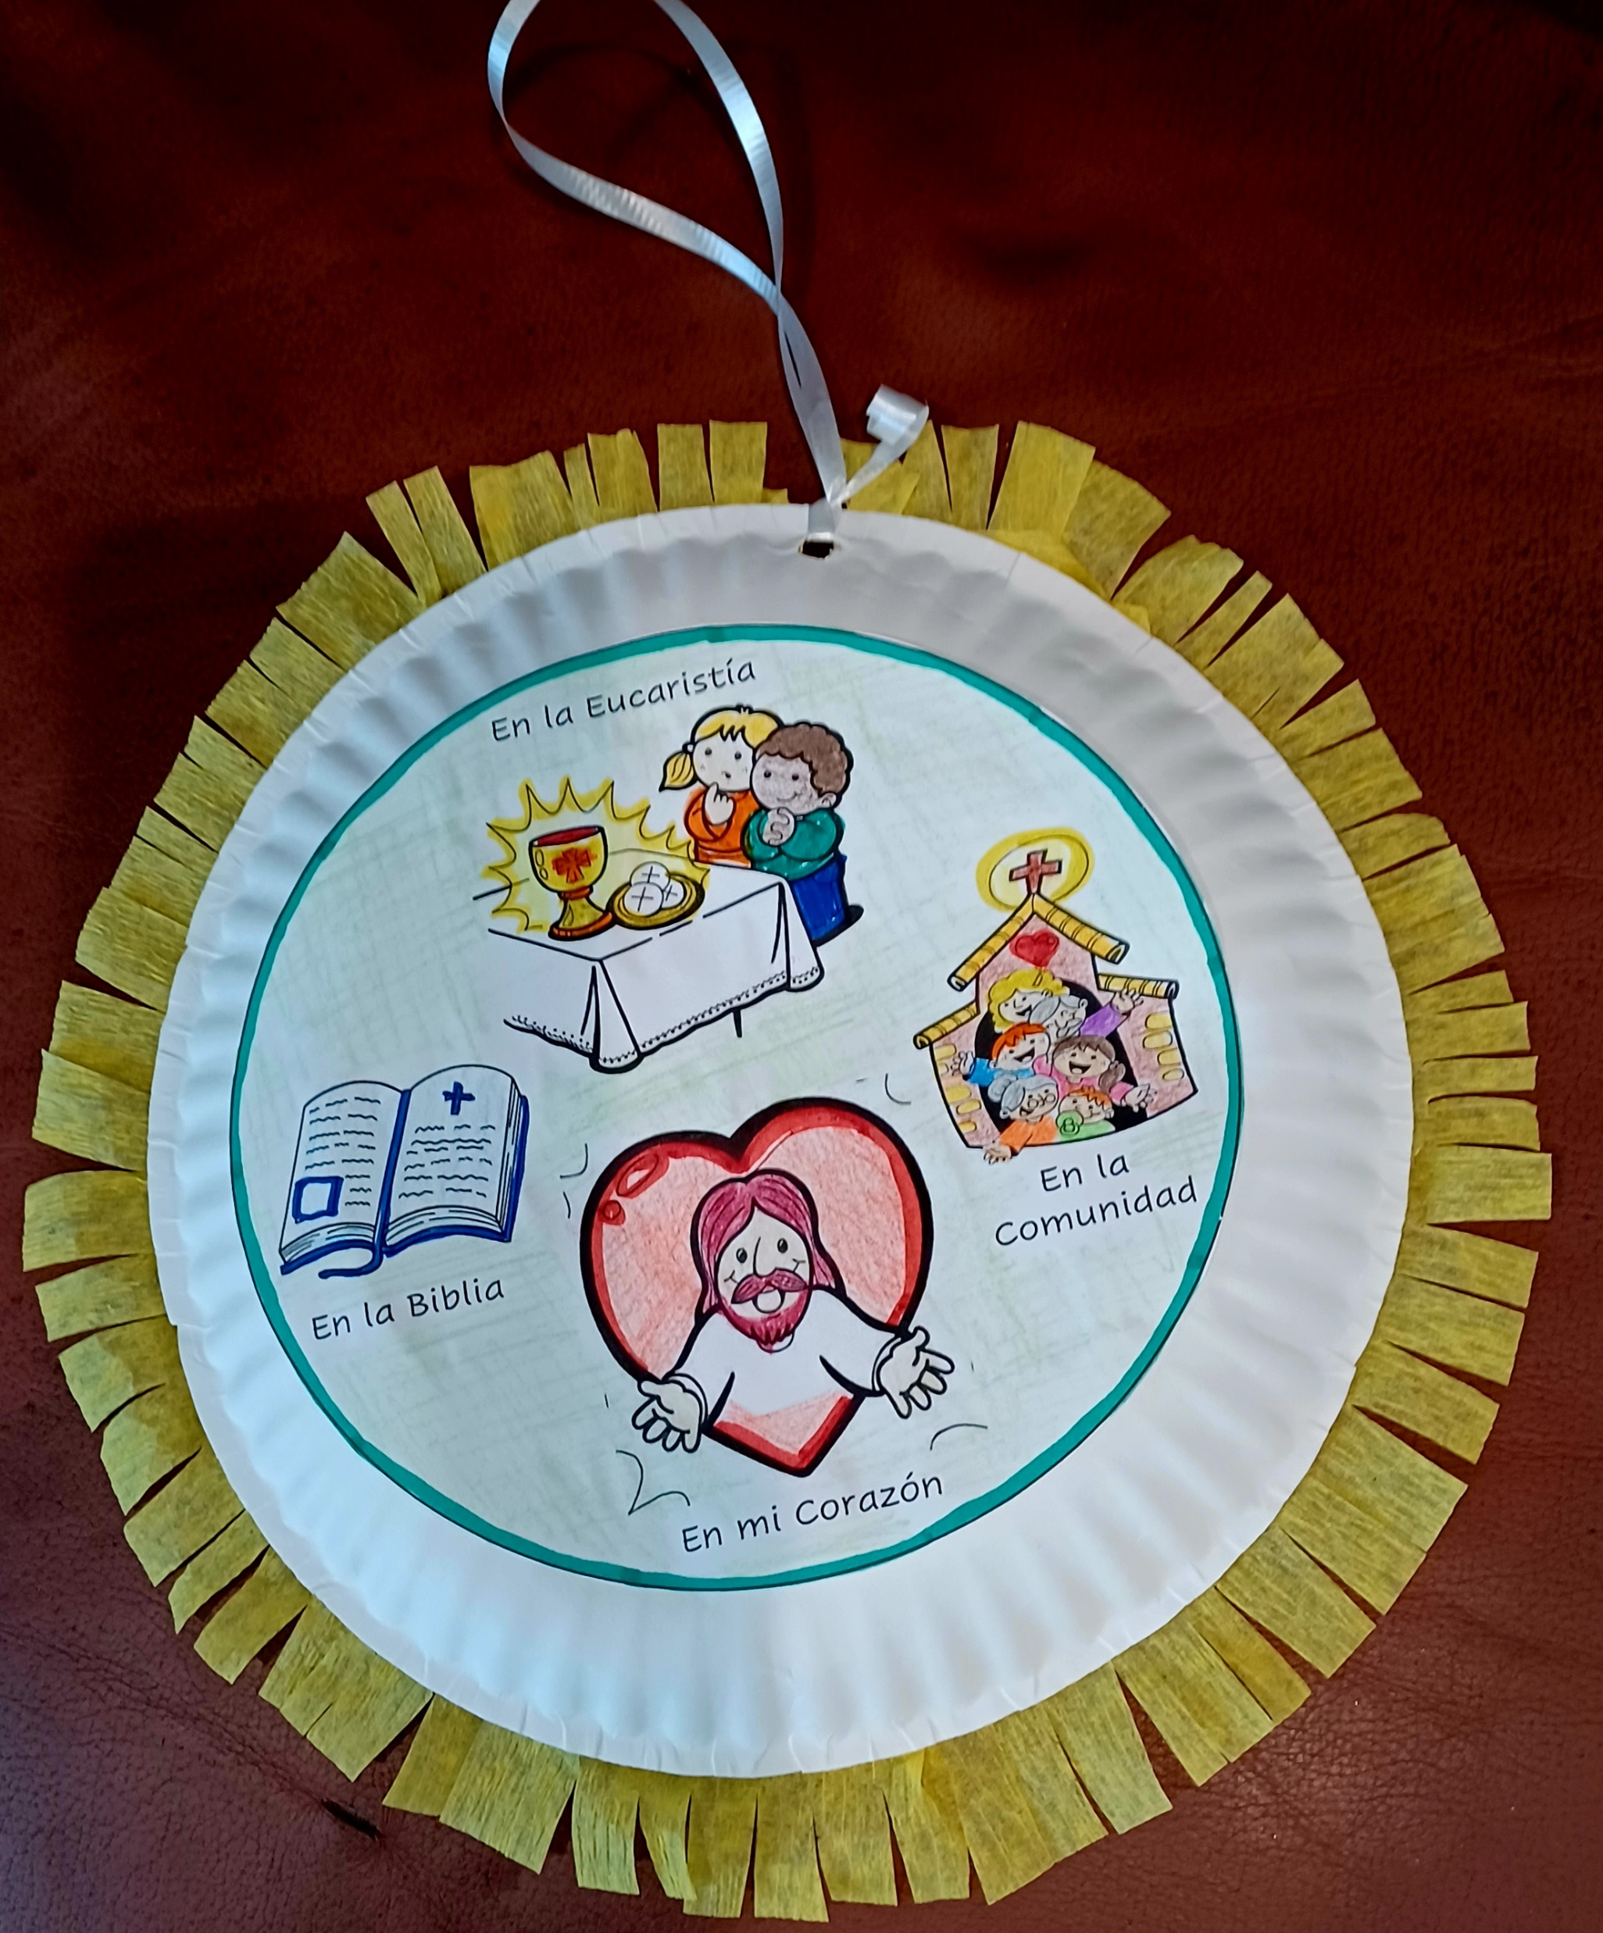
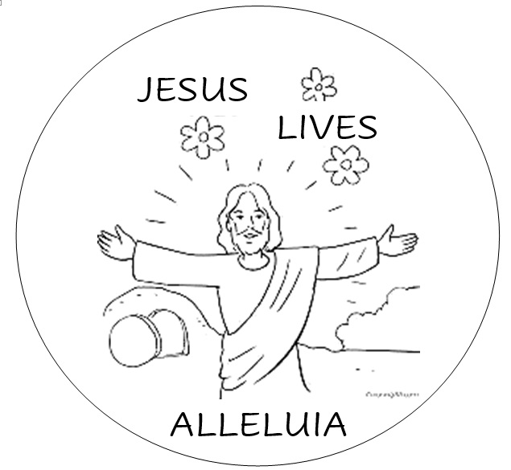
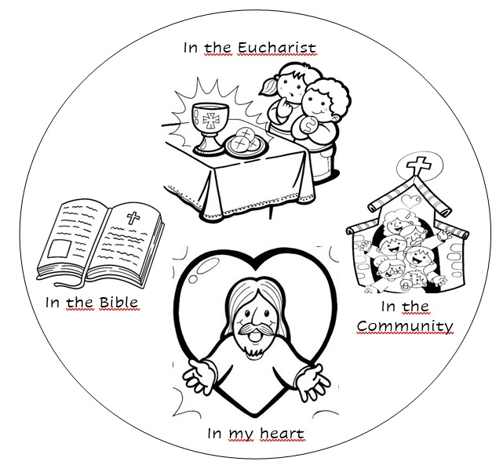
Jesus Lives - Craft Instructions: Cut circles; color, and glue to either side of a paper plate. Cut a piece of streamer to size and glue to the border of the front of the plate. Can do the same to the other side also. Cut strips to the outer edge of the streamer. Punch a hole at the top and hang with a ribbon.

Slide 19
Jesus Resurrected, project (orientaltrading.com/freefun)
Need:
Paper Plate
Grey Paper
Popsicle sticks
Grey paint
Printed figures
Instructions
Paint the paper plate grey on both sides. Allow to dry.
Print or draw, color, and cut Jesus and angel.
Cut the paper plate in half and cut a semi-circle on the flat part of one side of the plate. Glue the edges of the plate together to form a cave.
Glue Jesus on the inside wall of the cave facing the door and the angel above the door.
Make 3 crosses with the popsicle sticks and glue to the top back of the cave.
Crumble into a ball the grey paper to cover the door of the cave.

Slide 20
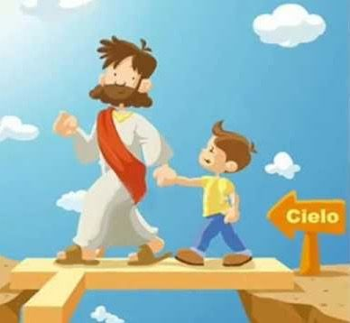
Prayer
Lord, today we celebrate your Resurrection with great joy. May our gatherings always be full of joy because we have faith and hope that, as you have conquered death, we, too, will rise with you. Amen.

Slide 21
Jesus Song, Saddlebag Kids

