Slide 1
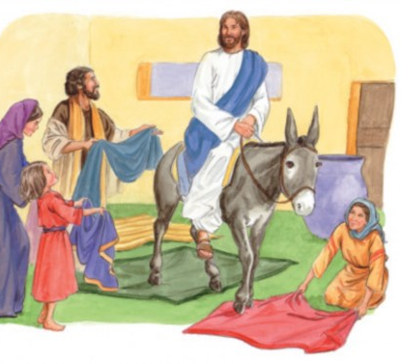
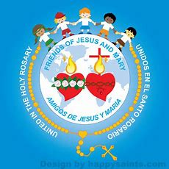
Ministry Friends of Jesus and Mary
Prayer Group for Children
HOLY WEEK
Cycle B – Palm Sunday
“Jesus Enters Jerusalem“
Mark 11: 1-10
Passion and Death of Jesus
Mark 14:1—15:47
www.fcpeace.org

Slide 2
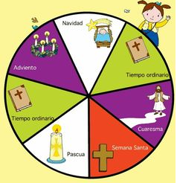
HOLY WEEK begins on Palm Sunday and ends the following Sunday when Easter begins.
JESUS RESURRECTS!

Slide 3
IT INCLUDES…
THE PASCHAL TRIDUUM
We celebrate the mystery of Easter;
Jesus moves from this life to His Father.
RESURRECTION
SUNDAY
HOLY THURSDAY
GOOD FRIDAY

Slide 4
What is Holy Week? https://youtu.be/O___M05czhg?si=VwWLujUaKukGI8CY

Slide 5
Jesus’ teachings and works made many follow Him. He was honored when He entered Jerusalem for the last time, but He knew some did not accept Him.
HOLY WEEK Palm Sunday

Slide 6
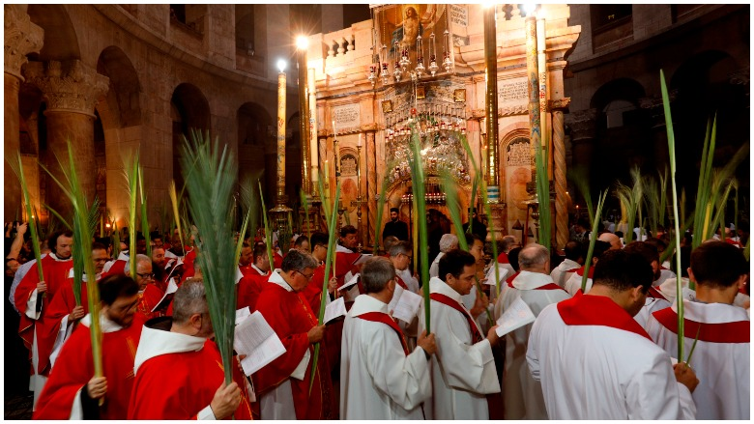
We begin Palm Sunday Mass with a procession with palms honoring Jesus as our King and Savior.

Slide 7
HOLY WEEK-Holy Thursday
Jesus went to Jerusalem to celebrate Passover, when God freed His chosen people from slavery in Egypt. He shared the first Eucharist with His apostles, gave them the power to be priests who could consecrate the Bread and Wine, and washed their feet showing the importance of service to each other and others.

Slide 8
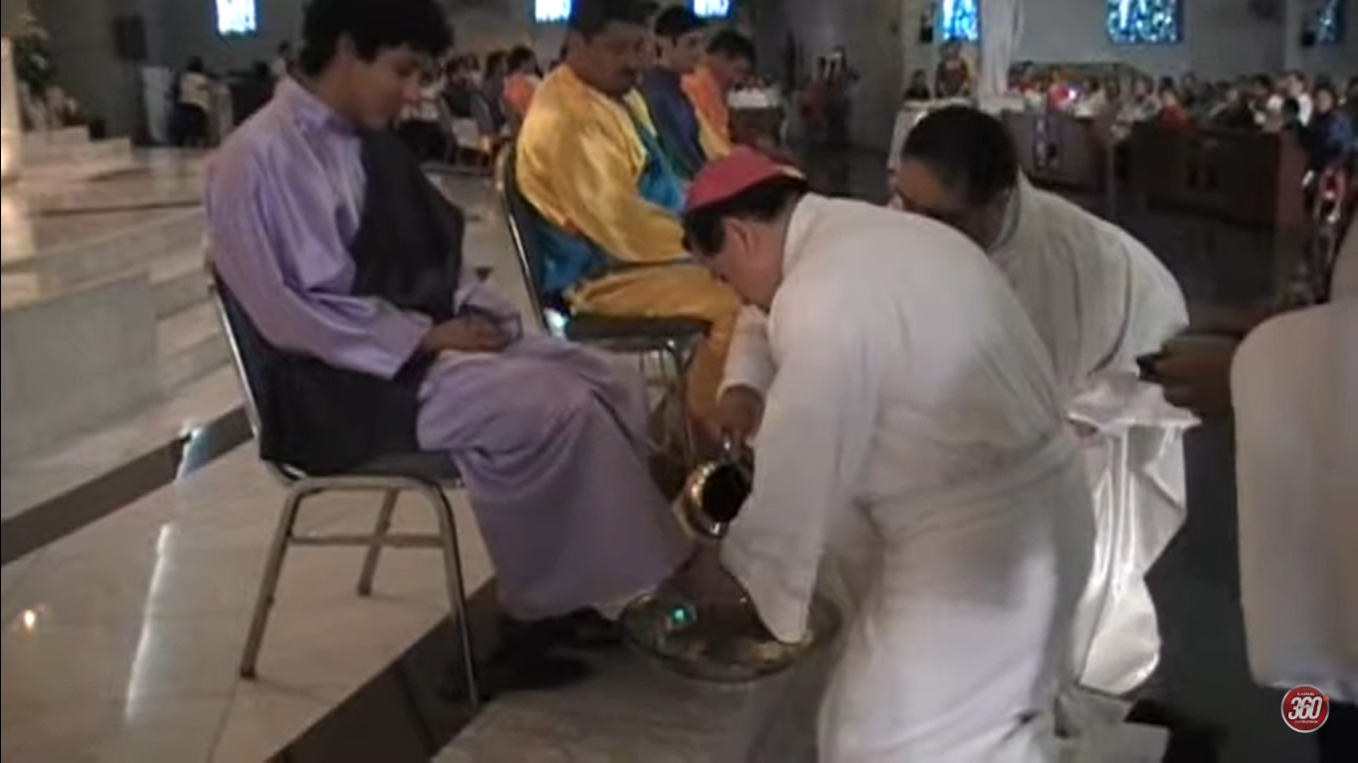
On Holy Thursday, during mass, the priest washes the feet of 12 people to show us the importance of imitating Jesus’ service to others.

Slide 9
HOLY WEEK– Good Friday-Jesus Dies on the Cross
We remember Jesus dying on the cross for us. We gather as a family to honor the cross because it is the “Tree of Salvation” which offers us new life.

Slide 10
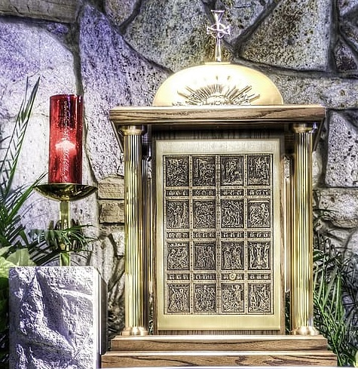
During the service, there is no Consecration; at the end, Jesus is removed from the Tabernacle along with the linens. It is the only day that Jesus is not in the Church.
The red candle is put out to show that Jesus is not in the Tabernacle.

Slide 11
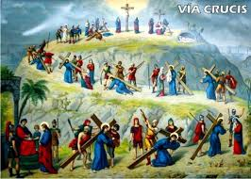
On Good Friday, we accompany Jesus during His passion and death on the cross by making the Stations of the Cross.

Slide 12
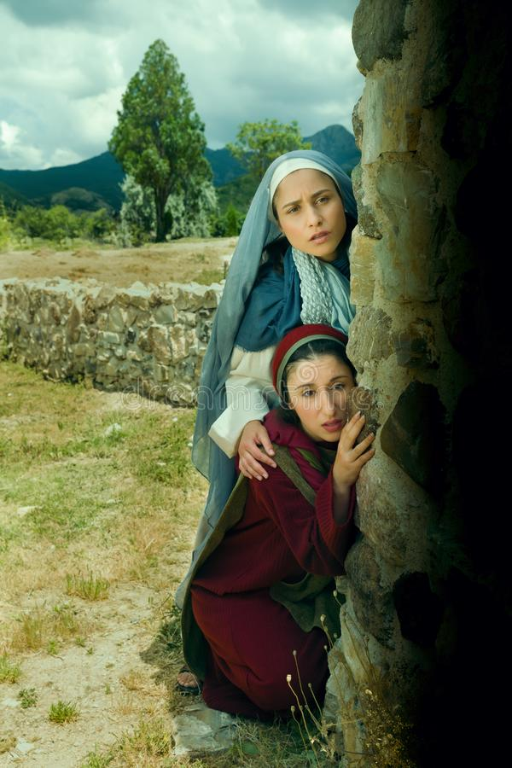
HOLY WEEK- Holy Saturday (Paschal Vigil)
During the day, the Church is in mourning, awaiting near the tomb.

Slide 13
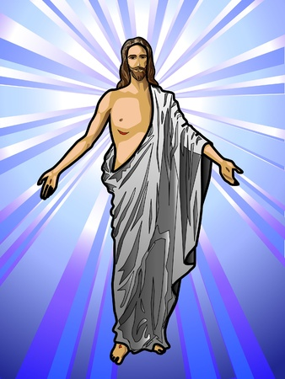
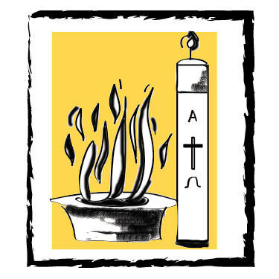
At dusk, on Holy Saturday, we celebrate the Paschal Vigil. In the dark waiting of Holy Saturday enters the joy and light when, in the evening, outside a fire is lit, and with the fire the candles that represent the presence of our risen King!
During the mass, new members of the Christian family are baptized.

Slide 14
HOLY WEEK– RESURRECTION SUNDAY
We celebrate again that, Our King, is resurrected, victorious over death and opens the gates of heaven for us!
Alleluia!

Slide 15
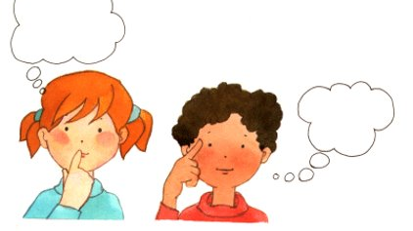
Reflection

Slide 16
On Palm Sunday we celebrate the triumphant entry of Jesus into Jerusalem.
Jesus entered Jerusalem for the last time to celebrate Passover, and to complete His mission to suffer and die on the cross for our sins.
What do Jewish people celebrate on Passover?
They celebrate when God freed the Israelites from slavery in Egypt.

Slide 17
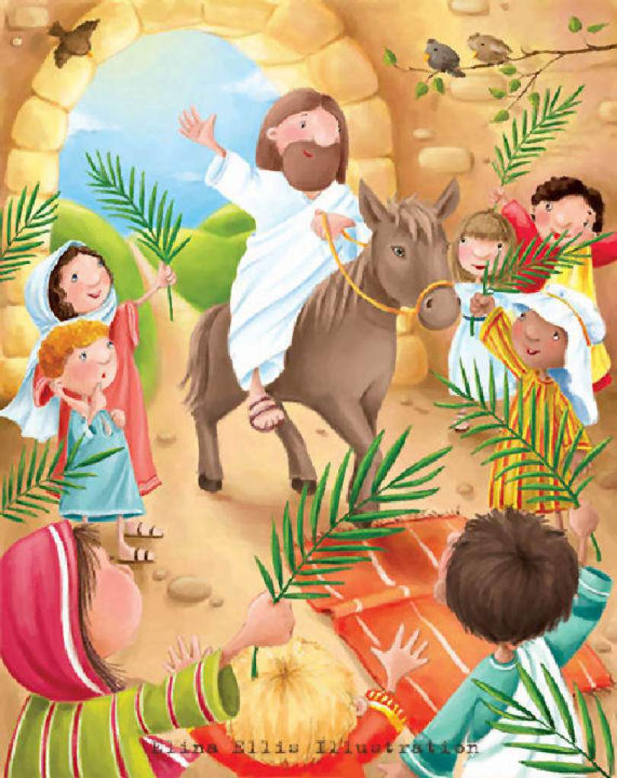
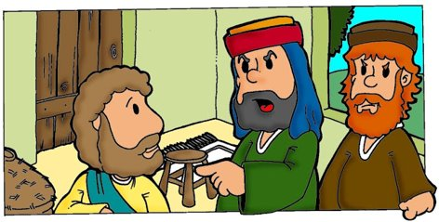
How did the people receive Him in Jerusalem?
They spread their cloaks on the road, while others cut branches from the trees and spread them on the road; they praised Him for all his good works!
What did they shout?
Hosanna to the Son of David; blessed is he who comes in the name of the Lord; hosanna in the highest.
Why did the Pharisees want the people to stop shouting?
The people were praising the coming of the Savior, the King who comes in the name of the Lord. But the Pharisees did not accept Jesus as the promised Messiah.

Slide 18
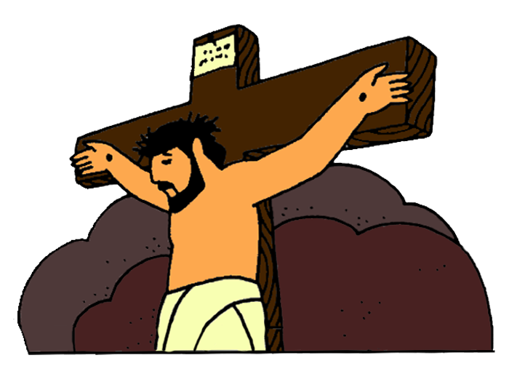
What does Hosannah mean?
Oh save us.
Why do they call him the son of David?
Scripture says the Messiah would be a descendent of King David. They knew He was the promised Messiah.
Jesus is our Savior!
Why didn’t Jesus defend himself with Pontius Pilate?
He knew His mission and God’s will was to suffer and die on the cross to save us. He always did God’s will.
Why did the people turn on Him?
The Pharisees convinced them He was not the Son of God and had blasphemed.

Slide 19
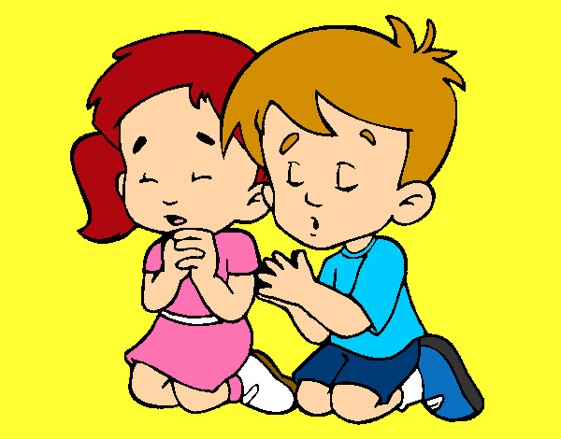
How do we show Jesus every day that He is the King of our heart?
Praying
Obeying
Loving others…

Slide 20
Activity

Slide 21
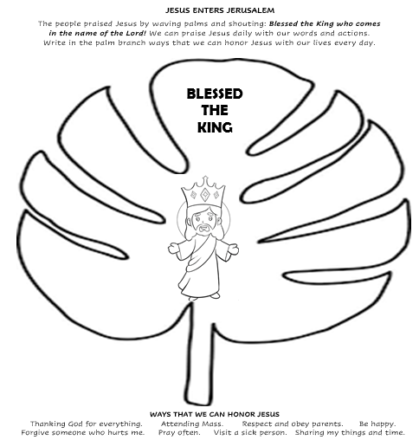

Slide 22
How does the Church Celebrate the Triduum?
THE PASCHAL TRIDUUM
We celebrate the mystery of Easter;
Jesus moves from this life to His Father.

Slide 23
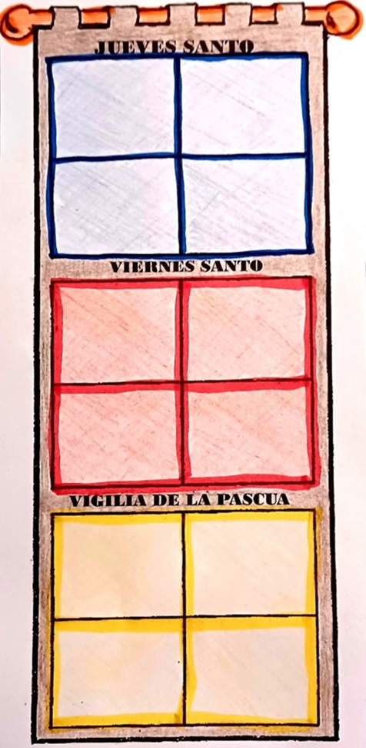
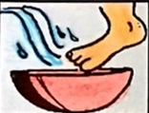
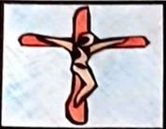
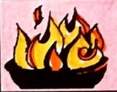
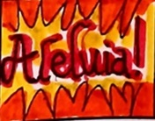
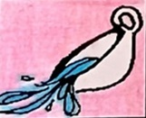
The evening of Holy Thursday, we celebrate the mass of the Lord’s Supper where we relive the Last Supper, when Jesus left to the disciples His testament of love, His lasting presence in the Eucharist. Repeating the words of Jesus: “This is my Body…; This is my Blood…”, the priest consecrates the bread and wine changing it to the Body and Blood of Christ. Jesus gave them the power to consecrate with the words, “Do this in memory of me.” He also showed them how to serve each other by washing their feet.
HOLY THURSDAY
THE LORD’S SUPPER
THIS IS MY BODY
GOOD FRIDAY
Good Friday is a day of penance, fasting, and prayer. We do the Stations of the Cross. At the service, we recall the history of salvation by reading the stories of the Old Testament. We act out Jesus’ passion and death in the Gospel. The priest processes with the cross and we pray for the needs of the suffering and the world. We adore the cross by bowing to or kissing it. Finally, Jesus is removed from the church and the candle put out as we remember His death on the cross. The linens are also removed from the church.
PRAYERS FOR THE WORLD
EASTER VIGIL
In the dark waiting of Holy Saturday enters the joy and light when, in the evening, outside a fire is lit, and with the fire the candles that represent the presence of our risen King! We sing Alleluia again which was silenced during Lent! The catechumens receive the sacraments and enter into the family of God. The Easter celebration continues for 50 days until the coming of the Holy Spirit on Pentecost.

Slide 24
Place the pictures in the correct day which they occur.
HOLY THURSDAY
THIS IS MY BODY
THE LORD’S SUPPER
THIS IS MY BODY
GOOD FRIDAY
PRAYERS FOR THE WORLD
THE LORD’S SUPPER
EASTER VIGIL
PRAYERS FOR THE WORLD

Slide 25
Prayer Lord, thank you for loving me so much! Although King of the Universe, you humbled yourself to be crucified and died for me. Help me to always honor you. May my words and actions always give you glory. Amen

Slide 26
Hosanna Rock, Yancynotnancy, https://youtu.be/iVwhdqDrfz8

Slide 27
You are my King, Amazing Love, https://youtu.be/BcsYWrPTkn0 (9+)

