Slide 1
Friends of Jesus and Mary
Prayer Group for Children
Cycle B - I Sunday of Advent
Be Watchful, Be Alert! Mark 13, 33-37
www.fcpeace.org

Slide 2
Jesus said to his disciples:

Slide 3
Be watchful! Be alert! You do not know when the time will come.

Slide 4
It is like a man traveling abroad. He leaves home and places his servants in charge, each with his own work,

Slide 5
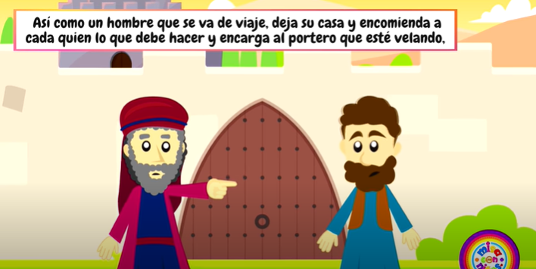
and orders the gatekeeper to be on the watch.
Y encarga al portero que esté velando.

Slide 6
Watch, therefore; you do not know when the Lord of the house is coming,

Slide 7
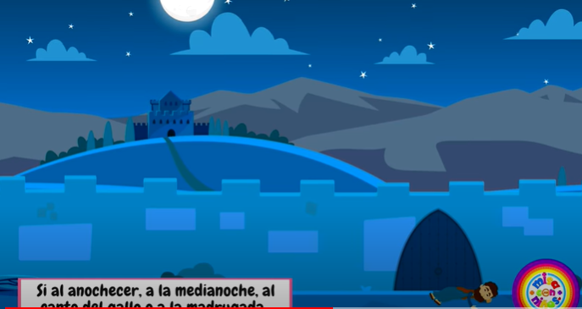
whether in the evening, or at midnight,

Slide 8
or at cockcrow,

Slide 9
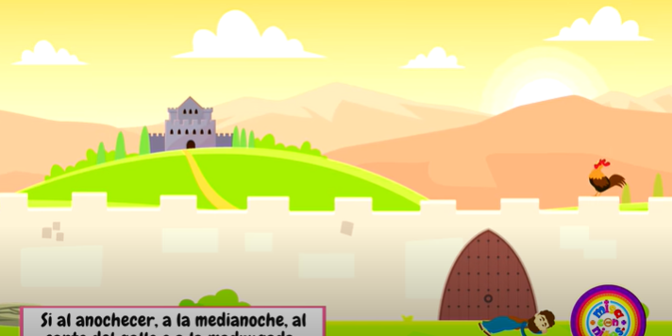
or in the morning…

Slide 10
May he not come suddenly and find you sleeping.

Slide 11
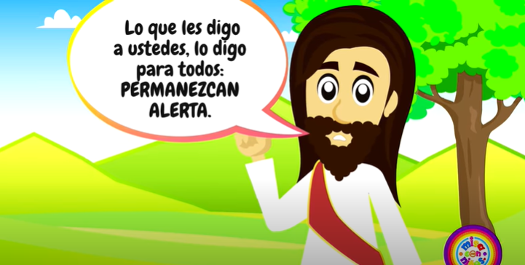
What I say to you, I say to all: ‘Watch!’
The Gospel of the Lord,
Praise to You, Lord Jesus Christ

Slide 12
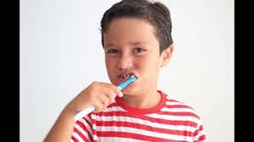
How do we prepare to go to school?

Slide 13
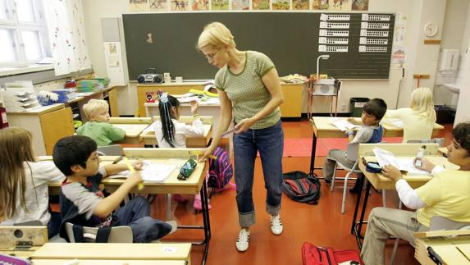
What happens if we get to school and we forgot our bookbag or left our homework?
We have to borrow books and pencils; we may get a bad grade on homework.

Slide 14
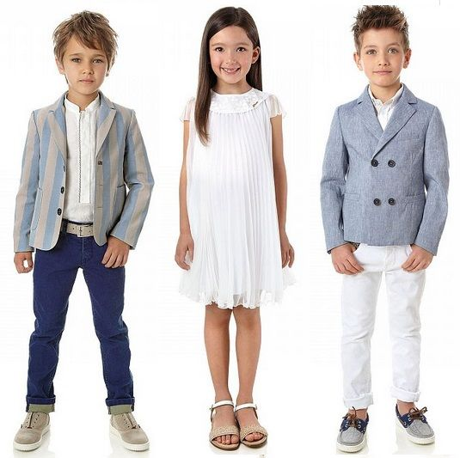
How do we prepare to go to a party?

Slide 15
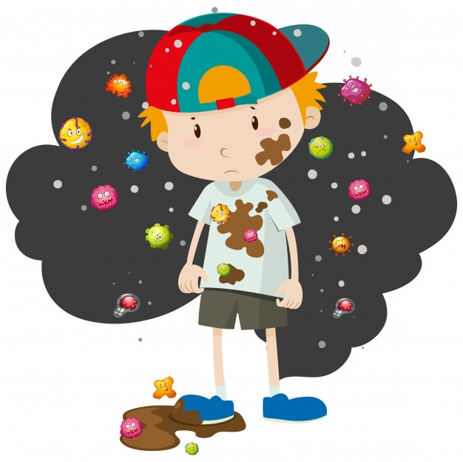
How do we feel if we get to the party without bathing, with dirty clothes and flip flops, without a present?
Embarrassed!

Slide 16
Jesus wants us to be prepared and He gives us the example of a man who went on a trip and left employees to take care of his house.

Slide 17
He expects his employees to keep it clean inside, and cut the grass outside .

Slide 18
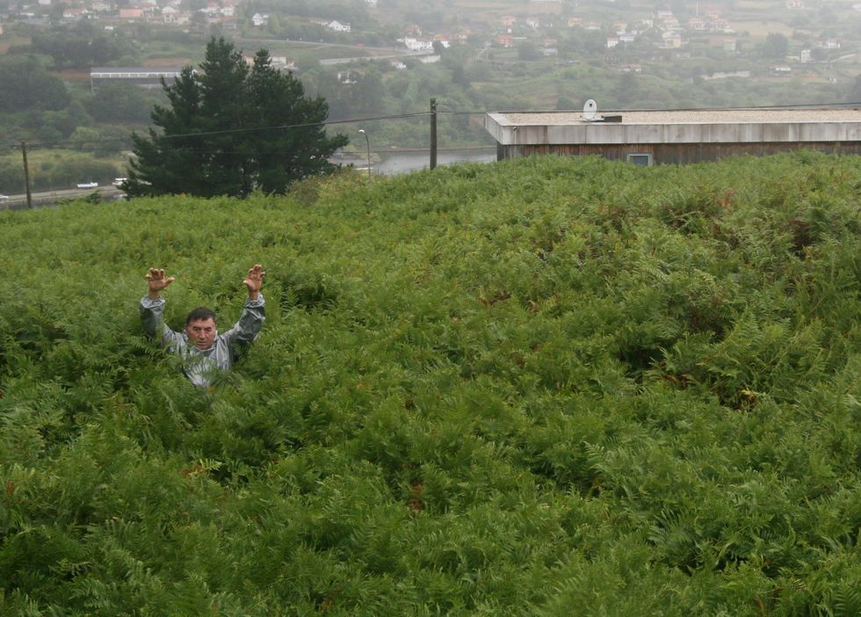
What would he do if he arrived home and found his house dirty and disorganized and the lawn uncut and filled with weeds?

Slide 19
He would be enraged and may fire his employees.

Slide 20
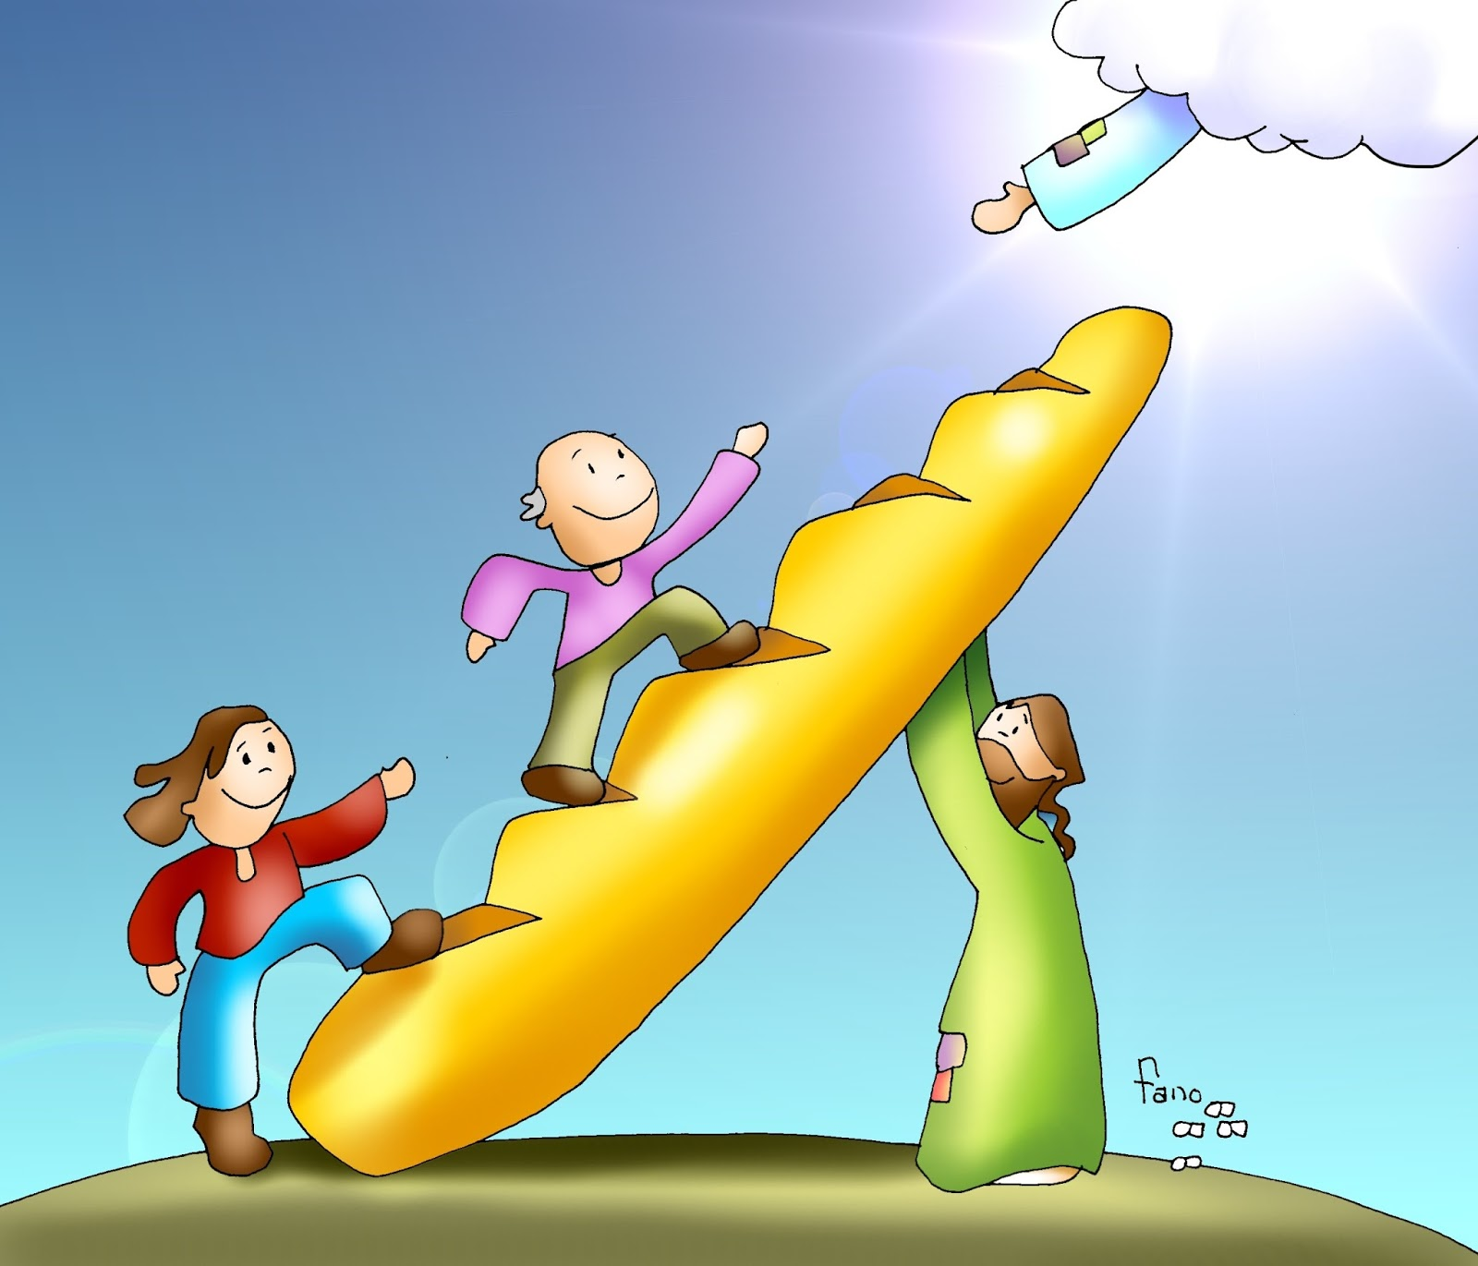
For what does Jesus want us to be prepared?
For the time when He comes to take us to Heaven.

Slide 21
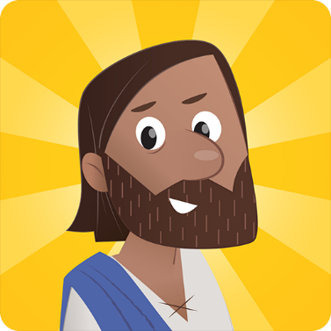
How does He want to find us?
With a clean heart, full of love for God and our neighbor.

Slide 22
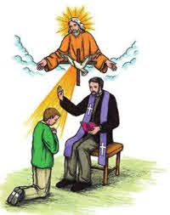
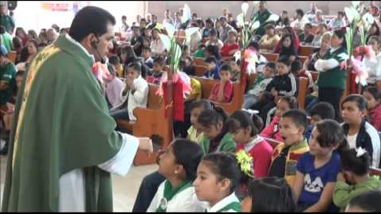
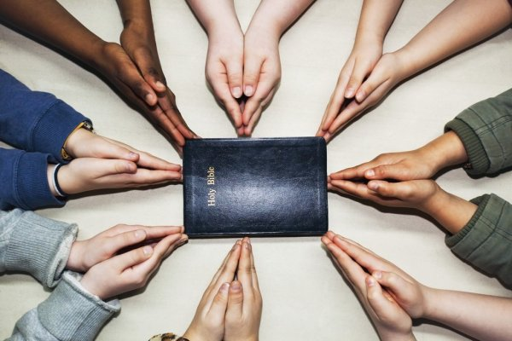
How can we prepare our heart?
Participate in the Holy Mass.
Pray Often
Go to the Sacrament of Reconciliation.
Do Good Works
Do Small Sacrifices

Slide 23
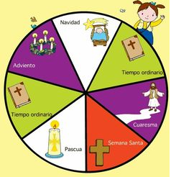
We begin Liturgical Cycle B with the Season of Advent.
Christmas
Advent is the beginning of the Liturgical Year.
(Liturgy is the Mass.)
It begins the Sunday after Christ the King Sunday.
There are 3 Liturgical Cycles: A, B, y C which determine the readings during Mass.
Advent
Ordinary Time
Ordinary Time
Lent
Holy Week
Easter

Slide 24
Advent begins, a time when we prepare our heart to receive baby Jesus on Christmas morning.

Slide 25
Activities

Slide 26
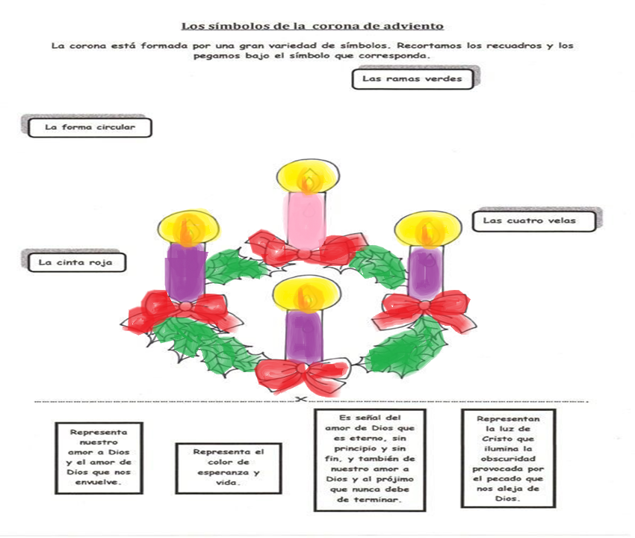
SYMBOLS OF THE ADVENT WREATH
Draw a line matching the symbol with the description.
The color purple that the priest wears during mass represents prayer and penance.
The green leaves
The circular shape
The Advent Wreath marks the time of preparation until the birth of Jesus.
The 4 candles
The red bow
Represents God’s love that envelops us and our love for Him.
Represents the light of Christ that shines in the darkness caused by sin which separates us from God.
Represents God’s love which is eternal, with no beginning and no end and our love for our neighbor which should never end.
Represents the color of life and hope.

Slide 27
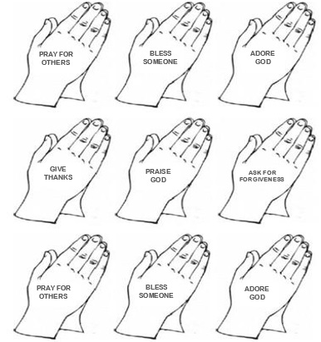
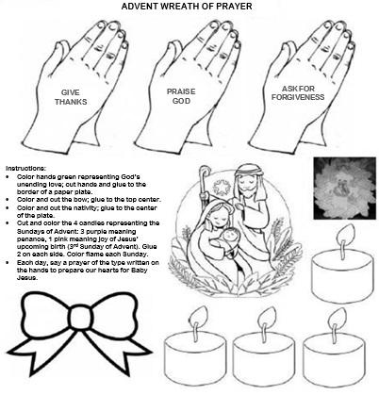
The Advent Wreath of Prayer

Slide 28
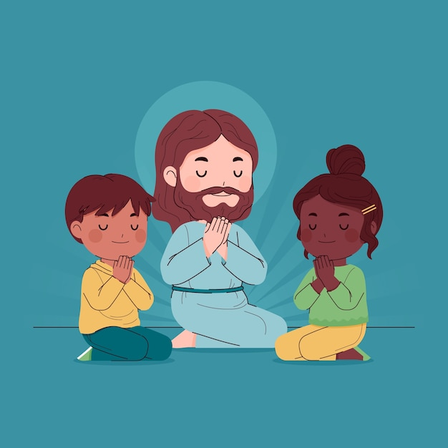
Prayer Dear Jesus, Thank you for all you did to open the gates of Heaven for me. Help me get closer to you through prayer. Help me to share your love with others so that my heart may be ready for your birth this Christmas. I love you very much. Amen.

Slide 29
Emmanuel, https://youtu.be/NVCcYugGRsg?si=rZJIE2gRugTvhVVF

