Slide 1
Friends of Jesus and Mary
Prayer Groups for Children
Cyclo B-I Sunday of Lent
Jesus is Tempted in the Desert– Mark 1, 12-15
www.fcpeace.org

Slide 2
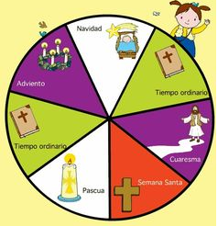
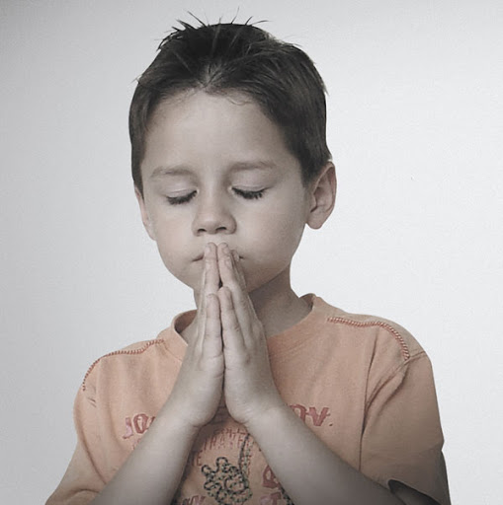
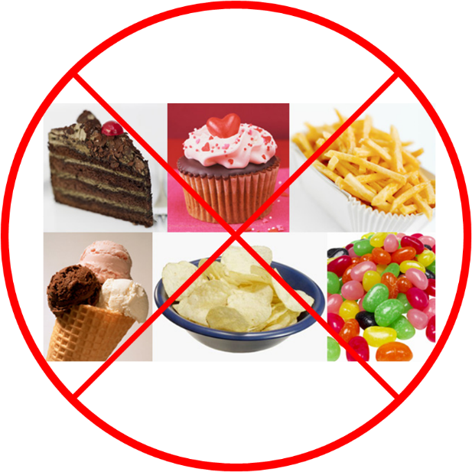
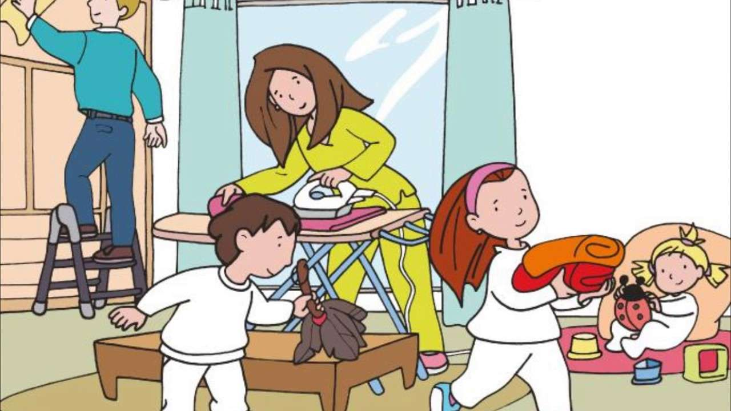
We Begin the Season of Lent
During the 40 days of Lent, we prepare our hearts with:
Prayer,
Sacrifices,
And acts of love,

Slide 3
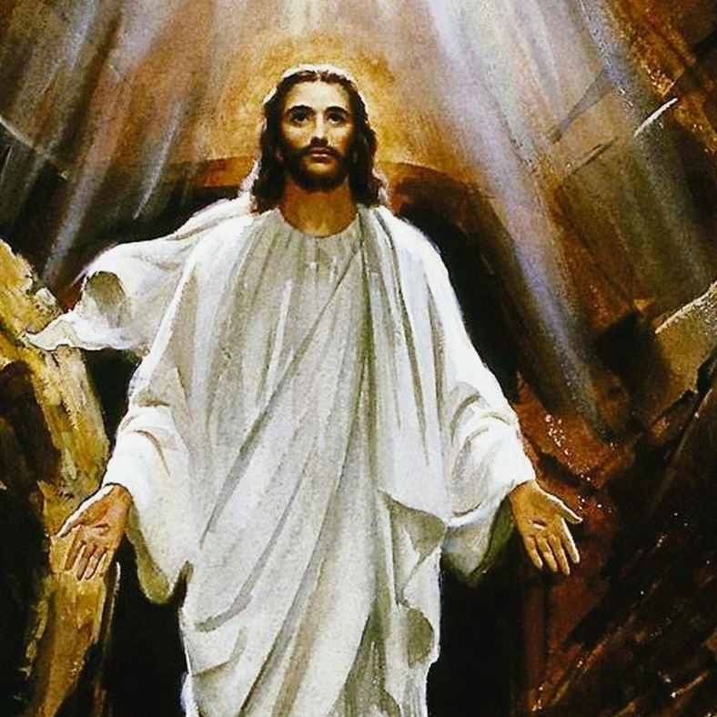
So our hearts are ready to receive the Resurrected Christ on Easter Sunday.

Slide 4
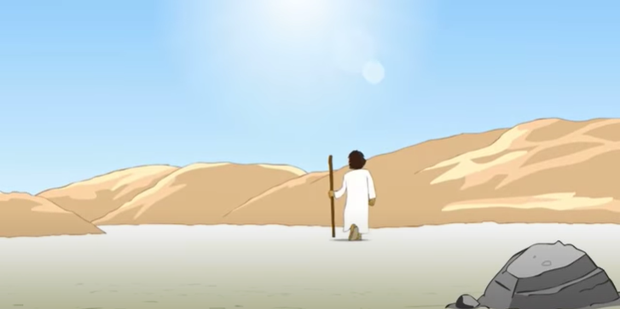
Gospel- 1st Sunday of Lent: The Spirit drove Jesus out into the desert,

Slide 5
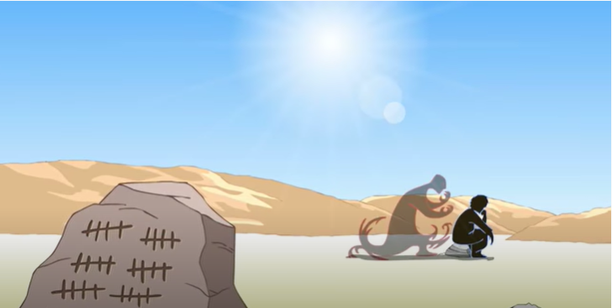
And he remained in the desert for 40 days, temped by Satan.

Slide 6
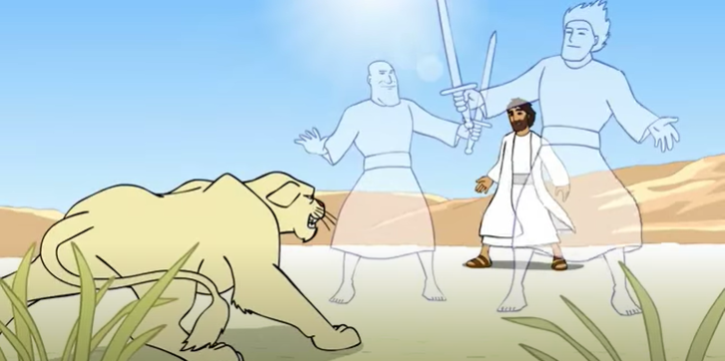
He was among wild beast, and the angels ministered to him.

Slide 7
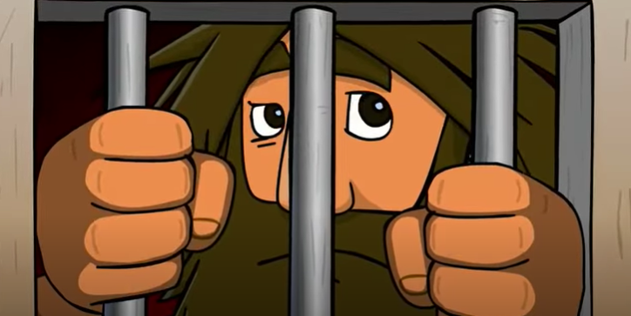
After John had been arrested, Jesus came to Galilee proclaiming the gospel of God:

Slide 8
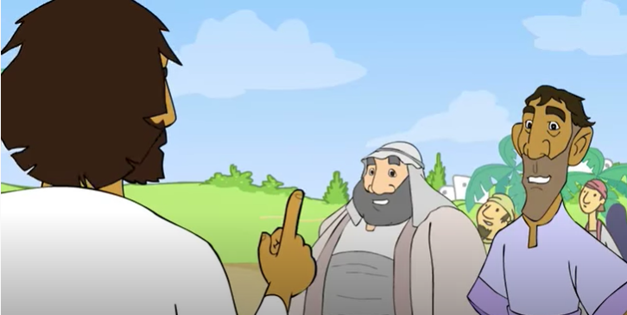
“This is the time of fulfillment. The Kingdom of God is at hand.
Repent, and believe the gospel.”
The Gospel of the Lord, Praise to You Lord Jesus Christ.

Slide 9
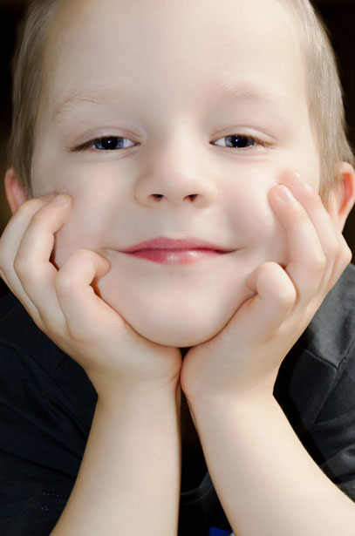
The Holy Spirit inspired Jesus to go to the desert.
Have you ever felt the impulse of the Holy Spirit to go be alone with God to pray?
Maybe you needed consoling or
healing of a hurt,
Direction in a decision or doubt,
Peace during difficult times.
Or you wanted to give thanks for good times.

Slide 10
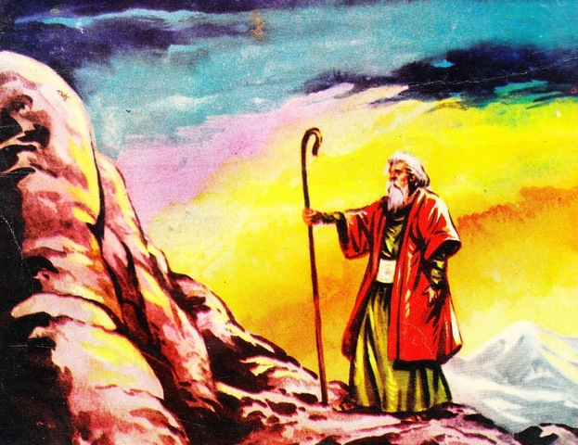
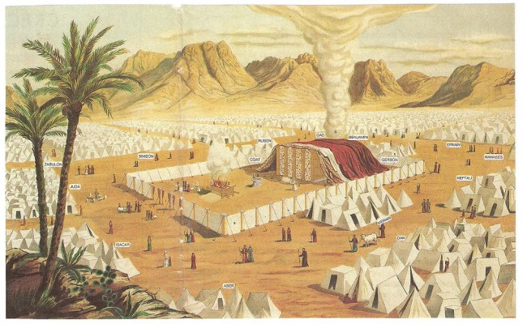
Jesus stayed in the desert for 40 days.
Do you know of another important time in the bible where
the number 40 occurs?
After God saved His people from slavery in Egypt, Moses went up to Mount Sinaí to receive the 10 Commandments from God to establish a Covenant with them. Here he fasted and prayed for 40 days.
God’s people remained in the desert for
40 years preparing for their entrance
to the Promised Land, Canaan.

Slide 11
The number 40 represents a time of preparation in the bible.
For what was Jesus preparing?
Soon He would begin His public ministry where he would preach about the love of God.
What did He say?
The Kingdom of God is near.
Repent and believe in the gospel.

Slide 12
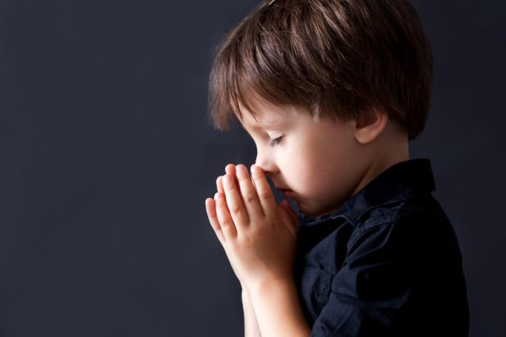
In the desert, Satan tempted Him, trying to destroy God’s plan of salvation. Jesus resisted and went out to preach the gospel.
Do you ever feel tempted not to do what your parent’s or teacher’s ask of you?
Do you ask God to help you resist temptations?

Slide 13
Activity

Slide 14
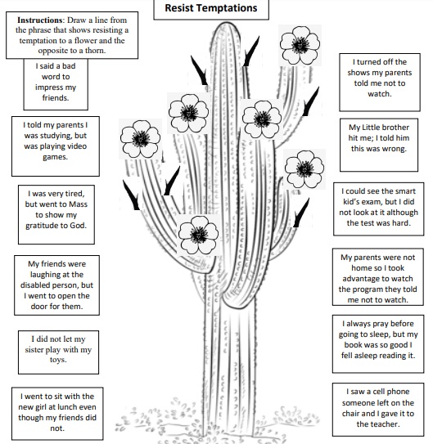

Slide 15
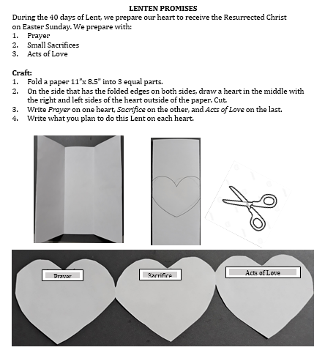
We Prepare our Hearts for Jesus

Slide 16
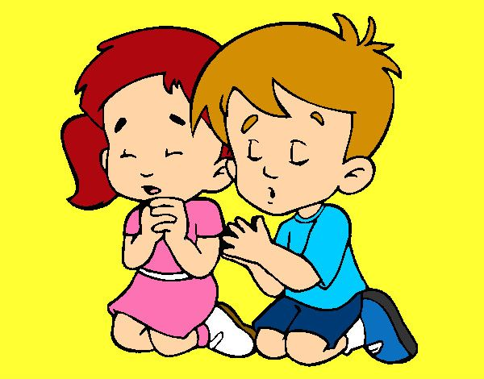
Prayer Lord, sometimes we seek what’s easiest. Give us a spirit of sacrifice and strength in our temptations. Help us to follow you in obedience and in serving our neighbor. Fill our hearts with love and forgiveness for those who hurt us. Amen

Slide 17
Song: Open the Eyes of My Heart Lord, Ft. Paul Baloche

