Slide 1
Friends of Jesus and Mary
Prayer Group for Children
Cycle B-I Sunday in Ordinary Time
Solemnity of the Epiphany
Matthew 2, 1-12
www.fcpeace.org

Slide 2
Three Wise Men, Sharefaithids, https://youtu.be/VySzDA07N-c

Slide 3
REFLECTION

Slide 4
The word Epiphany means revelation. How is the Three Kings visiting a revelation?
The Three Kings knew the Jewish scripture that a Savior King would be born, preceded by a star.
That is why, when they saw the star, following the inspiration of the Holy Spirit, they set out to find the newborn King.

Slide 5
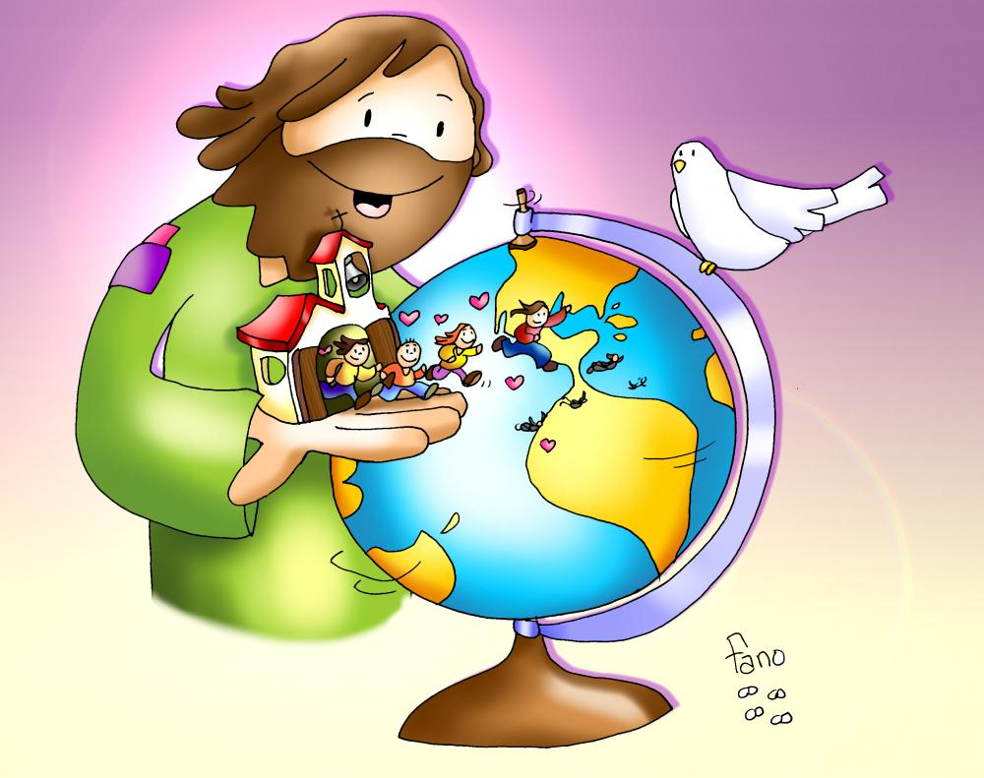
The Three Kings were not Jewish like Joseph and Mary; they were from foreign lands. What does God reveal to us by this?
Jesus’ message is for the whole world, not just the Jewish people.

Slide 6
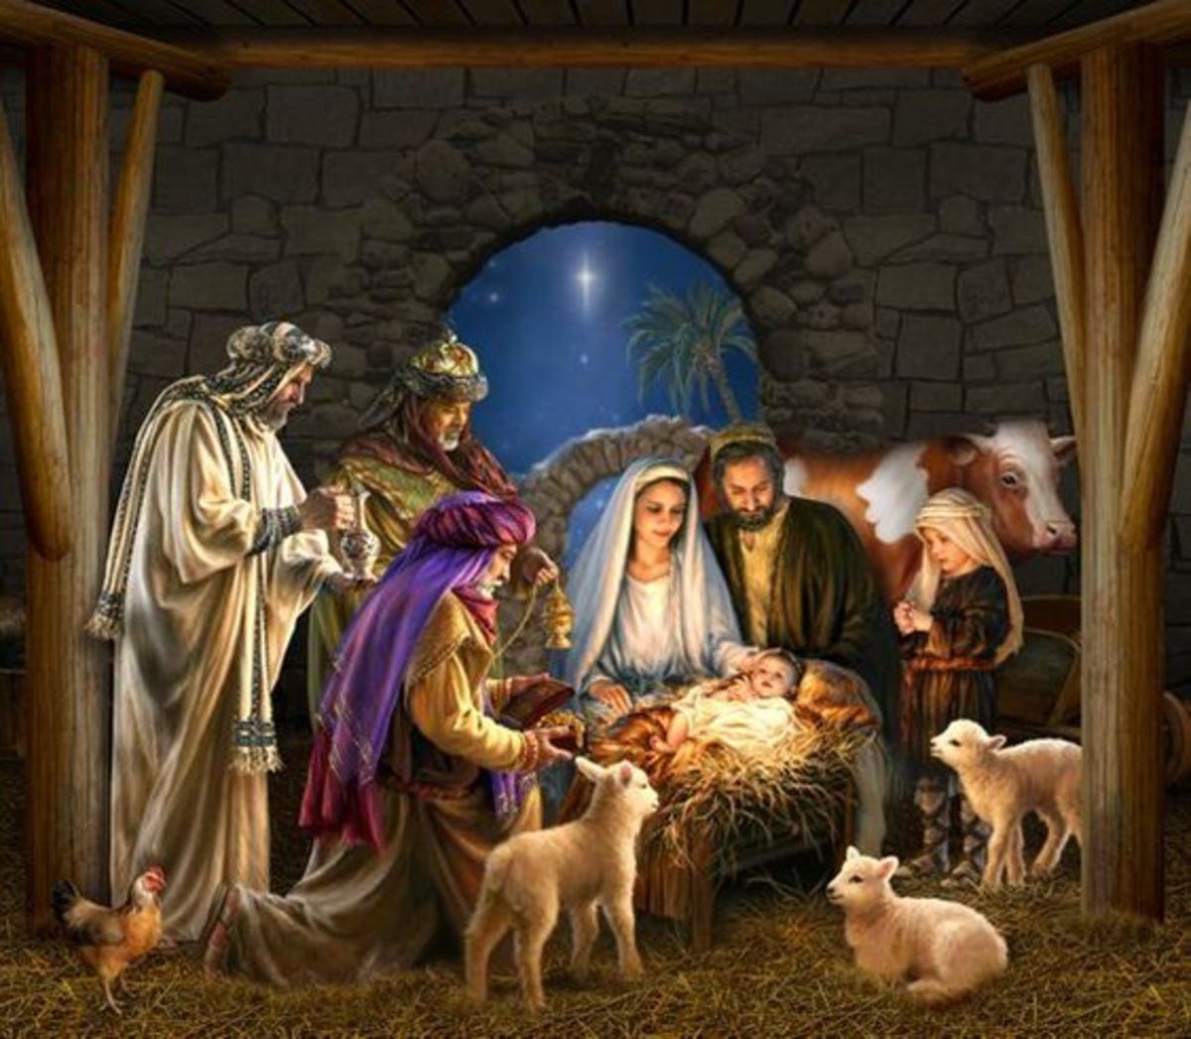
God is humble and loves poverty.
Traveling a long way bearing gifts for a newborn King reveals that a very special King would be born.
What must they have thought when they found the baby in a stable?

Slide 7
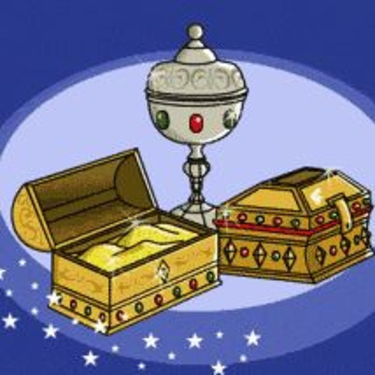
They took gold, incense, and myrrh as gifts. What did this reveal?
Myrrh was used to bury people and Jesus is human and would suffer and die for us.
Gold is offered to kings and Jesus is a King.
Incense is offered up to God and Jesus is God.

Slide 8
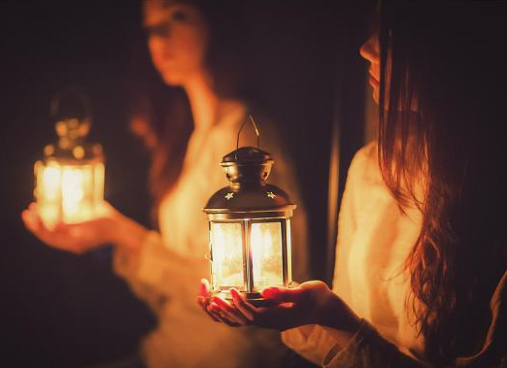
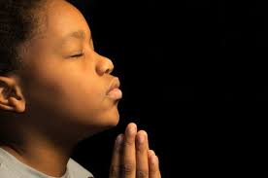
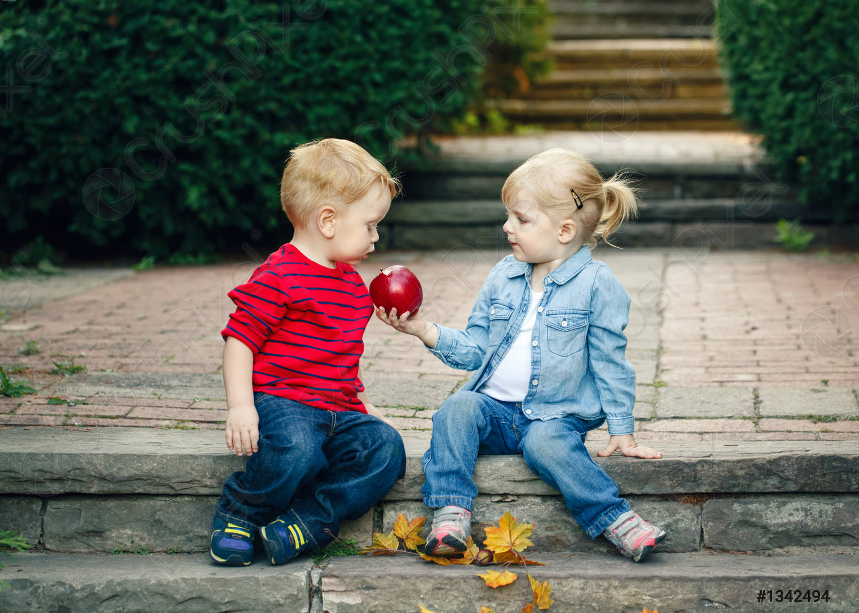
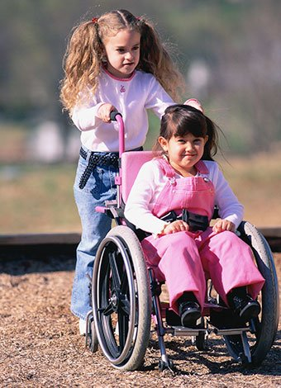
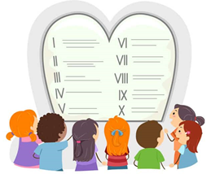
For them, the star was the presence of God. How can we be God’s light for others?
Helping Others
Praying Often
Obeying God and our Parents
Sharing

Slide 9
ACTIVITY

Slide 10
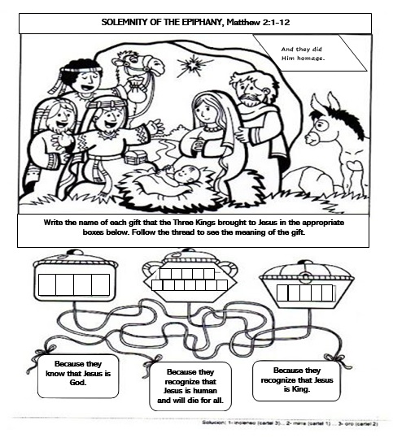
G O L D
I N C E N S E
M Y R RH

Slide 11
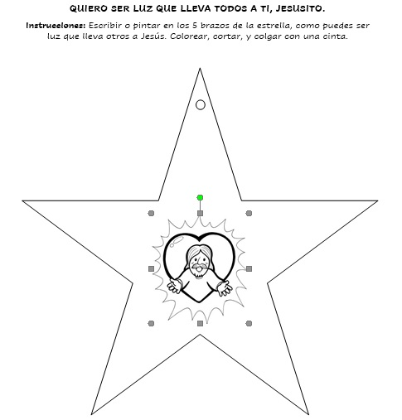
I WANT TO BE A LIGHT THAT TAKES OTHERS TO JESUS.
Instructions: Write or draw on the 5 arms of the star, how you can be a light leading others to Jesus. Color, cut and hang with a ribbon.

Slide 12
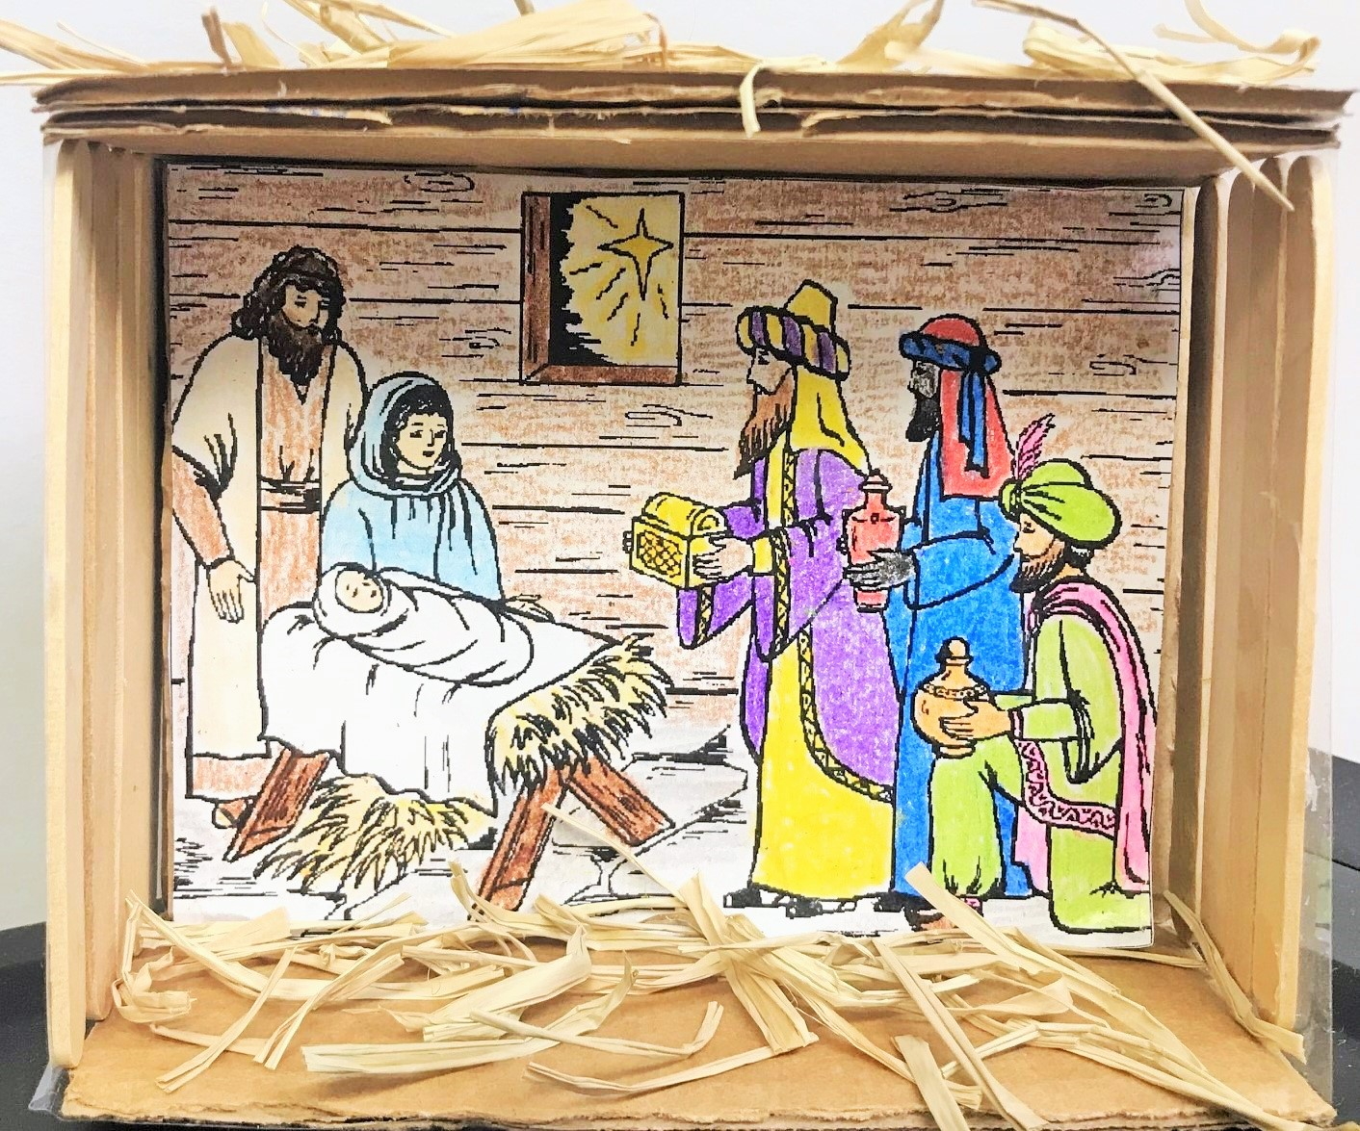
Make a Nativity with the Three Kings. See www.fcpeace.org, Friends of Jesus and Mary Cycle C – II Sunday of Christmas

Slide 13
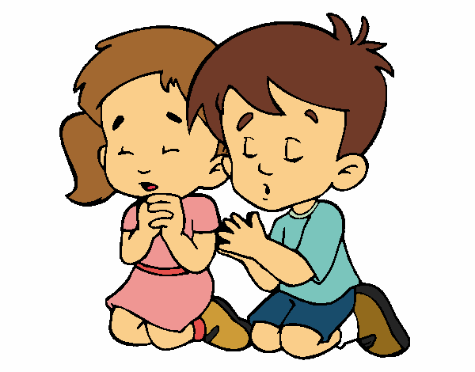
Jesus, you are the light of the world. Sometimes I get lost because I am interested in things that lead me away from you. Teach me to follow your light always so I may lead others to you. Amen.
PRAYER

Slide 14
O Come all Ye Faithful, Lifetree Kids (Ctrl Click) https://youtu.be/1Yl3Kaxx2gk

