Slide 1
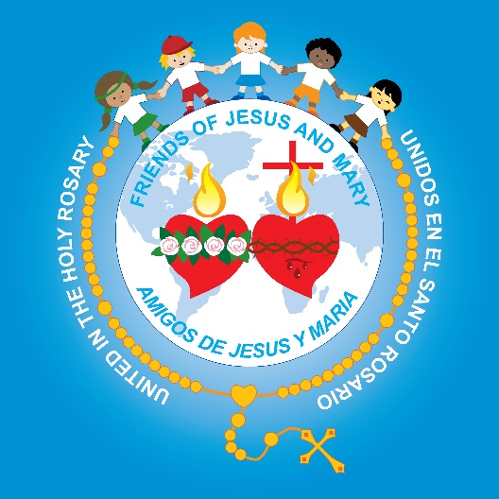
Friends of Jesus and Mary
Prayer Group for Children
Cycle B - II Sunday of Advent
Prepare the Way of the Lord- Mark 1, 1-8
www.fcpeace.org

Slide 2
Note:
The prophet Isaiah lived 700 years before Christ.
The beginning of the gospel of Jesus Christ the Son of God. As it is written in Isaiah the prophet:

Slide 3
Behold, I am sending my messenger ahead of you; he will prepare your way. A voice of one crying out in the desert: “Prepare the way of the Lord, make straight his paths.”

Slide 4
John the Baptist appeared in the desert proclaiming a baptism of repentance for the forgiveness of sins.
REPENT!
BE BAPTIZED!

Slide 5
People of the whole Judean countryside and all the inhabitants of Jerusalem…

Slide 6
…were going out to him and were being baptized by him in the Jordan River as they acknowledged their sins.
Reconocían sus pecados y el los bautizaba en el Jordán.

Slide 7
John was clothed in camel’s hair, with a leather belt around his waist.

Slide 8
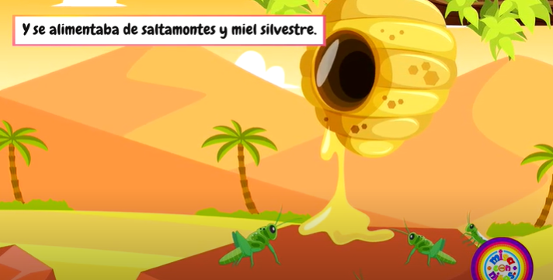
He fed on locusts and wild honey.

Slide 9
…and proclaimed:
One mightier than I is coming after me. I am not worthy to stoop and loosen the thongs of his sandals.

Slide 10
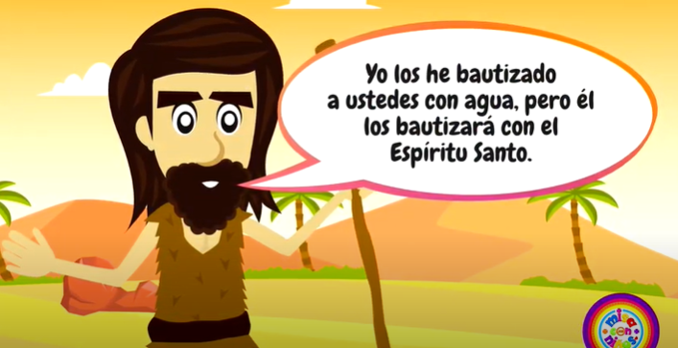
I have baptized you with water; he will baptize you with the Holy Spirit.
The Gospel of the Lord,
Praise to you Lord Jesus Christ.

Slide 11
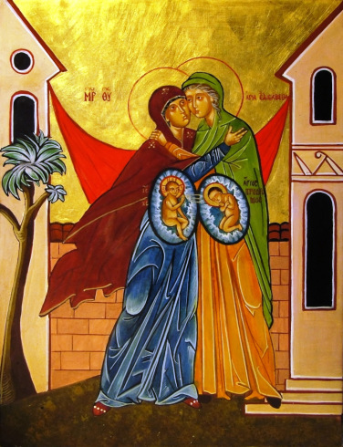
Who was St. John the Baptist?
Jesus’ cousin, the son of St. Elizabeth and St. Zachariah.

Slide 12
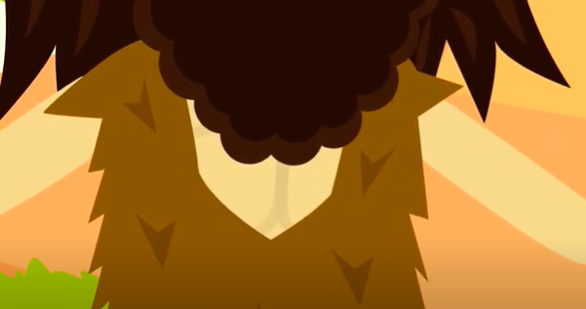
Why did he dress in camel hair and eat locusts and wild honey?
His appearance didn’t matter to him. He dedicated himself completely to uniting with God in prayer and sacrifice because God had given him a special mission.

Slide 13
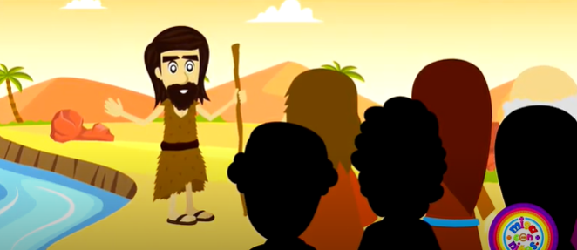
What was his mission?
He was a prophet or messenger of God announcing to His people to prepare themselves for the coming of the Messiah.

Slide 14
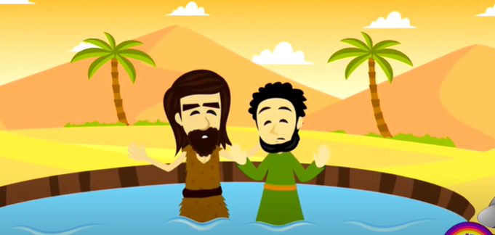
How does he tell them to prepare?
Confess your sins and be baptized.

Slide 15
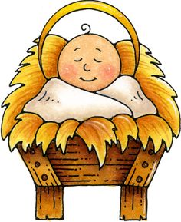
When we sin, our heart gets stained and we separate ourselves from Jesus.
But when we sincerely confess our sins to God, He forgives us and cleans our heart to receive Jesus, our King, with love.

Slide 16
Why does he say that he baptizes with water, but someone will come to baptize with the Holy Spirit?

Slide 17
His baptism is only symbolic of conversion,
It has no power!

Slide 18
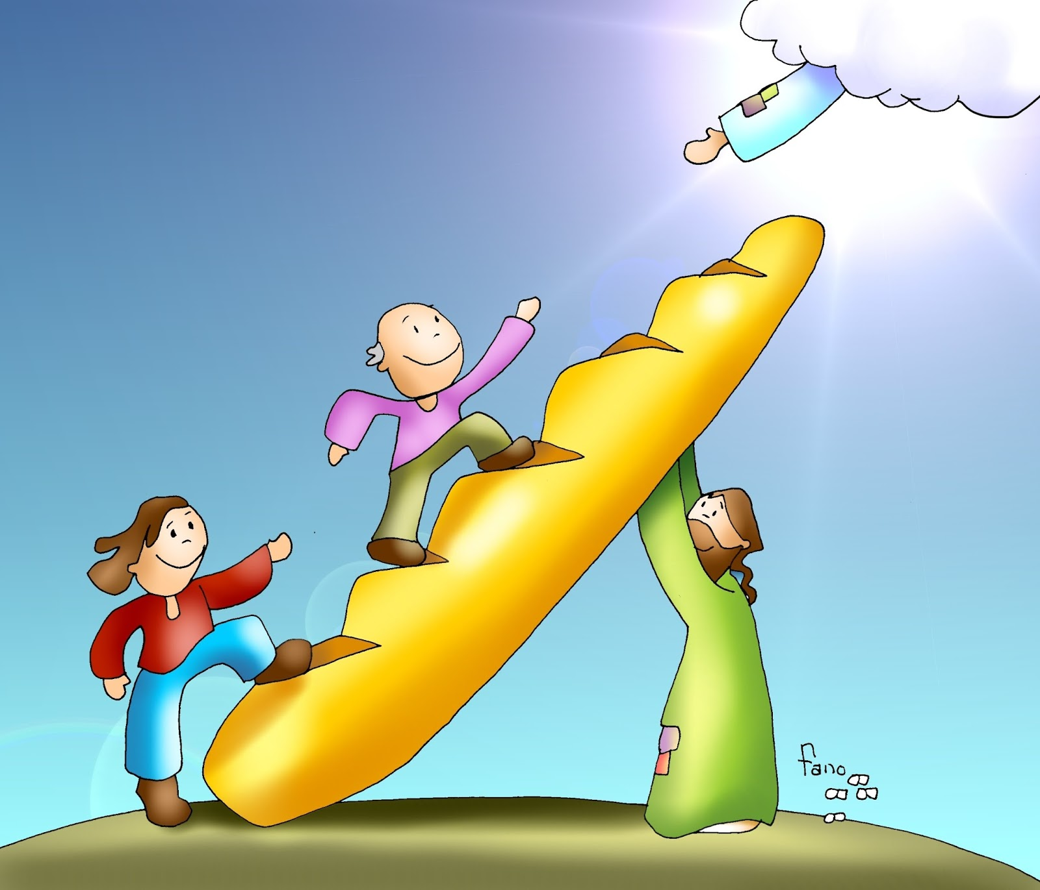
…but the Savior’s baptism, has the power to forgive our sins and give us eternal life.

Slide 19
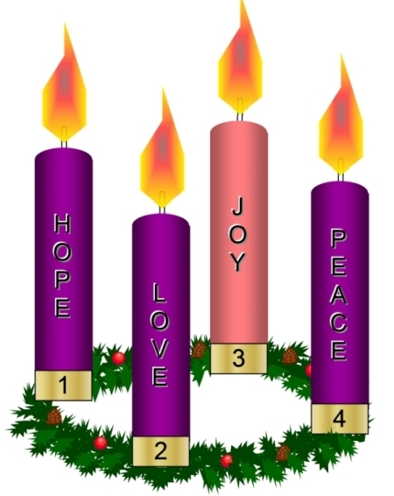
This Sunday begins the second week of Advent.

Slide 20
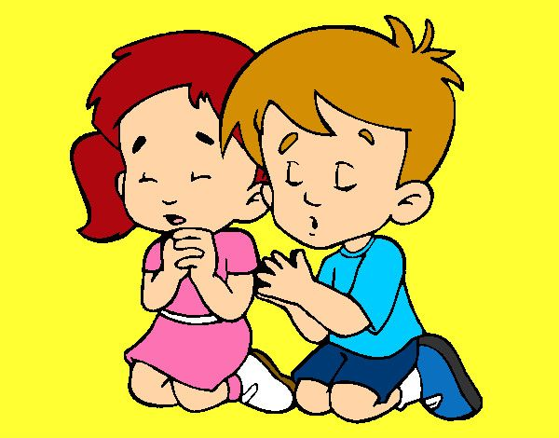
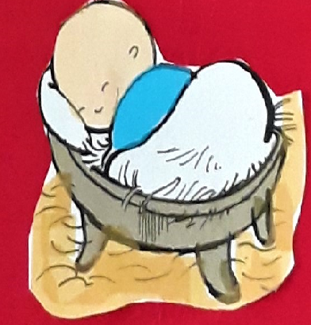
We continue to prepare our hearts to receive Jesus on Christmas morning.
HOW?
Praying more
Helping others
Offering small sacrifices.

Slide 21
Activities

Slide 22
4
1
3
2

Slide 23
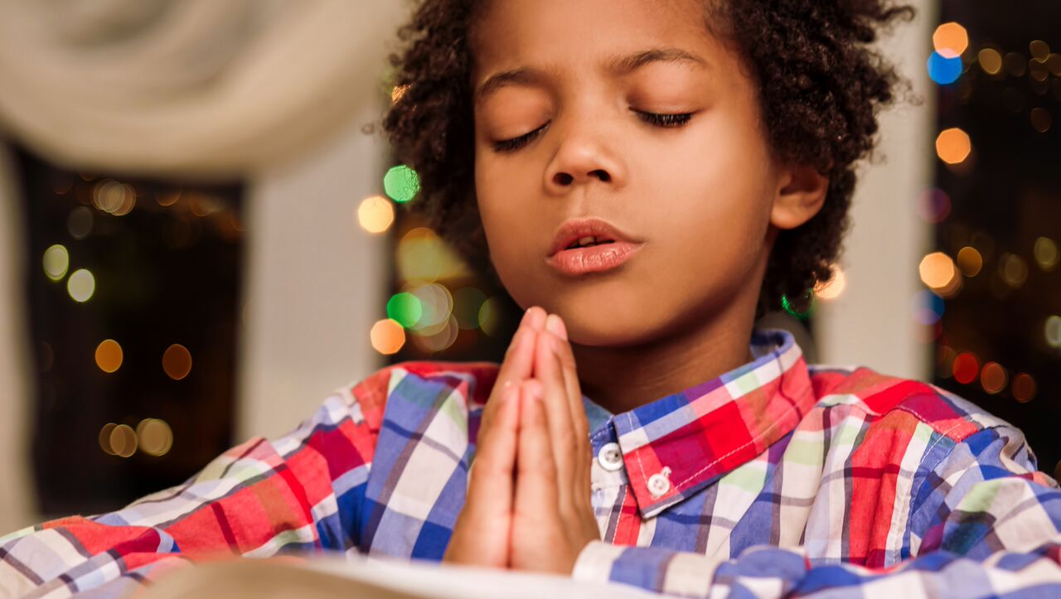
Prayer Lord, help me to repent of my sins and to want only to please you and to love you. Help me to prepare my heart this Advent so it is worthy of You. Amen.

Slide 24
The King Is on the Way, David’s Dynasty, https://youtu.be/V6kIuetbQdY

