Slide 1
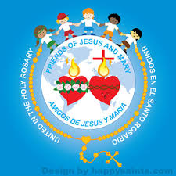
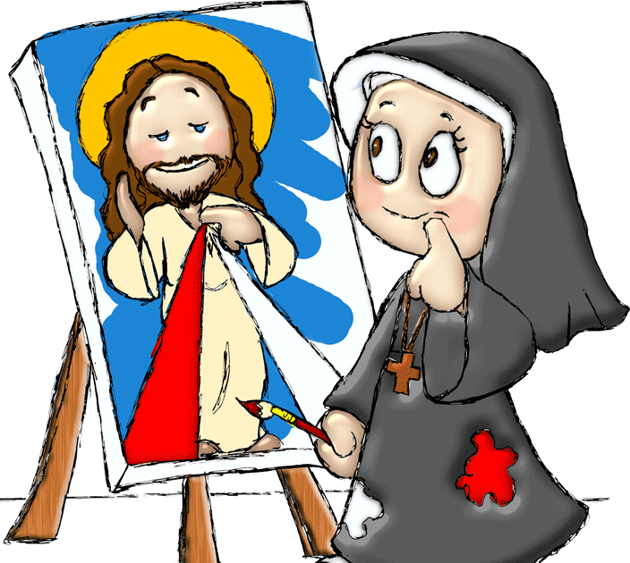
Ministry Friends of Jesus and Mary
Cycle B - II Sunday of Easter
Jesus Appears to His Disciples John 5: 1-6
Feast of the Divine Mercy
www.fcpeace.org

Slide 2
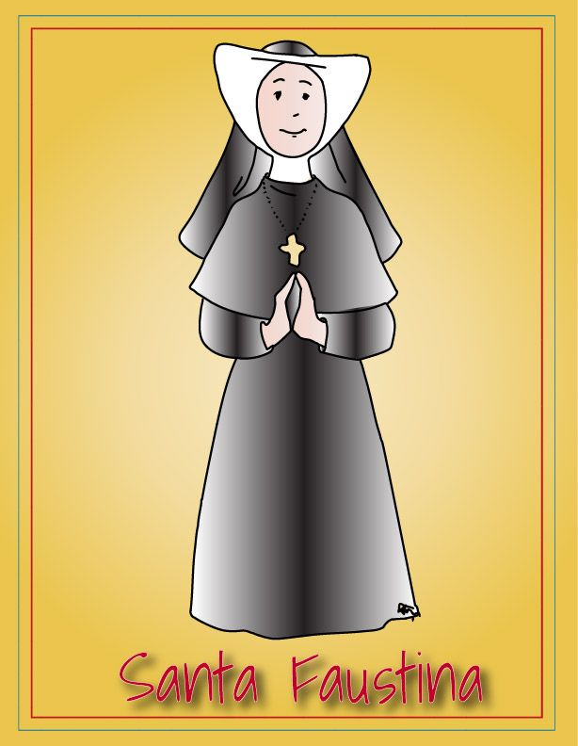
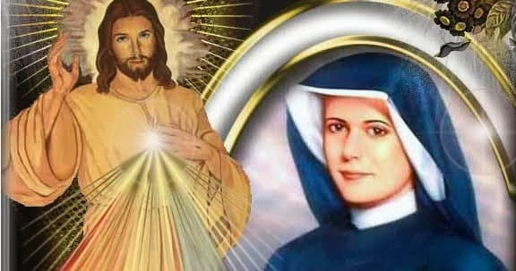
Second Sunday of Easter
Divine Mercy Sunday
Movie: https://youtu.be/SAv4CeyU4Ao
- Saint Faustina was born in Poland in 1905.
- When she was 7 years old, she heard the voice of God for the first time inviting her to live a more perfect life.
- At 15 years old, she begins to work as a domestic servant; she feels a strong call to the religious life, but her parents oppose it.
- Despite their opposition, Faustina eventually leaves her family and joins the religious life.

Slide 3
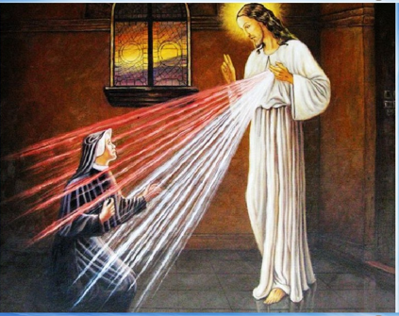
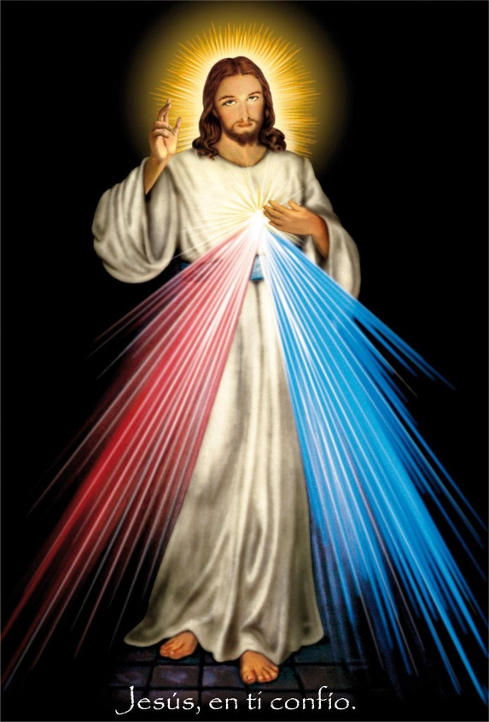
Divine Mercy Sunday
-Jesus appeared to Sister Faustina and told her that 3pm in the afternoon, the time Jesus died…is a time of great mercy.
-From His heart flowed two rays: one red and one white, symbolizing the blood and water that gushed from His side.
-Jesus said to her: My daughter, Paint a picture of what you see with the words: “JESUS I TRUST IN YOU”.
-Jesus promised great blessings for those who venerate this picture.

Slide 4
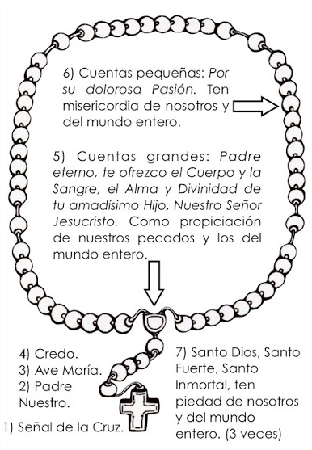
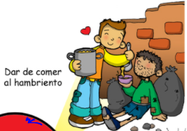
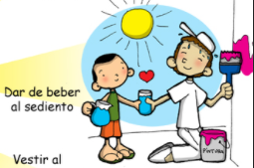
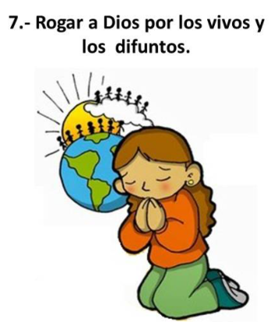
Chaplet and Feast of the Divine Mercy
-Jesus also asked that everyone pray at 3pm in the afternoon the Chaplet of Divine Mercy and that,
-The Church celebrate on the 2nd Sunday of Easter the FEAST OF THE DIVINE MERCY.
-In this feast we celebrate Jesus’s Love and Mercy for us, and He invites us to share this love and mercy with others, especially the most needy.
Pray for the living and the dead.
Feed the Hungry
Give drink to the thirsty

Slide 5
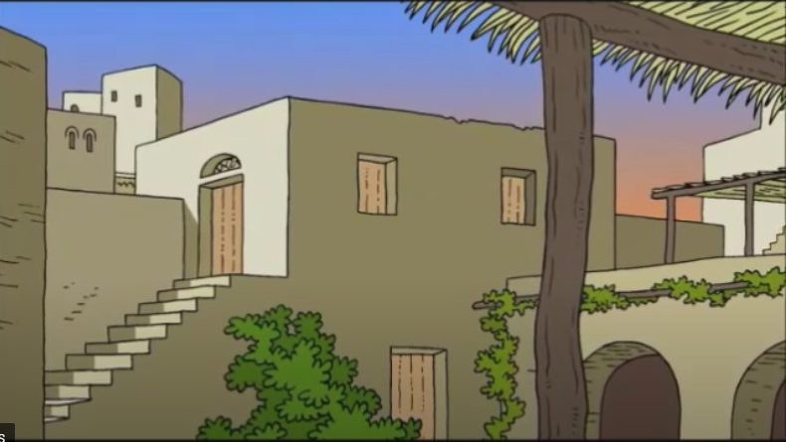
Gospel of John 5: 1-6
It was late that Sunday evening, and the disciples were gathered together behind locked doors…

Slide 6
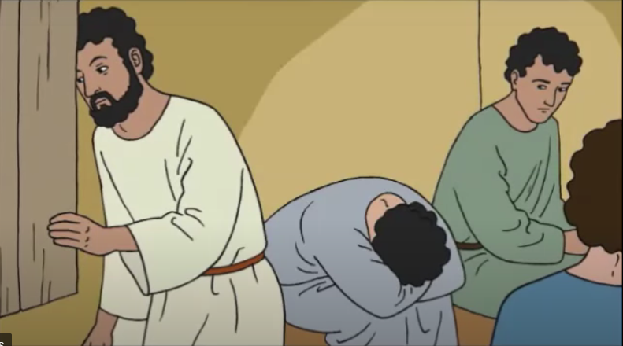
… because they were afraid of the Jewish authorities.

Slide 7
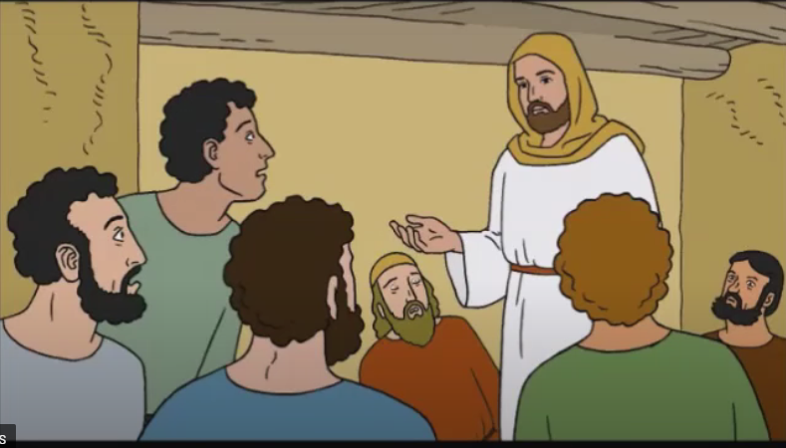
Then Jesus came and stood among them “Peace be with you,” he said.

Slide 8
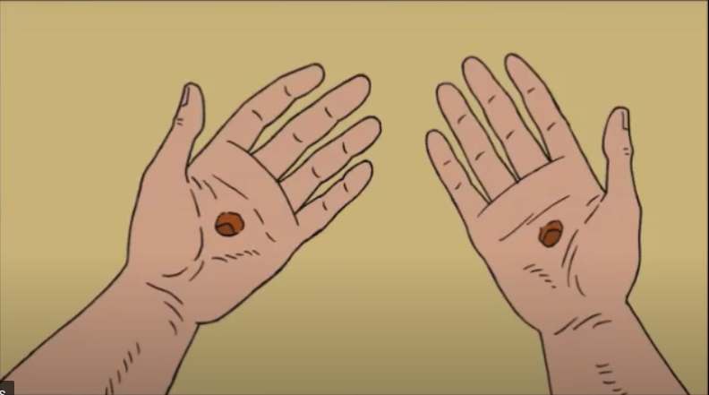
After saying this, he showed them his hands and his side.

Slide 9
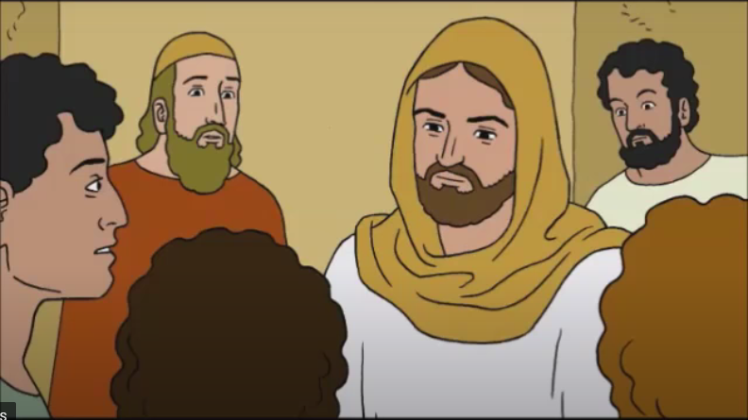
The disciples were filled with joy at seeing the Lord. Jesus said to them again, “Peace be with you. As the Father sent me, so I send you.”

Slide 10
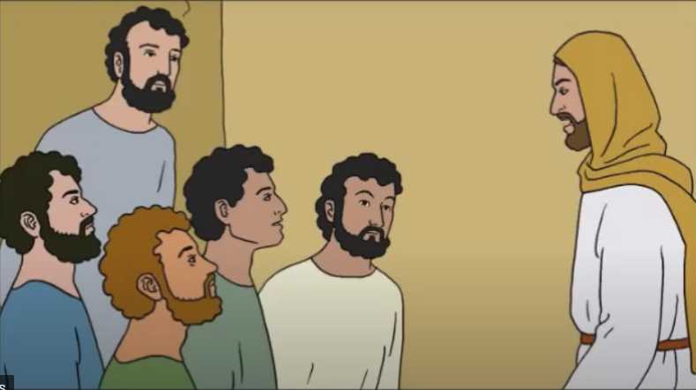
Then he breathed on them and said, receive the Holy Spirit. If you forgive people’s sins, they are forgiven; if you do not forgive them, they are not forgiven.”.

Slide 11
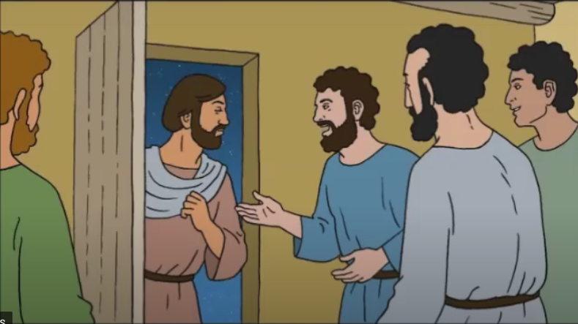
One of the twelve disciples, Thomas (called the twin), was not with them when Jesus came. So the other disciples told him, “We have seen the Lord!”

Slide 12
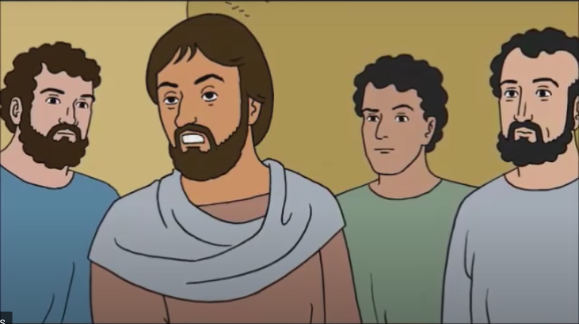
Thomas said to them, “Unless I see the scars of the nails in his hands and put my finger on those scars and my hand in his side, I will not believe.”

Slide 13
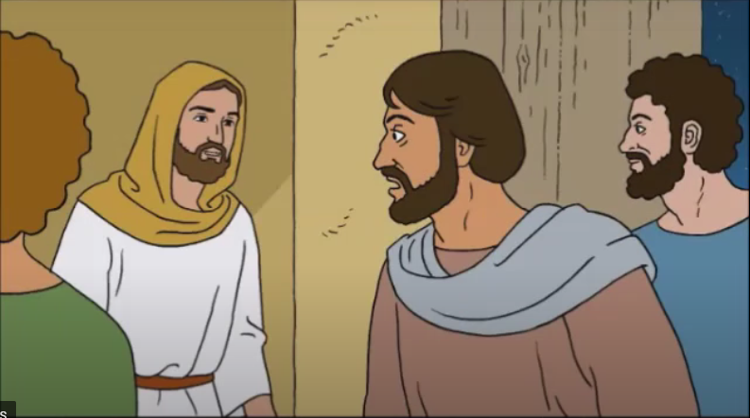
A week later the disciples were together again indoors, and Thomas was with them. The doors were locked, but Jesus came and stood among them and said:

Slide 14
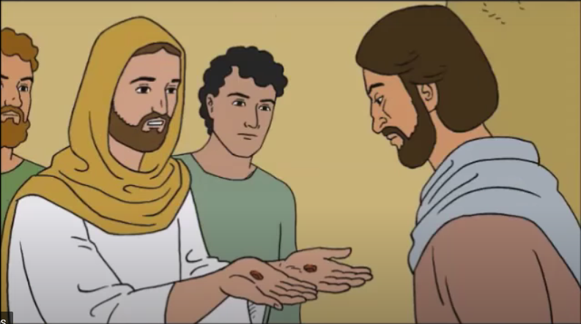
Peace be with you.” Then he said to Thomas, “Put your finger here, and look at my hands, then reach out your hand and put it on my side. Stop your doubting and believe!”

Slide 15
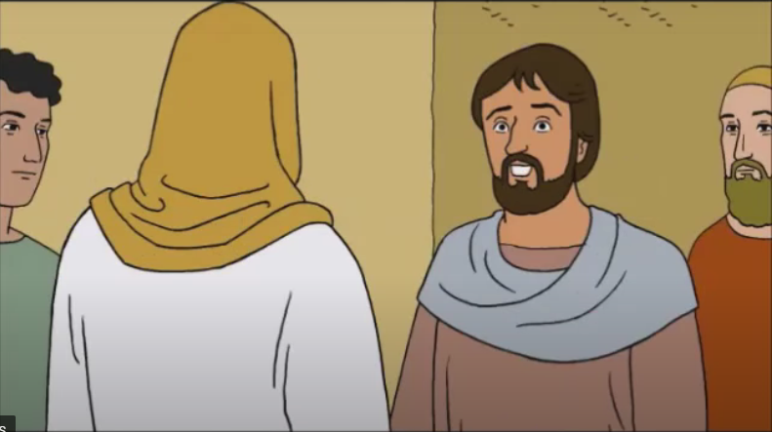
Thomas answered him, “My Lord and my God”. Jesus said to him, “Do you believe because you see me? How happy are those who believe without seeing me!”
THE GOSPEL OF THE LORD. PRAISE TO YOU LORD JESUS CHRIST

Slide 16
REFLECTION
Why were the disciples hiding? Who did they fear?
They were afraid of dying because those who killed Jesus were looking for them.
How did Jesus enter if the doors were locked? What does He say?
Jesus is God, He did not need to open doors to enter. He appears to them and says, “Peace be with you.”
How do you think the disciples felt seeing Jesus?
The fear and terror changes to
peace, happiness, and joy.

Slide 17
Jesus knows He will soon depart to Heaven, but first He must prepare His apostles to continue His mission. So He sends them to do something very important and Jesus breathes on them. What does this mean?
He gives them the Holy Spirit, God Himself, to help them.

Slide 18
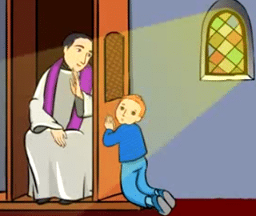
When Jesus tells His disciples, “If you forgive people’s sins, they are forgiven; if you do not forgive them, they are not forgiven,” He gives them the power to forgive sins. Do you remember to which Sacrament we go to for the forgiveness of our sins?
The Sacrament of Confession
(also called Reconciliation or Penance)
Who were the first priests?
Jesus’ disciples
Can I confess directly to God?
Or do I need to confess my sins to a priest?
Jesus gave authority and power exclusively to the priests so they can forgive our sins because He wants us to confess our sins to the priest and to forgive us through them.

Slide 19
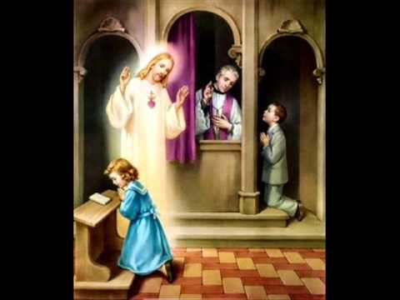
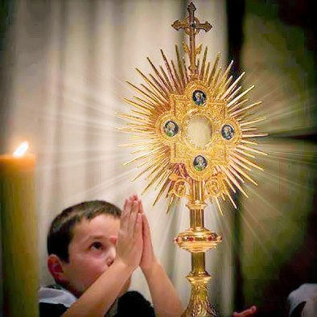
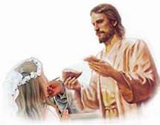
One apostle was missing the first time Jesus appeared to them. Do you remember his name?
Thomas
Did Thomas believe his friends?
NO
What did he need to do to believe?
Thomas needed to touch Jesus’ scars. (See to believe)
And you? Do you need to see to believe? Or is your faith capable of believing that which you cannot see?
JESUS FORGIVES US THROUGH THE SACRAMENT
THE REAL PRESENCE OF JESUS IN THE EUCHARIST
THE EUCHARIST, REAL FOOD: HIS BODY AND BLOOD.

Slide 20
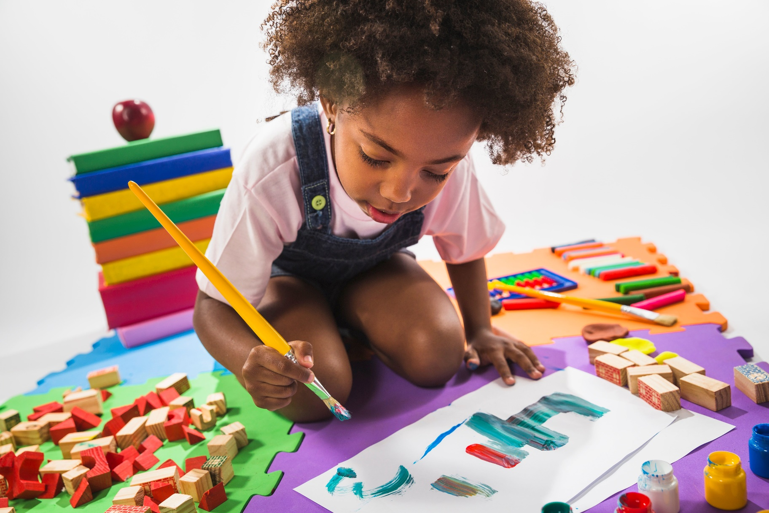
ACTIVITY

Slide 21
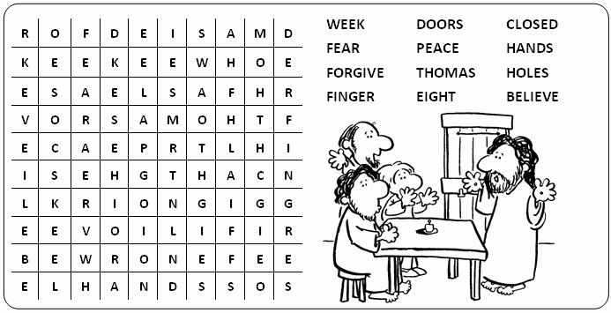

Slide 22
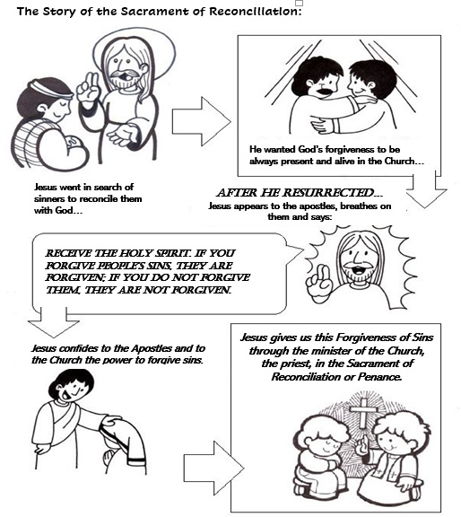

Slide 23
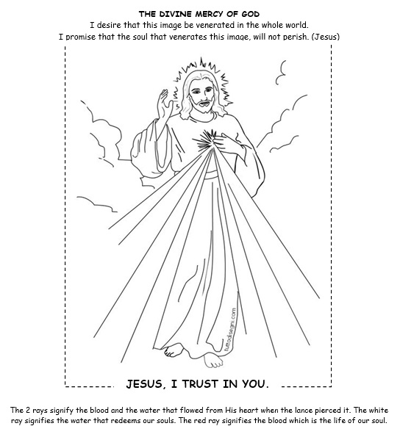

Slide 24
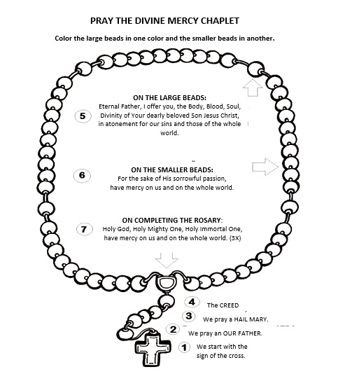
LINK TO PRAY WITH POWERPOINT:
https://docs.google.com/presentation/d/1IHt9DdwZKF2GmHdFhasuq_zJkqYgP1yZ/edit?usp=drive_link&ouid=115268475267556305384&rtpof=true&sd=true

Slide 25
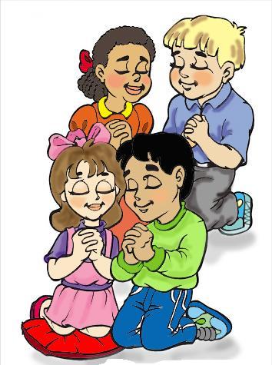
PRAYER
Lord,
We are worried and afraid about so many things. Be present among us with your peace. Give us the faith to always trust in your mercy. Help us to see You in the suffering of others. Amen.

Slide 26
Song: I Trust in You, Timbercity, https://youtu.be/JcLlKVgwCqM?si=r1MIOLOVPhjArlPn (3-7 yrs.)

Slide 27
Jesus, I will Trust You, VBS 2021, https://youtu.be/NVBEo6H9x4o?si=Ficn10s4gjQ7YFoh (8+ yrs.)

