Slide 1
Friends of Jesus and Mary
Cycle B-II Sunday in Ordinary Time
John 1: 35-42
Jesus’ First Disciples
www.fcpeace.org

Slide 2
Jesus’ First Disciples
John was standing with two of his disciples,

Slide 3
And as he watched Jesus walk by, he said, "Behold, the Lamb of God."
The two disciples heard what he said and followed Jesus.

Slide 4
Jesus turned and saw them following him and said to them,
"What are you looking for?"

Slide 5
They said to him, "Rabbi" — which translated means Teacher —, "where are you staying?“ He said to them, "Come, and you will see."
So they went and saw where Jesus was staying, and they stayed with him that day.

Slide 6
It was about four in the afternoon. Andrew, the brother of Simon Peter, was one of the two who heard John and followed Jesus.
He first found his own brother Simon and told him, "We have found the Messiah" — which is translated Christ —.

Slide 7
Then he brought him to Jesus. Jesus looked at him and said, "You are Simon the son of John; you will be called Cephas" — which is translated Peter.
The Word of the Lord
Praise to you Lord Jesus Christ.

Slide 8
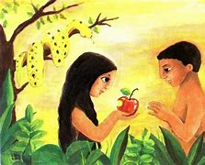
Reflection
What does John the Baptist call Jesus?
The Lamb of God
Why?
During that time, God’s people sacrificed sheep in the Temple so that God would forgive their sins and in Thanksgiving for blessings. Jesus came to sacrifice His life for our sins.
Jesus
The Lamb of
God
The sin of Adam and Eve had separated us from God in Paradise and Jesus came to reunite us with Him. They no longer had to sacrifice sheep for their sins. He becomes the Lamb that forgives all sins.

Slide 9
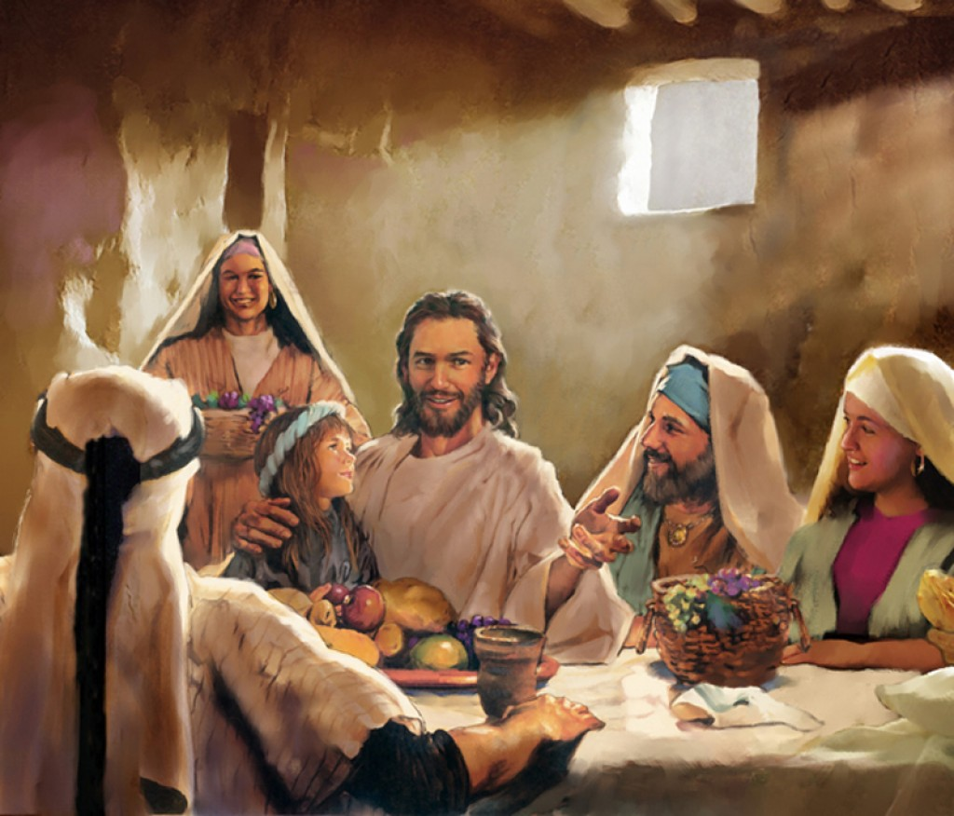
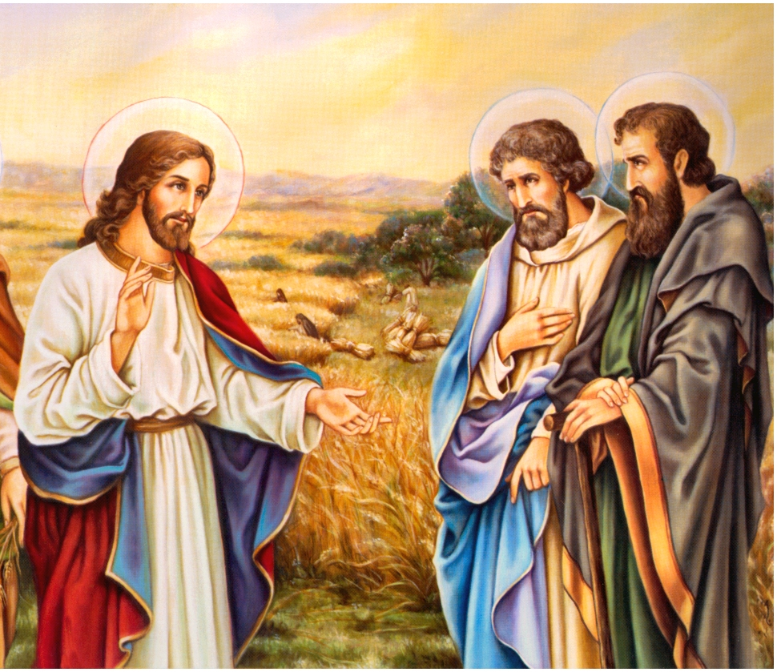
Upon hearing this, John’s followers followed Jesus. What did they ask Him?
What are you looking for?
What do we seek when talking to Jesus?
Share
What did they respond?
They wanted to know where he was staying.
They wanted to spend time with Him and get to know Him.

Slide 10
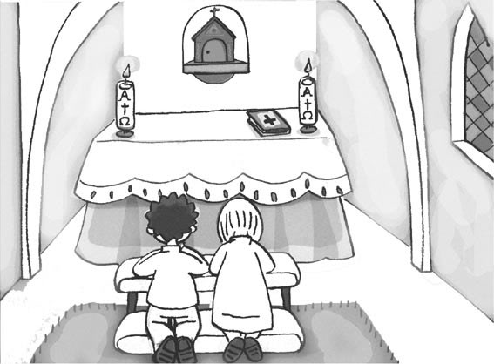
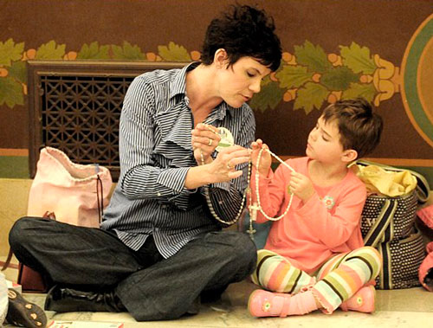
Do we spend time with Jesus daily to get to know Him better?
Andrew then took his brother Peter to meet the Messiah. How can we take others to meet Jesus?
Sharing our faith with them.

Slide 11
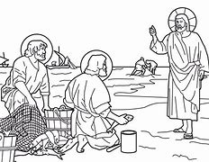
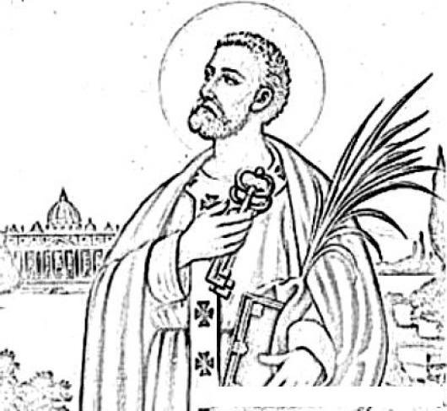
Jesus changes Simon’s name to Peter to give him a special mission. What was his new mission?
Fisher of men
Director of His Church

Slide 12
An activity for today

Slide 13
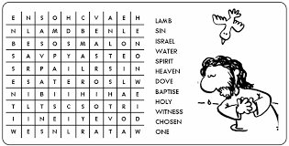

Slide 14
Instructions: Cut the lamb and color the face. Glue cotton onto the body. Cut the cross and color the light yellow and the cross brown. Glue the lamb onto the cross. Cut the prayer and glue onto the back. Pray together the prayer we pray during mass to prepare our hearts to receive Jesus.
How do sheep behave?
They are social, peaceful, and followers of the shepherd.
Jesus is without sin, peaceful, and always follows His Father in Heaven.
We are called to follow Jesus in the same way.

Slide 15
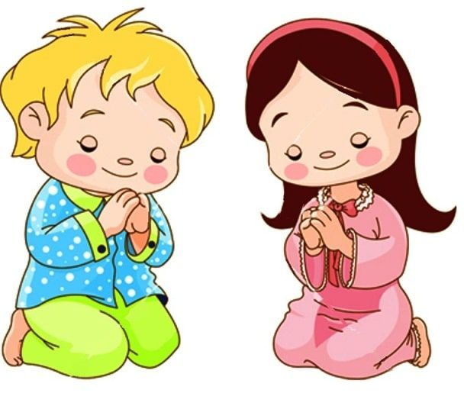
Prayer
Thank you, Jesus, for loving us so much that you left Heaven to be born a man and to sacrifice yourself for our sins. Help us to follow you like you followed your Father so we may live with you forever in Heaven. Help us to lead other to you to save many souls.
Amen

Slide 16
(3-7 yrs. old) I Want to Know You Lord, Apple Crisol, https://youtu.be/3UzW7wfn0L0

Slide 17
I Will Follow You, Roy RN, https://youtu.be/jpVuBcbZ24c?si=xM0JtPmjnIMOeP0Z

