Slide 1
Friends of Jesus and Mary
The Transfiguration
Cycle B - Mark 1, 40-45
www.fcpeace.org

Slide 2
The Transfiguration
This is my beloved son, listen to Him.
Mark 9:2-10

Slide 3
And he was transfigured before them, and his clothes became dazzling white, such as no fuller on earth could bleach them.
Jesus took Peter, James, and John and led them up a high mountain apart by themselves.
Then Elijah appeared to them along with Moses,
and they were conversing with Jesus.

Slide 4
Then Peter said to Jesus in reply,
“Rabbi, it is good that we are here! Let us make three tents: one for you, one for Moses, and one for Elijah.”

Slide 5
Then a cloud came, casting a shadow over them;
from the cloud came a voice,
“This is my beloved Son. Listen to him.”
“This is my beloved Son. Listen to him.”
He hardly knew what to say, they were so terrified.

Slide 6
Get up! Do not fear.
Suddenly, looking around, they no longer saw anyone but Jesus alone with them.
As they were coming down from the mountain, He commanded them:
Do not relate what you have seen to anyone, except when the Son of Man has risen from the dead.
THE GOSPEL OF THE LORD PRAISE TO YOU LORD JESUS CHRIST

Slide 7
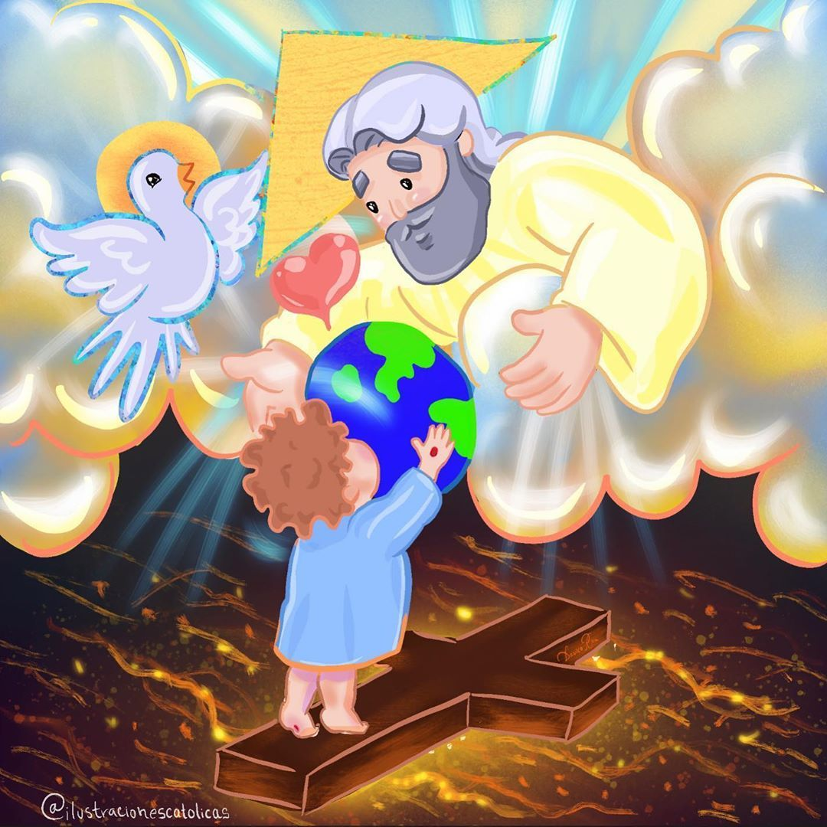
Reflection

Slide 8
Who did Jesus take up to the mountain with Him?

Slide 9
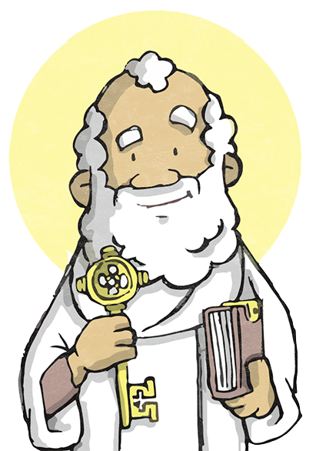
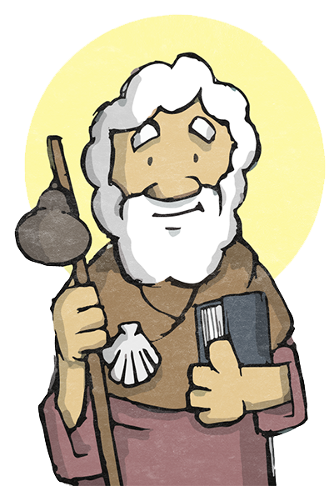
Peter, James and John

Slide 10
What does it mean “He was transfigured”?

Slide 11
His appearance changed.

Slide 12
How did He look?

Slide 13
His clothes became a dazzling white, never seen on earth.

Slide 14
Jesus is Divine and human. Here Jesus reveals His divinity as God’s Son..
Who appeared speaking with Jesus?

Slide 15
Elijah and Moses,
people from the Old Testament who represented the prophets and
the Law of God.
Jesus reveals that He is the long-awaited Messiah.

Slide 16
What does Peter say?

Slide 17
“Rabbi, it is good that we are here!
Let us make three tents: one for you, one for Moses, and one for Elijah.”

Slide 18
Why does he say this?

Slide 19
He feels so happy with this experience of Heaven that he doesn’t want it to end.

Slide 20
Why does a cloud cover them?

Slide 21
In the Old Testament, God revealed Himself in a cloud.

Slide 22
What does God say?

Slide 23
“This is my beloved Son.
Listen to him.”

Slide 24
Jesus asked them to keep this quiet until when?

Slide 25
Until the Son of Man had risen from the dead.

Slide 26
The experience of the Transfiguration gives us the promise of a world way past our own imagination and dreams.
Jesus invites His Friends to know Him well and to know that He is the Son of God. He promises His friends eternal life.

Slide 27
Activities

Slide 28
M
O
P
S
A
S
L
E
E
P
E
S
D
S
U
N
A
I
I
R
E
S
U
R
R
E
C
T
I
O
N
E
H
D
R
E
E

Slide 29
Prayer
Jesus,
I want to listen to you; I know you are always with me no matter what. Help me to keep my eyes on eternal life and to always trust you. I pray for the souls in Purgatory, especially those who have no one to pray for them. Amen.

